Slide 1

Recky Pramana P
Dumbways Bootcamp
4th weeks

Slide 2

1.
Deploy PHP Application in cPanel
2.
Automation
Setup Server with Ansible
3.
Setup Monitoring Server
4.
Connect Multiple Server to Prometheus

Slide 3
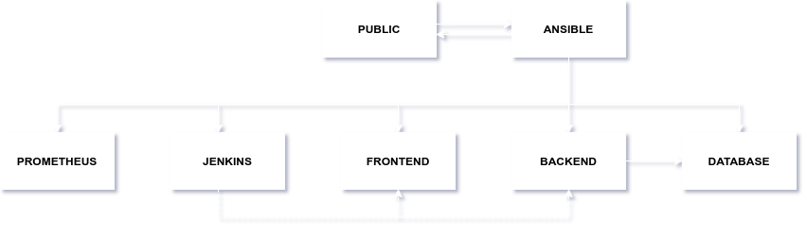

Slide 4
Deploy PHP Application in cPanel

Slide 5
1.
Deploy PHP Application in cPanel
CMS
cPanel
WordPress Forums
Infinity
Free
Daftar cPanel
Transfer File
Install CMS
FTP
SSL
FileZilla/FileManager
Download CMS
Add
SSL
GoGetSSL

Slide 6
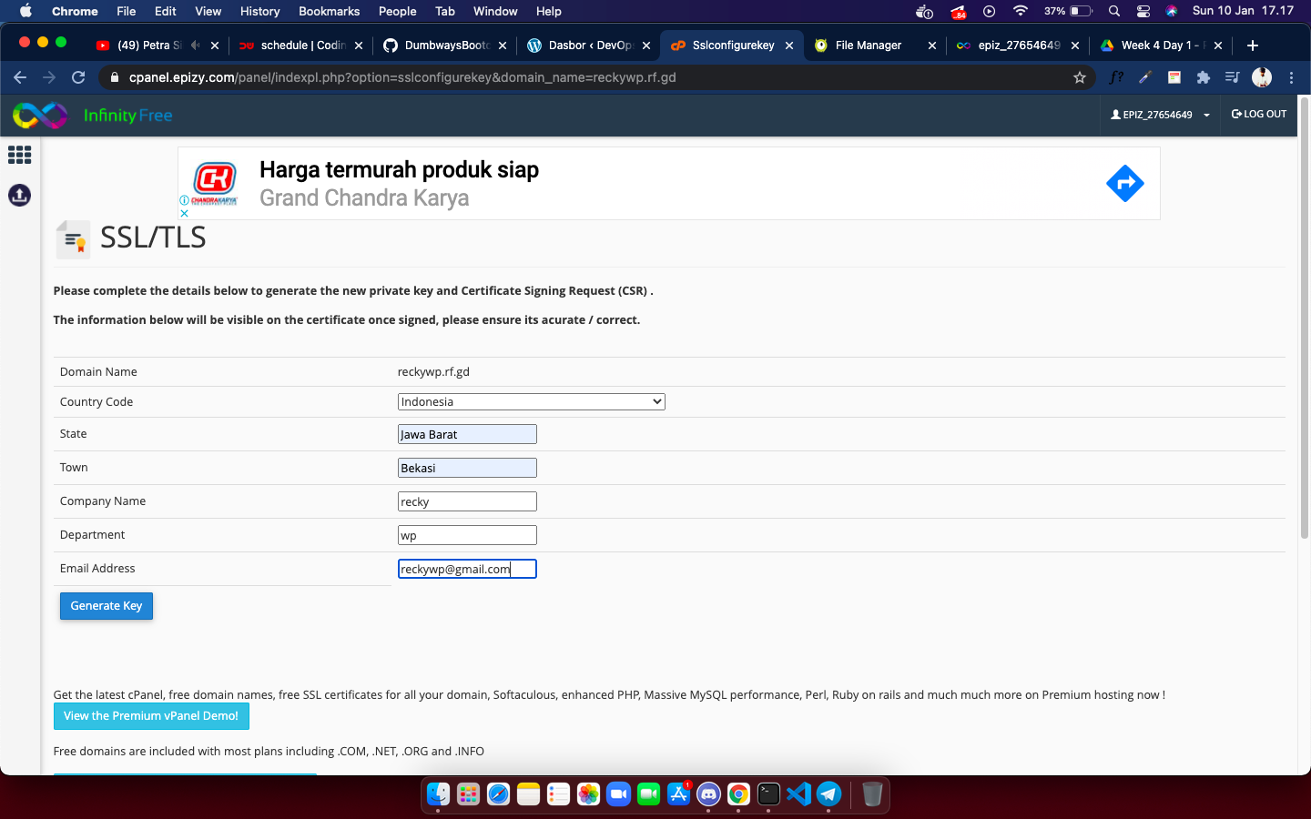
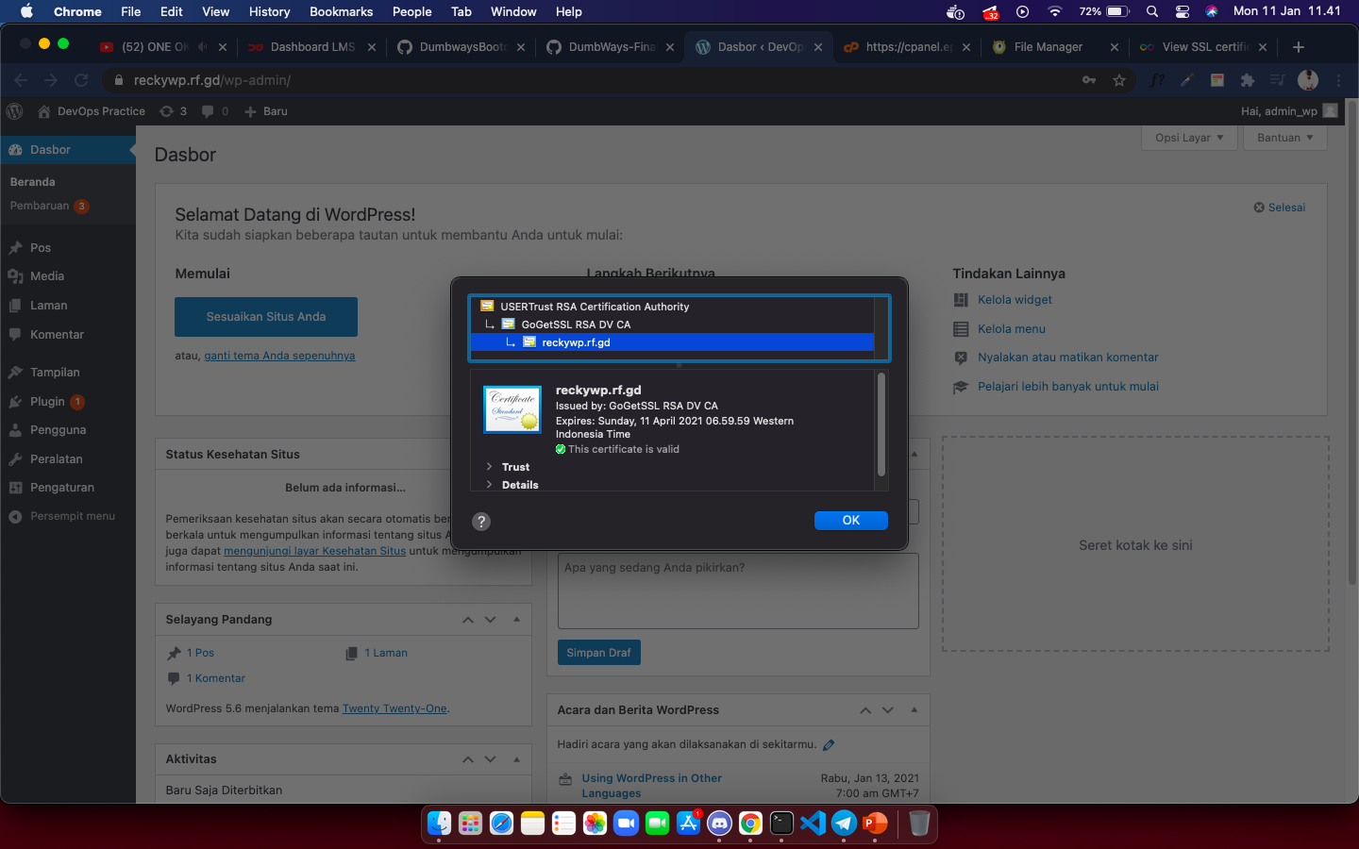
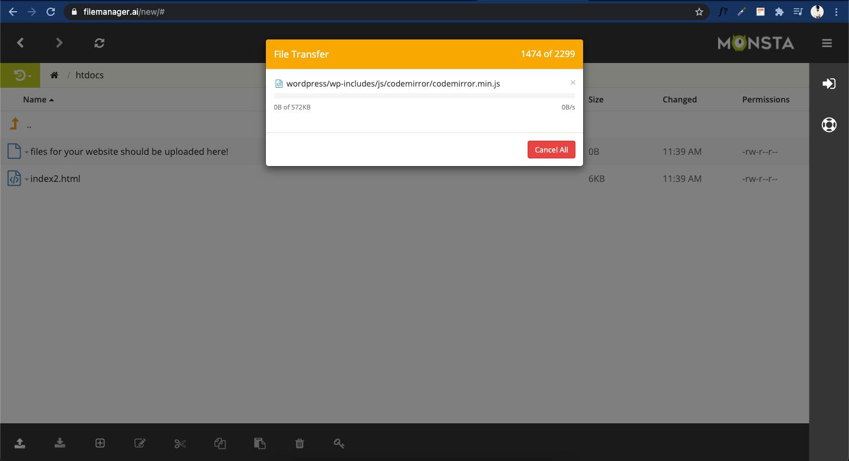
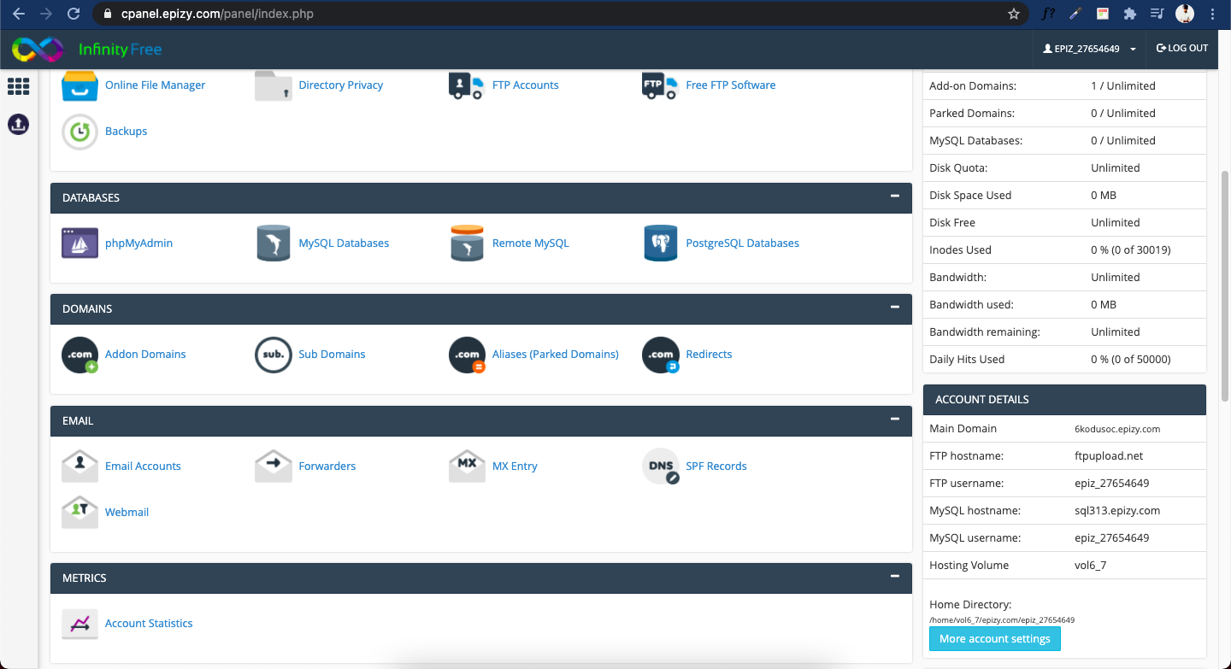
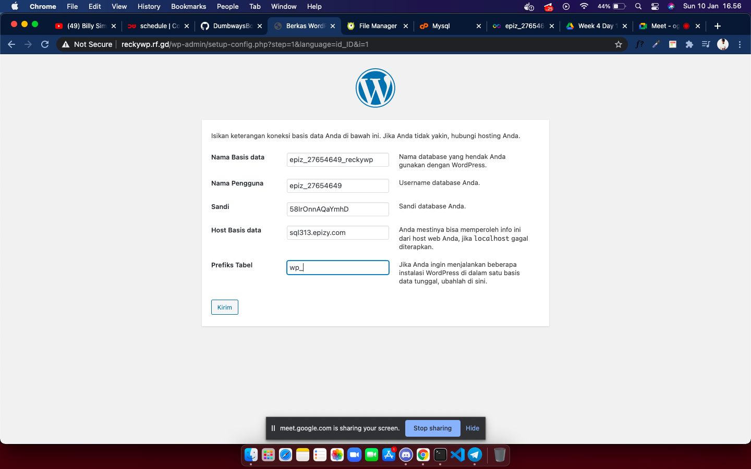
1.
Deploy PHP Application in cPanel

Slide 7
Setup Server with Ansible

Slide 8
2.
Setup Server with Ansible
Install Python
apt install python3
Add Ansible repository
sudo apt-add-repository ppa:ansible/ansible
Update cache
apt update
Install Ansible
apt install ansible

Slide 9
2.
Setup Server with Ansible
Aplikasi Pendukung
Nginx
Mysql
Docker
Node exporter
Grafana
Jenkins
Housy
Create Inventory
Membuat inventory berisi host remote
Create User and Group
Buat user dan group pada server remote
SIKLUS
Install Modul
Install aplikasi pendukung
Try and error
Percobaan

Slide 10
Setup Monitoring Server

Slide 11
3.
Setup Monitoring Server
DOCKER
Cepat dan mudah
MANUAL
Paham Konsep

Slide 12


3.
Setup Monitoring Server
Download & Extract
Bisa menggunakan wget / curl
Docker Run
Get Image and run with volume
Copy & Chown
Promtool & prometheus /usr/local/bin/
consoles & console_library
/etc/prometheus
Config
/etc/prometheus/prometheus.yml
Config Prometheus
/etc/systemd/system/prometheus.service
/etc/prometheus/prometheus.yml
Start service
daemon-reload
start prometheus

Slide 13
3.
Setup Monitoring Server
Create Ansible-playbook config
SSL Let’s Encrypt
Add credentials
Copy to Public Server
Create Reverse Proxy File
Copy to Public Server
Reverse Proxy

Slide 14
Connect Multiple Server to Prometheus

Slide 15
4.
Connect Multiple Server to Prometheus
Install node exporter
1.
Install node exporter with docker
Config Prometheus
2.
Add host target with port 9100 open
Check Target Prometheus
3.
Check endpoint state, make sure it’s up
Import Data to Grafana
4.
Copy all prometheus target into grafana
Customize Grafana
5.
Dashboard theme

Slide 16
THANK YOU

