Slide 1

AR Drag and Drop
Department of Computer & Applications
Vinay Kumar
Yash Mathur
Rachit
Ritesh Dwivedi
Kanhaiya Sharma
Project Supervisor:-
Md.Farman Sir

Slide 2
Objective
Imagine being able to snap a picture of something and bringing it into another canvas.
To take a snap of real-world object and pasted into pc app.
User will able to get resolve with the problem of transferring the images or any object from one device to another.

Slide 3
Technical Tools
Computer Vision
Raw Sockets
Kivy
RemoveBg API
PyCharm
Github

Slide 4
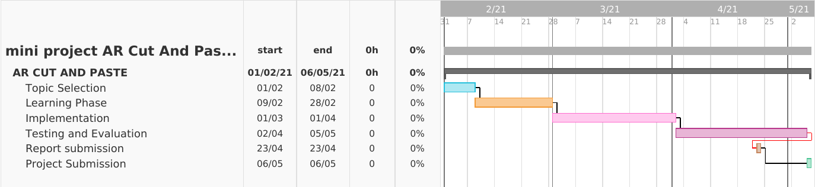
Chart

Slide 5
Working
The smartphone camera process that singles out an object, isolates it from the background and, when pointed to desktop camera, inserts the image into a document
This is all done in under few seconds.
Removes the background automatically
No fiddling around emailing images to yourself or cutting out objects in the software.

Slide 6
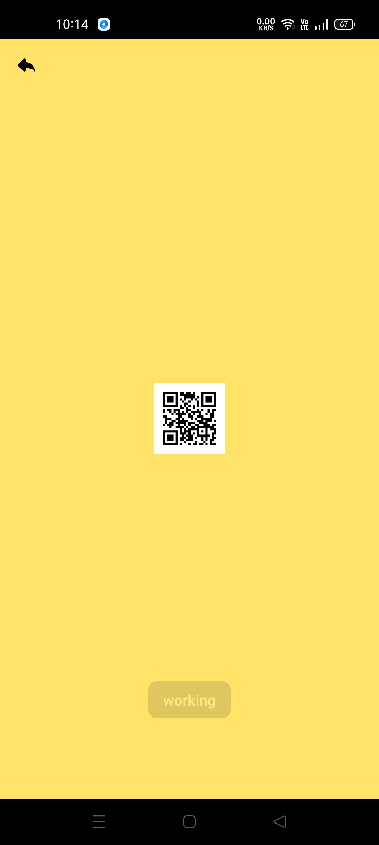
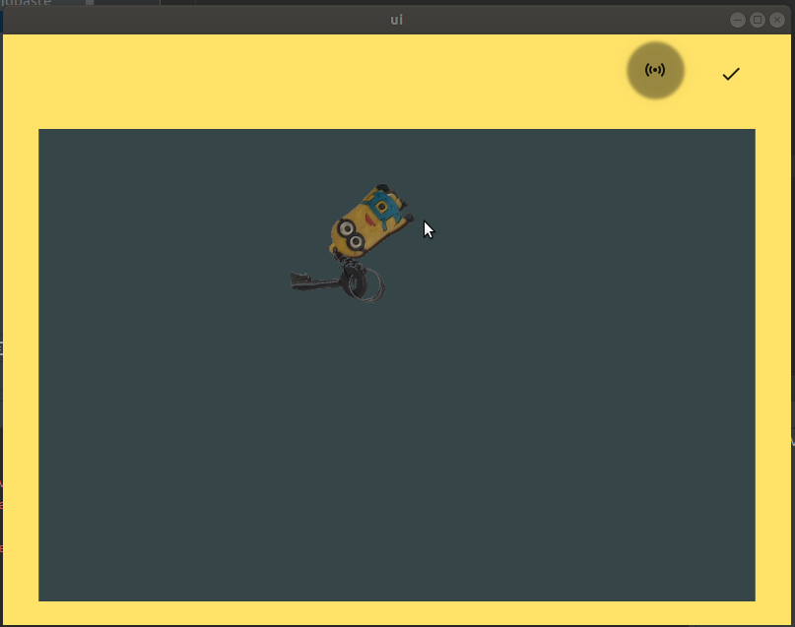
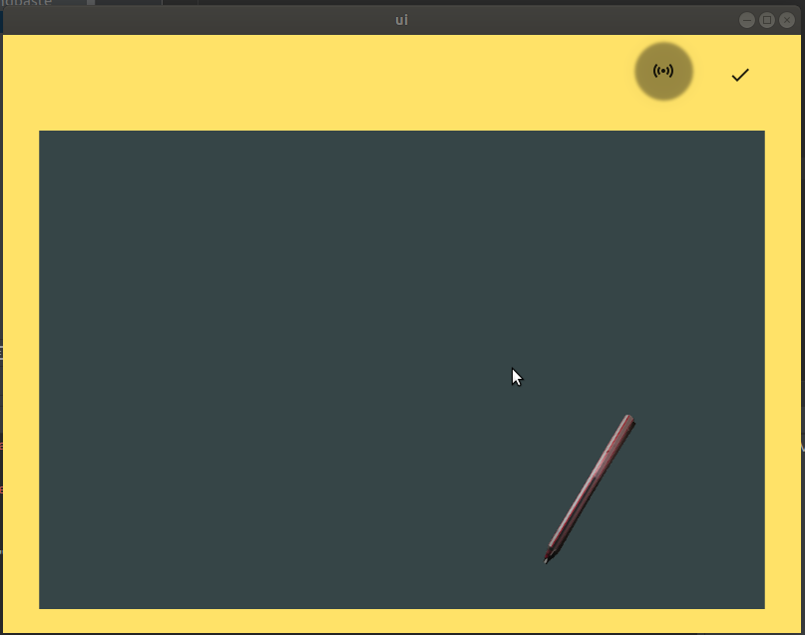
Screen Shots

Slide 7
Thank you
Vinay Kumar
Yash Mathur
Rachit
Ritesh Dwivedi
Kanhaiya Sharma

