Slide 1
SAARTHI – Natural Disaster Website
Rachit
Vinay Kumar
Yash Mathur
Team Members :

Slide 2
Motivation For Project Topic
Natural Disasters kill on Average 60,000 people per year and responsible for 0.1% of global deaths
The number of death from natural disasters can be highly variable from year to year
Very Few No people are aware About how to survive In these condition
Make people aware about how to Survive in these Conditions

Slide 3
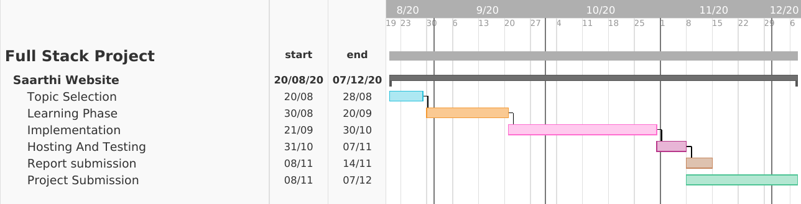
Gantt Chart

Slide 4
ABSTRACT
Natural calamities are not the new events they are since the beginning of earth and almost every civilization has faced it. In ancient times people believes that it was due to god’s anger but in today’s world technology is so advanced we know the actual reason behind these calamities the only thing we must know is how to save ourselves from these calamities and our project ‘SAATHI’ a website which will help others to take necessary steps while dealing with these events.

Slide 5
Website Specification
Home
Donate
Separate Page for Every Natural Disaster(Full Article,details,Tips,videos)
Conatact Us
Responsive For Mobile Desktop tablet

Slide 6
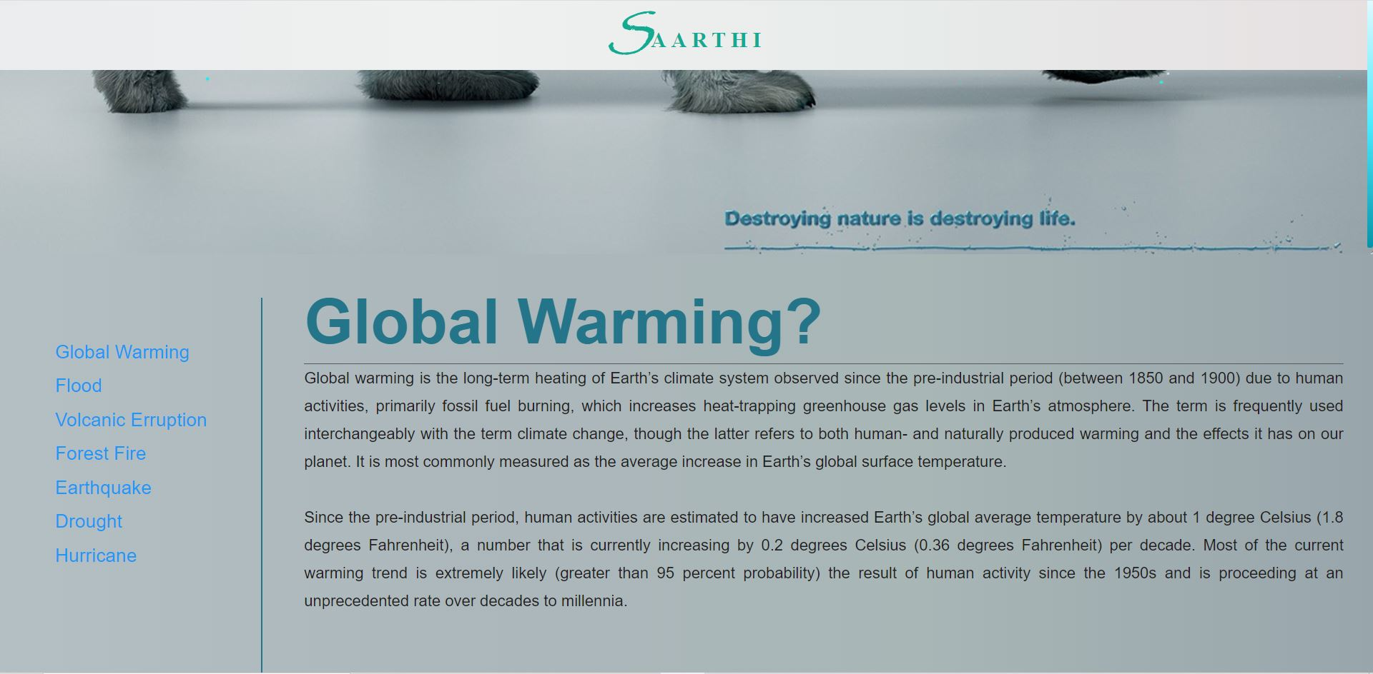
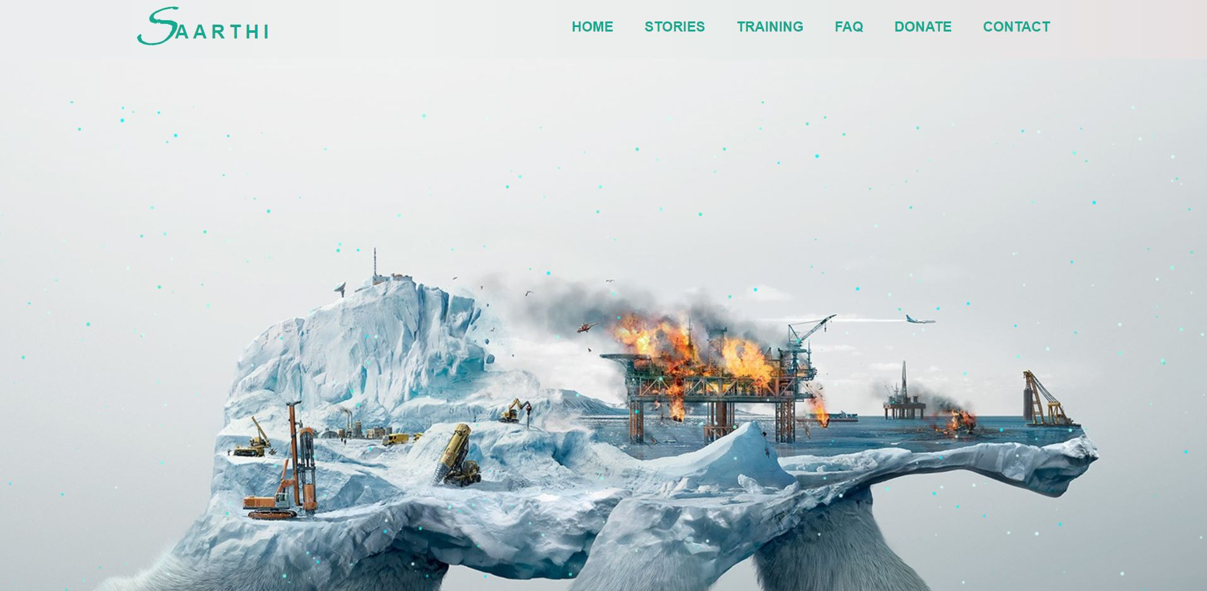

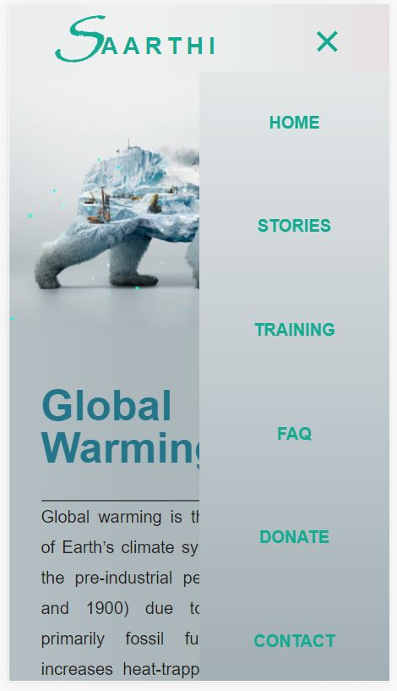
Responsive View

Slide 7

Technology Used
HTML 5(Hyper Text Markup Language)
CSS(Cascading Style Sheets)
JAVASCRIPT

Slide 8

Thank YOU

