Slide 1
Supporting Joins and Numerical Computations over Encrypted Databases
Department of Information Engineering and
Computer Science
University of Trento
Author:
  Alex Pellegrini
  Supervisors:
    Associate Prof. Dr. Bruno Crispo
    Dr. Muhammad Rizwan Asghar

Slide 2
Background
The system considers :
- A cloud Server (SQL database)
- Many Clients (users)
- Key Management Authority

Slide 3
Encryption Schemes
Discrete Logarithm Problem
Data Retrieval
- Proxy Encryption (PE)
Data Search
- Keyword Encryption (KE) :: Data searchable
- Trapdoor Encryption (TD) :: Query (read) Encryption

Slide 4
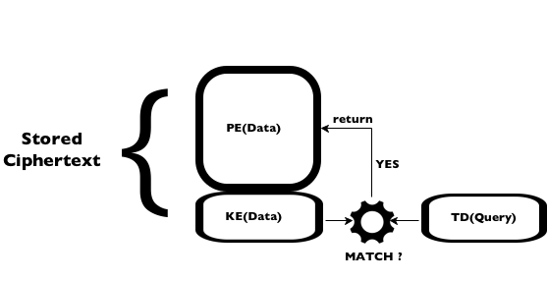
Encrypted Match
function PE[] SEARCH(TD(Q), Data)
PE[] matching ← new PE[Data.size];
for all D in Data do:
if MATCH( TD(Q), KE(D)):
matching.append(PE(D));
end if
end for
return matching;
end function
Match(KE(D), TD(Q)) → {0, 1}

Slide 5
Goals
Support computations between numerical ciphertexts
Evaluate range SQL encrypted queries on encrypted databases
Combine encrypted records to join tables

Slide 6
Numerical Data
Introduction of Integer(s) data type.
Probabilistic Homomorphic Encryption (HE)
- Adapted Paillier Cryptosystem
PE is replaced with HE for numerical data

Slide 7
HE : Encryption
x : secret key from Z*q
n : product of two large primes
g : an nth-residue of Z*n²
D : numerical value
rD : random number
Compute :
CD1 = { c’1 = g^{rD1}, c”1 = g^{xrD1}(1 + D1n) }

Slide 8
HE : Sum
CD2 = { c’2 = g^{rD2}, c”2 = g^{xrD2}(1 + D2n) }
Sum (element-wise product):
CD = CD1CD2 = { c’ = c’1c’2, c” = c”1c”2 } =
{
c’ = g^{rD1+rD2},
c” = g^{x(rD1+rD2)}(1 + D1n + D2n + D1D2n²)
}

Slide 9
HE : Decryption
Decrypt CD = { c’, c” }:
λ = c”(c’)^{-x} = (1 + D1n + D2n + D1D2n²)
Compute D :
(λ - 1) / n mod n = D1 + D2 = D

Slide 10
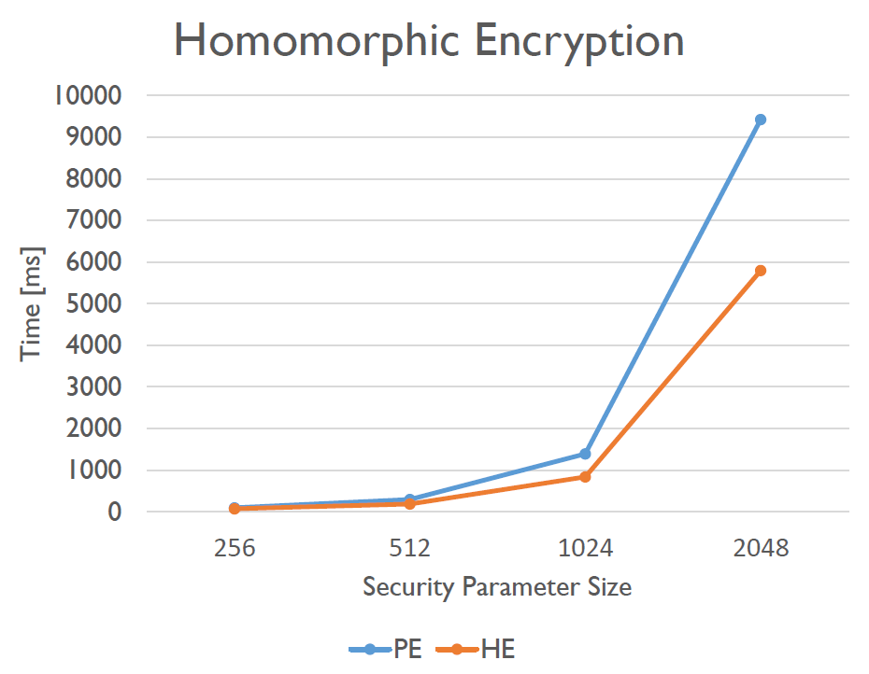
HE : Encryption Performances

Slide 11
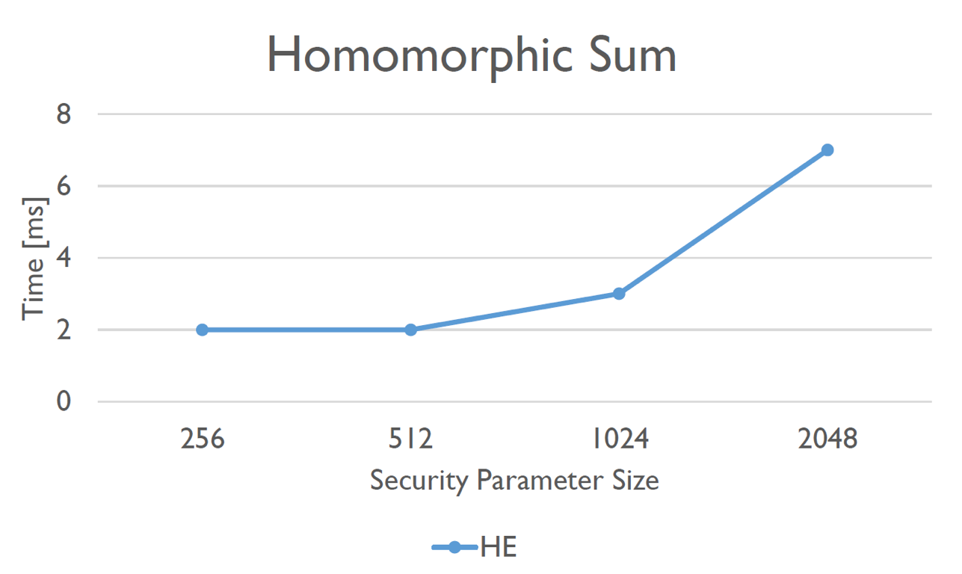
HE Sum Performances

Slide 12
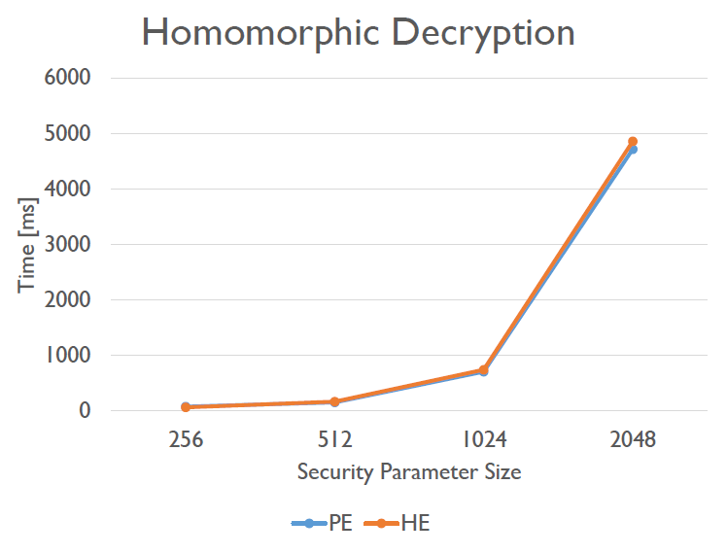
HE : Decryption Performances

Slide 13
Range Queries Evaluation
Requirements :
- Numerical columns’ bit length known a a lllpriori
- A supplementary table related to lllnumerical columns
- The Bag of Bits approach

Slide 14
Bag of Bits
A set (for each value) made up by strings composed by every bit of the value and filled up with *
n = 5, n2 = 101
k = 3
Bag of Bits for n is then made up by :
{ KE(1**), KE(*0*), KE(**1) }

Slide 15
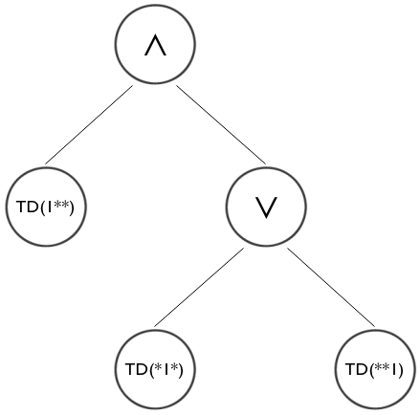
Policy Tree
n > 4;
5 = 101,
6 = 110,
7 = 111
1** AND (*1* OR **1)

Slide 16
Join
Data Stored as PE/HE and KE (probabilistic)
No way to compare stored data.

Slide 17
Cross Join
No constraints on field values
Combine records of a table with records of other tables (Cartesian Product)
The DBMS can do the work.

Slide 18
ON Policy
Joinable columns known a priori
Store values in joinable columns as PE and TD ciphertexts
- No need of Match function evaluation
- String equality comparison

Slide 19
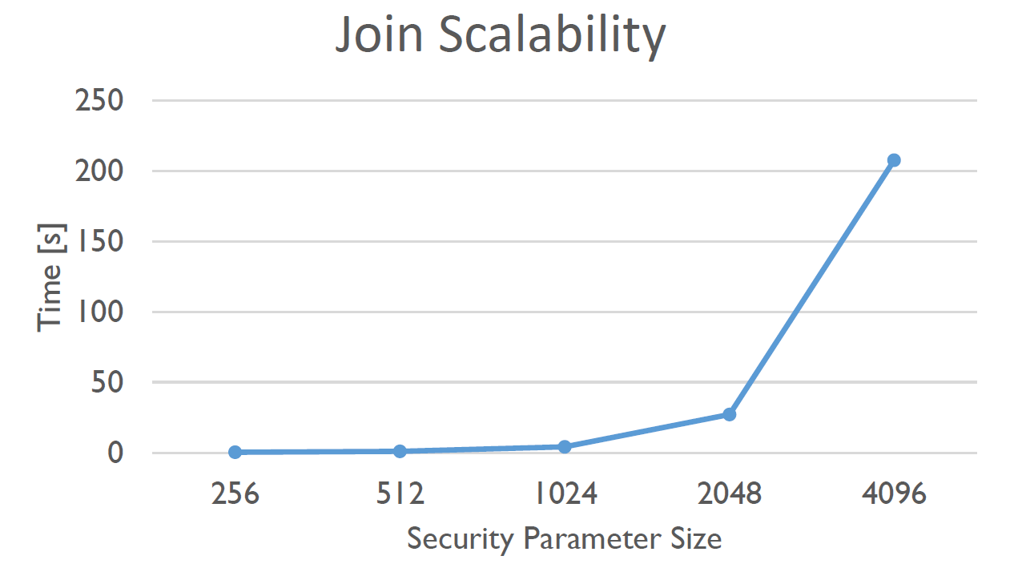
Join Performances

Slide 20
Conclusions
Relatively fast Paillier Cryptosystem adaption
Bag of Bits approach for numerical range queries
Performant Join solution

Slide 21
That’s it !
Thank you for paying attention.
Alex

