Slide 1
Logical network & VLAN topologies
Notes:
Teaching Tip
Recall Chapter 3 and the terms physical topology and signaling topology. Review these terms with the students. Also review the concept of broadcasting, using the example of sending a unicast via a switch, versus sending a broadcast via that same switch. Then, remind them of the term broadcast domain and how switches pretty much eliminated broadcast domains.

Slide 2
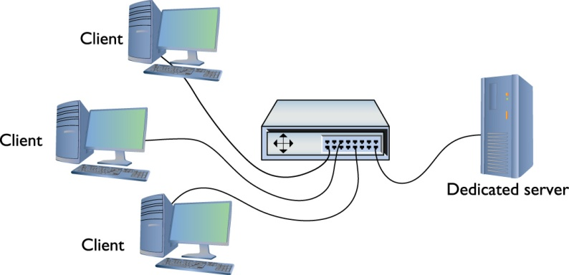
Figure 12.1 A simple client/server network

Slide 3
Virtual private network (VPN)
  VPN over Internet
    Alternative to expensive remote connections
    Connection using an encrypted tunnel
  Data encrypted and decrypted at endpoints
  Connecting computers must have same network ID as network
  Tunneling protocols: PPTP and L2TP
Notes:
Teaching Tip
The introduction to the VPN section comes at the end of the peer-to-peer section. It states that advanced network devices enable creation of networks of amazing complexity, security, and power: VPNs and virtual LANs (VLANs).

Slide 4
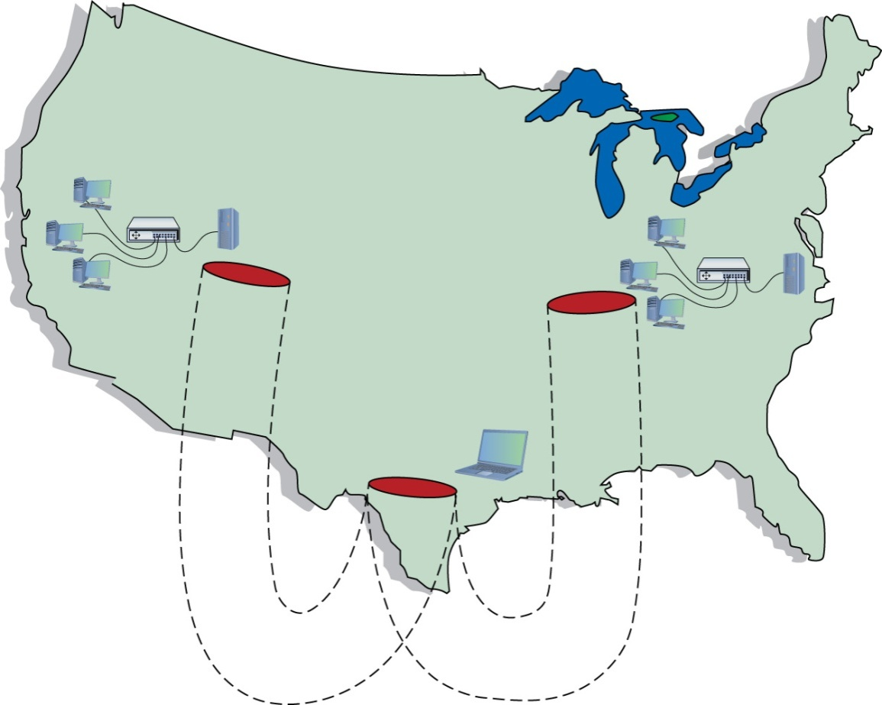
Figure 12.5 VPN connecting computers across
the United States

Slide 5
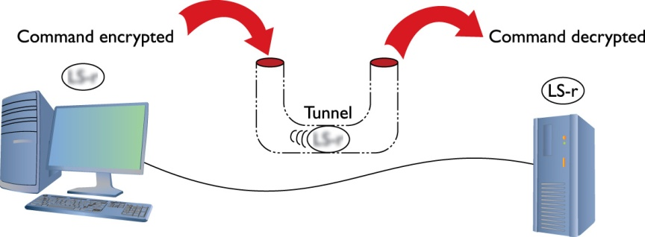
Figure 12.6 Typical tunnel

Slide 6
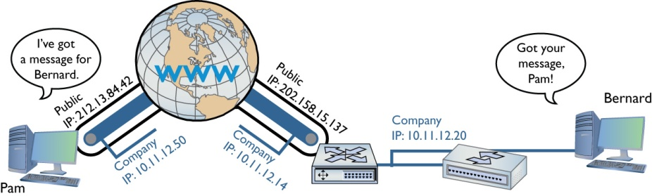
Figure 12.7 Endpoints must have their own
IP addresses.
Notes:
Clever network engineers have come up with many ways to make this work and those implementations function at different layers of the TCP/IP model. PPTP and L2TP, for example, work at the Link layer. Many VPNs use IPsec at the Internet layer to handle encryption needs. SSL VPNs work at the Transport layer. You’ll even find some applications marketed as VPNs that work at the Application layer, though those more commonly are just encrypted traffic and not true VPNs.

Slide 7
PPTP VPNs
  Point-to-Point Tunneling Protocol (PPTP)
  Advanced version of PPP
  One endpoint on client—other on Routing and Remote Access Service (RRAS)
  Clients use a virtual NIC that acquires a DHCP address
  Client connects to RRAS, PPTP creates tunnel over Internet

Slide 8
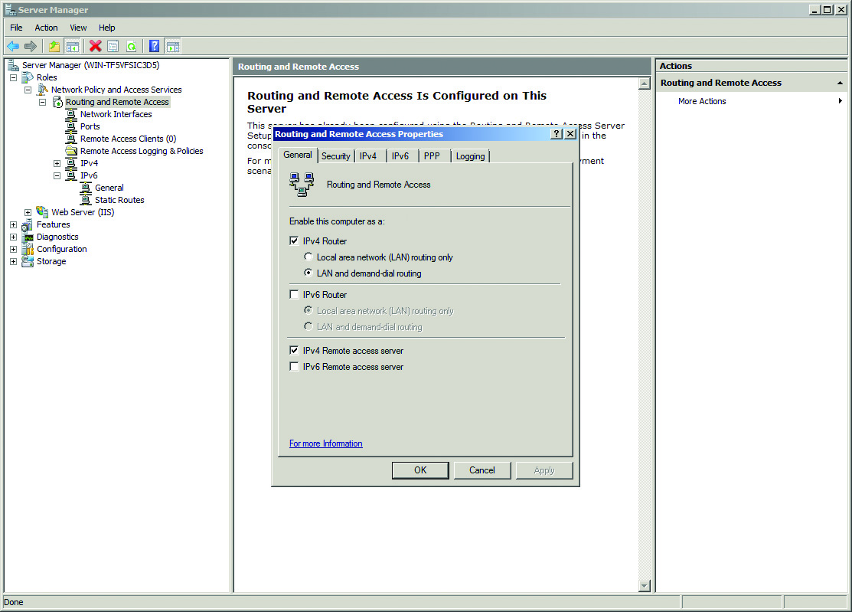
Figure 12.8 RRAS in action

Slide 9
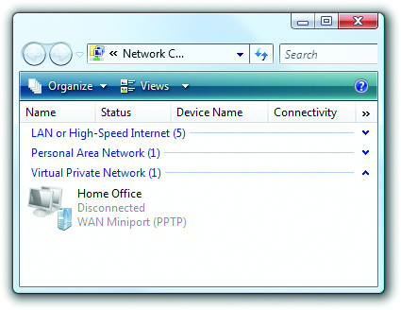
Figure 12.9 VPN connection in Windows

Slide 10
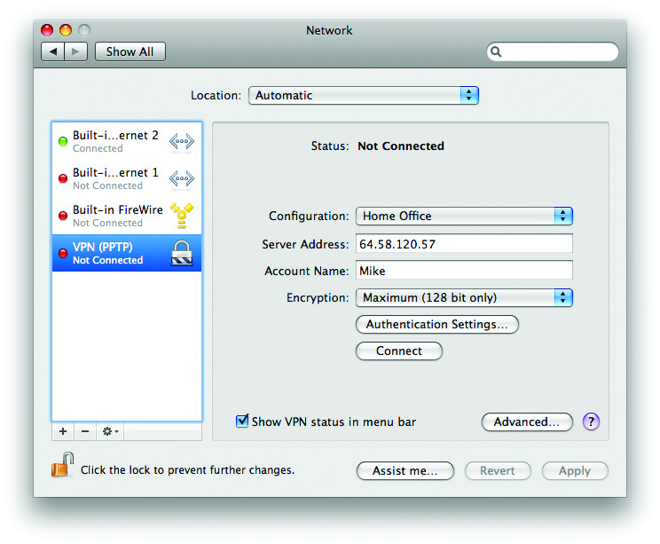
Figure 12.10 VPN on a Macintosh OS X system
Notes:
This type of VPN connection, where a single computer logs into a remote network and becomes, for all intents, a member of that network, is commonly called a client-to-site connection.

Slide 11
L2TP VPNs
  Layer2 Tunneling Protocol (L2TP)
  Cisco developed
  Good features of PPTP plus…
  Added support to run on most connections
  Moved the endpoint on the local LAN
    VPN concentrator can be endpoint
    Can connect two remote LANs using two VPN concentrators
Notes:
Cisco made hardware that supported PPP traffic using a proprietary protocol called Layer 2 Forwarding (L2F). L2F did not come with encryption capabilities, so was replaced by L2TP a very long time ago. You’ll sometimes see the term on the CompTIA Network+ exam as an incorrect answer.

Slide 12
L2TP has no authentication or encryption
  Usually uses IPSec for security
  Technically should be “L2TP/IPSec” VPN
  Connects client to LAN or LAN to LAN
  VPN clients in all OSs support L2TP/IP Sec

Slide 13
Site-to-site VPNs
  Used to connect two LANs separated by a WAN or the cloud
  Uses a VPN concentrator
  Slower, but cheaper, than dedicated leased line between LANS

Slide 14
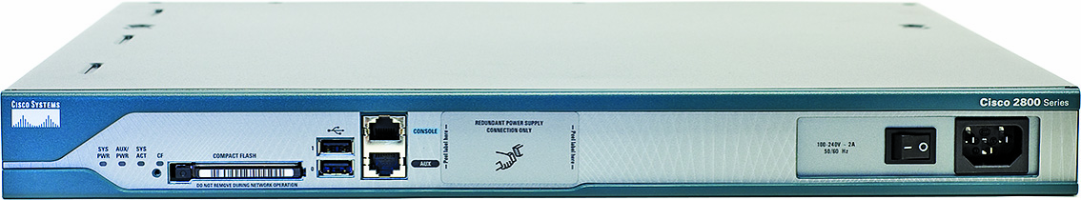
Figure 12.11 Cisco 2811 Integrated Services Router

Slide 15
SSL VPNs
  VPNs using Secure Sockets Layer
  Work at the Transport layer
  Don’t require any special client software
  Clients connect using Web browser
  Traffic secured using SSL
  Two most common types are SSL Portal and SSL Tunnel VPNs
Notes:
Cisco has made a big push for companies to adopt VPN hardware to enable VPNs using Secure Sockets Layer (SSL). These types of VPN work at the Transport layer and offer the advantage over link- or Internet-based VPNs because they don’t require any special client software. Clients connect to the VPN server using a standard Web browser, with the traffic secured using SSL. The two most common types of SSL VPNs are SSL Portal VPNs and SSL Tunnel VPNs.

Slide 16
SSL VPNs (cont.)
  SSL portal VPNs
    Client accesses VPN and is presented with a secure Web page
    Able to access anything on that page, such as email, data, links, etc.
Notes:
With SSL portal VPNs, a client accesses the VPN and is presented with a secure Web page. The client gains access to anything linked on that page, be it e-mail, data, links to other pages, and so on.

Slide 17
SSL VPNs (cont.)
  SSL tunnel VPNs
    Client browser runs an active control, such as Java or Flash
    Enables much greater access to VPN-connected network
    Creates a more typical client-to-site connection than SSL portal VPNs
    User must have sufficient permissions to run active browser controls
Notes:
With tunnel VPNs, in contrast, the client Web browser runs some kind of active control, such as Java or Flash, and gains much greater access to the VPN-connected network. SSL tunnel VPNs create a more typical client-to-site connection than SSL portal VPNs, but the user must have sufficient permissions to run the active browser controls.

Slide 18
Alternatives to PPTP, L2TP, and SSL
  Majority of VPNs use PPTP or L2TP
  Open VPN using Secure Shell (SSH)
  Pure IPSec using IPSec tunneling

Slide 19
VLANs in depth

Slide 20
VLAN
  Virtual Local Area Network (VLAN)
  Used by all but smallest LANs

Slide 21
Serious networks are complex
  Remote incoming connections
  Public Web or e-mail servers
  Wireless networks
  String of connected switches
  Tremendous amount of traffic
  Security Issues

Slide 22
VLANs as solution
  Separate networks with multiple switches
  Segment networks using switches
    Break up broadcast domains
    Serious networks have more than one switch
    Trunking connects VLANs on separate switches
    One port on each switch is trunk port
    Inter-Switch Link (ISL) Cisco form of trunking

Slide 23
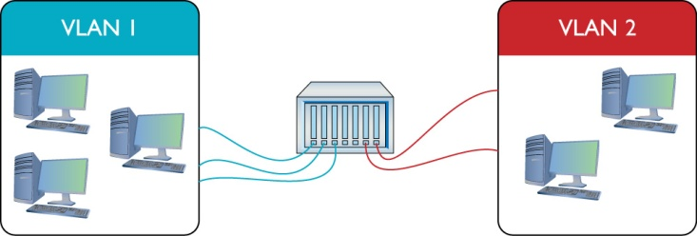
Figure 12.12 Switch with two VLANs

Slide 24
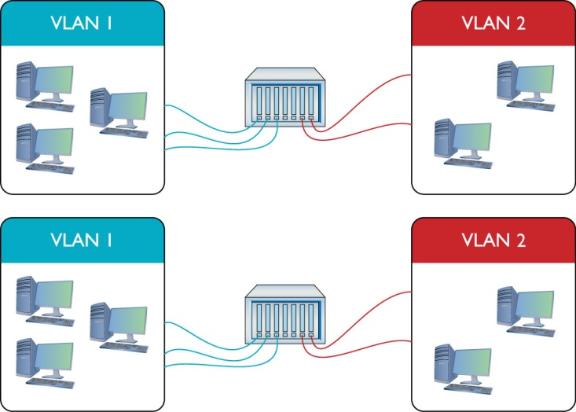
Figure 12.13 Two switches, each with a VLAN 2
and a VLAN 1
Notes:
There is a VLAN0. This is the default VLAN. When you buy new VLAN-capable switch and plug it in, every port on that switch is preset to VLAN0.

Slide 25
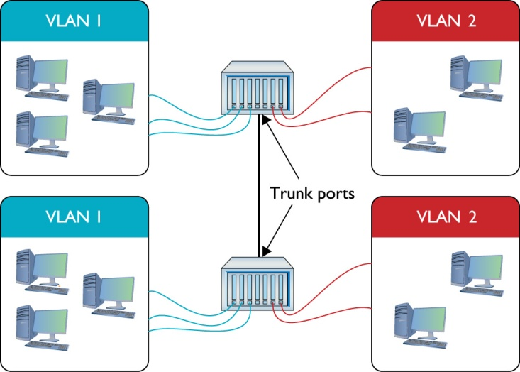
Figure 12.14 Trunk ports
Notes:
Trunking is the process of transferring VLAN traffic between two or more switches. We want all of the computers connected to VLAN1 on one switch to talk to all of the computers connected to VLAN1 on the other switch. Of course we want to do this with VLAN2 also. To do this, a port on each switch must be configured as a trunk port. A trunk port is a port on a switch configured to carry all traffic, regardless of VLAN number, between all switches in a LAN (Figure 12.14).

Slide 26
VLANs today
  Every Ethernet switch uses IEEE 802.1Q
  Connect switches from different sources
Notes:
Cisco, for example, had a proprietary form of trunking called Inter-Switch Link (ISL), which most Cisco switches still support. Today, every Ethernet switch prefers the IEEE 802.1Q trunk standard, enabling you to connect switches from different manufacturers.

Slide 27
Configuring a VLAN-capable switch
  Connect to Web server on switch
  Cisco Catalyst models
  Simple switches at Layer 2 (use MAC addresses)
  Managed switches use Layer 3 (IP addresses)
  Define the VLANs
  Assign MAC addresses or ports to VLANs
Notes:
Teaching Tip
Point out the note on the top of page 340 explaining the terms “static VLAN” and “dynamic VLAN.”
Static VLANs are based on ports, while dynamic VLANs are based on MAC addresses.

Slide 28
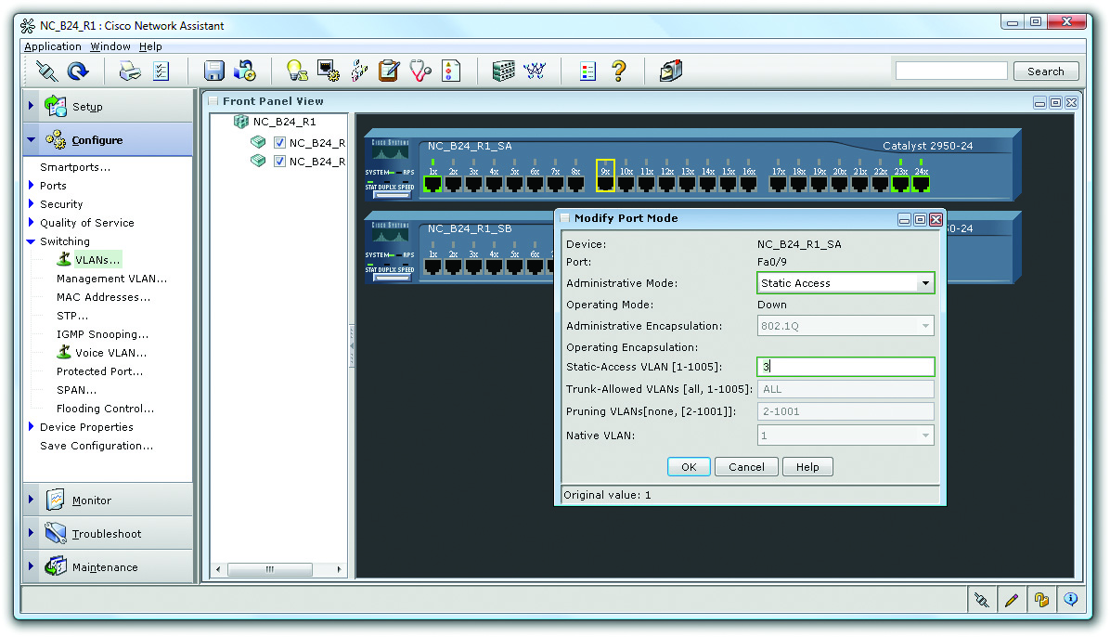
Figure 12.17 Assigning a port to a VLAN

Slide 29
InterVLAN routing
  Each VLAN a separate broadcast domain
  Need router to communicate between
  Problems with physical routers
  Some switches can do InterVLAN routing
  Cisco 3550
    Supports VLANs and virtual routers
    Works at Layers 2 and 3
Notes:
InterVLAN Routing is the process of routing between two VLANs

Slide 30
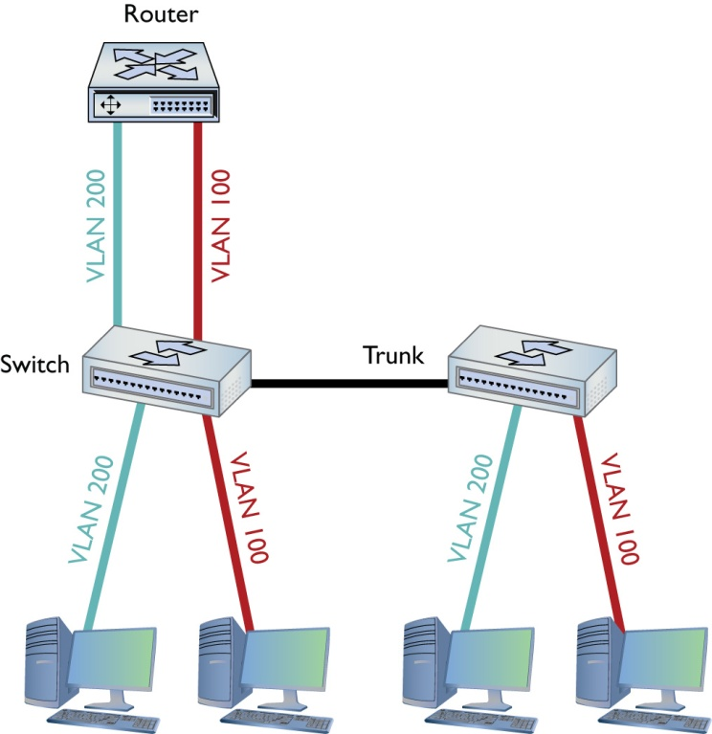
Figure 12.18 One router connecting multiple VLANs

