Slide 1
Lecture 3 — CS 2603
Applied Logic for Hardware and Software
WFFs = Combinational Circuits
CS2603 Applied Logic for Hardware and Software
Rex Page – University of Oklahoma
Notes:
CS2603 - Applied Logic, University of Oklahoma

Slide 2
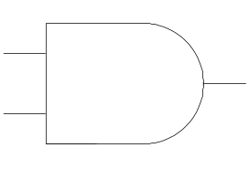
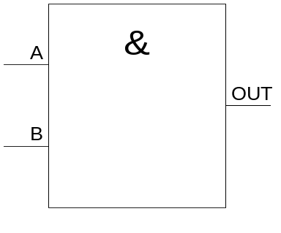


Gate Diagram – Logical And
This course uses Math way and EE way, interchangeably
P Q P ∧ Q
False False False
False True False
True False False
True True True
a
ab
b
a∧b
Math way
INPUTS OUTPUT
A B AB
0 0 0
0 1 0
1 0 0
1 1 1
EE way
IEC Symbol
A
B
circuit here
OUT
build gate as electrical circuit
Nobody uses these … Why?
CS2603 Applied Logic for Hardware and Software
Rex Page – University of Oklahoma

Slide 3
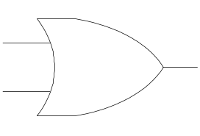
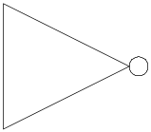
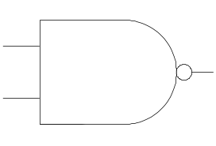
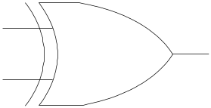
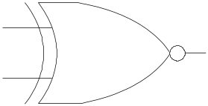
AND
OR
NOT
a
a
ab
a+b
a
a
b
b
a∧b
a∧b
¬a
NAND
XOR
XNOR
a
a
a
ab
a ⊕ b
a ⊕ b
b
b
b
¬(a∧b)
¬(a∨b)
(a→b)∧(b→a)
Notes:
CS2603 - Applied Logic, University of Oklahoma
Applied Logic, Rex Page, Univ of Oklahoma

Slide 4
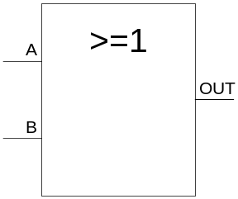
Gate Diagram – Logical Or
IEC Symbol
P Q P ∨ Q
False False False
False True True
True False True
True True True
OR
A
A+B
B
INPUTS OUTPUT
A B A+B
0 0 0
0 1 1
1 0 1
1 1 1
A
OUT
circuit here
B
build gate as electrical circuit
CS2603 Applied Logic for Hardware and Software
Rex Page – University of Oklahoma

Slide 5
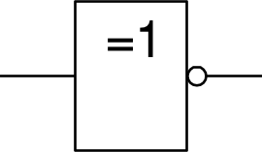
Gate Diagram – Logical Not
IEC Symbol
P ¬ P
False True
True False
NOT
A
A
INPUT OUTPUT
OUT
circuit here
A A
0 1
1 0
A
build gate as electrical circuit
CS2603 Applied Logic for Hardware and Software
Rex Page – University of Oklahoma

Slide 6
Gate Diagram – Logical Nand
P Q ¬(P ∧ Q)
False False True
False True True
True False True
True True False
NAND
IEC Symbol
A
AB
B
NOT
A
A
INPUTS OUTPUT
AND
A
AB
A B AB
0 0 1
0 1 1
1 0 1
1 1 0
B
AB
= AB
A
A
OR
A
B
= A+B
B
B
NAND is all you need
CS2603 Applied Logic for Hardware and Software
Rex Page – University of Oklahoma

Slide 7
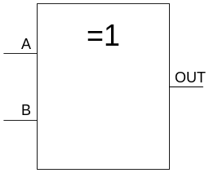
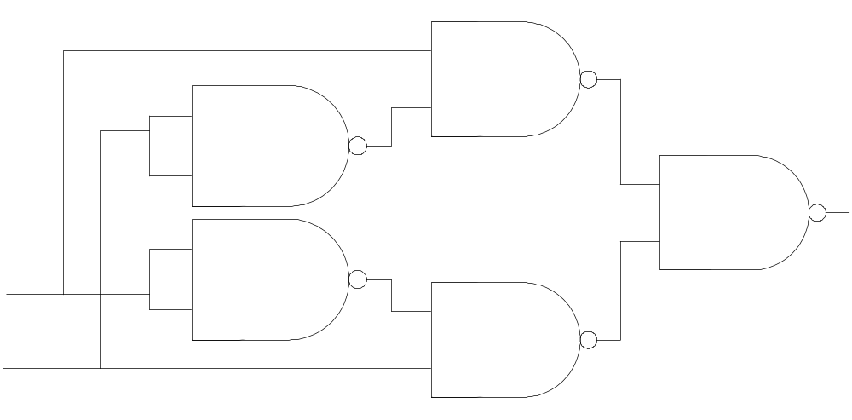
Gate Diagram – Exclusive Or (XOR)
IEC Symbol
P Q P ∨ Q
False False False
False True True
True False True
True True False
XOR
A
A ∨ B
B
INPUTS OUTPUT
A B A∨B
0 0 0
0 1 1
1 0 1
1 1 0
A B
B
A∨B
AB AB
A
=
A
A B
A ∨ B
B
XOR with nothing but NAND gates
CS2603 Applied Logic for Hardware and Software
Rex Page – University of Oklahoma
Notes:
CS2603 - Applied Logic, University of Oklahoma

Slide 8
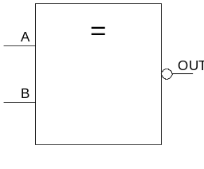
Gate Diagram – Equivalence
IEC Symbol
=
P Q P↔Q
False False True
False True False
True False False
True True True
A
A=B
B
INPUTS OUTPUT
A B A=B
0 0 1
0 1 0
1 0 0
1 1 1
NAND is all you need
A∨B
A∨B
=
A
A=B
B
What goes here?
CS2603 Applied Logic for Hardware and Software
Rex Page – University of Oklahoma
Notes:
CS2603 - Applied Logic, University of Oklahoma

Slide 9
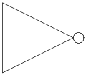
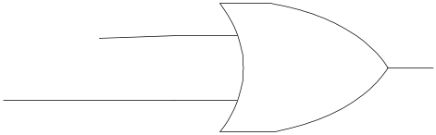
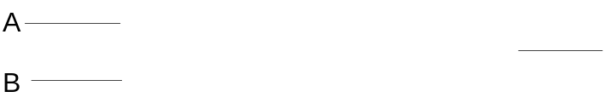
What Kind of Circuit is A → B ?
A B A→B
0 0 1
0 1 1
1 0 0
1 1 1
If you need an "implication gate"
you can use this circuit
What gate converts 0 to 1 ?
What goes here when 0 is on the A line ?
0
What goes here with 1 on B?
1
1
1
0
1
0
A=1, B=0?
a → b
circuit
What gate preserves 1 on line B ?
CS2603 Applied Logic for Hardware and Software
Rex Page – University of Oklahoma

Slide 10
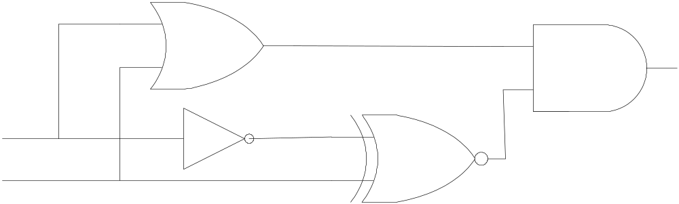
Every WFF Has a Circuit Diagram
WFF
EE notation
((P ∨ Q)∧((¬P)↔Q))
(A+B)( A=B)
+
ab
=
a
∨
∧
¬
↔
(A+B)( A=B)
A
B
But … NAND is all you need
What would it look like then?
Three notations
Same mathematical object
CS2603 Applied Logic for Hardware and Software
Rex Page – University of Oklahoma

Slide 11
Digital Circuits
Sequential circuit
  Circuit diagram
    May have multiple output lines
  Outputs may depend on history of inputs
  Usually clocked (synchronous sequential circuit)
    Sequence of outputs depends on sequence of inputs
Combinational circuit
  Circuit diagram (perhaps with multiple output lines)
  Output signals depend only on input signals
    Cannot depend on a previous state of the input signals
Acyclic circuit diagrams are always combinational
  Acyclic diagram: cannot trace along transmission lines from output of one gate to input of another, and reach any gate-input-point more than once
  No way to “save” an input to affect subsequent output
In this course: All combinational circuits acyclic
CS2603 Applied Logic for Hardware and Software
Rex Page – University of Oklahoma

Slide 12
Acyclic Circuits with one output ≅ WFFs isomorphism: map preserving relationship among elements
s : C₁ → W
  C₁ = acycylic (combinational) circuit diagrams, 1 output
  W = WFFs
s( ) = A ∧ B … similar for other gates
A
B
Substitute α for A, β for B,
for Z
a
A
s( ) = [α | A, β | B, … ζ | Z] in s( )
where
α = s( )
β = s( )
…
ζ = s( )
b
c
B
c
Z
A
a
in the formula s( )
z
B
c
Z
b
This mapping is invertible
So, it establishes a
one-to-one correspondence
between C₁ and W
z
CS2603 Applied Logic for Hardware and Software
Rex Page – University of Oklahoma

Slide 13
Practice Exercise s: C₁ ≅ WFFs
s( ) = A ∧ B … similar for other gates
A
B
Substitute α for A, β for B,
for Z
a
A
s( ) = [α | A, β | B, … ζ | Z] in s( )
where
α = s( )
β = s( )
…
ζ = s( )
b
c
B
c
Z
A
a
in the formula s( )
z
B
c
Z
b
z
Compute s( ) where is the following circuit
Α
x
c
Α
x
c
Β
Β
Α
c
Β
x
c
A
B
CS2603 Applied Logic for Hardware and Software
Rex Page – University of Oklahoma

Slide 14
Solution to Practice Exercise s: C₁ ≅ WFFs
Α
c
Β
x
c
A
B
1. Express in the form of
a hierarchy of circuits
2. Perform substitutions
in the hierarchy
Α
α = s( ) = s( ) = A∨B
a
A
a
a
Α
a
Α
x
c
=
Β
Β
Β
Β
c
c
Α
b
Α
β = s( ) = s( ) = (¬A)↔B
Β
A
b
b
Β
Β
b
where
s( ) = [α | a, β | b] in s( )
A
x
c
a
c
c
Α
a
a
=
Α
a
Β
b
Β
Β
= [α | a, β | b] in s( )
a
c
A
=
Α
b
Β
b
b
b
= [α | a, β | b] in (a ∧ b)
Β
a
c
c
=
a
c
= (A∨B) ∧ ((¬A)↔B)
b
b
CS2603 Applied Logic for Hardware and Software
Rex Page – University of Oklahoma

Slide 15
We Skipped a Step in the Solution
Α
hierarchical computation of s( )
Β
b
1. Express in the form of
a hierarchy of circuits
2. Perform substitutions
in the hierarchy
Α
Α
a
b
=
Β
c
c
Β
b
α = s( ) = s( ) = ¬A
Α
a
Α
a
where
a
β = s( ) = s( ) = B
Β
b
Α
a
=
Α
a
b
Β
b
a
s( ) = [α | a, β | b] in s( )
A
c
a
c
=
Β
x
b
c
Β
b
Β
b
b
a
= [α | a, β | b] in s( )
b
c
a
c
=
a
c
b
c
b
= [α | a, β | b] in (a ↔ b)
= (¬A)↔B
CS2603 Applied Logic for Hardware and Software
Rex Page – University of Oklahoma

Slide 16
Acyclic Circuits ≅ WFFs ⁺
s⁺ : W⁺ → C
  C = acyclic (combinational) circuits (any number of outputs)
  W⁺ = {(w, V) | w ∈WFFs, V ⊆ subformulas of w}
The mapping works like this
  s⁻¹ : W → C₁ — inverse of the one-output isomorphism
  s⁺(w, V) = s⁻¹(w) augmented with extra output lines
    Each v ∈ V adds an output line to s⁻¹(w)
    Output line added by v is the output line of subcircuit s⁻¹(v)
  Example — next slide
CS2603 Applied Logic for Hardware and Software
Rex Page – University of Oklahoma

Slide 17
Combinational Circuits ≅ WFFs ⁺ example
Compute s⁺(w, V)
  w = (A∨B) ∧ ((¬A)↔B) —formula (WFF)
  V = { (A∨B) ∧ ((¬A)↔B) , (¬A)↔B } —subformulas
In previous slide, we computed s⁻¹((A∨B) ∧ ((¬A)↔B)) =
c
A
B
Α
We also computed: s⁻¹((¬A)↔B) =
Β
d
c
So, s⁺(w, V) =
A
d
B
CS2603 Applied Logic for Hardware and Software
Rex Page – University of Oklahoma

Slide 18
The End
CS2603 Applied Logic for Hardware and Software
Rex Page – University of Oklahoma

