Slide 1
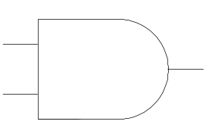
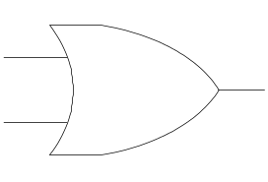
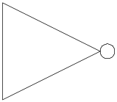
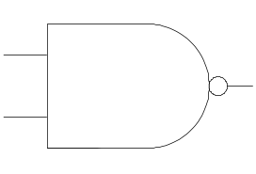
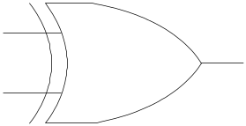
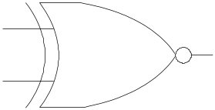
AND
OR
NOT
a
a
ab
a+b
a
a
b
b
a∧b
a∨b
¬ a
NAND
XOR
XNOR
a
a
a
ab
a ⊕ b
a ⊕ b
b
b
b
¬(a∧b)
(a∨b)∧(¬(a∧b))
(a→b)∧(b→a)
a
circuit diagram
b
( a + b)(b + a)
logic formulas
((¬a) ∨ b) ∧ ((¬b) ∨ a)
Notes:
CS2603 - Applied Logic, University of Oklahoma
Applied Logic, Rex Page, Univ of Oklahoma

