Slide 1
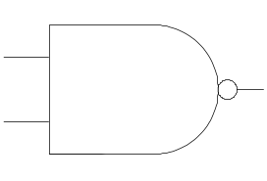
nand for ¬
nand for ∧
a
ab
a
a
ab
= ab
b
(¬a) = (¬(a ∧ a))
(a ∧ b) = (¬((¬(a ∧ b)) ∧ (¬(a ∧ b))))
nand for ∨
a
a
a
b
= a+b
b
b
(a ∨ b) = (¬((¬(a∧a))∧(¬(b∧b))))
Notes:
CS2603 - Applied Logic, University of Oklahoma
Applied Logic, Rex Page, Univ of Oklahoma

