Slide 1
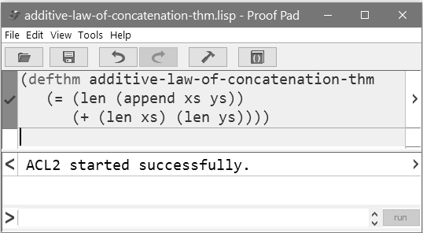
proof bar
Notes:
CS2603 - Applied Logic, University of Oklahoma
Applied Logic, Rex Page, Univ of Oklahoma

