Slide 1
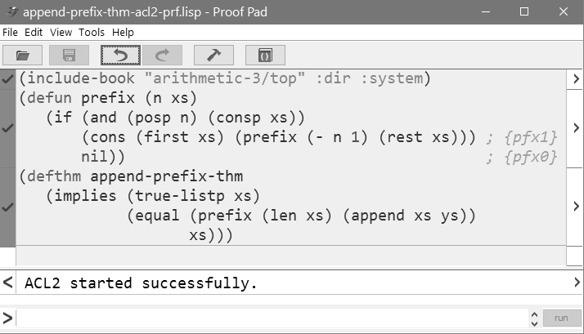
import theorems
admit operator
prove theorem

