Slide 1
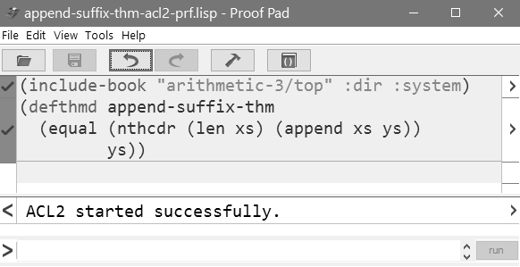
import arithmetic
theorems
prove theorem

