Slide 1
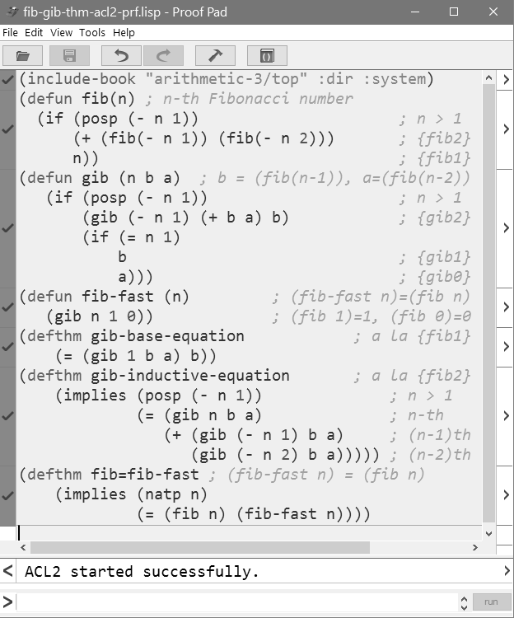
import theorems
admit operators
prove theorems

