Slide 1

Deep FM
By 骰子人工智能

Slide 2
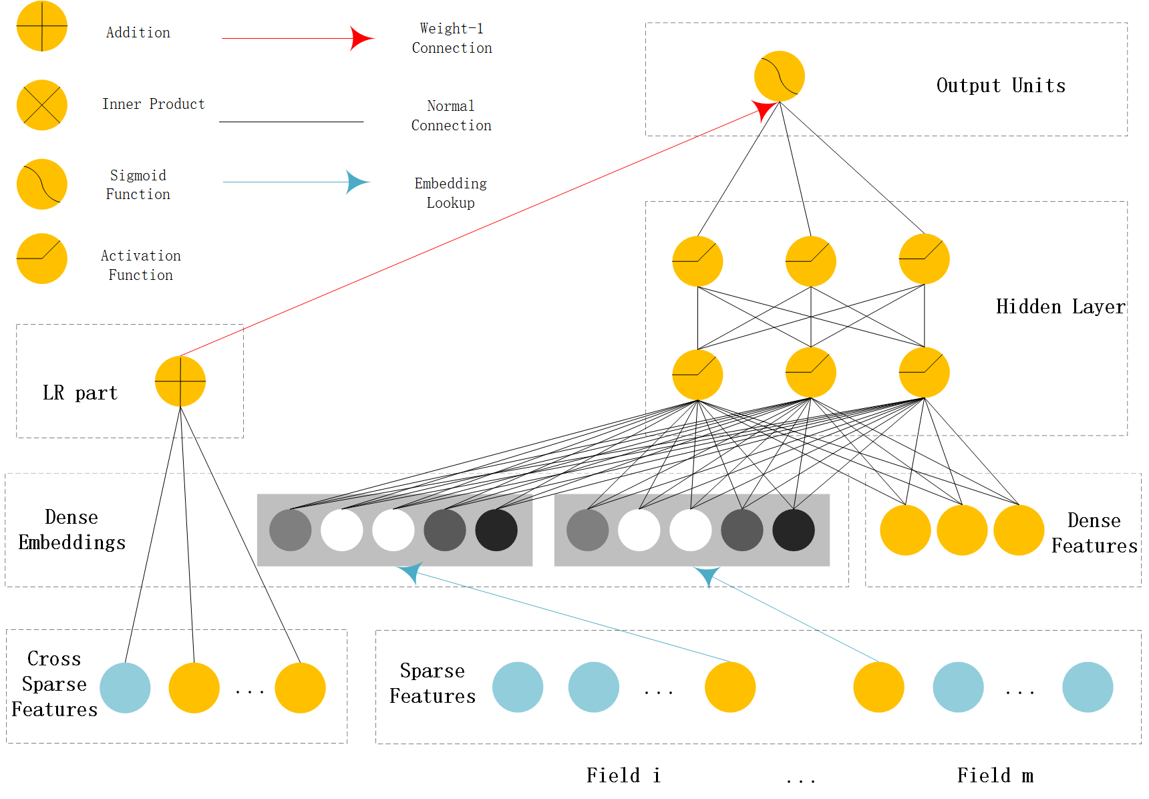
Wide & Deep示意图

Slide 3
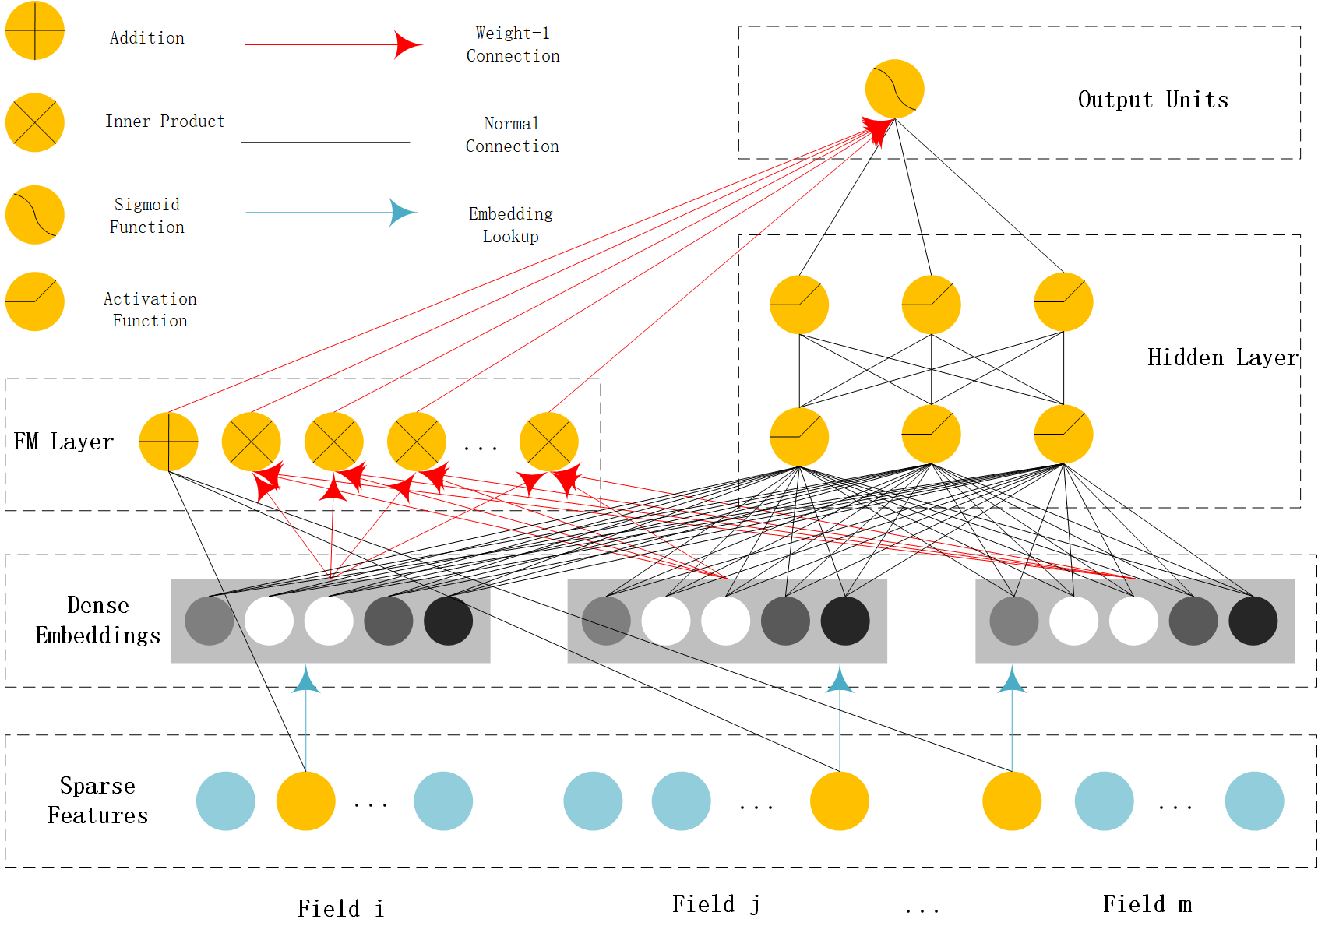
Deep FM 示意图

Slide 4

FM推荐系统
FM二次项公式： y’ $=$ $\sum_{j1}^{n}{\sum_{j2=j1+1}^{n}{(w_{j1}·w_{j2})∗x_{j1}x_{j2}}}$
代码表示:
sum=0 , n =len(x)
w = 随机初始化w数组shape是( n , k ) k是超参 for j1 in range(n): for j2 in range(j1+1,n): sum += w[j1].dot(w[j2]) * x[j1] * x[j2] return sum

