Slide 1
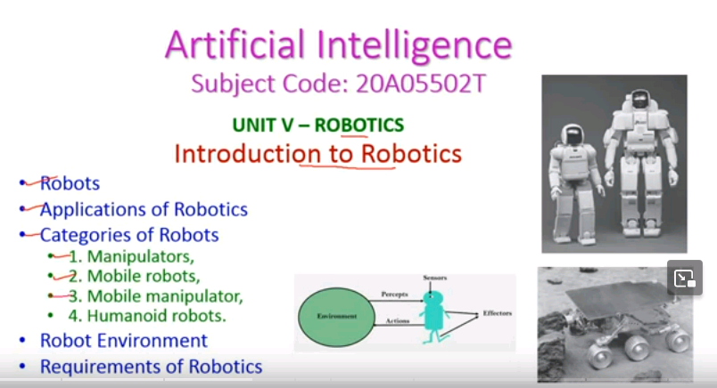

Slide 2
Robots
A robot is an artificial agents and is capable of performing actions and replicating certain human movements automatically, by giving commands through programming.
Al Robot is aimed at manipulating the objects by perceiving, picking, moving, destroying it.
The robots have mechanical construction, giving shape to robot designed to do a particular task.
They have electrical components, which power and control the machinery.
They have computer program that determines what, when and how a robot does something

Slide 3
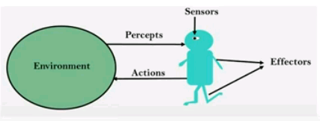
Robots...
Robots are physical agents that perform tasks in the physical world.
Robots are equipped with effectors such as legs, wheels, joints and grippers .
Effectors have a single purpose to do the task on the environment.
Robots are also equipped with sensors, which allow them to perceive their environment.
The sensors - including cameras and lasers to measure the environment, and gyroscopes and accelerometers to measure the robot's own motion.

Slide 4
Applications of Robotics
The robotics has been instrumental in the various domains such as
Industries - Robots are used for handling material, cutting, welding, color coatlng, drilling, polishing,etc.
Military - Autonomous robots can reach inaccessible and hazardous zones during war. A robot named Daksh, developed by Defense Research and Development Organization (DRDO), is in function to destroy life­ threatening objects safely.
Medicine - The robots are capable of carrying out hundreds of clinical tests simultaneously, supporting and recovering disabled people, and performing complex surgeries such as brain tumors.
Exploration - The robot rock climbers used for space exploration, underwater drones used for ocean exploration and etc.
Entertainment - Disney's engineers have created hundreds of robots for movie making.

Slide 5
Categories of Robots
1. Manipulators
2. Mobile robots
3. Mobile manipulator,(combination of 1and 2)
4. Humanoid robots mimic the human torso.

Slide 6
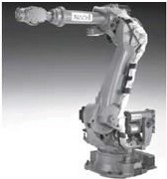
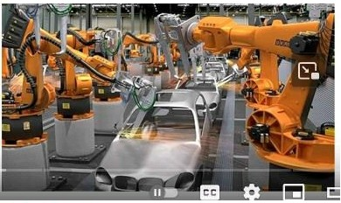
Categories of Robots – Manipulators
The robot arms are physically attached to
their workplace
These robots are used in factory assembly
line, international Space Station, hospitals
etc.
Manipulator motion usually involves a
chain of controllable joints, used the
robots to place their effectors in any
position within the workplace .
Manipulators robots, with more than a
million units installed worldwide.--

Slide 7
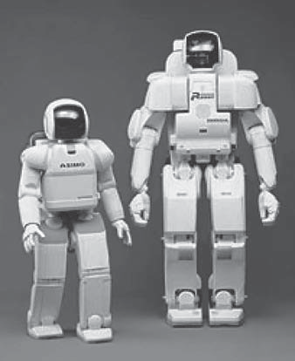
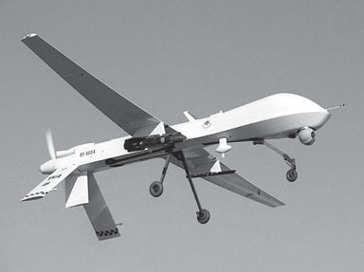
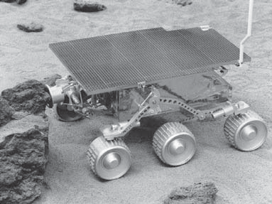
Categories of Robots - Mobile Robots
Mobile robots move about their environment using
wheels, legs, or similar mechanisms.
They are used to delivering food in hospitals,
moving containers at loading docks, and similar tasks.
Unmanned ground vehicles, or UGVs, drive
autonomously on streets, highways, and off-road.
Unmanned air vehicles {UAVs), commonly used for
surveillance, crop-spraying, and military operations.

Slide 8
Categories of Robots - Mobile Manipulator
The third type of robot combines mobility with
manipulation, and is often called a mobile
manipulator.
Humaniod robots mimic the human
The early humanoid robots shown in figure,
both manufactured by Honda Corp. in Japan.
Mobile manipulators' task is made harder
because they replace human in difficult tasks
Sorne mobile manipulators are used in
hospitals to assist surgeons.

Slide 9
Robot –Environment
The robot environments are partially observable, stochastic, dynamic, and continuous,
Many robot environments are sequential and multiagent as well.
Robot cameras can see around the corners, and understand motion commands .
In a simulated environment, it is possible to use simple algorithms (such as the Q-learning algorithm) to learn very quickly.
In a real environment, it might take years to run these trials.

Slide 10
Requirements of Robotics
Practical robotic systems need
a prior knowledge about the robot,
its physical environment, and
the tasks that the robot will perform
• so that the robot can learn quickly and perform safely.
• Robotics brings together many of the concepts including
probabilistic state estimation,
perception,
planning,
unsupervised learning, and
reinforcement learning.

Slide 11
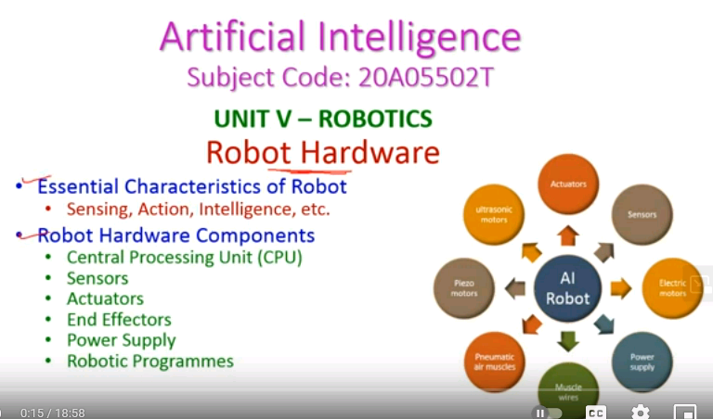

Slide 12
Essential Characteristics of Robot
Feature of robots - is that they
interact with the real world
making changes to the world through their actions and
Responding to events in the world.
Robots perform useful tasks, extend the capabilities of humans.
In critical environment they reduce our risks.
Robotic systems can be defined as interconnected, interactive, cognitive and physical tools that are able to:
Perceive the environment using sensors
perform act1ons enabled by actuators
reason about events
make plans using algorithms implemented in computer programs

Slide 13
Essential Characteristics of Robot...
Sensing- perceive the enviornment using sensors
Robot gets its input by sense its surroundings through sensors
Based on the applications robotics uses different sensors
Robot sensors
light sensors (eyes),
touch and pressure sensors (hands},
chemical sensors (nose),
hearing and sonar sensors (ears), and
taste sensors (tongue)

Slide 14
Essential Characteristics of Robot...
Movement – perform actions enabled by actuators
Actuators act like hands and legs of robots to do its task on environment.
Also robot sometimes needs to move around its environment.
These movements done by rolling on wheels, walking on legs or propelling by thrusters (third party products)

Slide 15
Essential Characteristics of Robot...
lntelligence
reason about events
make plans using algorithms Implemented in computer programs
A robot needs some kind of "smarts.“
The robot will have to have some machine learning algorithms to reason the events to make decisions and implementations.

Slide 16
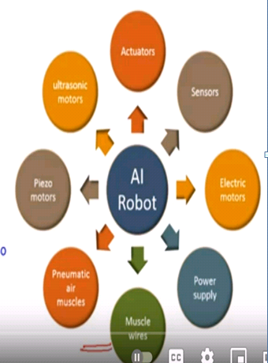
Robot Hardware Components
l.Actuators
Acting on environment, convert energy into
movement.
2.Sensors
Input to the robot
3. Electric motors (AC/DC)
For the rotational movement
4.Power Supply
Al robots are powered by batteries ,solar power
hydraulic.
5.Data cables and connecting Wires
To send and receive data and control signals
and also give electric current to the robots.
6.Pneumatic Air Muscles
7.Piezo Motors and Ultrasonic Motors
Basically used in industrial robots

Slide 17
Central Processing Unit (CPU)
The CPU acts as the “brain" of the robot.
A robot 's CPU
collect data from sensors,
process the data by analyzing in terms of reasoning and making decision
Select the required action and that will be done by actuators .

Slide 18
Sensors
They act like “eyes” and “ears” to the help the robot in takin¡g the surrounding information.
Sensors can be of two types :
a. Passive sensors - true observers such as cameras
Cameras feed in visual information, then an Al process called machine vision algorithms analyzes the video footage to recognize objects, guiding the robot.
b. Active sensors - send energy to the environment, like SONAR

Slide 19
Sensors ...
Types of Sensors:
SONAR sensor (sound navigation and ranging),
LIDAR sensor (light detection and ranging),
Light sensors,
Sound sensors,
Temperature sensors,
Contact sensors,
Distance sensors,
Proximity sensors,
Pressure sensors,
Positioning sensors(GPS)
Some robots even have touch, taste and smell.
The robot's CPU interprets signals from these sensors and adjusts its actions accordingly

Slide 20
Actuators
The sensors are like eyes and ears of the robot,
The actuators functions like hands and legs
Actuators are small motors attached directly to the structure of the robot that facilitate movement .
Some of them are:
Hydraulic - uses oil to facilitate movement.
Penumatic - uses air to facilitate movement.
Electric - uses electric current and magnets to facilitate movement

Slide 21
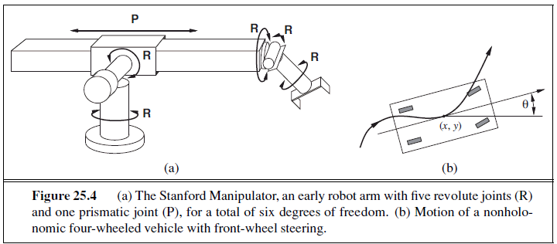
Actuators ...
The simplest robots consist of an arm wíth a tool attached for a particular task .
lt can flex the upper arm towards or away, and ca n rotate right or left.
The wrist has three degrees of freedom
lt can move up and down, side to side, and can also rotate.
Robot joints also have one, two, or three degrees of freedom each.
Six degrees of freedom are required to place an object, such as a hand, at a particular point in a particular orientation.
More advanced robots may move around on wheels.
Human old robots have arms and legs that mimic human movement

Slide 22
End Effectors
In order to carry out assigned tasks, robots are equipped with tools called "effectors" or "end effectors".
These are the tools that perform the actual work and interact with the environment.
Some of them are:
Industrial robots may have interchangeable tools such as welding torches, screw drivers, pain sprayers and etc.
Mobile robots sent to other planets, and
bomb disposal robots
Some robots have universal grippers that mimic the function of the human hand.

Slide 23
Power Supply
Most robots get their energy from electricity.
Stationary robots in factories receive use A.C power.
Mobile Robots are usually powered with D.C power/Batteries.
Space robots or Satellites are designed to collect solar power.

Slide 24
Robotic Programmes
A robot's programming is not a physical component, but it's still essential part of the system.
In robotics the machine learning algorithms are used to determine what, when and how a robot do something.
In a simulated environment, it is possible to use simple algorithms like reinforcement learning (such as the Q-learning algorithm) to learn very quickly, that a human cannot.

Slide 25
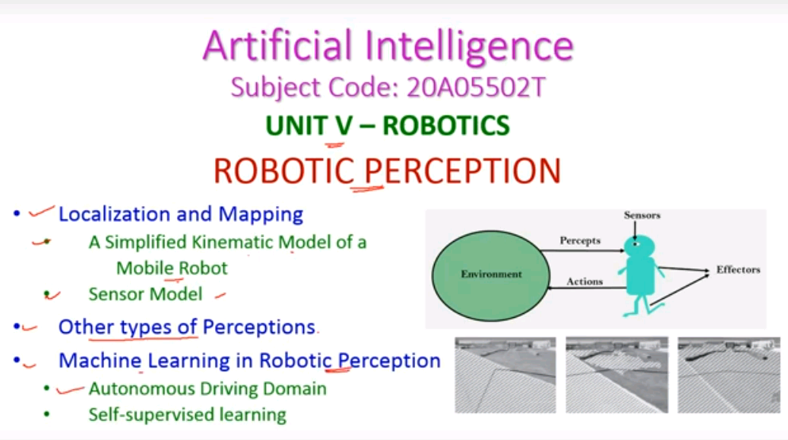

Slide 26
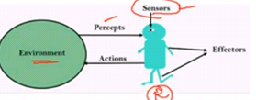
ROBOTIC PERCEPTION
Perception is the process by which robots map sensor measurements into internal representations of the environment
Perception is difficult because sensors are noisy and the environment is partially observable, unpredictable, and often dynamic.
Robots have all the problems of state estimation.
Good internal representations for robots have three properties:
they contain enough information for the robot to make good decisions,
they are structured so that they can be updated efficiently, and
they are natural in the sense that internal variables correspond to natural state variables in physical world

Slide 27
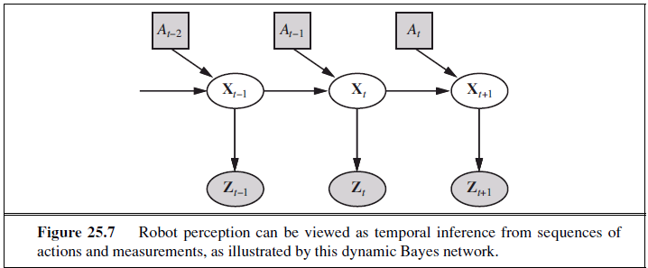

Robot perception
Robot perception can be viewed as
temporal interference from sequences
of actions and measurements, as
illustrated by this dynamic Bayes network.
Xt is the state of the environment (including the robot) at time t
Zt is the observation received at time t and
At is the action taken after the observation is received.
Compute the new belief state P(Xt+l | Zl:t+l, a1:t), from the current
belief state P(Xt | Zl:t, a1:t-1) and the new observation Zt+l.

Slide 28
Robot perception
This equation states that, the posterior over the state variables X at time t+1 is calculated recursively from the corresponding estimate one time step
Earlier
This calcultion involves the previous action and the current sensor measurement zt+l.
The posterior probability is a probability distribution over all states that captures from past sensor measurements and controls.
The equation recursively estimate this location, by incrementally folding in
sensor measurements (e.g., camera images) and robot motion commands.
The probability P(Xt+l 1 xt, at) is called the transition model or motion
model, and
The probability P(zt+l 1 Xt+l) (observation model) is the sensor model.

Slide 29
Localization and Mapping
Localization is the problem of finding out where things are- including the robot itself in the environment.
For example, robot manipulators must know the locatíon of objects they seek to manipulate;
They should know the path of robot as well as the current location of robot

Slide 30
Localization and Mapping...
Let us consider a mobile robot that moves slowly in a flat 2D world, and assume the robot is given an exact map of the environment.
Mobile robot is defined by its two Cartesian coordinates with values x and y and its heading with value θ
lf we arrange those three values in a vector, then
any particular state is given by Xt =(xt,yt, θt).

Slide 31
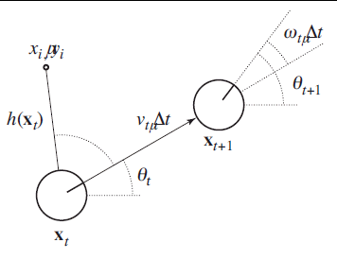
A Simplified Kinematic Model of a Mobile Robot
The robot is shown as a circle with an
interior line marking the forward direction.
The state Xt consists of the (Xt,Yt) position
(shown implicitly) and the orientation θt.
The new state Xt+l is obtained by an update
in position of Vt ∆t and in orientation of
ὼt∆t.
Also shown is a landmark at (Xi, yi) observed at time t.

Slide 32
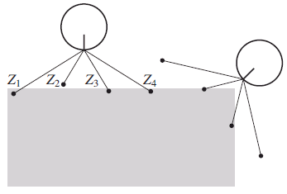
A Simplified Kinematic Model of a Mobile Robot...
The range-scan sensor model.
Two possible robot poses are shown
for a given range scan (zl, z2, z3,z4)
.
lt is much more likely that the pose on
the left generated,
the range sean,than
the pose on the right.

Slide 33
Sensor Model
The sensors detect stable, recognizable features of the environment
called landmarks.
For each landmark, the range and bearing (behavior) are reported.
Sensor model is used for an array of range sensors, each of wh ich has a fixed bearing relative to the robot.
Such sensors produce a vector of range values,sometimes noise will be included.
The Noise will be corrupted by Gaussian noise
Comparing the range-scan model to the landmark model,
the range-scan model has the advantage that there is no need to
identify a landmark until it required

Slide 34
Other Types of perception
Not all of robot perception is about localization or mapping.
Robots also perceive the temperature, smells, audio signals and so-on.
Many of these quantities can be estimated using variants of
-dynamic Bayes networks.
All that is required for such estimators are conditional probability distributions.
The perception models characterized to
the evolution of state variables over time, and
sensor models that describe the relation of measurements to state variables.

Slide 35
Other Types of Perception...
A robot is a reactive agent represented with well-defined sematics
The two techniques in perception model
Probabilistic techniques is good in many hard perceptual problems such as localization and mapping.
Statistical techniques are sometimes too heavy, and simpler solutions, are best for effective in practice

Slide 36
Machine Learning in Robot Perception
Machine learning plays an important role in robot perception.
When the best internal representation is not know, then we can go
for machine learning.
One common approach is to map high dimensional sensor streams
into lower-dimensional spaces using unsupervised machine learning methods.
Such an approach is called low-dimensional embedding.
Machine learning makes it possible to learn sensor and motion models from data,while simultaneously discovering a suitable
internal representations

Slide 37
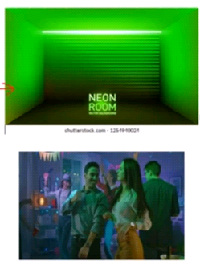
Machine Learning in Robot Perception...
Ml techniques enables robots to continuously
adapt the huge changes in sensor measurements
Example, walking from a sun-lit space into
a dark neon-lit room.
Clearly things are darker inside.
But the change of light source also affects all
the colors:
Neon light has a stronger component of green
light than sunlight.
Yet somehow we seem not to notice the change.
lf we walk together with people into a neon-lit
room, we don't think that suddenly their faces
turned green.
Our perception quickly adapts to the new lighting conditions, and our brain ignores the differences

Slide 38
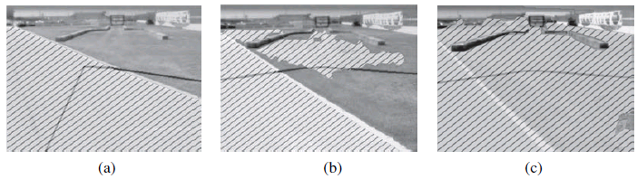
Autonomous Driving Domain
Adaptive perception techniques enable robots to adjust such changes.
Example the autonomous driving domain.
Sequence of "drivable surface" classifier results using adaptive vision.
In (a) only the road is classified as drivable (striped area).The V-shaped dark line shows where the vehicle is heading.
In (b) the vehicle is commanded to drive off the road, onto a grassy surface, and the classifier is beginning to classify some of the grass as drivable .
In (e) the vehicle has updated its model of drivable surface to correspond to grass as well as road.

Slide 39
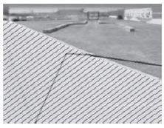
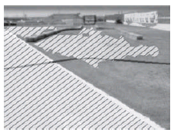
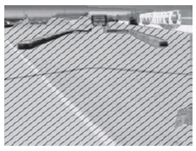
Autonomous Driving Domain...
This is how an unmanned ground vehicle adapts
its classifier of the concept "drivable surface .“
A mixture-of-Gaussians technique similar to
the EM algorithm, is then trained to recognize
the specific color and texture coefficients of the
small sample patch.
The images are the result of applying this classifier
to the full image.

Slide 40
Self Supervised Learning
Methods that make robots collect their own training data (with labels!) are called self-supervised Learning
In this instance, the robot uses machine learning to control a short- range sensor, that works well for land classification into a sensor that can see much farther.
That allows the robot to drive faster, slowing down only when the sensor model says there is a change in the road, that needs to be examined more carefully by the short-range sensors

Slide 41
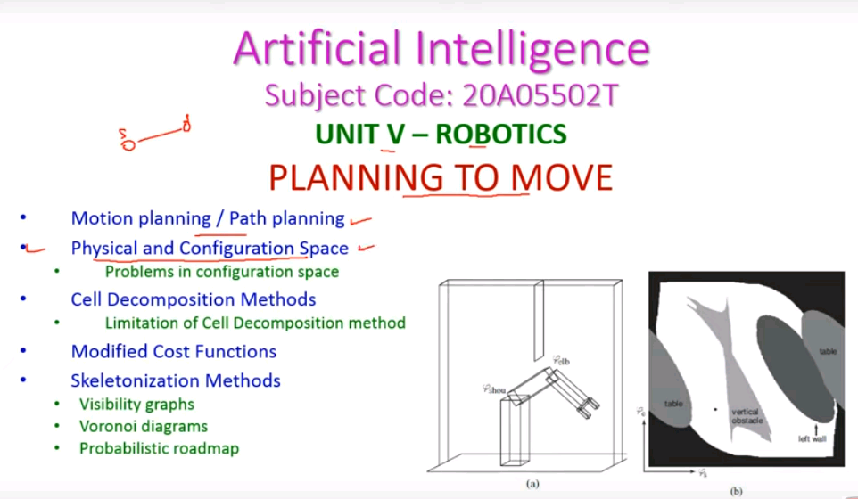

Slide 42
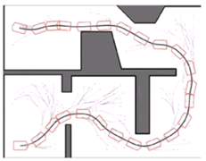
Planning to Move - Motion Planning Problem
Planning to Movement in Robotics is to deciding how
to move effectors to do or to reach the destination.
Planning is arranging a sequence of actions to achieve
a goal
Motion planning or the path planning is a
computational problem to find a the valid
sequences, that moves the robot/object
from the source to destination in the physical space.
Example: A mobile robot movement inside a building.
lt should execute this task while avoiding walls and
not falling down stairs.
A motion planning algorithm would take a description
of these tasks as input, and produce the speed and
turning commands sent to the robot's wheels

Slide 43
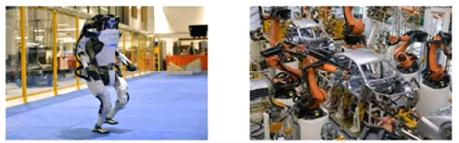
Types of Motion
Two types of motion:
Point-to-point: deliver robot to target location.
Complaint motion: move while in contact to an obstacle
A greater challenge is the compliant motion problem, in which a robot moves while being in physical contact with an obstacle.
An example of compliant motion is a robot manipulator that screws in a light bulb, or a robot that pushes a box across a table top.

Slide 44
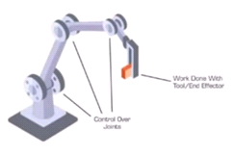
Planning to Move.
First find a suitable representation in which motion
planning problems can be described and solved
The configuration space-the space of robot states
defined by location, orientation,and joint angles-
is a better place to work than the original 30 space.
The path planning problem is to find a path from
one to another in configuration space in
continuous environment

Slide 45
Planning to Move...
There are two main Approaches:
Cell decomposition and
Skeletonization .
Each reduces the continuous path-planning problem to a discrete graph-search problem.
Assume that motion is deterministic and that localization of the robot is exact, then motion-planning problem will be easy

Slide 46
Configuration space
Configuration space- the space of robot states defined by location, orientation, and joint angles
lt is the space of possible positions the robot may attain .
A path of robot maps to a curve i n the "configuration space" or "C-space

Slide 47
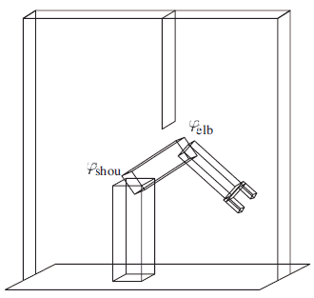
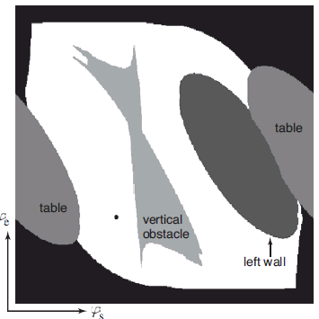
Configuration Space...
A simple representat ion for a simple robot
motion problem
(a) Workspace representation of a robot arm
The workspace is a box with a flat obstacle
hanging from the ceiling.
(b) Configuration space of the same robot.
Only white regions in the space are
configurations that are free of collisions.
The dot in this diagram corresponds to the
configuration of the robot shown on the left

Slide 48
Configuration space...
Robot arm has two joints that move independently.
Moving the joints alters the coordinates of the
elbow and the gripper.
Workspace representations are well-suited for
collision checking.
Configuration space is to represent the state by a
configuration of the robot's joints .
The robot would then move its joints at a constant
velocity, until a target location is reached

Slide 49
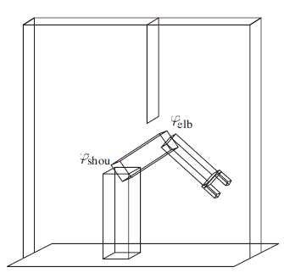
Kinematics and inverse Kinematics
Problems in configuration spaces.
The task is usually expressed in workspace.
coordinates not in configuration space coordinates.
The chain of coordinates transforming configuration
space coordinates into workspace coordinates is
Kinematics.
kinematic are simple.
The inverse problem of calculating is known as
inverse kinematics.
transforming workspace space coordinates into
configuration coordinates, is complicated

Slide 50
Free space and Occupied space
The configuration space can be decomposed into
two subspaces
the space of all configurations that a robot may
attain, commonly called free space, and the space
of unattainable configurations, called occupied
space
The white area in Figure (b) corresponds to the
free space.
All other regions correspond to occupied space.
The different shadings of the occupied space
corresponds to the different objects in the robot's
workspace;
the black region surrounding the entire free space
corresponds to configurations in which the robot
collides with itself.

Slide 51
Cell decomposition methods
The cell decomposition used for path planning that is, it decomposes the free space inta a finite number of contiguous regions, called cells.
These regions have the important property that the path-planning problem within a single region can be solved by simple means (e.g., moving along a straight line).
The path-planning problem then becomes a discrete graph-search problem

Slide 52
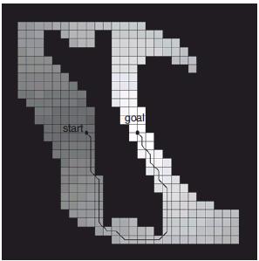
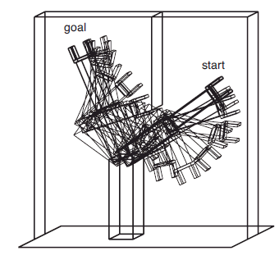
Cell decomposition methods...
The simplest cell decomposition consists
of a regularly spaced grid.
a square grid decomposition of the space
and a solution path that is optimal for
this grid size.
Grayscale shading indicates the value of
each free-space grid cell-
i.e.,the cost of the shortest path from
that cell to the goal.
(b) shows the corresponding
workspace route for the arm.
Use the A* algorithm to find a shortest
path.
This cell decomposition is simple to
implement.

Slide 53
Limitation of Cell Decomposition method
Three limitations.
l. it is workable only for low-dimensional configurat ion spaces, because based on number of dimensions,the number of grid cells increases and also the complexity increased
2. there is the problem of what to do with cells that are "mixed"- that is, neither entirely within free space nor entirely within occupied space.
3. any path through a state space will not be smooth.
lt is generally difficult to guarantee that a smooth solution exists near the discrete path.
So a robot may not be able to execute the solution found through this decomposition.

Slide 54
Modified cost functions
Notice that in Figure, the path goes very close to the obstacle.
Anyone who has driven a car knows that a parking space with one millimeter of clearance on either side is not really a parking space at all;
for the same reason, we would prefer solution paths that are robust with respect to small motion errors.

Slide 55
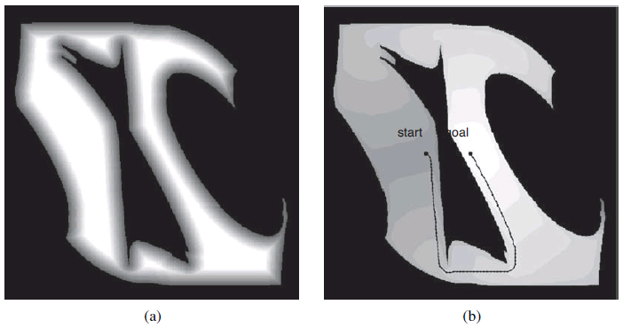
Modified cost functions - Potential Field.
This problem can be solved by introducing a potential field
A potential field is a function defined over state space, whose
value grows with the distance to the closest obstacle.
Figure (a) shows such a potential field-the darker a configuration state, the closer it is to an obstacle.

Slide 56
Skeletonization methods
The skeletonization is another major family of path-planning
algorithm
These algorithms reduce the robot’s free space to a one-dimensional
represetion, for which the planning problem is easier.
This lower-dimensional representation is called a skeleton of the
configu ration space.
Three Skeletonization methods:
Visibility graphs
Voronoi diagrams
Probabilistic roadmap

Slide 57
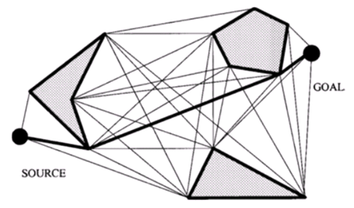
Visibility graphs
This graph for the configuration space consists of edges
joining all pairs of vertices that can see each other

Slide 58

Voronoi Diagrams
To do path planning,the robot
First changes its present configuration to a point on
the Voronoi graph, by a straight-line motion in
configuration space.
Second, the robot follows the Voronoi graph until
it reaches the point nearest to the target configuration.
Finally,the robot leaves the Voronoi graph and moves
to the target.
Again,this finalstep involves straight-line motion in
configuration space.
Hence, the original path-planning problem is reduced one­
dimensional,and has finitely many points where three or
more one-dimensional curves intersect

Slide 59
Voronoi graph
Disadvantages of Voronoigraph techniques are that
they are difficult to apply to higher-dimensional configuration spaces, and that they tend to make unnecessarily large deviations when the configuration space is wide open.

Slide 60
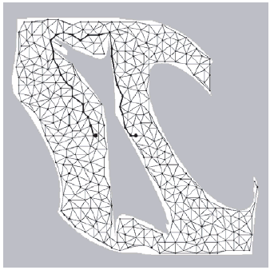
The Probabilistic Roadmap
An alternative to the Voronoi graphs is the probabilistic
roadmap,a skeletonizatioñaj)proach that offers more
possible routes,and thus deals better with wide-open spaces.
Figure shows an example of a probabilistic roadmap.
The graph is created by randomly generating a large
number of configurations and discarding those that
do not fall into free space.
Two nodes are joined by an arc if it is "easy" to
reach one node from the other-for example, by a
straight line in free space.
The result of all this is a randomized graph in the robot's free space.

