Slide 1
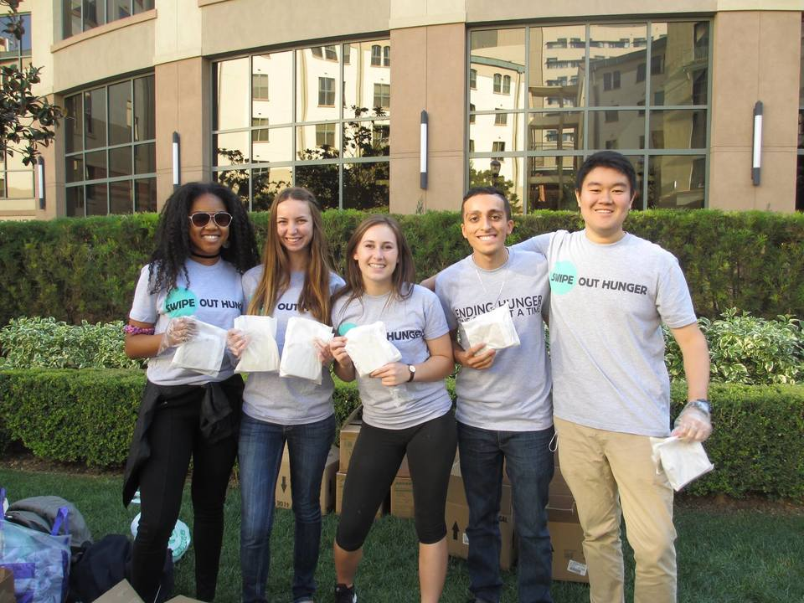


DATE

Slide 2

your
school
logo
DATE

Slide 3
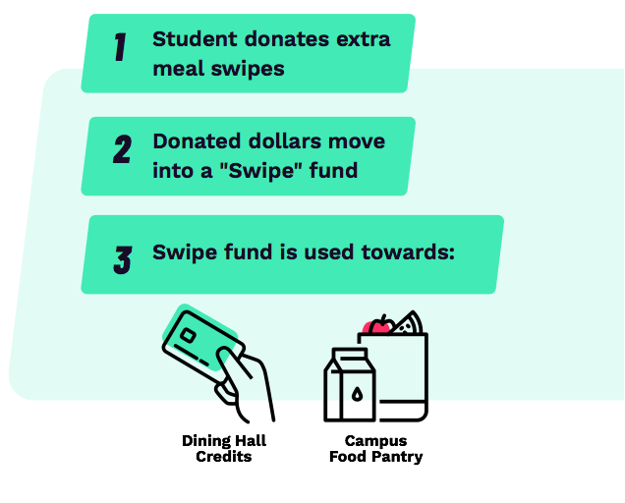

SWIPE OUT HUNGER
Swipe Out Hunger partners with colleges and universities to end college student hunger.
This year, 1 in 3 college students will go hungry. Because traditional programs aren’t meeting their needs, we’re taking action.

Slide 4


OUR IMPACT
23
States With
campus partners
400
Campus Influencers Nationwide
100,000+
Meals served
in 2017-18

Slide 5

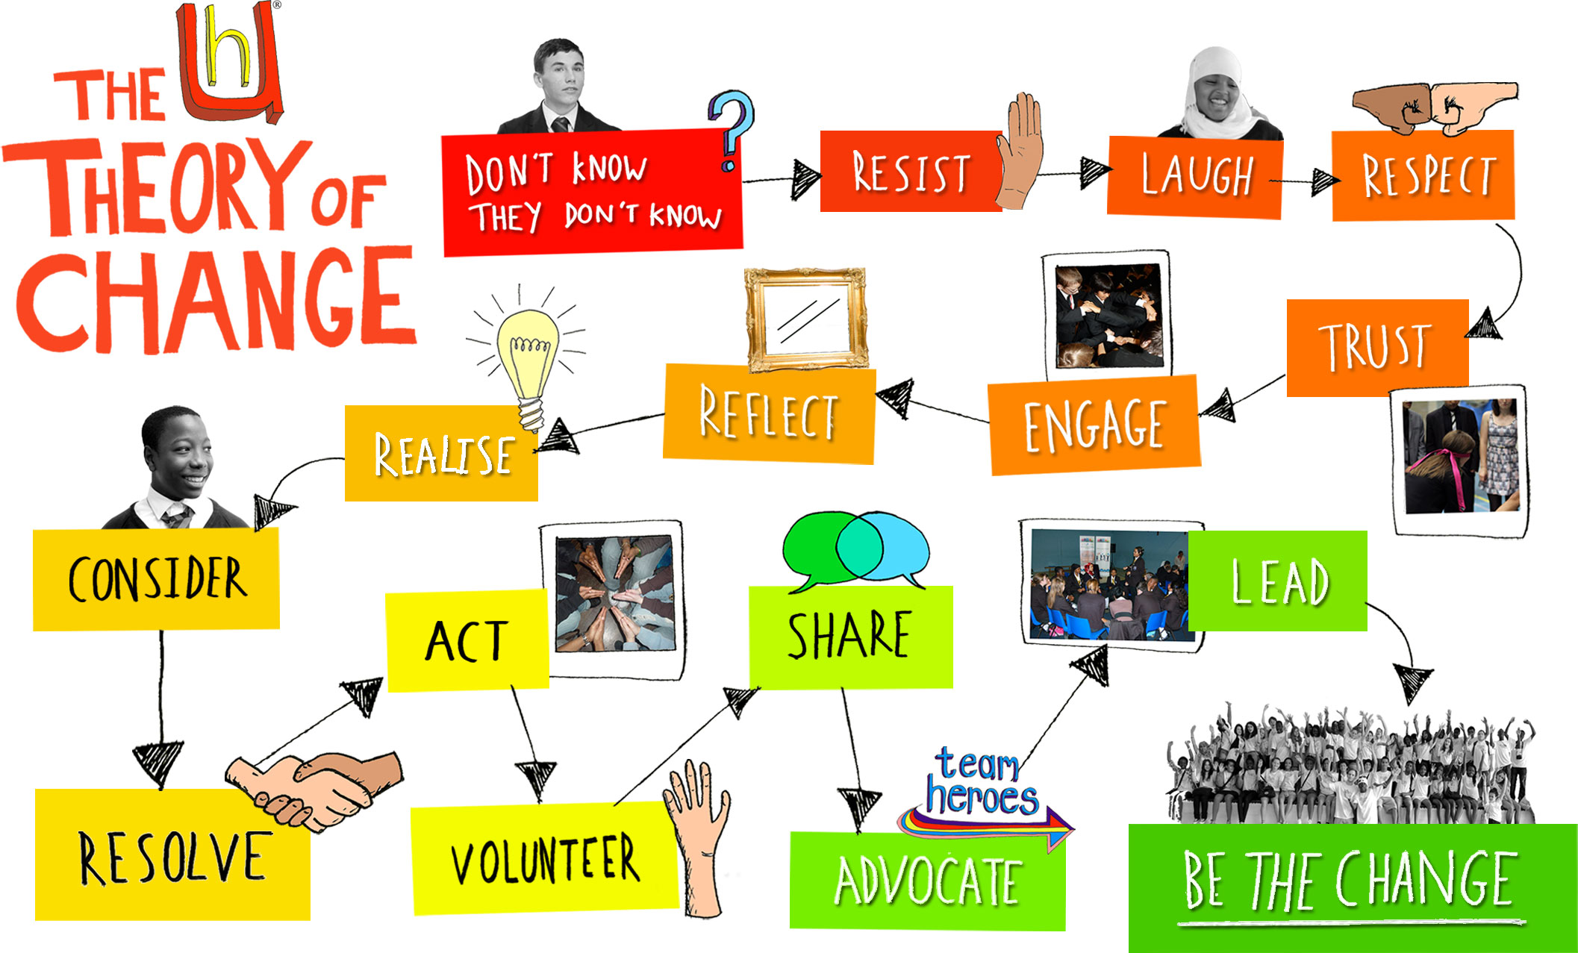
THEORY OF CHANGE
After an effective campus
meal share program is adopted…
What We Serve
The program provides students with warm, nourishing dining hall meals
or groceries from a campus food pantry.
Students will experience improved health and nutrition, less stigma and isolation, and increased academic wellbeing
The campus will achieve higher retention and graduation rates and become more inclusive as a whole
The movement to support college students’ basic needs will gain greater momentum
Challenging the Stigma
From more positive, tailored marketing materials to changing the campus culture by educating and training staff on how to support food insecure students, we can push back on stigma and encourage students to effectively utilize supportive services.
The Higher Ed space will move closer towards becoming a true platform
for equity and equality
4

Slide 6
TITLE
TEXT
TEXT
TEXT
TEXT
TEXT

Slide 7
TITLE
TEXT
TEXT
TEXT
TEXT

Slide 8
TITLE
TEXT TEXT TEXT TEXT TEXT TEXT TEXT TEXT TEXT TEXT TEXT TEXT TEXT TEXT TEXT TEXT TEXT TEXT TEXT TEXT TEXT TEXT TEXT TEXT TEXT TEXT TEXT TEXT TEXT TEXT TEXT TEXT TEXT TEXT TEXT TEXT

