Slide 1
Car prices
By Rex Hughes

Slide 2
Introduction
My name is rex
Associates in computer networking and security technology
Currently work at sonic drive in

Slide 3
The big question
What affects the price of a used car?
What should I be looking for in a used car?
Why would the same model have different prices?

Slide 4
The big question (cont.)
Could the engine affect the price?
Could the age?
Could the miles?

Slide 5
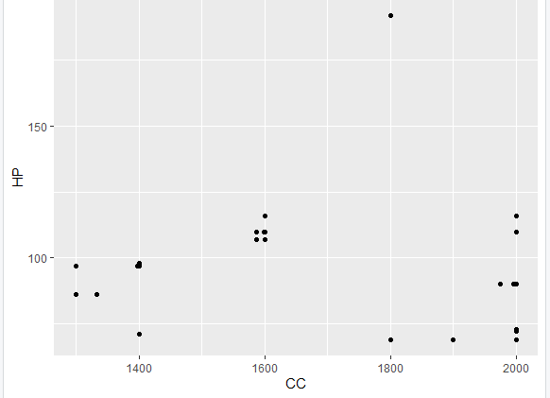

Does size of the engine affect the horse power?
First, ran a chi-square test
Proved to be insufficient

Slide 6
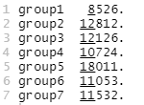
How does the size of the engine affect the price?
First, sorted the sizes into groups
Then got the average price for each group
Group 5 had largest average price
Other groups were close to each other
Group1 sizes from 1300 to 1399
Group2 sizes from 1400 to 1499
Group3 sizes from 1500 to 1599
Group4 sizes from 1600 to 1699
Group5 sizes from 1800 to 1899
Group6 sizes from 1900 to 1999
Group7 sizes from 2000 to 2099

Slide 7
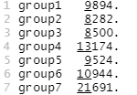
How does the horsepower affect the price?
First, sorted the HP into groups
Then got the average price for each group
The highest average was group7
Groups 6 and 4 were noticeable
Rest were close
Group1 HP 60 to 69
Group2 HP 70 to 79
Group3 HP 80 to 89
Group4 HP 90 to 99
Group5 HP 100 to 109
Group6 HP 110 to 119
Group7 HP 190 to 199

Slide 8
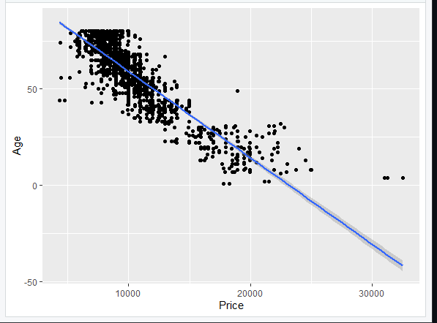
How does the age affect the price?
Is an older car cheaper than a newer car?
The chart show’s that an older car is cheaper than a newer car.

Slide 9
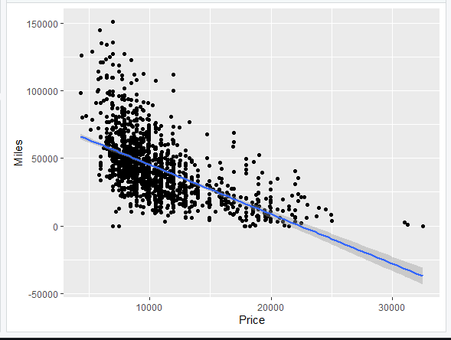
How does the miles affect the price?
The data is in KM, so it needed to be changed to Miles
Does having more miles make the car cheaper?
The chart shows that cars with more miles are cheaper than cars with less.

Slide 10
Conclusion
Size of the Engine does not have an impact on the horsepower.
Size of the engine and horsepower don’t have a big impact on the price.
The older the car, the lower the price is compared to a new car.
The more miles on the car, the lower the price is compared to an unused car.

Slide 11
Questions?

Slide 12
References
https://www.kaggle.com/datasets/adityakrbarik/car-prices-data?resource=download

