Slide 1
Testing in TDD and BDD

Slide 2
Agenda
What is TestNG
Create a TestNG Test.
TestNG.XML
Download TestNG jar for Eclipse, Maven or Ant.
Running TestNG- Run As, Maven, Ant, testng.xml, Programmatically.
How to create a TestNG Class in Eclipse.
Launch and create configurations in TestNG.
Hands-on with different annotations using testng.xml.
Advanced Test-NG
How is it different and better than JUNIT.
Examples to show the difference between TestNG and JUNIT.
Generating XSLT Reports.

Slide 3
ALL ABOUT TESTNG
Lets Begin…

Slide 4
What is TestNG
TestNG is a Unit Test Framework inspired from JUnit.
It is designed to simplify broad range of testing needs – Unit Testing (Testing individual @Test annotations), integration testing (testing classes, packages and suites).
Logs
Scripts
TestNG
TestNG Reports
Excel Sheets

Slide 5
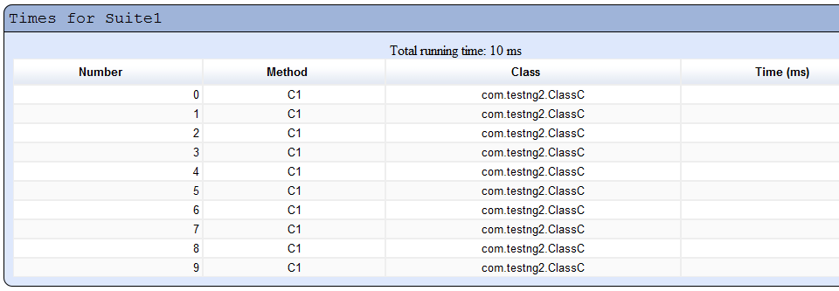
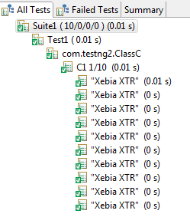
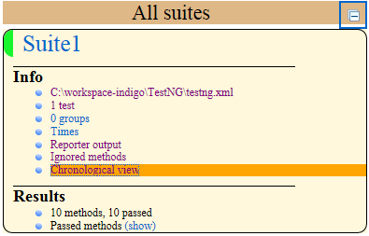
What is TestNG
TestNG is a Reporting Framework.

Slide 6
Jars for Eclipse, Maven and Ant
The latest version of TestNG for Maven/Ant can be downloaded from http://testng.org/doc/download.html.
The TestNG Eclipse plug-in allows you to run your TestNG tests from Eclipse and easily monitor their execution and their output.
For the Eclipse plug-in:
  Select Help / Software updates / Find and Install.
  Search for new features to install.
  New remote site.
  For Eclipse 3.4 and above, enter http://beust.com/eclipse.
  For Eclipse 3.3 and below, enter http://beust.com/eclipse1.
  Make sure the check box next to URL is checked and click Next.
  Eclipse will then guide you through the process.

Slide 7
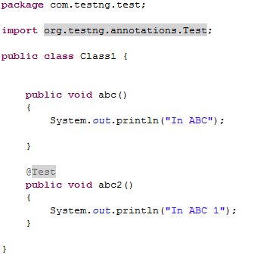
Create @Test in a Class

Slide 8
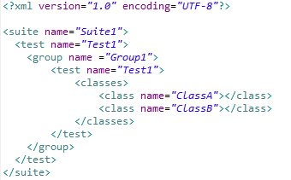
Create a TestNG Test
Writing a test is typically a three-step process:
Write the business logic of your test and insert TestNG annotations in your code.
2. Add the information about your test (e.g. the class name, the groups you wish to run, etc...) in a testng.xml file or in build.xml.
3. Run TestNG.

Slide 9
TestNG.xml
A suite is represented by one XML file. It can contain one or more tests and is defined by the <suite> tag.
A test is represented by <test> and can contain one or more TestNG classes.
A TestNG class is a Java class that contains at least one TestNG annotation. It is represented by the <class> tag and can contain one or more test methods.
A test method is a Java method annotated by @Test in your source.
A TestNG test can be configured by @BeforeXXX and @AfterXXX annotations which allows to perform some Java logic before and after a certain point, these points being either of the items listed above.

Slide 10
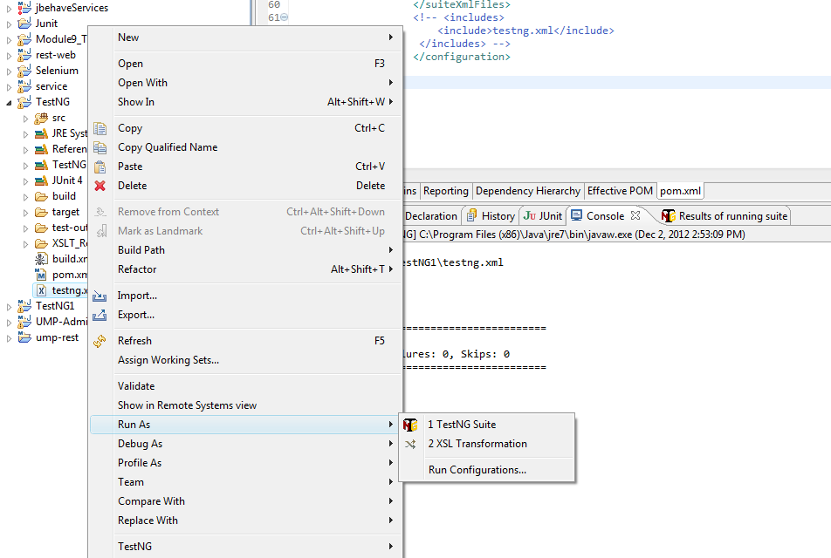
Various method of running TestNG Test Cases
Using testNG.xml
  Create a Project in IDE.
  Create a Package-> Class-> Create a @Test method.
  Create the testng.xml

Slide 11
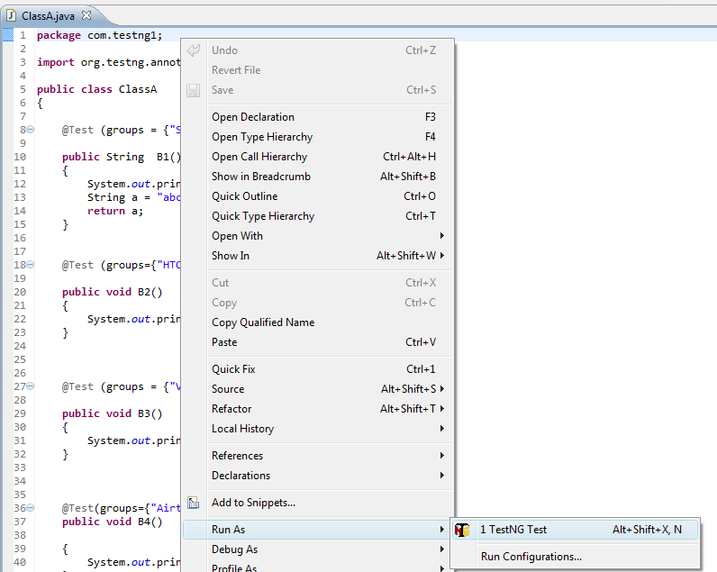
Various method of running TestNG Test Cases
2. Running the Class/Packages manually (all the Annotations of a Class/Package)
  Create a Project in IDE.
  Create a Package-> Class-> Create a @Test method.
  Run the Class.

Slide 12
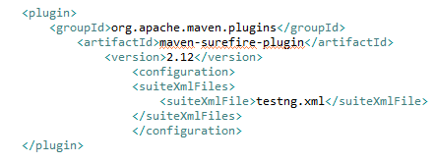
Various method of running TestNG Test Cases
3. Through Maven
  Create a Maven Project in IDE.
  Create a Package-> Class-> Create a @Test method.
  Create a testng.xml.
  Include the following surefire plugin in your pom and include the ‘testng.xml’ in it.
  Run the command ‘mvn test’ in the command line to run all the tests in the testng.xml.

Slide 13
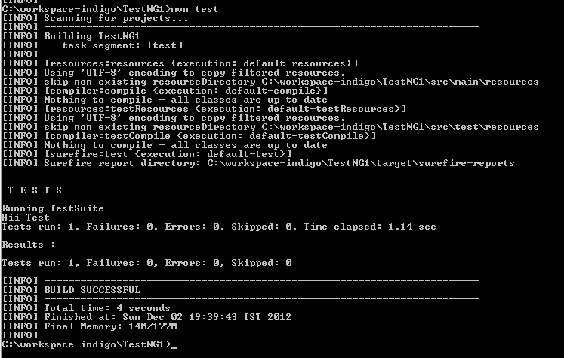
Various method of running TestNG Test Cases

Slide 14
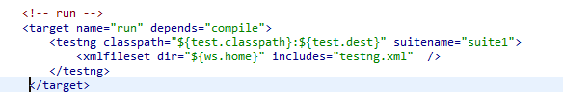
Various method of running TestNG Test Cases
4. Through ANT
  Create a Java Project in IDE.
  Create a Package-> Class-> Create a @Test method.
  Create a testng.xml.
  Create a build.xml and add the following target in it:
  Run the command ‘ant run’ in the command line to execute the testng.xml.
  It will run all the test cases configured in the testng.xml.
  I

Slide 15
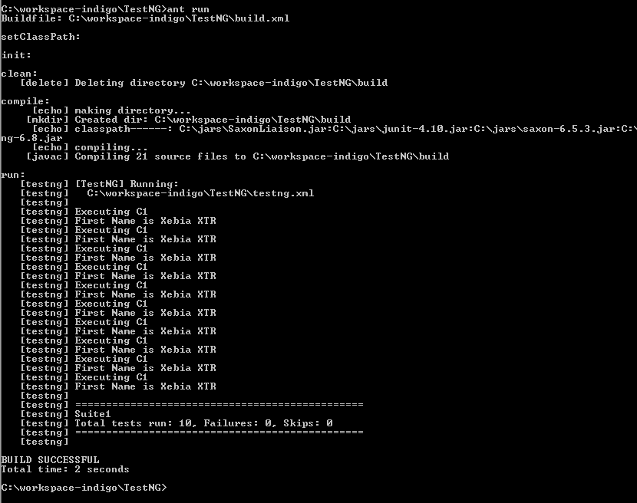
Various method of running TestNG Test Cases

Slide 16
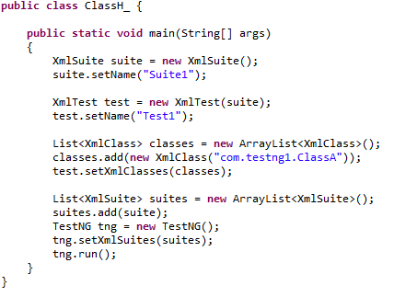
Various method of running TestNG Test Cases
Run TestNG Programmatically
  Create a Maven Project in IDE.
  Create a Package-> Class-> Create a @Test method.
  Create a testng.xml.
  Create a Class and add the following Code snippet in it.

Slide 17
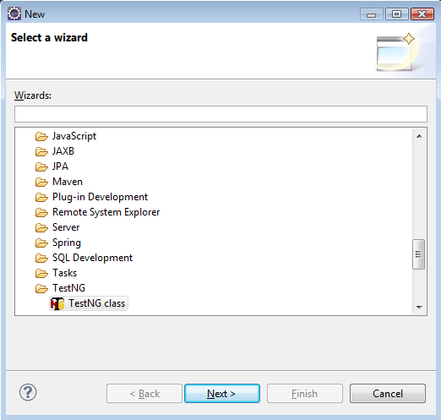
Create a TestNG Class in Eclipse
  Select the File-> New-> Other-> TestNG Class.

Slide 18
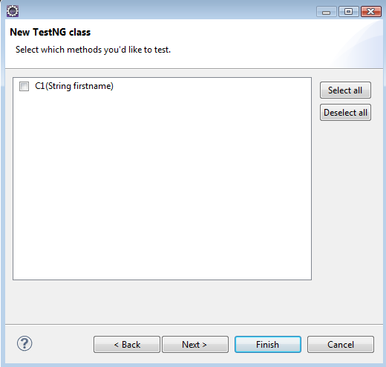
Create a TestNG Class in Eclipse
  If Any Class file is opened in the editor -> It will be added into the new Class.

Slide 19
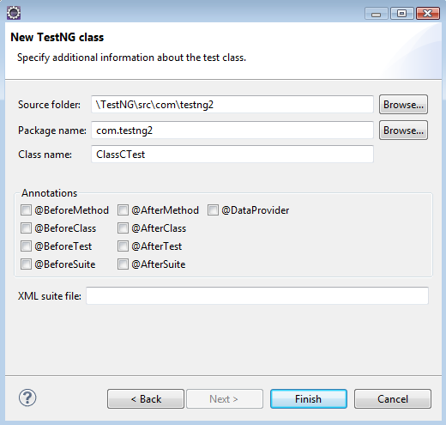
Create a TestNG Class in Eclipse
  Next-> It asks for the source folder where this class will be created, Package name in which this class will be created and Class name.
  Select the annotations and the name of testng.xml if required.

Slide 20
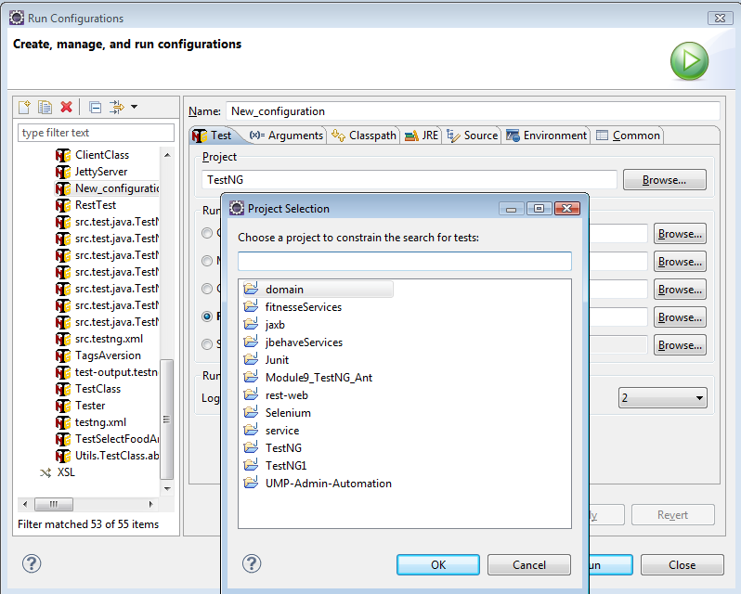
Launch a TestNG Configuration
  Run-> Run Configurations-> Browse and Select a Project

Slide 21
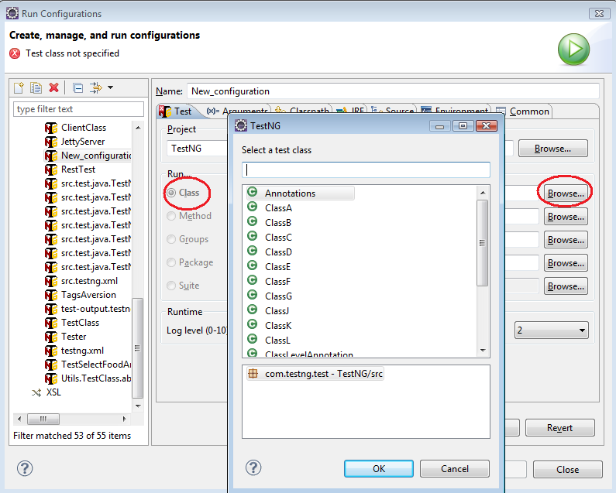
Launch a TestNG Configuration
  Choose to launch your TestNG tests from a Class File.

Slide 22
  HANDS-ON WITH TESTNG.XML

Slide 23
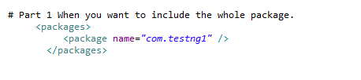
Include the Whole Package

Slide 24

Include the Class

Slide 25
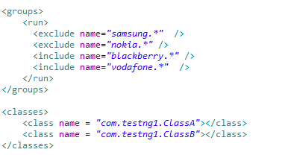
Include a Group

Slide 26
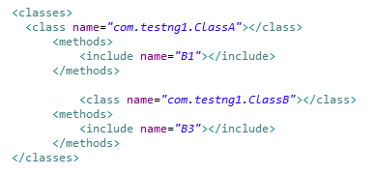
Include a Method of a Class

Slide 27

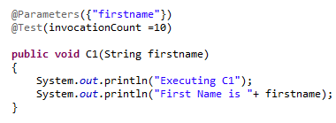
Include a Parameter
  In testng.xml
  In Class

Slide 28
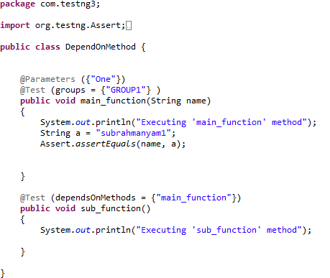
Dependent On Methods

Slide 29
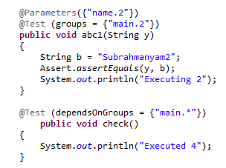
Dependent on Group

Slide 30
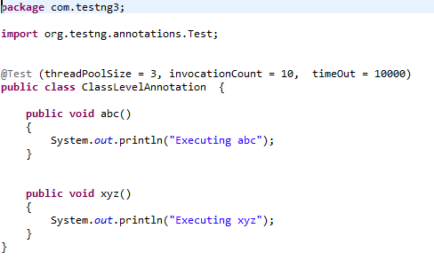
Class Level Annotation

Slide 31




Class Level Annotations -@Test parameters
Soft and Hard Dependencies

Slide 32
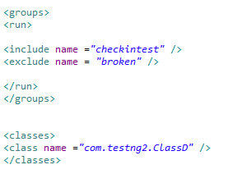
Include or Exclude methods form a Class

Slide 33

Parallel Methods, Classes and Tests

Slide 34
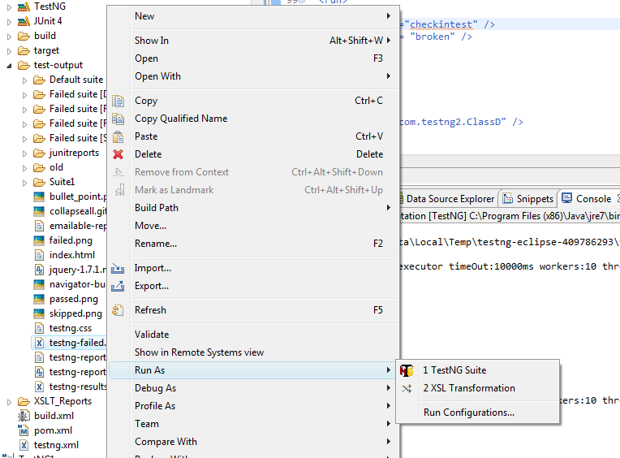
Running Failed Test Cases

Slide 35

Running JUnit Test Cases

Slide 36
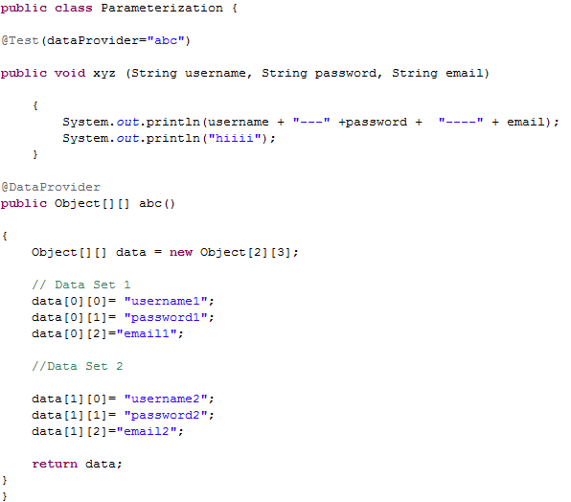
Parameterization -@DataProvider

Slide 37
Advanced Test-NG

Slide 38
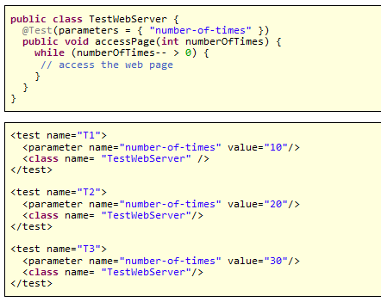
@Factory Annotation
Factories allow you to create tests dynamically. For example, imagine you want to create a test method that will access a page on a Web site several times, and you want to invoke it with different values:

Slide 39
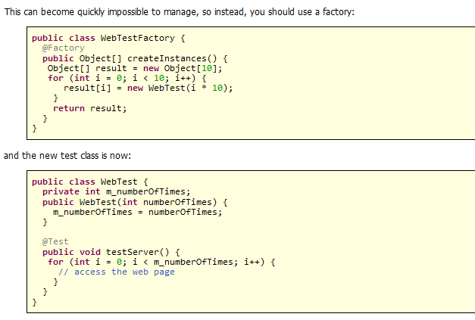

@Factory Annotation…
One should use @Factory to overcome unmanageable Test Cases in testng.xml
  And one has to just use in your testng.xml

Slide 40
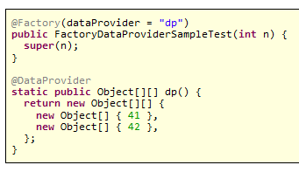
@Factory Annotation using @DataProviders

Slide 41
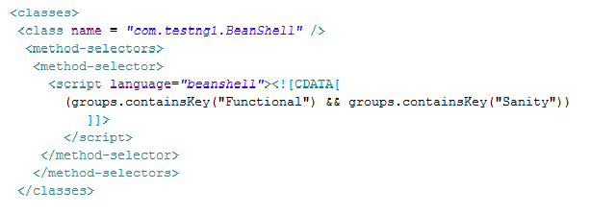
BeanShell Usage in testng.xml

Slide 42
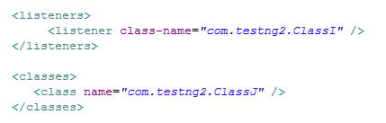
Annotation Transformers
  An annotation transformer is code that will override the behavior of annotations elsewhere in your project.

Slide 43
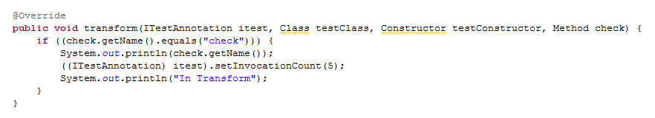
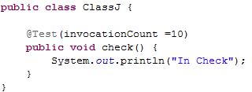
Annotation Transformers…
  The method ‘transform’ will be invoked by TestNG to give you a chance to modify a TestNG annotation read from your test classes. You can change the values you need by calling any of the setters on the ITest interface.

Slide 44
Listeners in TestNG
  IAnnotationTransformer
  IAnnotationTransformer2
  IHookable
  IInvokedMethodListener
  IMethodInterceptor
  IReporter
  ISuiteListener
  ITestListener

Slide 45
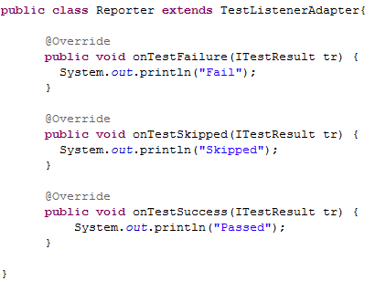
Reporter API

Slide 46
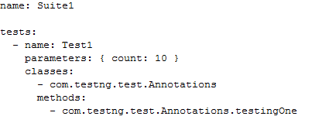
YAML
YAML is a recursive acronym for "YAML Ain't Markup Language“.
YAML is a human readable data serialization format for programming languages.

Slide 47
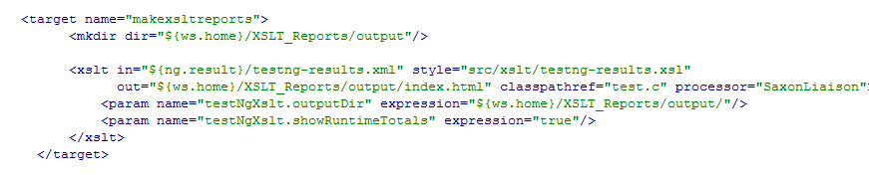
XSLT Reports (Extendable Style Language)

Slide 48
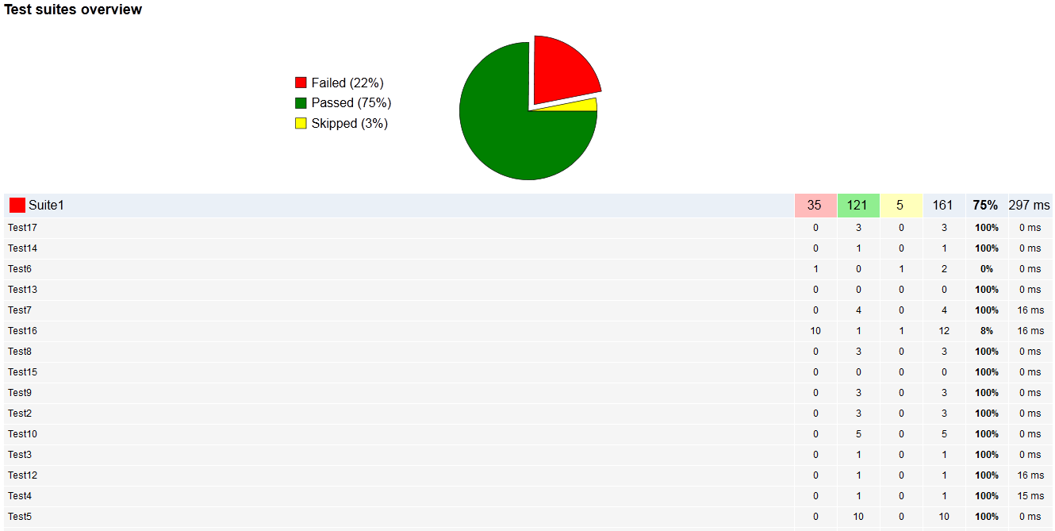
XSLT Reports

Slide 49
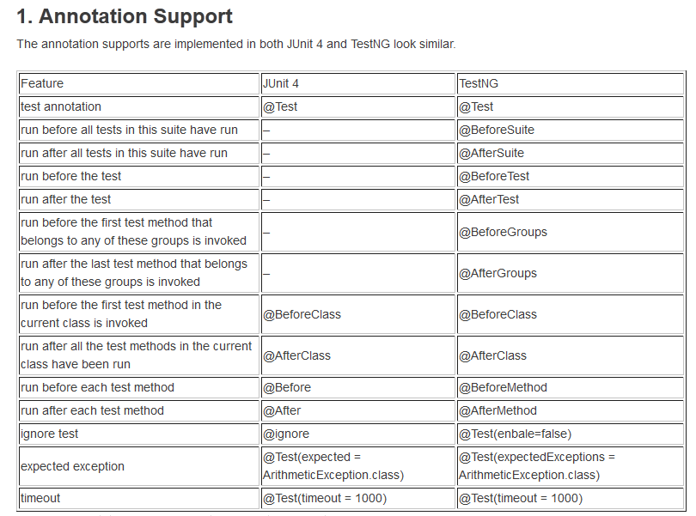
JUnit vs. TestNG – Annotation Support

Slide 50
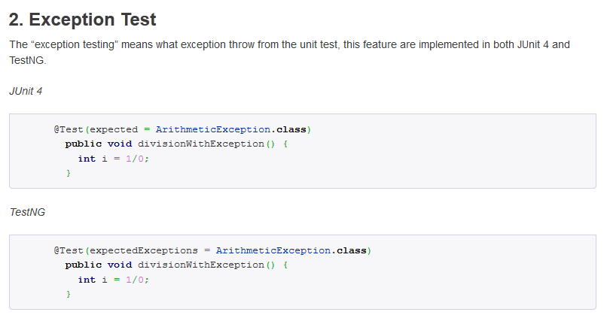
JUnit vs. TestNG – Exception Test

Slide 51
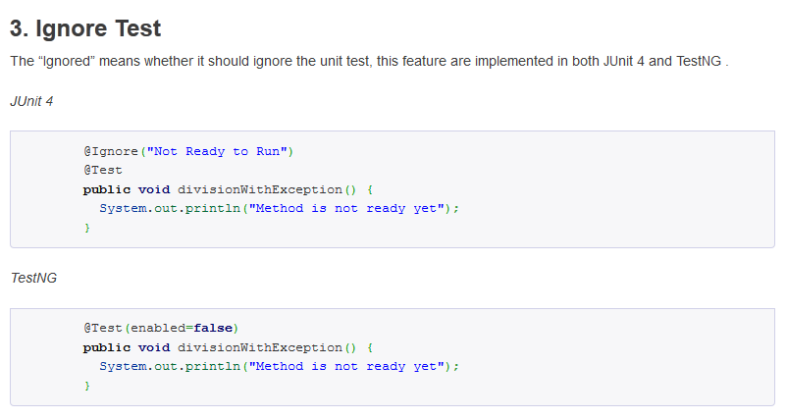
JUnit vs. TestNG – Ignore Test

Slide 52
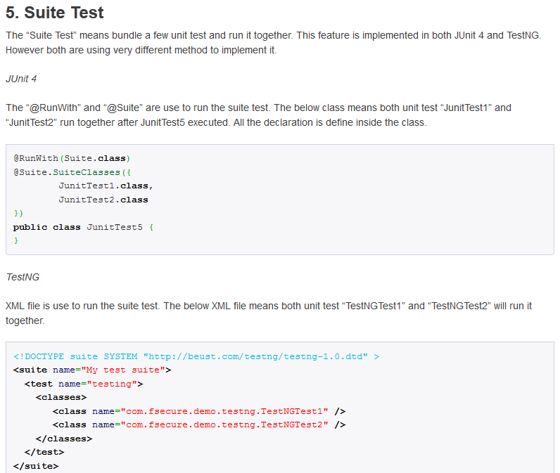
JUnit vs. TestNG – Suite Test

Slide 53
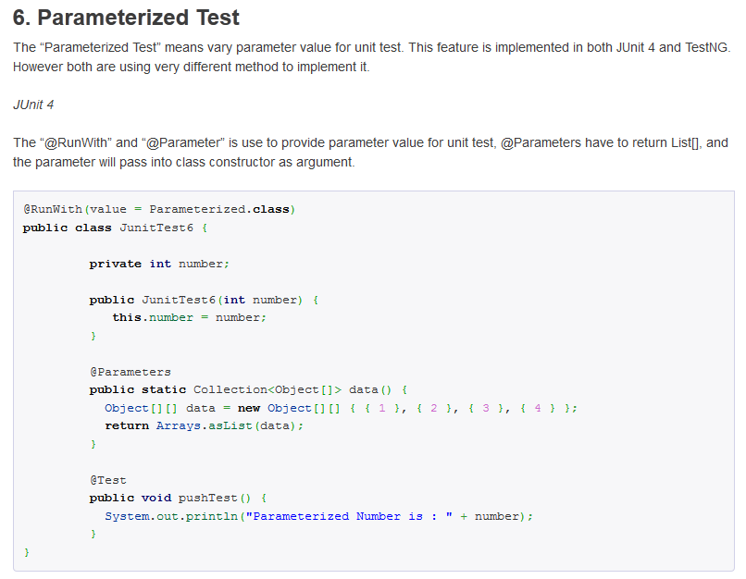
JUnit vs. TestNG – Parameterized Test

Slide 54
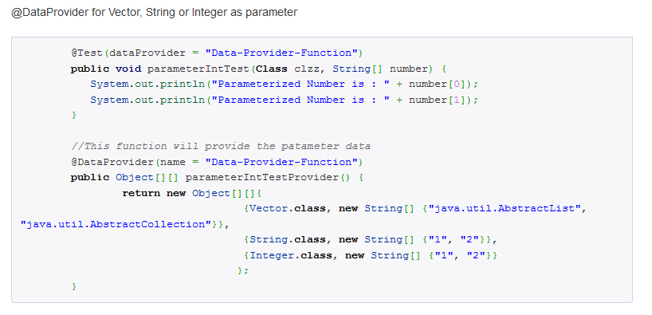
JUnit vs. TestNG – Parameterized Test

Slide 55
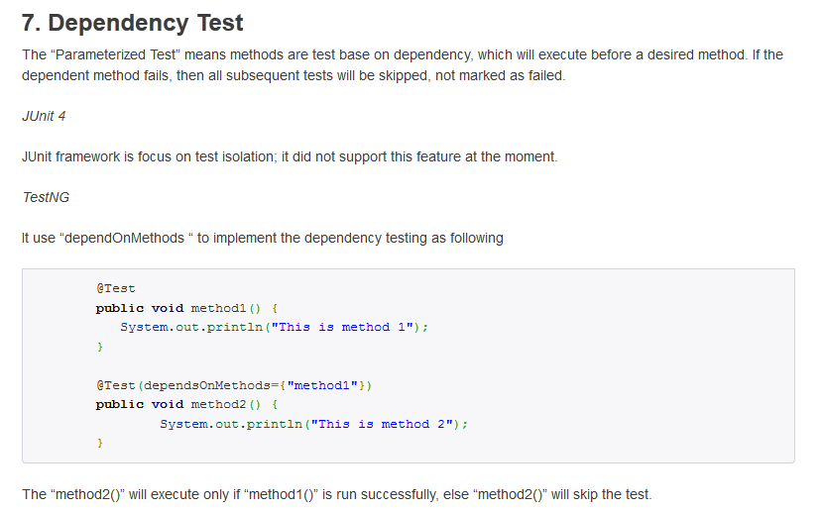
JUnit vs. TestNG – Dependency Test

Slide 56
‘Thank You ’
☺

