Slide 1
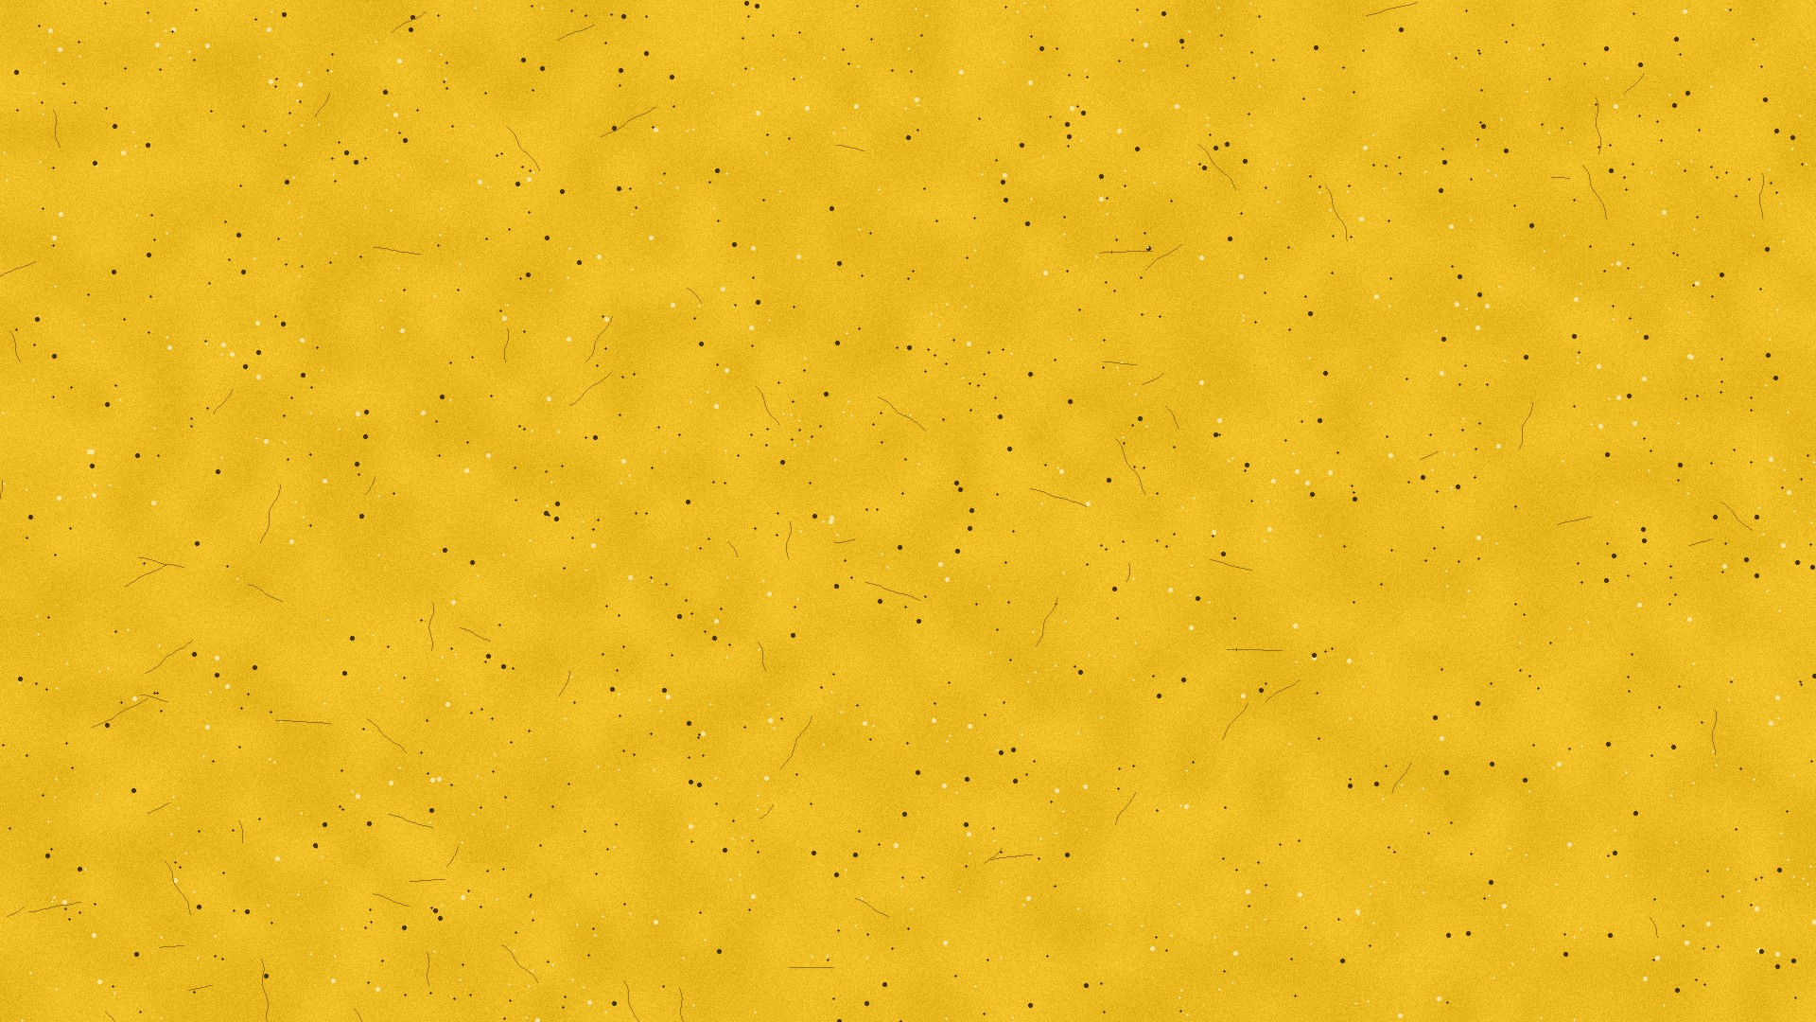
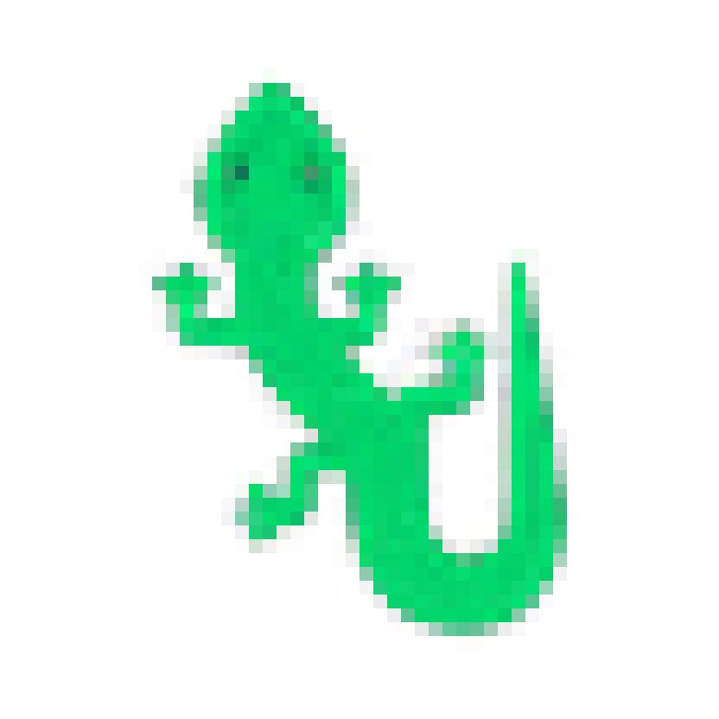
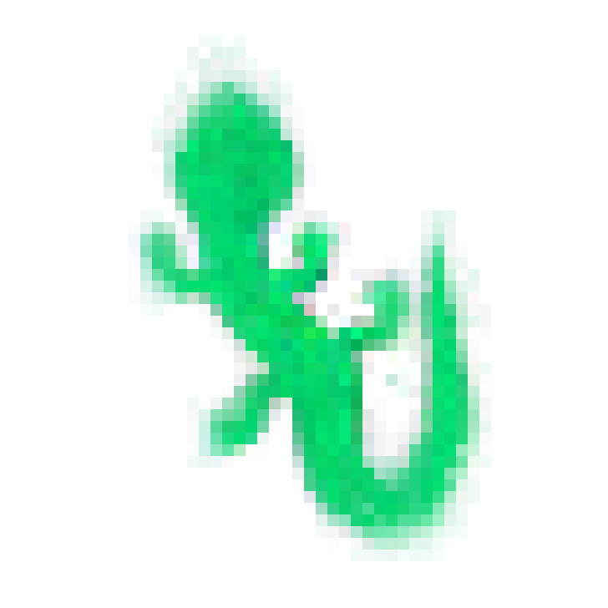
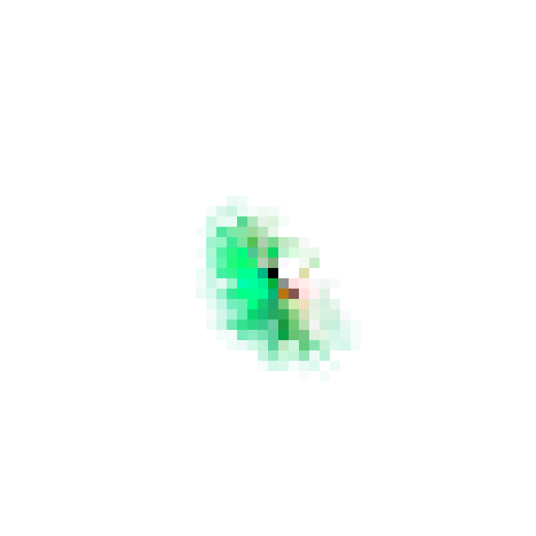
WAIT! A COMPUTER CAN DO THAT?
LECTURE 02
I TAUGHT PIXELS TO HEAL THEMSELVES
Notes:
SAY: "Welcome to lecture 2 of Wait! A computer can do that? Today: pixels that grow into a lizard — and heal themselves when you cut them."
WHAT'S ON THE SLIDE: the three lizards are real frames from the trained model at steps 15, 60 and 300. Nobody drew them — the program grew them.

Slide 2
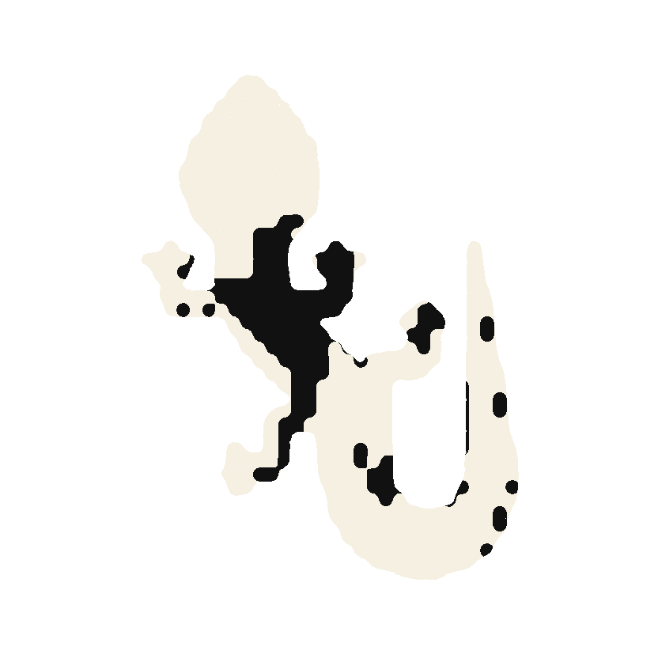
ONE CELL.
ONE RULE.
ONE LIZARD.
A tiny neural network that grows a creature from a single pixel — and grows it back when you cut it.
WAIT! A COMPUTER CAN DO THAT? · LECTURE 02
Notes:
SAY: "Everything today comes from three things: one cell, one rule, one lizard. By the end you'll know exactly how."
WHAT IT MEANS:
• One cell — everything starts from a single living pixel.
• One rule — every cell runs the same tiny program (a neural network).
• One lizard — the result.
The black markings on the white lizard are the lizard's own hidden "chemistry" (hidden channels 5 and 7), printed like a stencil.

Slide 3
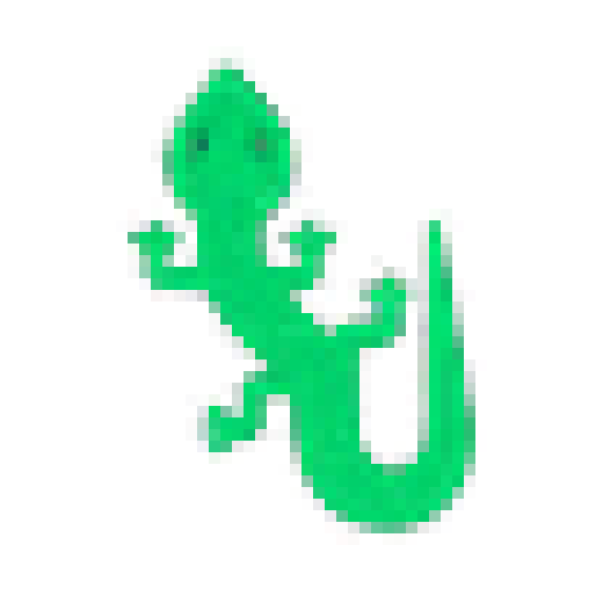
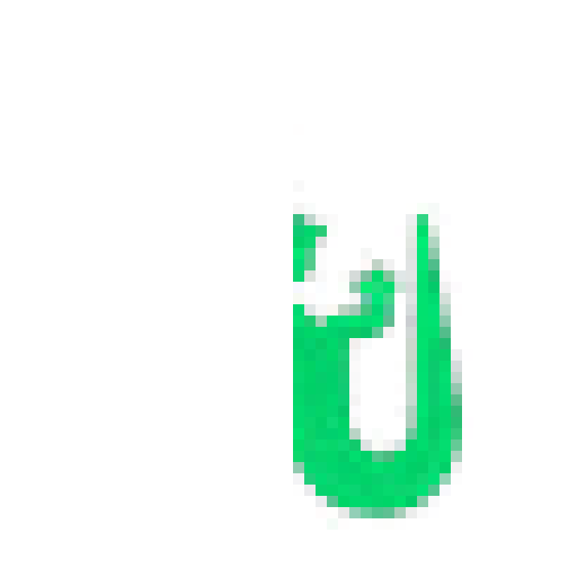
THE JOURNEY
01 ONE CELL
02 GROWING
03 THE CUT
04 HEALED
Everything starts from a single living pixel.
No pixel knows what a lizard is.
Half the body, gone.
The survivors rebuild it.
Notes:
SAY: "Here's the journey. One cell. It grows. I cut it in half. And it grows back. Let me show you live."
→ LIVE DEMO NOW (about 3 minutes): open the site, plant one cell, let it grow, then cut it with the mouse and let the room watch it heal.
WHAT IT MEANS: the story of the whole talk — a single living pixel → growth with no blueprint → half the body deleted → the surviving cells rebuild it.

Slide 4
01
NOBODY DRAWS
THE LIZARD
What a single cell can and can't see.
Notes:
SAY: "Part one. The strangest thing about what you just saw: nobody drew that lizard."

Slide 5
NO PIXEL KNOWS
WHAT A LIZARD
LOOKS LIKE.
EACH ONE ONLY SEES ITS 8 NEIGHBOURS
Notes:
SAY: "No pixel knows what a lizard looks like. Each one can only see the 8 squares touching it. Like ants in a colony — each one simple, together building something none of them understands."
WHAT IT MEANS: each cell's whole world is a 3 × 3 square. It doesn't know where it is in the lizard, how big the lizard is, or that a lizard exists. The shape comes from all of them following the same local rule.

Slide 6
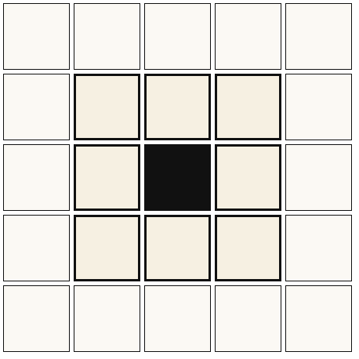
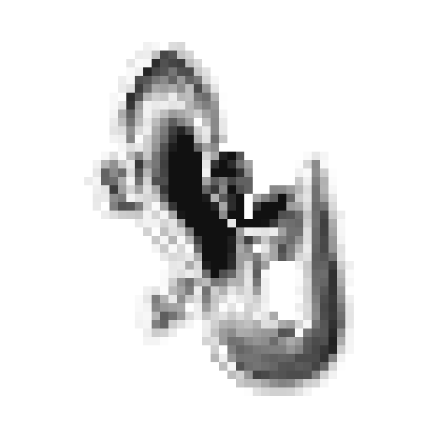

WHAT EACH CELL HAS
IT SEES 8 NEIGHBOURS
IT CARRIES 16 NUMBERS
IT FOLLOWS ONE RULE
Only the 3 × 3 square around it. Nothing further.
Colour, how alive it is, and 12 hidden signals.
The same tiny network runs in every cell.
Notes:
SAY: "Each cell has three things. Eyes that only see its neighbours. Sixteen numbers of memory — four visible colour, twelve invisible signals. And one rule, the same in every cell."
WHAT IT MEANS:
• Sees 8 neighbours — its input is only the 3 × 3 square.
• 16 numbers — red, green, blue, alive (alpha) + 12 hidden numbers that never show on screen. Cells use them to pass messages ("I'm near the head", "the tail is that way"). The middle picture is one hidden number across the whole body.
• One rule — the same neural network in every cell.

Slide 7
8,320
THE WHOLE BRAIN
That's every number in the rule. One copy, shared by every cell. No map of the lizard is stored anywhere.
Notes:
SAY: "This is the entire brain — 8,320 numbers. Not a picture of a lizard: a recipe for growing one. Every cell shares the same recipe."
THE MATHS:
• Layer 1: 48 inputs × 128 outputs = 6,144 weights, plus 128 biases.
• Layer 2: 128 × 16 = 2,048 weights.
• Total = 6,144 + 128 + 2,048 = 8,320.
One copy is shared by all 5,184 cells (72 × 72 grid). A plain picture of the lizard would be 6,400 numbers (40 × 40 × 4) — but these 8,320 are instructions for GROWING one, which can also repair it.

Slide 8
02
HOW ONE STEP WORKS
Repeated for every cell, 60 times a second.
Notes:
SAY: "Part two: what actually happens in one step." One "step" = every cell updates once. The page runs many steps a second.

Slide 9
ONE UPDATE STEP
04 LIVE OR DIE
No living neighbour means you're wiped.
03 ACT
Add the changes. Only half the cells, at random.
02 THINK
A small neural network: 48 → 128 → 16.
01 LOOK
Read the 3 × 3 square. 48 numbers.
Notes:
SAY: "Every step, every cell does four things: look, think, act, and live or die. The next four slides show each one in real code."
1. LOOK — read the 3 × 3 square and turn it into 48 numbers.
2. THINK — the neural network turns those 48 into 16 small changes.
3. ACT — add the changes, but only about half the cells (chosen at random) update each step.
4. LIVE OR DIE — a cell with no living neighbour is wiped back to empty.

Slide 10
THE RULE, IN CODE · PYTORCH
ONE STEP OF EVERY CELL
① Who's alive right now? Remember which cells have a living neighbour before anything changes.
② Look. Every cell reads its 3 × 3 neighbourhood — 48 numbers.
③ Think. The tiny network turns those 48 numbers into 16 small changes.
④ Flip a coin. Only about half the cells apply their change this step.
⑤ Live or die. A cell survives only if it had living neighbours before and after.
def forward(self, x):
pre = self.alive(x) ①
dx = self.w2(F.relu(self.w1( ③
self.perceive(x)))) ②
mask = (torch.rand_like(x[:, :1])
<= FIRE_RATE).float() ④
x = x + dx * mask
post = self.alive(x)
return x * (pre & post).float() ⑤
x holds the whole grid at once: 72 × 72 cells × 16 numbers. This function runs ~60 times a second.
Notes:
SAY: "This is the real code. Five lines do everything: check who's alive, look, think, flip a coin, live or die — on the whole grid in one go."
LINE BY LINE:
• forward = PyTorch's name for "run the model once". x = the whole grid (72 × 72 cells × 16 numbers), so every line acts on all cells at once.
❶ pre = self.alive(x): before changing anything, record which cells have a living neighbour.
❷ self.perceive(x): the LOOK step → 48 numbers per cell.
❸ self.w2(F.relu(self.w1(...))): the THINK step → layer 1, ReLU, layer 2 → dx = 16 changes per cell.
❹ mask = rand <= FIRE_RATE (0.5): a coin flip per cell. Only winners apply their change: x = x + dx * mask.
❺ return x * (pre & post): keep a cell only if it had living neighbours before AND after; everything else becomes zero.

Slide 11
STEP 1 · LOOK
HOW A CELL SEES
① “What am I?” The identity filter just copies the cell's own value.
② “Stronger to my left or right?” Sobel-x subtracts the left column from the right. Positive means more on the right.
③ “Above or below?” The same filter turned on its side.
④ All 16 channels, all cells at once. 16 numbers × 3 filters = 48 numbers per cell — its whole view of the world, and its sense of direction.
ident = [[0, 0, 0],
[0, 1, 0], ①
[0, 0, 0]]
sobel_x = [[-1, 0, 1],
[-2, 0, 2], ②
[-1, 0, 1]] / 8
sobel_y = sobel_x.T ③
def perceive(self, x):
return F.conv2d(F.pad(x, (1,1,1,1),
mode="circular"),
self.kernels,
groups=CHANNELS) ④
These are the same edge-detection filters used in photo apps. Here they let a cell feel which way the body is.
Notes:
SAY: "A cell sees through three filters. One asks 'what am I?' One asks 'is it stronger to my left or right?' One asks 'above or below?' That gives it a sense of direction — and direction is what lets a shape form."
WHAT A FILTER IS: a 3 × 3 grid of weights laid over the neighbourhood — multiply each neighbour by its number and add them up.
❶ Identity (1 in the middle) = the cell's own value.
❷ Sobel-x: −1, −2, −1 on the left, +1, +2, +1 on the right → (right side) − (left side).
❸ Sobel-y: the same, turned on its side → (below) − (above).
❹ Applied to all 16 numbers → 48 per cell. "circular" padding = the grid wraps at its edges like a video-game map. groups=CHANNELS = each of the 16 numbers is filtered separately.
WHY IT MATTERS: without a sense of direction every cell would behave the same and no shape could form.

Slide 12
STEPS 2 + 3 · THINK AND ACT
THE 8,320-NUMBER BRAIN
① Layer 1: 48 in, 128 out. A “1 × 1 convolution” means: run the same small network on every cell separately.
② Layer 2: 128 in, 16 out — one change for each of the cell's 16 numbers.
③ Start by doing nothing. Before training the last layer is all zeros, so nothing explodes.
④ ReLU keeps positive signals and zeroes negative ones — that's what lets the network make decisions.
⑤ Half the cells, at random. Real cells don't share a clock, so the rule must work whoever updates first.
self.w1 = nn.Conv2d(48, 128, 1) ①
self.w2 = nn.Conv2d(128, 16, 1, ②
bias=False)
nn.init.zeros_(self.w2.weight) ③
dx = self.w2(F.relu(self.w1(p))) ④
mask = (torch.rand_like(x[:, :1])
<= 0.5).float() ⑤
x = x + dx * mask
48 × 128 + 128 + 128 × 16 = 8,320 numbers. Every cell shares this one copy.
Notes:
SAY: "The brain is two layers: 48 to 128, then 128 to 16. It starts at zero so it can't go wild, and only half the cells update each step — like real cells with no shared clock."
❶ nn.Conv2d(48, 128, 1): layer 1. The final "1" = a 1 × 1 convolution = apply the same small network to every cell on its own.
❷ nn.Conv2d(128, 16, 1): layer 2 → one change for each of the cell's 16 numbers.
❸ zeros_: the last layer starts at zero, so an untrained creature does nothing instead of exploding into noise.
❹ ReLU: "negative becomes 0" — this kink lets the network make yes/no-style decisions instead of just averaging.
❺ The coin flip: randomness forces the rule to work in any update order, which also makes it robust.

Slide 13
STEP 4 · LIVE OR DIE
KEEPING THE BODY TIDY
① Channel 4 is “how alive am I” (0 = empty, 1 = fully alive).
② Max-pool looks at the 3 × 3 square and takes the biggest value — “is any neighbour alive?”
③ Above 0.1 counts as alive. Below that, the cell is treated as empty space.
④ Wipe the rest. Any cell that wasn't near life before and after is reset to zeros, so stray pixels can't spread across the dish.
def alive(x):
alpha = x[:, 3:4] ①
return F.max_pool2d(alpha, 3, ②
stride=1, padding=1)
> 0.1 ③
return x * (pre & post).float() ④
This is also why a single seed cell works: it's the only spot where life is allowed to start.
Notes:
SAY: "This keeps the body tidy. A cell can only be alive if a neighbour is alive. Life spreads outward from the seed, and stray pixels can't pop up in empty space."
❶ Channel 4 = alpha = "how alive am I", 0 to 1.
❷ max_pool2d(..., 3) looks at each 3 × 3 square and takes the LARGEST alpha → "is anyone near me alive?"
❸ > 0.1 → part of the living area.
❹ Everything outside the living area (before AND after the step) is set to all zeros.
WHY: without this, random noise could appear anywhere; with it, life can only spread outward from living cells, one ring per step — that's why one seed works.

Slide 14
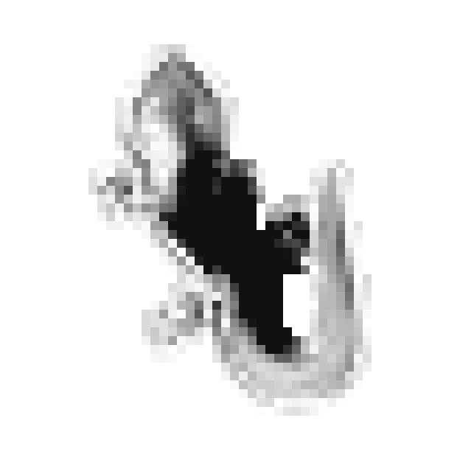
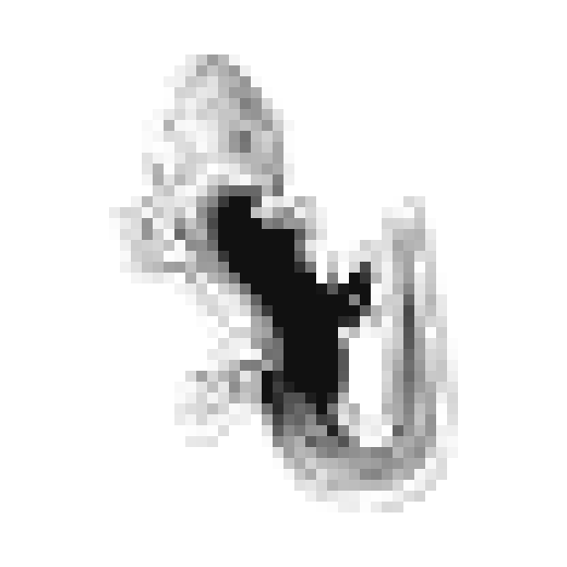
CHEMISTRY NOBODY DESIGNED
What does this signal mean?
Nobody told it to make this.
It invented these to coordinate.
CHANNEL 6
CHANNEL 12
CHANNEL 14
Notes:
SAY: "These are the cells' invisible signals. I never told it to make these — it invented them, the way an embryo uses chemical gradients to know where the head goes. Honestly, nobody fully knows what each one means."
WHAT IT MEANS: each picture is ONE of the 12 hidden numbers across the grown lizard (dark = strong). Some look like gradients ("strong at the head, weak at the tail") — that's how a cell can tell where it is. Others outline body parts. In biology, chemical gradients called morphogens tell embryo cells "you're becoming a leg" or "a head".

Slide 15
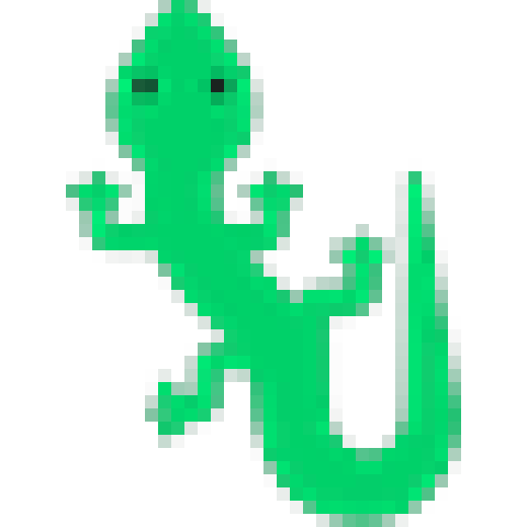
WHAT I ASKED FOR
WHAT IT GREW
A 40 × 40 lizard emoji.
Drawn by a person.
Every pixel placed.
Grown from one cell.
Drawn by nobody.
98.7% the same shape.
Notes:
SAY: "On the left, what I asked for. On the right, what it grew from one cell — nobody drew it. 98.7% the same shape."
HOW "SHAPE MATCH" IS MEASURED: count pixels that are alive in BOTH images, divided by pixels alive in EITHER. 100% would be a perfect overlap. The emoji is the only "answer key" the training ever saw.

Slide 16
TEACHING IT, ONE MISTAKE AT A TIME
Error dropped about 100× over 5,000 practice rounds on my laptop GPU.
Notes:
SAY: "This is the learning curve. Every round it makes mistakes, measures them, and adjusts. Over 5,000 rounds its error fell about a hundredfold."
READING THE CHART: each point is the error (loss × 1000) at that stage. The vertical axis is logarithmic — each gridline is 10× smaller than the one above — so 36.7 → 0.4 is about 100× better. Wobbles are normal: every round uses random creatures, random wounds and random coin flips. Training ran in two rounds (2,000 steps, then 3,000 more with the stress test) on my laptop's RTX 5060 GPU.

Slide 17
HOW I TRAINED IT · PYTORCH ON MY GPU
PRACTICE, CHECK, ADJUST, REPEAT
① Pick 8 creatures from a pool of 1,024 at every stage of life.
② The worst one restarts from a single cell, so it keeps practising growth.
③ The best three get wounded, so it keeps practising healing.
④ Let them live 64–96 steps.
⑤ Score them: average squared difference from the lizard emoji.
⑥ Learn: backpropagation works out how each of the 8,320 numbers caused the error and nudges them all.
⑦ Put them back so they keep living next round — that's what teaches it to stay a lizard.
for step in range(5000):
x = pool[idx] ①
x[:1] = seed(1) ②
x[-3:] = damage(x[-3:]) ③
for _ in range(random(64, 96)):
x = model(x) ④
loss = ((x[:, :4] - target)**2).mean() ⑤
loss.backward()
opt.step() ⑥
pool[idx] = x ⑦
Simplified from train_nca.py.
Notes:
SAY: "Training is practice. Pick some creatures, restart the worst, wound the best, let them live, score them, adjust the brain, put them back — thousands of times."
❶ Pool: 1,024 creatures at every stage (just seeded, grown, damaged). Each round picks 8.
❷ The worst one restarts from a single cell → it keeps practising growing from scratch.
❸ The best three get wounded → it keeps practising healing.
❹ They live 64–96 steps (random, so it can't cheat by timing itself).
❺ Loss = average squared difference from the emoji (colour + alpha). 0 would be perfect.
❻ backward() = backpropagation (how did each of the 8,320 numbers contribute to the error?). opt.step() = the Adam optimizer nudges each number slightly.
❼ Put them back: next time they're picked they continue from where they were. This is the secret to long-term stability — the rule must KEEP a lizard right across many rounds, not just reach it once.

Slide 18
HOW I TAUGHT IT TO HEAL
WOUNDING IT ON PURPOSE
① A round hole somewhere in the body.
② Or a straight cut at a random angle — like slicing it in half.
③ Half the wounds are each kind. At first I only used holes, and the butterfly couldn't regrow a missing wing. Adding cuts fixed it: 48% → 94.7% healed.
④ Wipe those cells completely — all 16 numbers set to zero. It's only rewarded if what's left grows it back.
def damage(x):
hole = circle(centre=random,
radius=random) ①
cut = half_plane(angle=random,
offset=random) ②
m = where(coin_flip, cut, hole) ③
return x * (~m) ④
Simplified from train_nca.py. Nobody tells it how to heal — only that healed lizards score better.
Notes:
SAY: "To teach healing, I hurt it on purpose — random holes and random cuts. Nobody told it how to heal; healed lizards just scored better, so the rule learned to heal."
❶ A round hole: random centre, random size.
❷ A straight cut: random angle, wiping everything on one side.
❸ A coin flip picks which. My first version only used holes → the butterfly couldn't regrow a whole wing because it had never practised that. Adding cuts took its healing from 48% to 94.7%.
❹ The wounded cells are wiped completely (all 16 numbers = 0).

Slide 19
MAKING IT STAY HEALTHY
THE STRESS TEST
① Can it grow? Score after 200 steps from one cell.
② Can it last? Keep going to 6,000 steps. My first butterfly looked perfect at step 200 and had fallen apart by 5,000.
③ Can it heal? Cut it in half and give it 300 steps.
④ Judge it by its worst result, not its best.
⑤ Only save a version that beats every earlier one, so the demo can never get worse.
def evaluate(model):
x = seed(4)
run(x, 200); grow = score(x) ①
run(x, 5800); persist = score(x) ②
cut_in_half(x)
run(x, 300); heal = score(x) ③
return worst(grow, persist, heal) ④
if evaluate(model) < best:
best = ...; save_weights() ⑤
Simplified from train_nca.py. It ran every 250 training rounds.
Notes:
SAY: "Every so often I gave it an exam: grow, survive a long time, heal after being cut in half. I graded it on its worst result and only kept versions that beat the previous best."
❶ Grow: score after 200 steps from one cell.
❷ Last: keep running to 6,000 steps and score again — this caught the biggest bug (the butterfly looked perfect at 200 and had fallen apart by 5,000).
❸ Heal: cut in half, 300 steps, score again.
❹ Judge by the worst of the three — one weakness ruins the demo.
❺ Save only if it beats the best so far → the demo can only ever improve.

Slide 20
RUNNING IT IN YOUR BROWSER · JAVASCRIPT
THE SAME BRAIN, NO PYTHON
① The Sobel filters, written out by hand — the 8 neighbours weighted −1, −2, +1, +2.
② The network as two plain loops. The 8,320 trained numbers load from a 240 KB file.
③ Add the changes and run again — about 100 steps a second, on any laptop or phone.
// LOOK: value, left-right, up-down
pc[c*3] = st[me + c];
pc[c*3+1] = (ur + 2*r + dr - ul - 2*l - dl) / 8; ①
pc[c*3+2] = (dl + 2*d + dr - ul - 2*u - ur) / 8;
// THINK: 48 -> 128, ReLU
for (h = 0; h < 128; h++) {
s = b1[h];
for (p = 0; p < 48; p++) s += w1[h*48+p] * pc[p];
hd[h] = s > 0 ? s : 0; ②
}
// ACT: 128 -> 16, add to my 16 numbers
for (c = 0; c < 16; c++) { ... next[me+c] += s; } ③
10⁻¹⁵
Biggest difference from PyTorch after 40 steps. I checked it number by number.
Notes:
SAY: "To run it in your browser I rewrote the brain in JavaScript and checked it against the original. The biggest difference was 10 to the minus 15. It's the same brain."
WHY: training happens in Python (PyTorch), but the website runs in any browser with nothing installed — so the rule was rewritten by hand in JavaScript.
❶ The Sobel filters as plain arithmetic: neighbours weighted −1, −2, +1, +2.
❷ The network as two loops: multiply, add, ReLU. The 8,320 trained numbers load from a 240 KB file (weights/lizard.json).
❸ Add the changes → about 100 steps a second.
10⁻¹⁵ = 0.000000000000001 — the biggest difference after 40 steps. Identical. Comparing number by number also found two real bugs: edge cells not being updated (the versions split after 22 steps) and tiny 32-bit numbers making the browser 7× slower.

Slide 21
03
WHEN IT FELL APART
Growing was easy. Staying alive was hard.
Notes:
SAY: "Part three. Getting it to grow was the easy part. Getting it to STAY alive was hard."

Slide 22
THE BUTTERFLY THAT FORGOT ITSELF
KEY TAKEAWAY
It learned to grow but not to stay. Stress-testing every version fixed it.
Notes:
SAY: "My butterfly looked perfect, then slowly forgot what it was. It had learned to grow but not to stay. Testing over thousands of steps exposed it, and fixing the training took it from 49% to 97%."
WHAT HAPPENED: after the first 2,000 training rounds the butterfly reached 88% at step 200, then slowly fell apart to 49% by step 5,000 — small errors piling up over thousands of steps, like a rumour getting more wrong each time it's retold. The fix: more training with the stress test and straight-cut wounds. The lizard went 86% → 98.7%. (Shape match measured after thousands of steps with the browser code.)

Slide 23
THE FINAL CHECK
98.7%
94.7%
10⁻¹⁵
Lizard shape held for 10,000 steps
Butterfly healed after being cut in half
Biggest difference between my browser code and PyTorch
Notes:
SAY: "The final numbers: the lizard holds 98.7% for ten thousand steps, the butterfly heals to 94.7% after being sliced in half, and the browser version is identical to the original."

Slide 24
WHAT BUILDING IT TAUGHT ME
TEST FOR LONG ENOUGH.
TRAIN ON THE HARD CASE.
It looked perfect at step 200 and fell apart by 5,000.
It only healed half-cuts once I practised half-cuts.
CHECK THE HARDWARE.
PROVE THE COPY.
On battery, training ran 5× slower.
I compared the browser and PyTorch number by number.
Notes:
SAY: "Four lessons I'd give anyone building something like this. Test longer than feels necessary. Practise the hard case. Check your hardware. And prove your copy matches the original."
DETAILS:
• Something can look perfect early and fail later (the butterfly).
• It couldn't heal half-cuts until training included them.
• On battery Windows throttles the GPU — training ran 5× slower.
• Comparing browser vs PyTorch number by number found two bugs: edge cells not being updated (versions split after 22 steps) and tiny 32-bit numbers ("denormals") making the browser 7× slower.

Slide 25
CUT A PLANARIAN WORM INTO PIECES AND EACH PIECE GROWS A WHOLE NEW WORM. THE CELLS DON'T HAVE A PICTURE OF THE WORM. THEY HAVE A RULE.
THE IDEA BEHIND GROWING NEURAL CELLULAR AUTOMATA · DISTILL, 2020
Notes:
Read it slowly. Pause. Then SAY: "That's what this whole project is. Not a picture. A rule."
BACKGROUND: planarians are small flatworms that regrow a complete body from a fragment. Biology doesn't store blueprints — it stores rules. The research this project is based on: "Growing Neural Cellular Automata" by Mordvintsev, Randazzo, Niklasson and Levin (Distill, 2020). Michael Levin is a biologist who studies how cells coordinate to build and repair bodies.

Slide 26

NOW YOU
CUT IT
Scan the code, plant one cell, and slice it however you like. It will grow back.
SCAN TO CUT IT YOURSELF
reyaattri.github.io/Wait-A-Computer-Can-Do-That-/heal
Notes:
SAY: "Your turn. Scan this, plant one cell, and cut it however you like. It will grow back. I'll take questions while you try."
The QR opens ONLY this demo on their phones — the other sessions are locked for them. To unlock on your own phone afterwards: visit the site with ?unlock at the end.
LIKELY QUESTIONS:
• Is this real AI? Yes — a neural network trained by gradient descent, the same method as every modern AI, just tiny (8,320 numbers).
• Does it store the lizard picture? No — only the 8,320 rule numbers.
• What if I cut off the head? It regrows, as long as enough cells survive. Erase almost everything and it can't recover — like biology.
• Why random updates? Real cells aren't in sync; randomness makes the rule robust.
• How long did training take? About an hour on a laptop GPU (much faster plugged in).
• Why useful? Self-repairing materials and robots, self-organising robot swarms, and understanding how bodies grow and heal.

