Slide 1

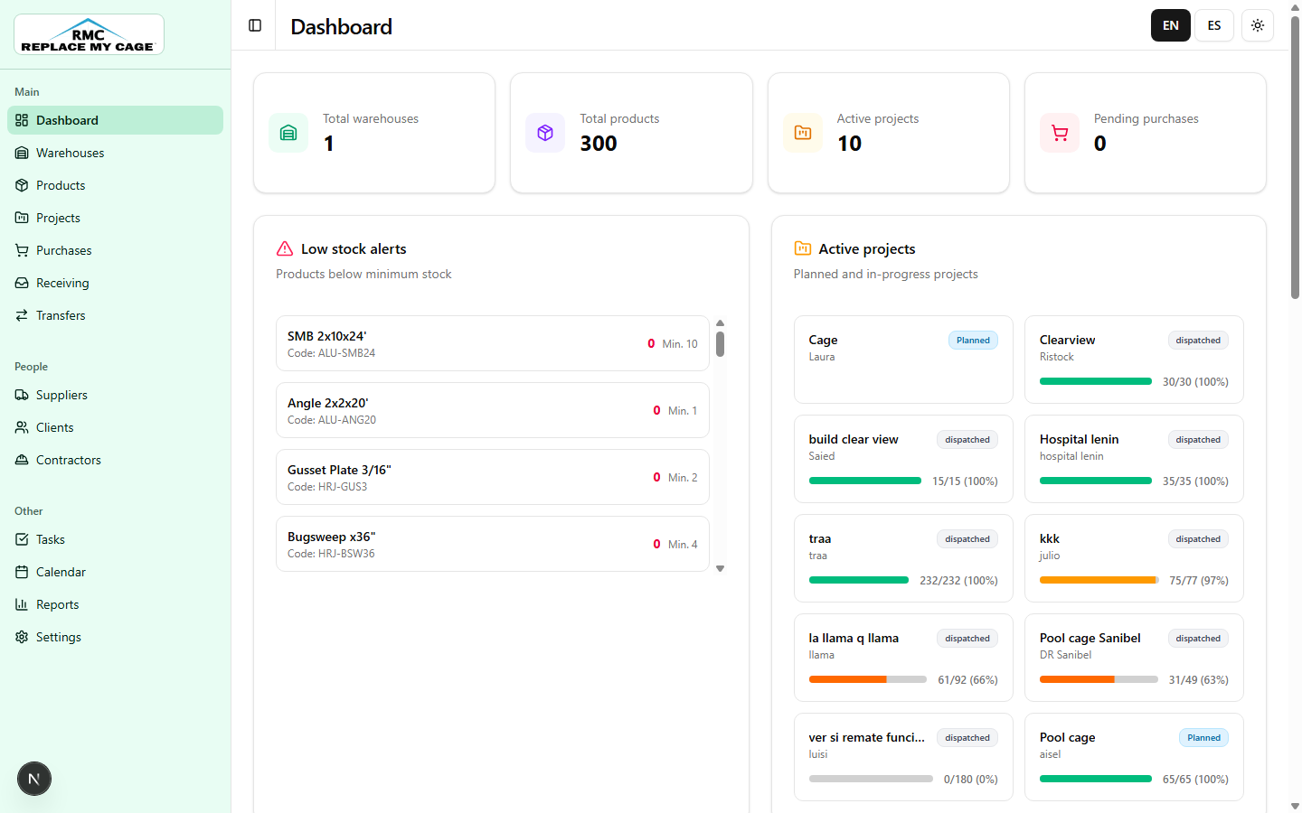
User guide
RMC Inventory
A practical guide to operate inventory, purchases, projects, receiving, reports, and settings.
Operational manual
April 2026
Operations guide
Real screenshots
Screenshot: Dashboard home view
Notes:
Guia para exponer: abre explicando que RMC Inventory centraliza inventario, compras, proyectos y reportes. Menciona que las pantallas estan en ingles para la audiencia, pero el flujo operativo es el mismo que usas en espanol.

Slide 2
RMC INVENTORY
SCOPE
02 / 12
What the system covers
RMC Inventory centralizes daily warehouse operations and connects stock with purchases and projects.
Inventory
Purchases
Projects
Product catalog, families, minimum stock, pricing, and physical location.
Supplier orders, line items, statuses, and attached documents.
Budget, client, required materials, progress, and dispatches.
Receiving
Reports
Settings
Material intake from purchases or returns, then placement on shelves.
Inventory, usage, purchases, projects, and operational risk indicators.
Sample data, bulk import, templates, and document viewer tools.
Expected result: one source of truth for what is available, where it is, what must be purchased, and what was dispatched to each project.
Notes:
Guia para exponer: antes de entrar a pantallas, explica el alcance. La idea clave es que el sistema cubre el ciclo completo del material: catalogo, compra, recepcion, ubicacion, despacho y reporte.

Slide 3
RMC INVENTORY
NAVIGATION
03 / 12
How to move through the app
2
3
The sidebar organizes work areas; the header keeps language and theme controls.
1
1. Module sidebar
2. Active page header
4
3. EN / ES and theme controls
4. Main work area
Tip: to document a process, identify the module first and then record the specific action in the main work area.
Screenshot: main navigation
Notes:
Guia para exponer: senala primero la barra lateral. Di que cada modulo se abre desde ahi. Luego explica que el encabezado muestra la pagina actual y permite cambiar idioma o tema. Termina indicando que todo el trabajo ocurre en el area central.

Slide 4
RMC INVENTORY
DASHBOARD
04 / 12
Daily control view
Use the Dashboard to review indicators, alerts, and recent activity before operating.
1
Review indicators
Confirm total warehouses, products, active projects, and pending purchases.
2
Handle low stock
Prioritize products below minimum and validate location before purchasing.
3
Monitor projects
Evaluate dispatch progress by project to anticipate missing materials.
4
Use material costs
Build a base material estimate and compare vendor alternatives.
Screenshot: Dashboard
Notes:
Guia para exponer: presenta el Dashboard como el punto de arranque diario. Explica que aqui ves indicadores, stock bajo, proyectos activos y costos. Enfatiza que sirve para decidir que atender primero.

Slide 5
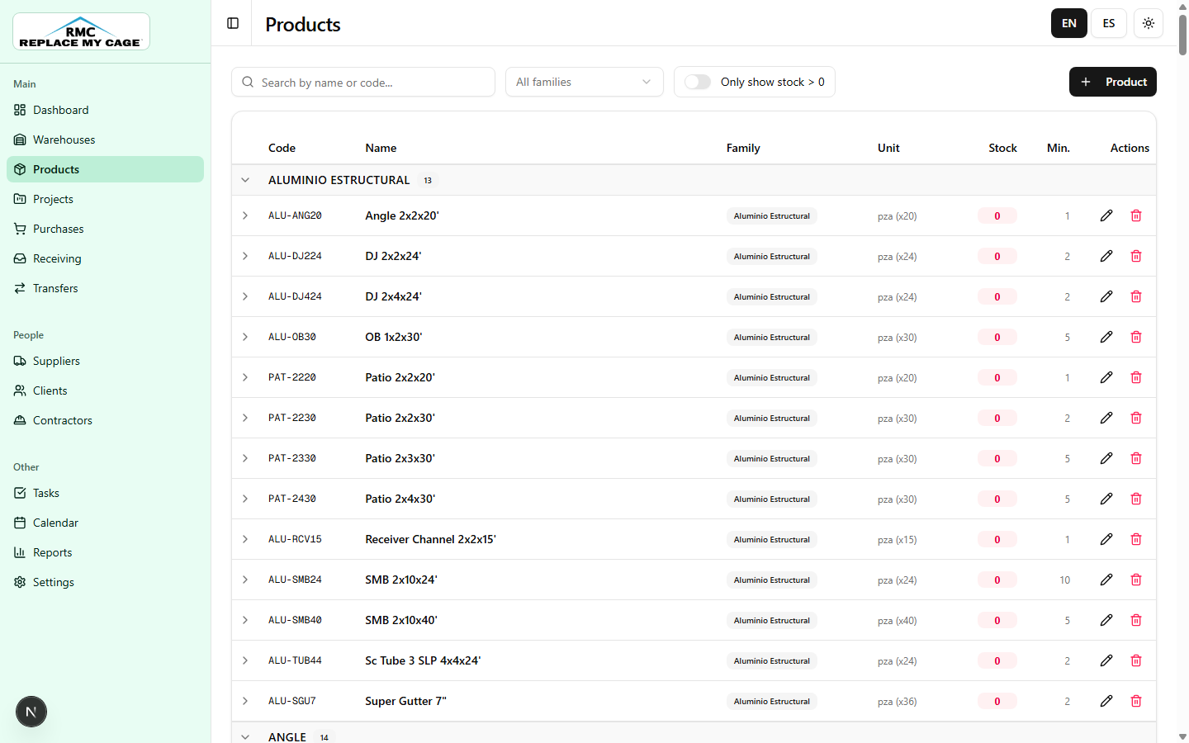
RMC INVENTORY
PRODUCTS
05 / 12
Manage catalog and stock
Search materials, review quantities, and maintain reference data.
1
Search products
Filter by name, code, or family to locate the material.
2
Validate stock
Compare current stock, minimum stock, and unit of measure before editing or purchasing.
3
Create or update
Use the module form to maintain family, pricing, and key data.
Best practice: unique codes prevent duplicates and improve bulk imports from Excel.
Screenshot: Products module
Notes:
Guia para exponer: Products es el catalogo maestro. Primero se busca el material, despues se revisa stock minimo y actual, y finalmente se edita o se crea si hace falta. Remarca que el codigo unico evita duplicados.

Slide 6
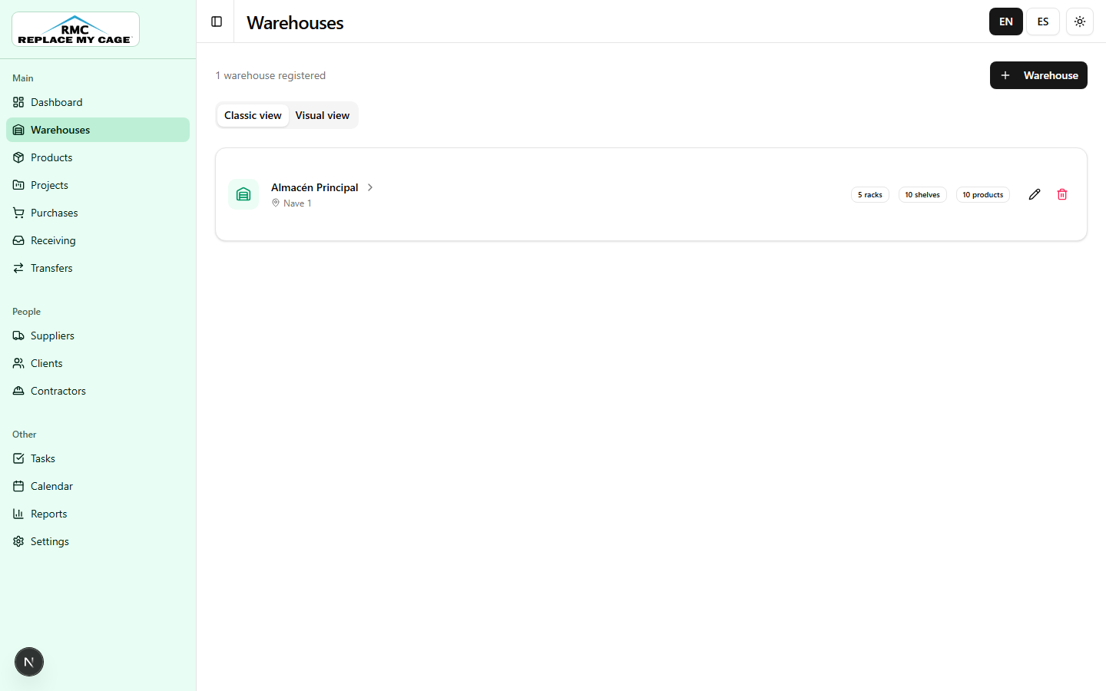
RMC INVENTORY
WAREHOUSES
06 / 12
Locate materials physically
Warehouses organizes racks, shelves, and available quantities.
1
Select a warehouse
Open the main location and review its structure.
2
Explore racks and shelves
Locate material by rack, shelf, and available quantity.
3
Confirm availability
Before dispatching, verify that stock is in the correct place.
Operating rule: receiving places material; projects and transfers consume or move material from existing locations.
Screenshot: Warehouses module
Notes:
Guia para exponer: Warehouses representa el lugar fisico del inventario. El usuario debe saber en que almacen, rack y estante esta cada material antes de despachar o mover stock.

Slide 7
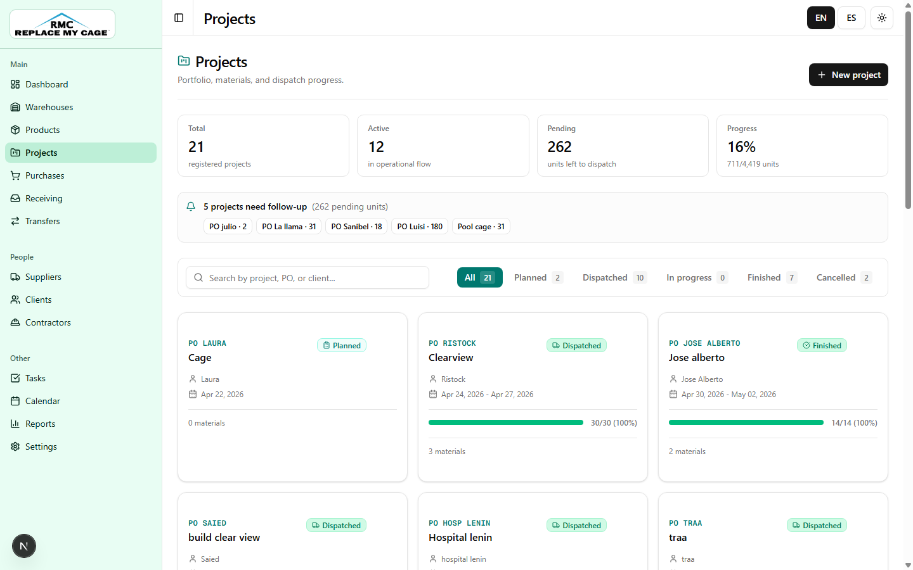
RMC INVENTORY
PROJECTS
07 / 12
Track jobs and materials
Connect client, budget, planned materials, and dispatch progress.
1
Create a project
Register name, client, dates, budget, and starting status.
2
Add materials
Define required quantities and review pending units.
3
Dispatch and measure progress
Progress shows dispatched units versus planned units.
4
Close or cancel
Update status when the job is finished or no longer active.
Screenshot: Projects module
Notes:
Guia para exponer: Projects es el puente entre la demanda del cliente y los materiales. El avance se mide comparando lo planificado contra lo despachado.

Slide 8
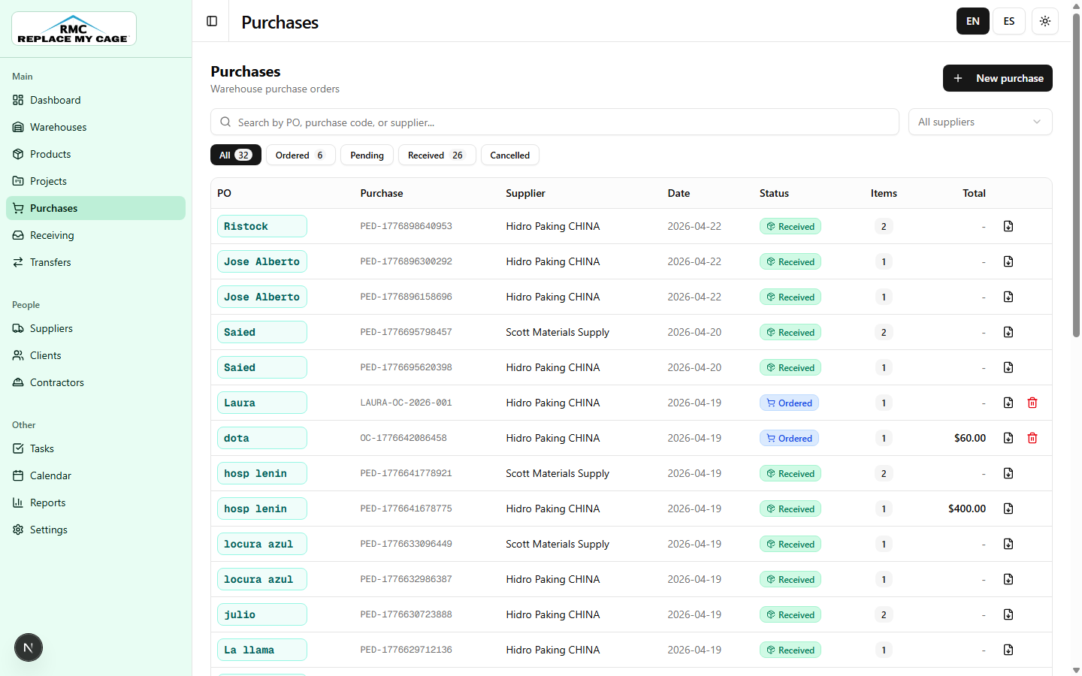
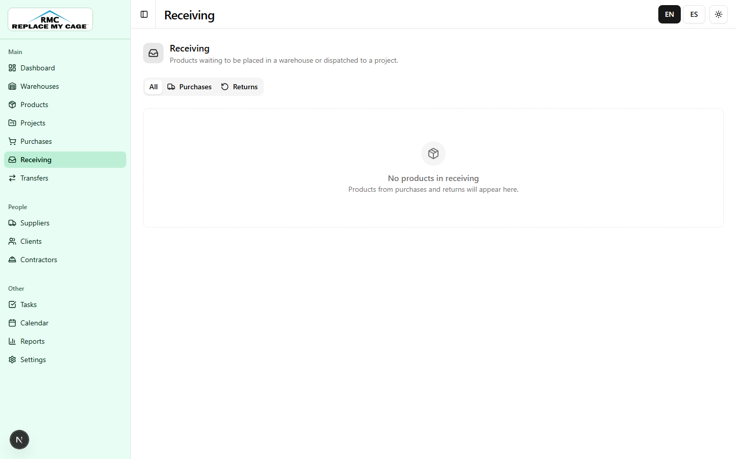
RMC INVENTORY
PURCHASES + RECEIVING
08 / 12
From order to available material
Purchases registers orders; Receiving decides whether material is stored or dispatched to a project.
1. Purchase
2. Receive
3. Place or dispatch
Screenshot: Purchases
Screenshot: Receiving
Recommended flow: New purchase -> register line items -> mark as received -> place on shelf or dispatch to project.
Notes:
Guia para exponer: primero se crea la compra, luego se reciben los materiales, y finalmente se decide si se guardan en almacen o se mandan directo a un proyecto.

Slide 9
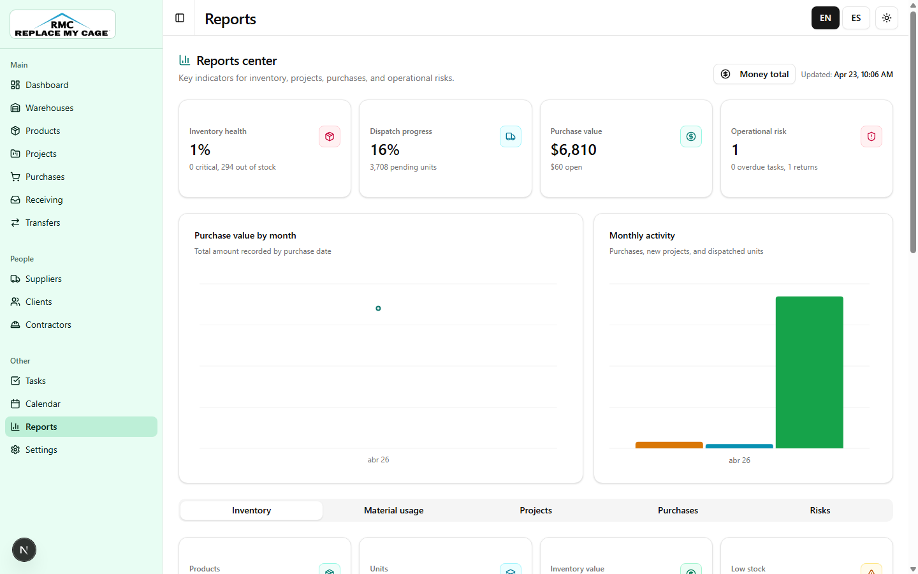
RMC INVENTORY
REPORTS
09 / 12
Measure inventory and operations
Summarize inventory, purchases, dispatch progress, and risk.
1
Choose a tab
Switch between Inventory, Material usage, Projects, Purchases, and Risks.
2
Read KPIs
Identify alerts and key values before opening details.
3
Analyze charts
Use monthly trends to decide purchases or stock minimum adjustments.
The Money total button opens the current financial view based on inventory, purchases, and budgets.
Screenshot: Reports center
Notes:
Guia para exponer: Reports es para gerencia y seguimiento. No es solo una lista de datos; ayuda a ver salud de inventario, compras abiertas, avance y riesgos.

Slide 10
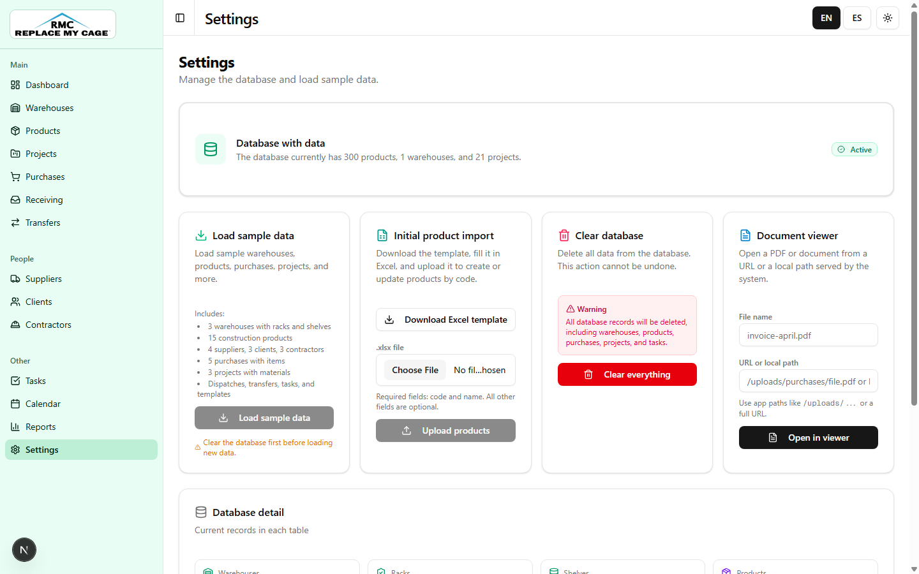
RMC INVENTORY
SETTINGS
10 / 12
Prepare data and templates
Manage imports, controlled cleanup, templates, and the document viewer.
1
Load sample data
Initialize examples for demos, validation, or training.
2
Import products
Upload an initial Excel catalog and review created, updated, or skipped rows.
3
Download templates
Use base files for product imports and material calculations.
4
Open documents
Test the viewer with internal paths or external URLs.
Screenshot: Settings
Notes:
Guia para exponer: Settings es administracion. Menciona datos de prueba, importacion inicial, plantillas y visor de documentos. Aclara que limpiar la base se usa con cuidado.

Slide 11
RMC INVENTORY
RECOMMENDED FLOW
11 / 12
Daily operating sequence
A consistent flow reduces shortages, duplicates, and movements without location.
1
2
3
4
5
6
Proyect
Purchase
Receive
Place
Dispatch
Report
Project creation, material list, dispatch, and tracking
Register the supplier order and its materials.
Confirm intake and decide the operational destination.
Locate stock in rack and shelf.
Deliver material to project and measure progress.
Review KPIs, risks, and usage.
Projects
Receiving
Reports
Notes:
Guia para exponer: recorre de izquierda a derecha: configurar, comprar, recibir, acomodar, despachar y reportar. Este es el orden que debes recordar durante la presentacion.

Slide 12
RMC INVENTORY
BEST PRACTICES
12 / 12
Quality operating criteria
These rules keep inventory reliable and make every project easier to track.
Unique codes
Required location
Do not create duplicate products. Search before registering new materials.
Every received material must be placed on a shelf or dispatched to a project.
Updated statuses
Attached documents
Keep purchases, projects, and tasks aligned with the real operation.
Store invoices, plans, or support files in purchases and projects when needed.
Periodic reports
Backup before cleanup
Review low stock, pending purchases, and risks at the start of each workday.
Use database cleanup only in test environments or with a confirmed backup.
RMC Inventory: traceable inventory, controlled purchases, and visible project materials.
Notes:
Guia para exponer: cierra con estas reglas como checklist. Lo mas importante es mantener codigos unicos, ubicacion correcta, estados actualizados y reportes periodicos.

