Slide 1

Repeat purchase prediction
Reya Sadhu
Imagineer’21, Fractal
Capstone Project

Slide 2
Problem Statement
An electronic market has shared their transaction details since they started one of their loyalty programs. They want to conduct focused campaigns with these customers highlighting the benefits of continued shopping with S-Mart. We are expected to identify the probability of each customer (in the loyalty program) making a purchase in next 12 months.
The evaluation metric is AUC-ROC score. So, we focus on mainly the TPR and FPR .

Slide 3
Model Building Flow
Exploratory Data Analysis
Base model formulation and Evaluation
Insights and Feature Engineering
Hyperparameter tuning and Cross Validation
Performance Evaluation
Final model Training and Predictions

Slide 4
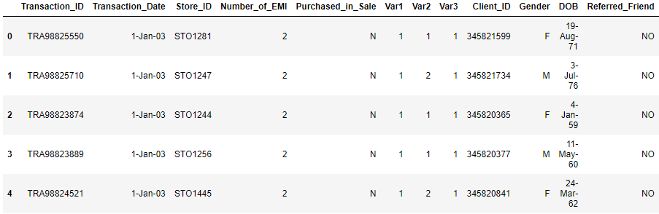
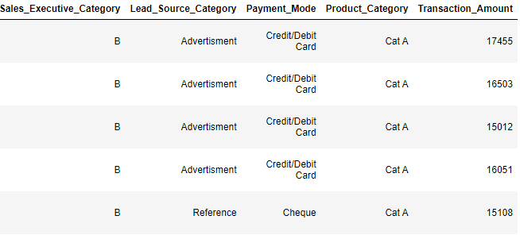
Data exploration
Only a training set is given.
The training set comprises of different transaction details along with the customer who had done the transaction.
It has no target column and no explicit separation between training and test set.
We have to predict the probability that these customers will make another purchase within a year.

Slide 5


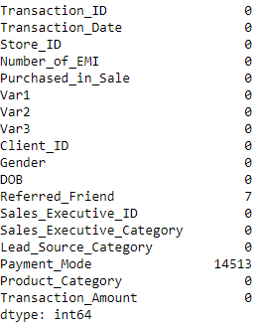
EDA
There are 439541 records and 18 features.
Check for null values:
Next, we go through different categorical columns and see how many categories are there or if there is any bad data.
As there are very few values missing in Referred friend column, we replace it with the mode of the column.
But in the Payment mode, a large no of values are missing. So, instead of imputing it, we replace them with Unknown. So, that will become a different category.

Slide 6

EDA
The gender column has two wrong values:
We find three columns are binary: Purchased_in_Sale, Referred_Friend and Gender.
Rest categorical features have more than two categories. So, we need to hot encode them later.
Var1-Var3 are masked categorical variables as stated in the problem statement. So, though they have numerical value we will consider them as categories and encode them as par.
As, maximum records have M as gender, we change the wrong values to M.

Slide 7
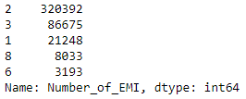
EDA
Number_of_EMI seems like a numerical variable.
Store_ID has 298 different IDS. So, each store attended a significant number of customers. So, we will hot encode this.
Sales_Executive ID has 36567 different IDs. So, we cannot hot encode them, because there will be large no of columns.
The data holds transaction history from the first day of 2003 to the last day of 2006.
But we find only 5 types of value there. So, it should be considered like a categorical value.

Slide 8
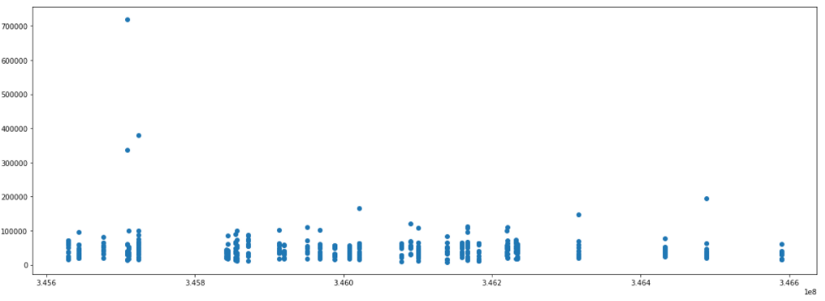
EDA
There are no duplicated rows.
But there are 22434 duplicate values in Client_ID column. So, a client is associated with more than one transaction.
We visualize the variation of transaction amount when a client buys from the store several times.
So, the transaction amount varies largely. A person who buys a good worth 30000 also buys something for 7 lac.

Slide 9
Base model formulation
Before making any complicated feature set or model, we formulate a simple base model to see which model works better.
We make a target variable repeat, whoever has more than one transaction, they are labelled as 1, rest are 0.
We drop the sales executive id from the dataset. Since, we cannot hot encode them.
We fit multiple classification models and XGBClassifier gives the best roc-auc score. So, we predict the probability for each row independently and for a single client, get the RMS of those probabilities.
This gives a 0.822 auc score on test data.

Slide 10
Insights
The evaluation metric is AOC score, so we can formulate the problem as a supervised learning.
We can not consider each record individually when training. Because our focus is on each client , not on each transaction. As there are rows with same client IDs. So, we have to make the data with Client_ID as the key column, summarizing all his purchasing history in a single row.
Dropping the executive id means loss of information. One way to incorporate them is considering them as numerical by their ID nos.
While considering data for train, we have to take the history of them only before the purchase, for which we are marking target variable 1 or 0, and not the whole history.

Slide 11
Data Grouping
So, we need to create a model, on which we can put history before 2007 and that can predict probability of repeating in 2007.
So, for training we take a subset from the data. A training set comprises history of transaction before 2006. That history is summarized for each client in that set in individual rows. The target variable is 1 if they made a purchase in 2006, otherwise 0.
This gave an AUC score of 0.8475. So, for the final model , we add one different training set comprises history of transaction before 2005. The target variable is 1 if they made a purchase in 2005, otherwise 0.
Using the same basic xgb model, after addition of these new training set, the AUC score goes up to 0.867.

Slide 12
Feature Engineering
The features that are engineered here, weren’t done in a single step. I made a number of submissions and kept the one which gave the highest score on both the cross-validation method and test set.
The date of birth information can be used only in the age form. People of different age has different buying tendencies. So, we add an age column based on the date 1st January, 2007.
We add a column for transaction year, since it will be used to split the dataset into two training groups.
A repeat purchase in same month won’t hold a lot value when we look for repeating customers within a year. So, we also add a year-month column for each transaction date. A person having multiple transaction in a month, will be considered as a single purchase.

Slide 13

Feature Engineering
The binary columns (Purchased_in_Sale and Gender) are label encoded as 0 and 1.
The Sales executive IDs are turned into numericals considering the last 4 numbers.
Now, the data is divided into four groups. First training set for the transaction before 2006 and for their labelling a dataset for the transaction n 2006. Similarly, second set is made for 2005.
The whole data will be our test set, since it will hold the history before 2007.

Slide 14
Feature Engineering
The next part of feature engineering is done on the three set differently. Since each set will summarize the data based on available data till the particular time( First training set before 2006, second before 2005 and test set before 2007).
Since for the training set, we are making Client_ID as key column, we form different pivot tables for Clients and merge them afterwards to form the whole set.
The different summarizing methods and the tables are shown.

Slide 15
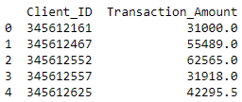
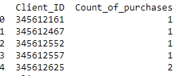
Feature Engineering
For each client, we consider the median of transaction amount. Because there are amounts for each client which have significant difference, so we cannot take the mean. We also try the max, min and range for it. But all of them reduces the validation auc score . So, for the final model we exclude this feature.
To get the total counts of purchase, we group the data by client ID and take the counts of different Year-month.

Slide 16
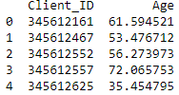
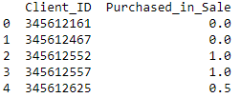
Feature Engineering
As the age is calculated from transaction date, different ages for a single person is there. So, we take the mean age.
A same client can do a purchase in sale or another purchase without sale. So, we take the mean of the purchased_in_sale column, as they are already labeled as 1 and 0.

Slide 17
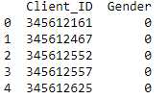
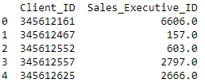
Feature Engineering
The gender for same person can be wrongly recorded different. So, we take the mean of gender .
For the executive id, we take the median. ( This step looks bizarre, but inclusion of them increases the AOC score).

Slide 18
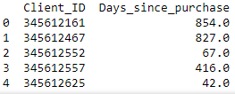
Feature Engineering
For each client we calculate the difference between the last transaction and the date for which data history is being calculated.
For train set 1, we take the difference from 2006-01-01.
For train set 2, we take from 2005-01-01
For test set, since we are predicting for 2007, we take the difference from 2007-01-01.
The pivot table for train set 1for that number of days is shown below.

Slide 19
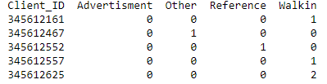
Feature Engineering
For column with multi categories, individual column is made for each category. A pivot table is made with Client ID as rows and values as the count of occurance in each category for that Client.
Table for lead source category

Slide 20
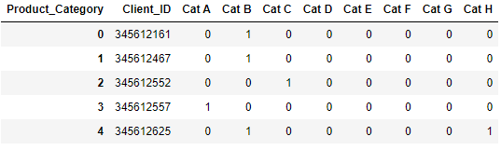
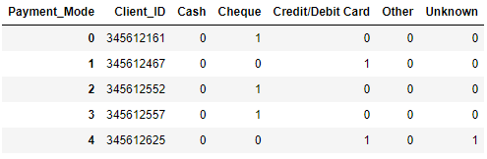
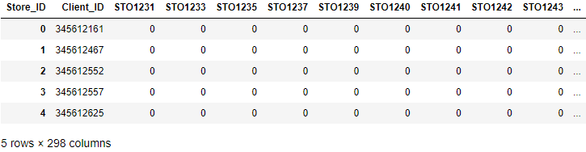
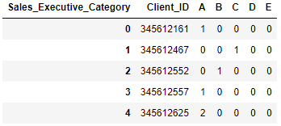
Feature Engineering
Similarly, tables for Sales Executive Category, Payment Mode, Store ID, product category is made.

Slide 21
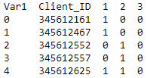
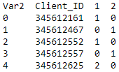
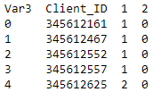
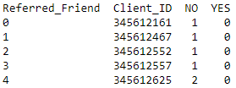
Feature Engineering
Since Var1, Var2 and Var3 are masked categorical variables , we made tables for them in similar manner.
Though Referred_Friend is a binary column and can be marked as 1 and 0, the count of them is much more significant. So, we made a table with the counts of yes and no.

Slide 22
Data preparation
Now after the feature engineering on each of the three sets, we concatenate the two training sets.
While concatenating, some columns will be null in the merged dataset, since both sets can have some different columns based on the categories available on their respective subset of data.
The test data set can also have some columns different than this merged training set. So, we drop the columns which are not in the training set and add which are in training set.
We replace the null values with 0 for both the set.

Slide 23
Hyperparameter tuning
First, we split the whole training set in 4:1 for validation purpose. We fit the basic XGBclassifier, which gives a 0.95 AUC on train, but 0.84 in validation. So, we need to tune the parameters to prevent overfitting.
Also, to get a generalized idea of test data performance, we opt for cross validation.
After trying a lot of different sets, we find a set of parameters which gives almost similar AUC on both sets, but much less score around 0.82.
So, we increase the number of boosting rounds and use early stopping in cross validation. We use 5 folds for CV. The best AUC score we got on validation set is 0.8858 and 0.9155 on training set.

Slide 24
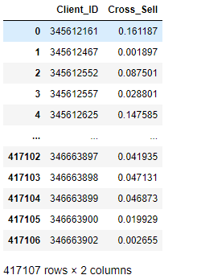
Final Model
We use the same model for training on the whole set. We get a score of 0.9133.
The model is applied on the test set to have the predicted probability. The result will show each client ID and their associated probabilities of repeating.
The final submission got a score of 0.8837 on the public test set.

Slide 25
Conclusion
This problem is different than others as it is not a straightforward classification, regression or supervised problem.
We learnt how to change the data as per the requirements of problem.
Feature engineering is the most important part in the model building, since using the same base classifier, after FE we saw a boost of 4% in the validation score.
Transaction_amount and number_of_emi are excluded from the final model, as they reduce the validation score significantly. But instead of this data loss, we can think another way to incorporate them in the model.
Cross-validation score is the true reflection of model performance on unseen test data.

