Slide 1

Automated Infrastructure Monitor with AI Summarisation
Transforming reactive alerts into instant, actionable insights — end-to-end in seconds.
R. Nandhana (RA2311003010689)
Renu Gopu (RA2311003010713)

Slide 2


The Problem with Manual Monitoring
Slow & Reactive
No Root Cause
Engineers respond after damage is done — never ahead of it
Alerts reveal what broke, not why — manual debugging required
Costly Downtime
Delayed responses translate directly into service degradation and lost revenue
Core gap: Alerts show what happened, not why it happened.

Slide 3
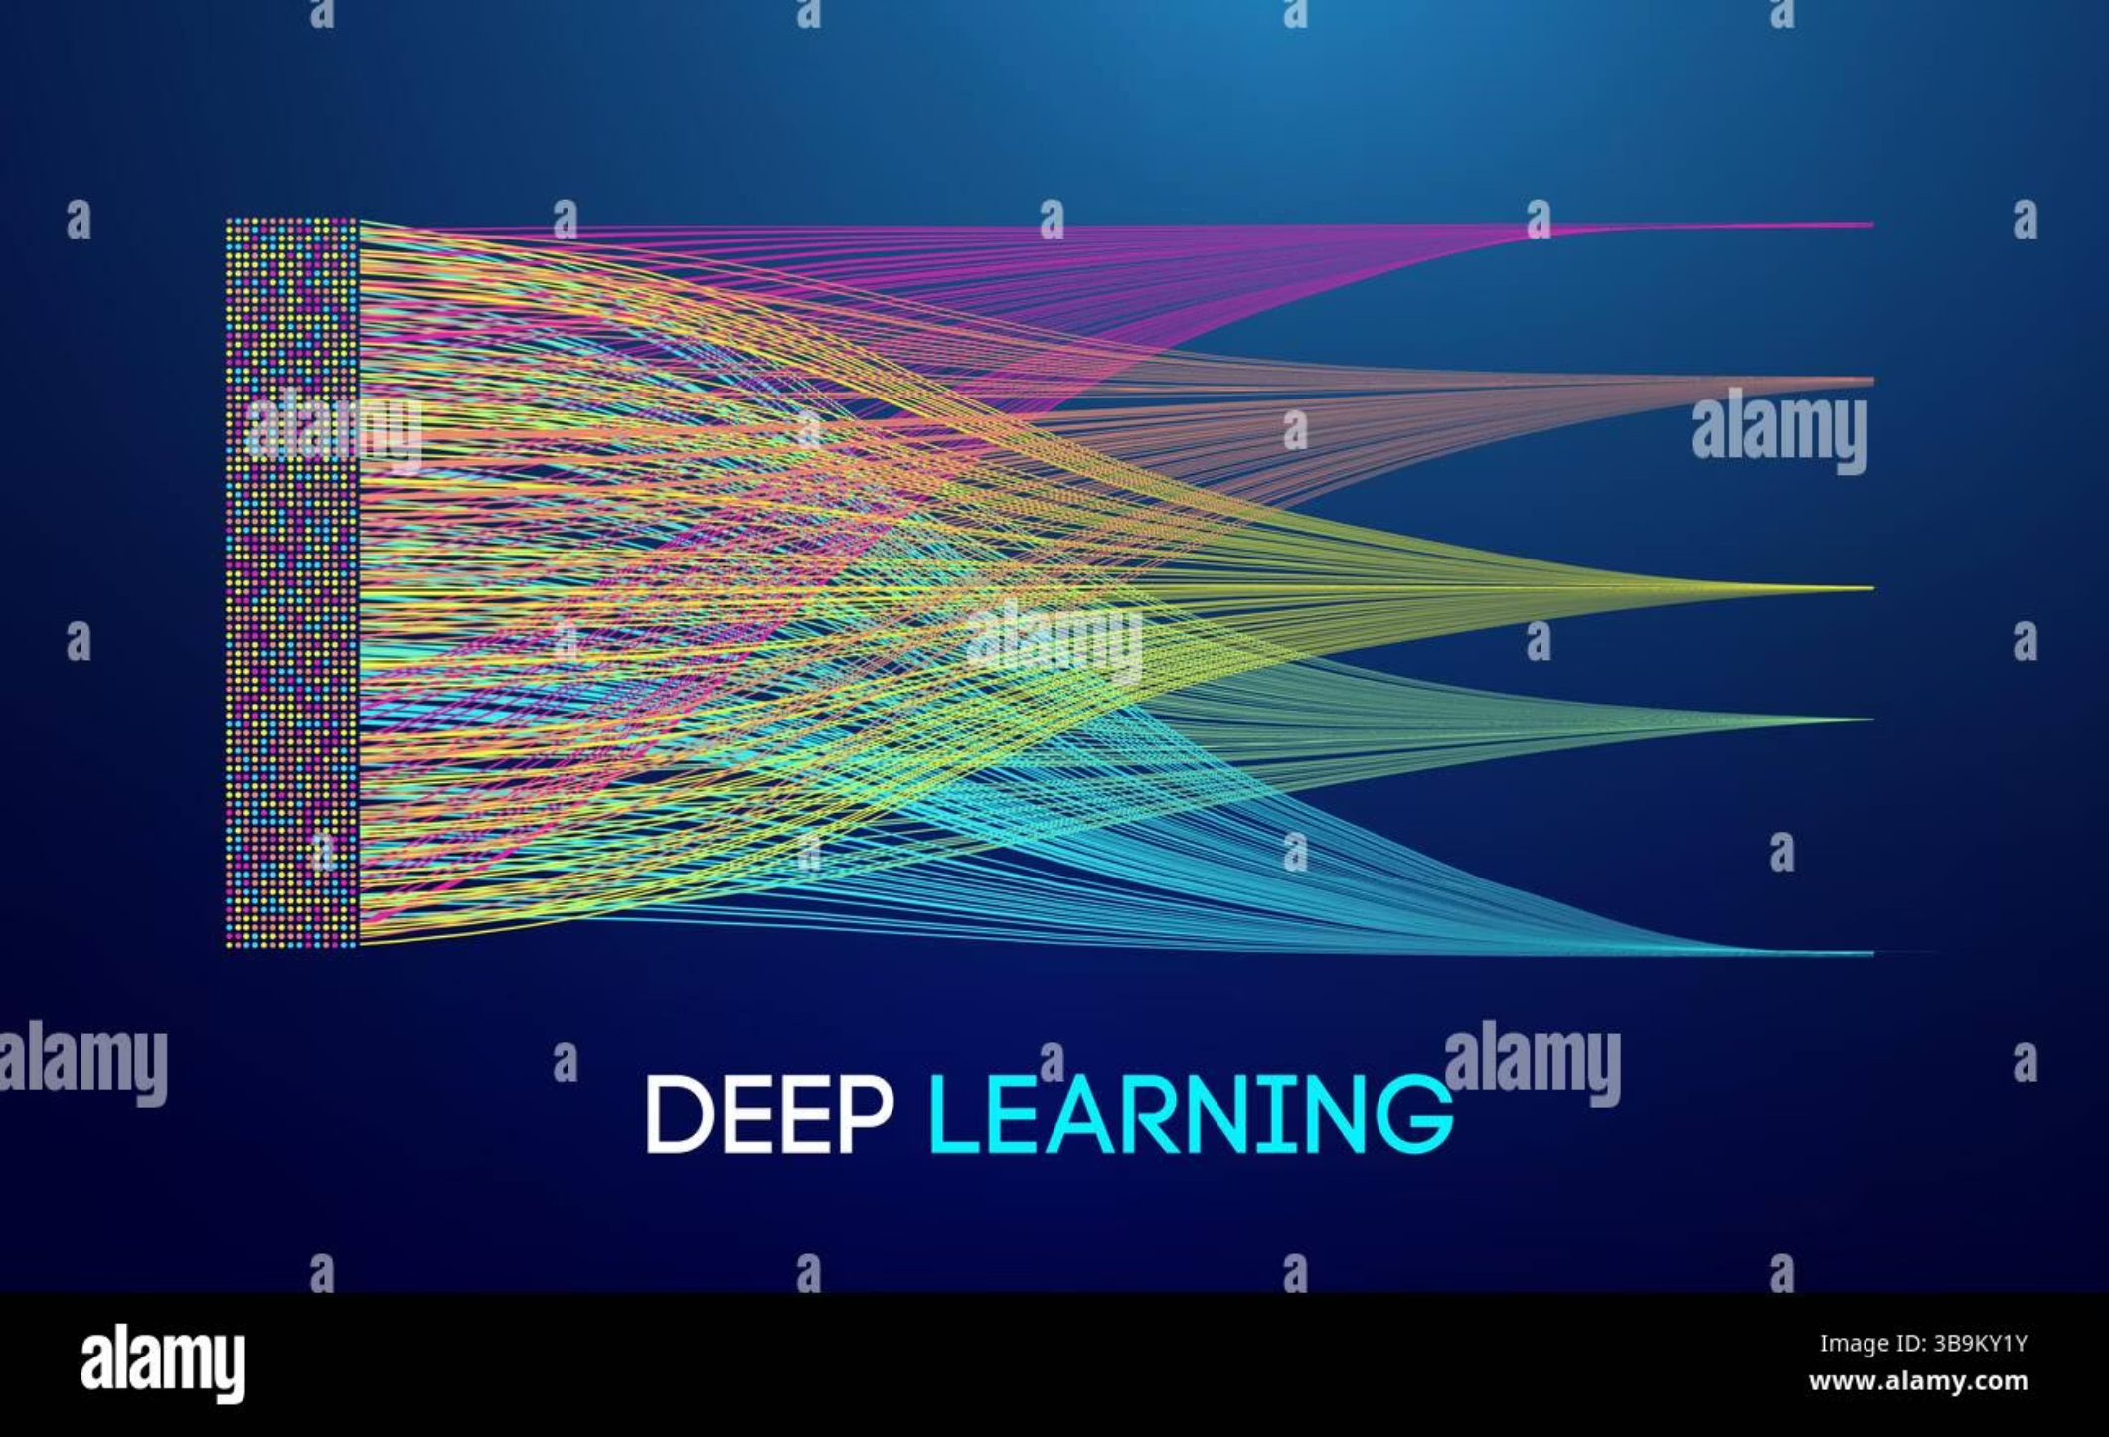
SOLUTION
AI-Powered Automated Monitoring
A fully automated pipeline that detects anomalies, analyses logs, and delivers root-cause insights — with zero human intervention.
Detect
Analyse
Act
Real-time anomaly detection across infrastructure
AI digests logs and alarm data instantly
Sends structured insights to your team in ~5–7 seconds

Slide 4
Key Features
Real-Time Anomaly Detection
AI Root Cause Analysis
Slack Alert Automation
Continuously monitors infrastructure metrics and flags deviations the moment they occur
Automatically identifies the underlying cause — no manual log-diving required
Rich, structured alerts delivered directly to your team's channel in seconds
Secure Log Sanitisation
Incident Storage & Tracking
Sensitive data stripped before AI processing — compliance-ready by design
Every incident logged in DynamoDB for audit trails and pattern analysis

Slide 5
CORE INTELLIGENCE
Summary
AI Summarisation Engine
1
Human-readable incident overview
The AI ingests raw logs and alarm data to produce a complete incident brief — replacing hours of manual debugging with instant clarity.
Root Cause
2
"Java heap exhaustion caused OutOfMemoryError — GC overhead exceeded 98% CPU threshold under peak load."
Precise technical diagnosis
AI replaces manual debugging with instant, structured insights.
Severity
3
Critical / High / Medium / Low classification
Immediate Actions
4
Step-by-step remediation for on-call engineers
Long-Term Fixes
5
Strategic recommendations to prevent recurrence

Slide 6

System Architecture
Alarm Detected
SNS → Lambda
AI Analysis
Store & Notify
A fully automated, event-driven serverless architecture — every component hands off seamlessly to the next with no manual touchpoints.

Slide 7

End-to-End Workflow
1
Alarm Triggered
CloudWatch detects threshold breach
2
SNS Event
Notification published to SNS topic
3
Lambda Processes
Serverless function invoked automatically
4
Logs Fetched & Sanitised
Raw logs retrieved and scrubbed of sensitive data
5
AI Analyses
Bedrock + OpenRouter generate full incident brief
6
Slack Alert Sent
Structured insight delivered to team channel
⚡ Complete pipeline executes in ~5–7 seconds from alarm trigger to Slack delivery.

Slide 8


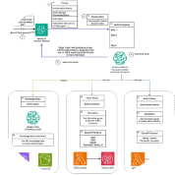
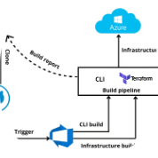
Tech Stack
Cloud — AWS
Backend — Python
AI — Bedrock + OpenRouter
DevOps — Terraform + GitHub Actions
CloudWatch, SNS, Lambda, DynamoDB, Secrets Manager, IAM
Lambda functions handling orchestration, log fetching, and AI integration
Foundation models powering root cause analysis and incident summarisation
Infrastructure as code with fully automated CI/CD deployment pipelines

Slide 9
Security & Performance
Security Controls
Log Sanitisation
Secrets Manager
Least-Privilege IAM
No sensitive data ever reaches the AI model
All credentials stored and rotated securely via AWS Secrets Manager
Every service granted only the permissions it requires — nothing more
Performance & Cost
5–7s
$30
Response Time
Monthly Cost
Alarm to Slack insight
~$25–35/month serverless pricing
Serverless architecture scales automatically with load — no over-provisioning, no idle costs.

Slide 10


Conclusion & Future Scope
What We've Built
What's Next
Faster Resolution
Auto-Remediation
Incidents detected and explained in seconds, not hours
Self-healing systems that resolve known issues autonomously
Less Manual Work
Predictive AI Monitoring
AI eliminates repetitive log-diving and root cause guesswork
Anticipate failures before they occur using pattern recognition
Greater Reliability
Multi-Cloud Support
Consistent, structured responses improve overall system resilience
Extend the pipeline beyond AWS to GCP, Azure, and hybrid environments
🚀 From alert → insight → action in seconds.

