Slide 1



USE CASE REVIEW 2
SDN-Based QoS Management
for Video Streaming
Course: Software Defined Networks
Presented by
Member 1 Name | Register Number
Member 2 Name | Register Number
Member 3 Name | Register Number
Department of Computer Science and Engineering

Slide 2
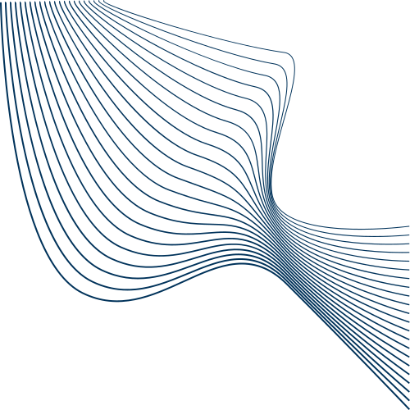
01
Problem Statement
Video is played while it is still arriving, so any break is seen at once
The Internet is best-effort: no guarantee on delay, bandwidth or delivery
When a link is congested, delay, jitter and packet loss all get worse
Traditional QoS is set by hand and cannot follow changing traffic
Delay
Jitter
Packet loss
Low throughput
What the viewer sees: buffering, freezing and poor picture quality

Slide 3
02
Why SDN Fits This Problem
In a normal network each switch decides alone and sees only its links
SDN moves decision making out of the switches into one controller
The controller sees the whole network and acts while the video plays
Video
Traffic
Network
Monitoring
SDN
Controller
QoS
Decision
Flow Rules
(OpenFlow)
Network
Switches
the loop repeats every few seconds, while the video plays

Slide 4
03
Objectives
1.
Monitor delay, jitter, packet loss and link usage from the controller
2.
Detect when a link carrying video becomes congested
3.
Identify video traffic and separate it from ordinary traffic
4.
Move the video flow to a free path and to a priority queue
5.
Reduce packet loss, delay and the number of buffering events
6.
Compare the result against a plain network with no QoS control
QoS
what the network measures
delay, jitter, packet loss, bandwidth
QoE
what the viewer feels
buffering, start-up delay, picture quality

Slide 5
04
Literature Review
2012
OpenQoS - Egilmez et al. [1]
Controller computes a QoS route for video; other traffic is not affected
2016
DASH assisting elements - Kleinrouweler et al. [2]
Network tells each player what bitrate to use, so quality stays stable
2016
SDNDASH - Bentaleb et al. [3]
Per-client bandwidth control; QoE improved by about 30 percent
2022
VQoSRR - Elbasheer et al. [4]
Adds bandwidth reservation with queues and reroutes when QoE drops
2022
RL routing - Al Jameel et al. [5]
Agent learns the best path; judged using VMAF and SSIM video scores
2025
Survey - Alsader et al. [6]
QoE-driven control is the current direction; several problems still open
[1] Egilmez et al., APSIPA ASC 2012 - ieeexplore.ieee.org/document/6411795
[2] Kleinrouweler et al., ACM MMSys 2016 - doi.org/10.1145/2910017.2910599
[3] Bentaleb et al., ACM MM 2016 - doi.org/10.1145/2964284.2964332
[4] Elbasheer et al., Electronics 2022 - doi.org/10.3390/electronics11081252
[5] Al Jameel et al., Electronics 2022 - doi.org/10.3390/electronics11152441
[6] Alsader et al., IEEE Access 2025 - doi.org/10.1109/ACCESS.2025.3597058

Slide 6
05
Research Gaps and What We Implement
Gaps we found in the literature
What our project implements
1.
Checks run once a second or slower, so reaction is late
1.
We poll switches often, so congestion is caught early
2.
Good QoS numbers do not always mean better video
2.
We record buffering at the player, not only delay and loss
3.
Many works pick a better path but reserve no bandwidth
3.
We reroute and also use a priority queue to reserve bandwidth
4.
Thresholds suit one test setup and are hard to reuse
4.
All thresholds sit in one small config file, easy to change
In short: we keep the control loop fast, we reserve bandwidth as well as reroute,
and we measure what the viewer actually sees.

Slide 7
06
System Architecture

Slide 8
07
How It Works
1.
Mininet builds a small network with two paths to the server
4.
The controller reads port statistics every few seconds
2.
The Ryu controller connects and learns the topology
5.
If a link passes the threshold, the flow is moved over
3.
Video traffic is recognised by its port number
6.
Monitoring continues and the change is checked next round
Read switch
statistics
Over the
threshold?
Reroute flow and
use priority queue
Yes
No

Slide 9
08
Tools and Test Plan
Tools we use
How we will test it
Mininet - builds the network
Case 1: plain network, no QoS control
Open vSwitch - OpenFlow switches
Case 2: same network, our controller on
Ryu (Python) - our controller
Run both with light and heavy traffic
tc / HTB - makes the two queues
VLC or DASH client - plays video
Record delay, jitter, loss, buffering
iperf3 - background traffic
Compare the two cases and plot results

Slide 10
09
Expected Results and Conclusion
Lower packet loss
on the video flow
Steadier delay
and jitter
Fewer buffering
events
Other traffic still
works normally
Conclusion
A best-effort network cannot promise steady quality for video
SDN gives one controller a full view and the power to act in real time
Our project turns this into a small setup: monitor, decide, reroute
Next step: build the topology, run both cases and compare results

