Slide 1

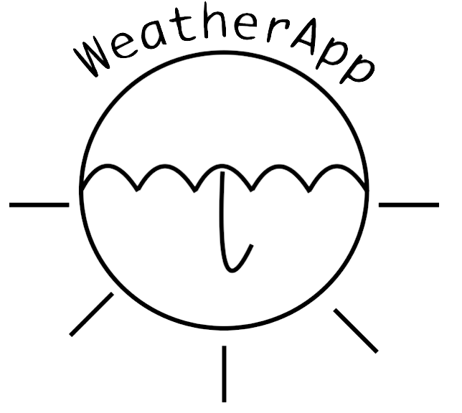
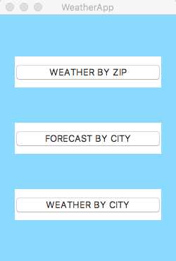
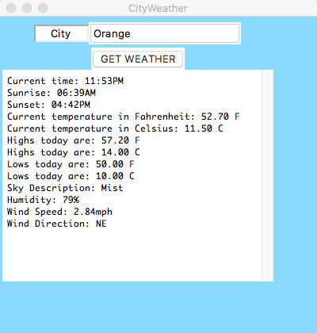
WeatherApp
Boyd, M., Eiroa Lledo, E., Keelan, S., Reyerson, A.
CPSC-353, Data Communications and Computer Networks
Department of Computer Science, Chapman University, Orange, CA
Overview
The program will ask the user to input a city name or zipcode, whose weather is checked in the API. Then, the program returns the data, collected in a Python dictionary, which contains dictionaries itself, and selects certain data for the user to read. This data will include the city’s name, country, current weather (e.g. clear sky, light rain, broken clouds, etc.), minimum, maximum and current temperatures in Fahrenheit and Celsius, wind speed and direction, humidity, times of sunrise and sunset, and other features. In addition, there will be a five day forecast option that will allow the user to view a brief estimate of the future weather in the desired location. This program will offer users another resource from which they may retrieve their data on the weather.
To respond with each output we had to isolate the given response out of multiple dictionaries and convert it into easy-to-read answers. For example, originally the temperature was provided in Kelvin and could be found under ‘main’ in ‘temp’. Our team was able to extract that information and convert it into Celsius and Farenheit. Below in Table 1. there are detailed descriptions for each item. All data is output in a GUI programmed using Python’s standard TkInter GUI package.
Future Research
No future research planned/determined.
Acknowledgements
Dr. Michael Fahy
OpenWeatherMap.org
References
“Weather API - OpenWeatherMap.” OpenWeatherMap,
http://openweathermap.org/api
..
Introduction
Various applications and methods exist by which individuals retrieve information on the weather conditions of a given city or region. This information can be utilized for preparations in traveling to these areas, for event planning, or other purposes. Such preparations allow for greater living comfort and economic convenience.
OpenWeatherMap, Inc. provides tools which programmers can use to create applications or programs which provide information on weather conditions. The program, designed by this team using Python 2.7, utilizes OpenWeatherMap’s “Current weather data” API, gathering data in the JSON format and outputting information on a city’s weather conditions. Data is gathered from OpenWeatherMap’s API, and modified by functions found in the main Github repository to make information more readable for users.
Scope
This application can be used as a tool to determine weather conditions and forecasts in a given city.
Compilation
Table 1. Explanation of output functions
Output | How to find in API | Provided by API | How we changed it
Time |  | UTC Time
Temperature | weather_city['main']['temp'] | Kelvin
Sky Description | weather_city['weather’]['description’] | Lower Case | description = weather_city['weather'][0]['description'].title()
Humidity | weather_city['main']['humidity'] | Number | Converted to a string and added a %
Wind Speed | weather_city['wind']['speed’] | Meter per Second | weather_city['wind']['speed']*2.23694 To out put in Miles per Hour
Wind Direction | weather_city['wind'][’deg’] | Degree | Each range of degree was assigned a cardinal direction (NE, E, SE, S, SW, W, NW, or, N) to be outputted
Figure 1.: From the main menu, the user has the options to receive (a) weather by zip code, (b) forecast by city, and (c) weather by city.
Figure 2.: The user enters the name of the city in the text box above, clicks on the ‘GET WEATHER’ button, and receives information on weather conditions as an output.
…
The user must have the 'requests' library installed (at least in this current iteration)
How to install 'requests':
If Pip is installed:
Enter the command: pip install requests in the Git Bash window
If Pip is NOT installed:
Enter: git clone git://github.com/kennethreitz/requests.git
Change current directory to requests
Type in: python setup.py install
Installation instructions for the 'requests' library can be found at: http://docs.python-requests.org/en/master/user/install/
To compile in Bash type: python *.py
Conclusions
This application will provide users with useful and comprehensible information on the current weather in multiple areas around the world, utilizing user-input zip codes and city names. Information gathered from OpenWeatherMap.org has been interpreted to produce readable weather forecasts, which has the potential to aid users in determining schedules and plans revolving around those given cities. The presentation of this information using the TkInter GUI should give users a collection of data in an appealing and informative manner.
..

