Slide 1

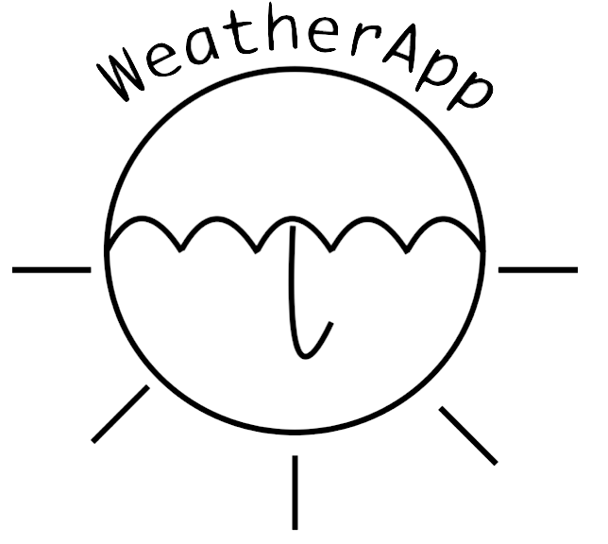
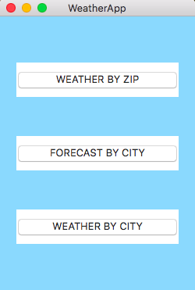
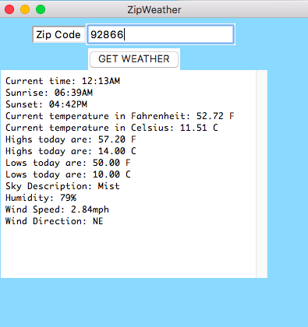
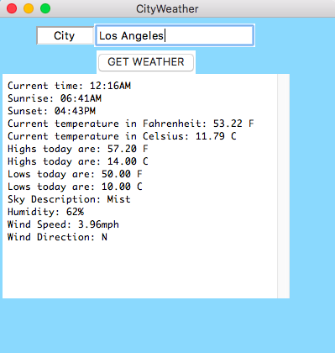
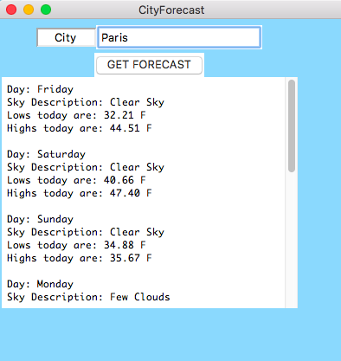
WeatherApp
Boyd, M., Eiroa Lledo, E., Keelan, S., Reyerson, A.
CPSC-353, Data Communications and Computer Networks
Department of Computer Science, Chapman University, Orange, CA
Introduction
Various applications and methods exist by which individuals retrieve information on the weather conditions of a given city or region. This information can be utilized for preparations in traveling to these areas, for event planning, or other purposes. Such preparations allow for greater living comfort and economic convenience.
OpenWeatherMap, Inc. provides tools which programmers can use to create applications or programs which provide information on weather conditions. The program, designed by this team using Python 2.7, utilizes OpenWeatherMap’s “Current weather data” API, gathering data in the JSON format and outputting information on a city’s weather conditions. Data is gathered from OpenWeatherMap’s API, and modified by functions found in the main Github repository to make information more readable for users.
Scope
Our goal was to creat code that would output tempeture based on data found through openweathermap.org. Originally the search tool only worker through city name but we were able to add a search by zip code function. We wanted to create clean code that was easy to read. We have many classes that converts the data into standard measurements that would be familiar to the user.
Compilation
Overview
The program will ask the user to input a city name or zipcode, whose weather is checked in the API. Then, the program returns the data, collected in a Python dictionary, which contains dictionaries itself, and selects certain data for the user to read. This data will include the city’s name, country, current weather (e.g. clear sky, light rain, broken clouds, etc.), minimum, maximum and current temperatures in Fahrenheit and Celsius, wind speed and direction, humidity, times of sunrise and sunset, and other features. In addition, there will be a five day forecast option that will allow the user to view a brief estimate of the future weather in the desired location. This program will offer users another resource from which they may retrieve their data on the weather.
To start we useed the python request library to requested the URL that would retrieve the data. From there we formatted the data using Json. To respond with each output we had to isolate the given response out of multiple dictionaries and convert it into easy-to-read answers. For example, originally the temperature was provided in Kelvin and could be found under ‘main’ in ‘temp’. Our team was able to extract that information and convert it into Celsius and Fahrenheit. Below in Table 1. there are detailed descriptions for each item. Our menu display GUI was created using Tkinter. This interface allows the user to select their preferred search method, by city or zip code. In addition the user may look up the predicted forecast.
..
Figure 1.
Main Menu
Table 1. Explanation of output functions
Output | How to find in API | Provided by API | How we changed it
Time | weather_city['sys']['sunset’] weather_city['sys']['sunrise’] | UTC Time | sunset_time = TimeConverter.time _convert(weather_city['sys']['sunset’]) sunrise_time = TimeConverter.time _convert(weather_city[‘sys’][‘sunrise’])
Temperature | weather_city['main']['temp'] | Kelvin
Sky Description | weather_city['weather’]['description’] | Lower Case | description = weather_city['weather'][0]['description'].title()
Humidity | weather_city['main']['humidity'] | Number | Converted to a string and added a %
Wind Speed | weather_city['wind']['speed’] | Meter per Second | windSpeed=weather_city['wind']['speed']*2.23694 To out put in Miles per Hour
Wind Direction | weather_city['wind'][’deg’] | Degree | Each range of degree was assigned a cardinal direction (NE, E, SE, S, SW, W, NW, or, N) to be outputted
Figure 2.
View from Zip Code
…
Figure 3.
View from City
The user must have the 'requests' library installed (at least in this current iteration)
How to install 'requests':
If Pip is installed:
Enter the command: pip install requests in the Git Bash window
If Pip is NOT installed:
Enter: git clone git://github.com/kennethreitz/requests.git
Change current directory to requests
Enter the comand: python setup.py install
Installation instructions for the 'requests' library can be found at: http://docs.python-requests.org/en/master/user/install/
In Bash type: python *.py
Conclusions
This application will provide users with useful and comprehensible information on the current weather in multiple areas around the world, utilizing user-input zip codes and city names. Information gathered from OpenWeatherMap.org has been interpreted to produce readable weather forecasts, which has the potential to aid users in determining schedules and plans revolving around those given cities. The presentation of this information using the TkInter GUI should give users a collection of data in an appealing and informative manner.
..
Figure 4.
View from Forecast
Acknowledgements
Dr. Michael Fahy
OpenWeatherMap.org
References
“Weather API - OpenWeatherMap.” OpenWeatherMap,
http://openweathermap.org/api

