Slide 1

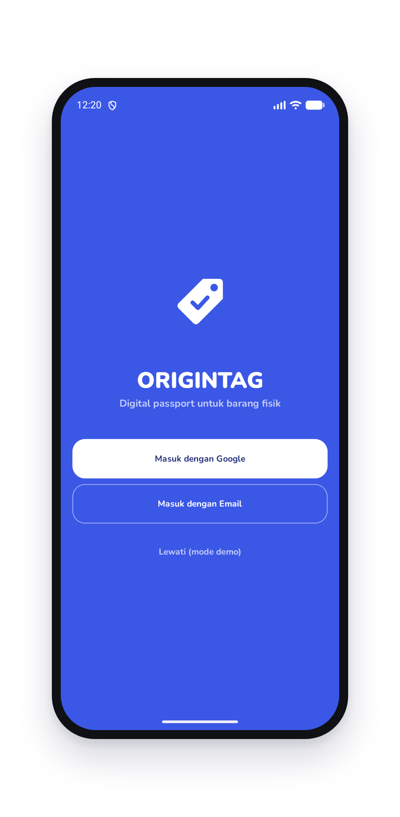

Built on BNB Chain
OriginTag
A digital passport for every physical product.
Authenticity · Ownership history · Escrow resale
Notes:
Buka dengan satu kalimat: OriginTag adalah paspor digital untuk barang fisik, dibangun di BNB Chain.

Slide 2
The Problem
Counterfeits flood resale markets
Paper certificates are easy to fake
Warranties can’t be verified
Ownership history is invisible
Buyers pay with zero proof…
Notes:
Masalahnya: barang palsu, sertifikat kertas gampang dipalsukan, garansi tak bisa dicek, dan pembeli barang bekas tidak punya bukti apa pun.

Slide 3
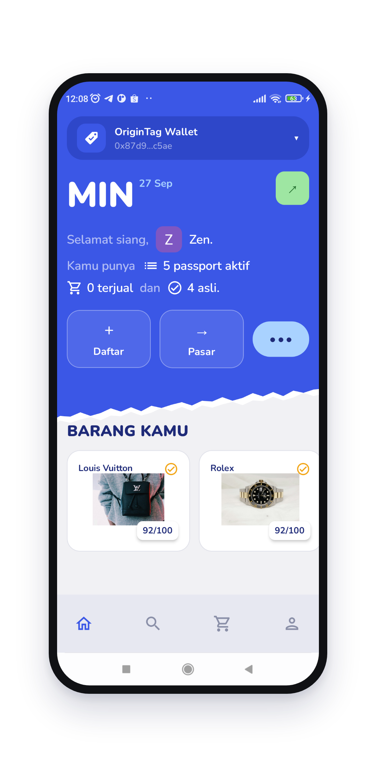
OriginTag gives every physical product an on-chain passport — proof of authenticity that travels with it for life.
Notes:
Solusinya: setiap barang dapat paspor on-chain. Tunjukkan Beranda — barang milik user, skor keaslian, dan aksi Daftar/Pasar.

Slide 4
How it works
01
02
03
04
Snap & register
AI verifies
Passport minted
Resell with escrow
Owner photographs the item and fills in brand, serial and warranty.
Vision AI scores authenticity 0–100. Below 70 goes to manual review.
A BEP-721 passport is minted to the owner. Evidence lives on BNB Greenfield.
NFT and payment swap atomically. History updates itself.
Notes:
Alurnya empat langkah: foto barang, AI menilai keaslian, passport NFT di-mint, lalu bisa dijual lagi dengan escrow.

Slide 5
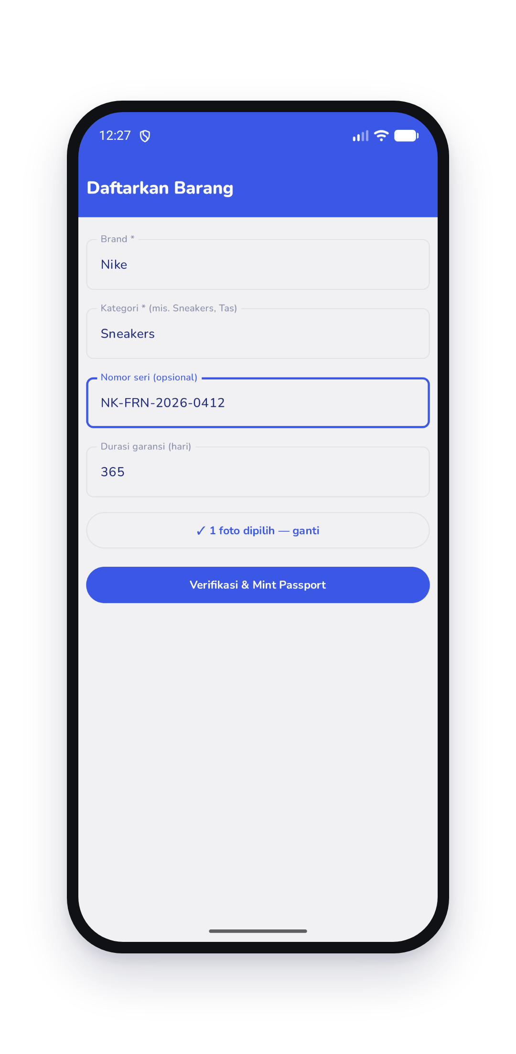
Register in one minute. Photos go to BNB Greenfield, AI scores authenticity, and a BEP-721 passport lands in the owner’s wallet.
Google / email login via Web3Auth — no seed phrase.
Notes:
Registrasi cukup satu menit. Foto disimpan di BNB Greenfield, AI menilai, passport langsung di-mint ke wallet pemilik. Login pakai Google — tanpa seed phrase.

Slide 6
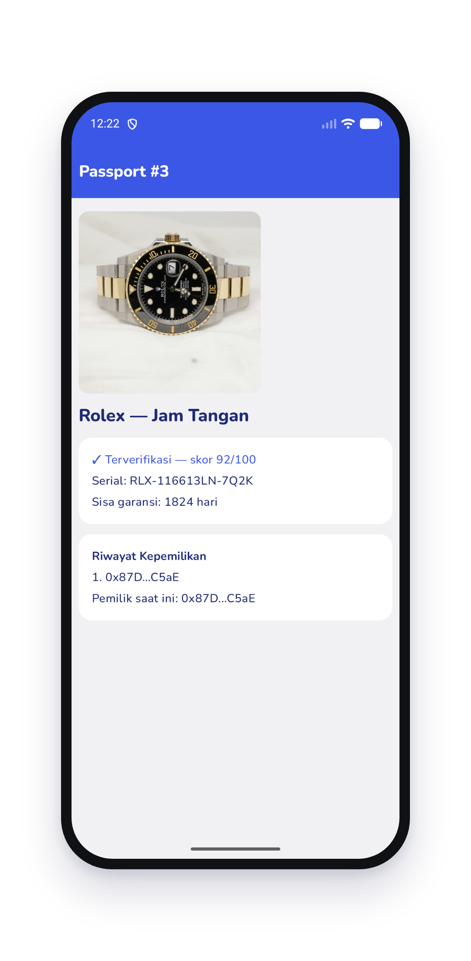
AI that can’t be fooled
70+ /100
50 /100
Minted automatically
Flagged for review
Items at or above the threshold get a passport right away.
Real result: a single catalog photo can’t prove the physical unit.
Every score, serial and warranty is written on-chain.
Notes:
AI bukan stempel otomatis: foto katalog/stok ditolak (skor 50, ditahan untuk review). Barang lolos ambang 70 baru di-mint.

Slide 7
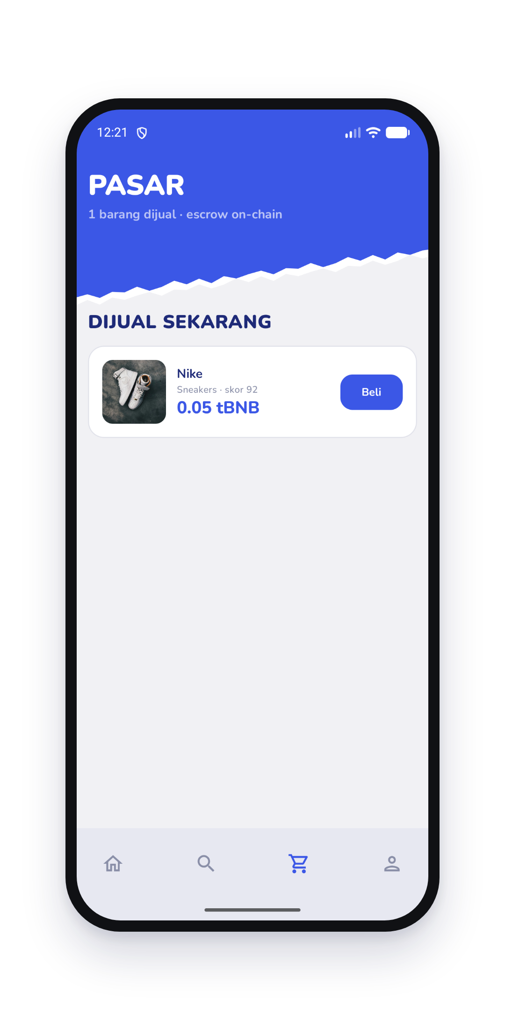
Resell with on-chain escrow. NFT and payment swap atomically — the seller gets paid, the buyer gets the passport, and history updates itself.
2% platform fee · overpayment refunded · cancel anytime
Notes:
Marketplace escrow: NFT dan pembayaran bertukar dalam satu transaksi. Penjual dibayar, pembeli dapat passport, riwayat tercatat otomatis. Fee 2%.

Slide 8
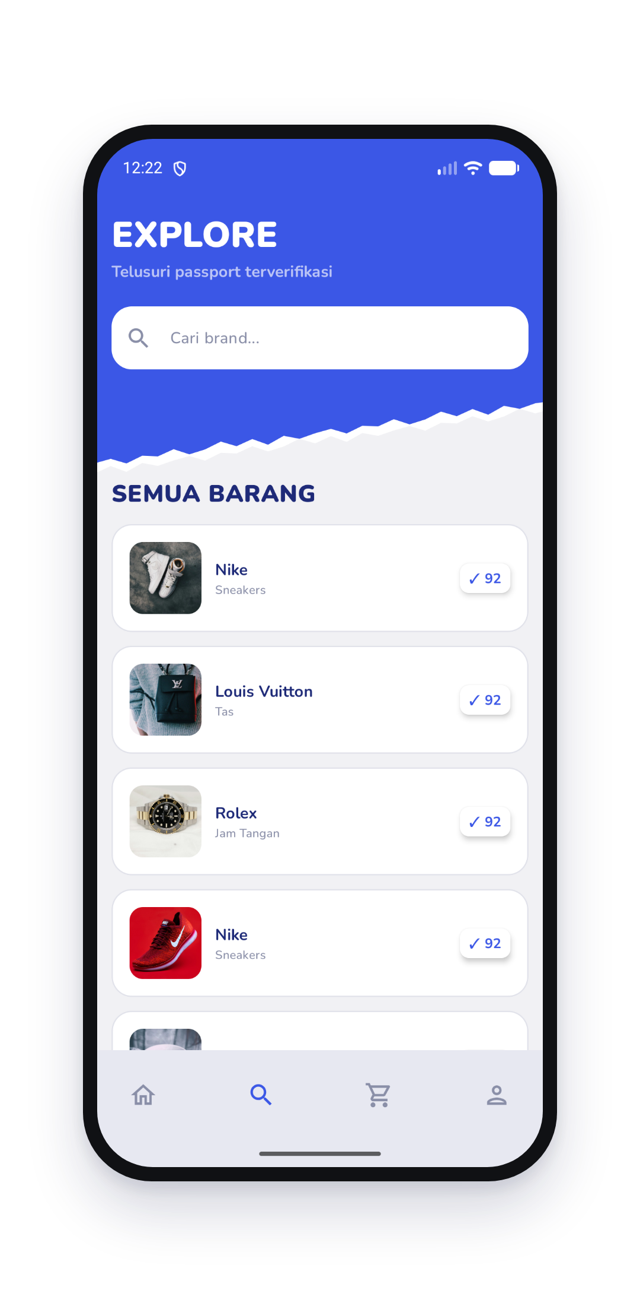
Every item carries its story.
Ownership history
Every transfer and sale, recorded automatically.
Trust score
Owner reputation from items held and sold.
Brand recalls
Brands flag affected items instantly.
Service records
Repairs and servicing stay with the item.
Notes:
Setiap barang membawa ceritanya: riwayat kepemilikan, trust score pemilik, recall dari brand, dan riwayat servis — bisa dicari siapa saja.

Slide 9
Architecture
Vision AI
Authenticity score 0–100
Android App
Backend
Kotlin · Jetpack Compose
Web3Auth social login
Signs txs with web3j
NestJS · ethers v6
Builds unsigned txs
Indexes events
BNB Greenfield
Photo evidence storage
BNB Smart Chain
OriginTagPassport (BEP-721)
OriginTagMarketplace (escrow)
Owner signs on-device
Notes:
Arsitektur: app Android menandatangani transaksi langsung dari wallet user; backend NestJS mengurus AI, penyimpanan Greenfield, dan menyusun transaksi.

Slide 10
Live on BSC Testnet
2
15/15
6
4
smart contracts deployed
contract tests passing
passports minted
flows verified on-chain
Register → list → buy → cancel, all signed from the app.
Passport 0xE3Be425968a96A79FC5a9bd370cc075247BD7b00
Marketplace 0xcE03f725544ed187776af608780A3F95df06F339
Notes:
Ini bukan mockup: kontrak sudah live di BSC Testnet, 15 test lulus, dan alur daftar–jual–beli–batal sudah diuji on-chain dari app.

Slide 11
Business & roadmap
2%
fee on every resale,
paid on-chain by the escrow contract.
Now
MVP live on BSC Testnet — app, AI, escrow marketplace.
Next
NFC tags on products, brand portal for recalls and verified minting.
Then
BSC Mainnet, partner brands, verification plans for resellers.
Notes:
Model bisnis: fee 2% tiap penjualan ulang, lalu layanan untuk brand. Roadmap: tag NFC, portal brand, lalu mainnet.

Slide 12
Team
Built solo, end to end.
RG
Raihan Ghifari
Founder · Full-stack & Web3
Smart contracts
Solidity · OpenZeppelin · Hardhat
Backend
NestJS · ethers · Greenfield
One builder shipped the contracts, backend, AI pipeline and the Android app.
AI
Vision authenticity scoring
Mobile
Kotlin · Compose · Web3Auth
github.com/reyghifari
Notes:
Saya membangun OriginTag sendirian: kontrak, backend, integrasi AI, dan app Android.

Slide 13
Authentic.
For life.
OriginTag — digital passports for physical goods, on BNB Chain.
Notes:
Tutup dengan tagline dan ajak juri mencoba demo / melihat repo.

