Slide 1
01 / 22
PRODUCT OVERVIEW · OCTOBER 2026
Relay
AI on your code, with the brakes on.
Desktop prototype · macOS · Bring your own API keys
Notes:
Hi, I'm here to show you Relay.
In one line: Relay lets your team use AI on real code, and you stay in control of three things: what it costs, what it sees and what it changes.
It's a desktop app for macOS, and it works with the API keys your company already has.

Slide 2
02 / 22
THE PROBLEM
AI coding help is fast.
It is not yet trustworthy.
— Costs are invisible until the provider bill arrives.
— Nobody is sure which files or secrets were sent.
— Changes land without a plan anyone approved.
Notes:
Most of your teams already use AI to help with code. It's fast. But for a company it isn't trustworthy yet, for three reasons.
- Cost. Nobody knows what a task costs until the provider bill arrives.
- Data. Nobody can say for sure which files, or which secrets, were sent.
- Changes. Code changes land without a plan anyone actually approved.
Those three gaps are why AI stays a personal tool and never becomes a team process.

Slide 3
03 / 22
WHAT RELAY IS
A control layer between
your code and your AI provider.
A desktop app that runs a repeatable review-to-patch workflow, with visible spending and your approval before any patch is drafted.
Notes:
Relay is a control layer that sits between your code and your AI provider.
It runs a repeatable workflow: review the code, plan a fix, draft a patch, check the patch. Spending is visible at every step, and nothing is drafted until a person approves the plan.
Let me show you the real app.

Slide 4
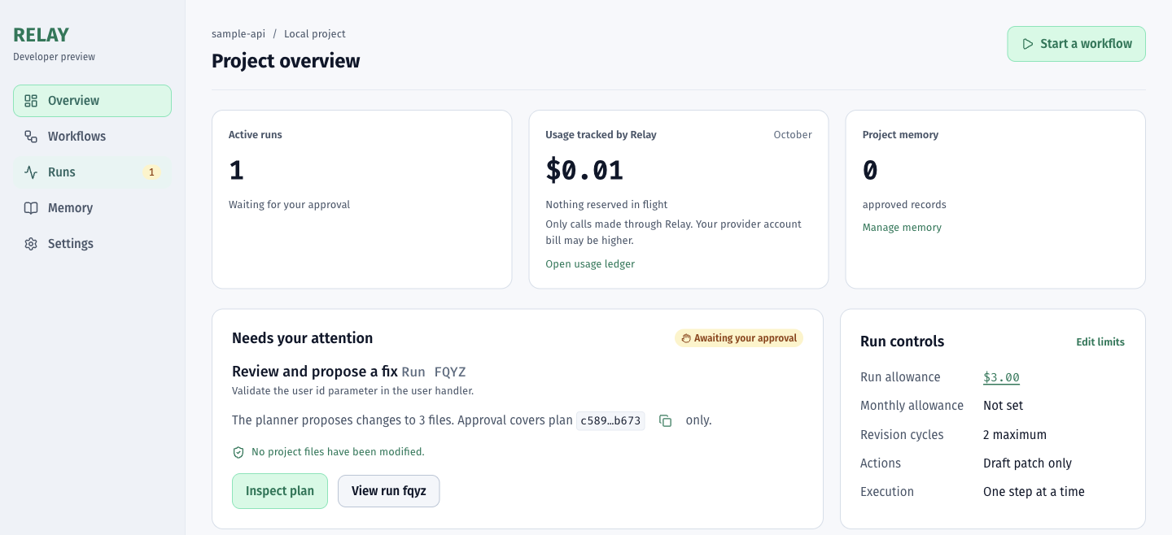
IN THE APP
04 / 22
Everything that needs you, on one screen.
The project overview: a run waiting for approval, spending so far, and the run limits.
Notes:
This is the project overview, and everything that needs you is on this one screen.
- On the left, a run is waiting for my approval.
- Next to it is what we've spent so far this month.
- On the right are the limits for this run: the allowance, how many revision cycles it may take, and the fact that it can only draft a patch.
Notice the line "No project files have been modified." That line comes back later.

Slide 5
05 / 22
HOW A RUN WORKS
Five steps. You hold the key one.
Each step can use a different model and provider.
01
02
03
04
05
Review
Plan
You approve
Patch
Verify
A model reads the files you chose and lists findings.
A second model proposes what to change, and why.
Approve, ask for a revision, or reject. Nothing else happens first.
A model drafts the code change the plan allows.
A reviewer model checks the patch against the plan.
Notes:
Every run is five steps: review, plan, approve, patch, verify.
Each step can use a different model, even a different provider. A cheap, fast model can do the review and a stronger one the patch.
Step three is yours. Relay stops, shows you the plan, and waits. You can approve it, ask for a revision, or reject it. Nothing else happens until you decide.

Slide 6
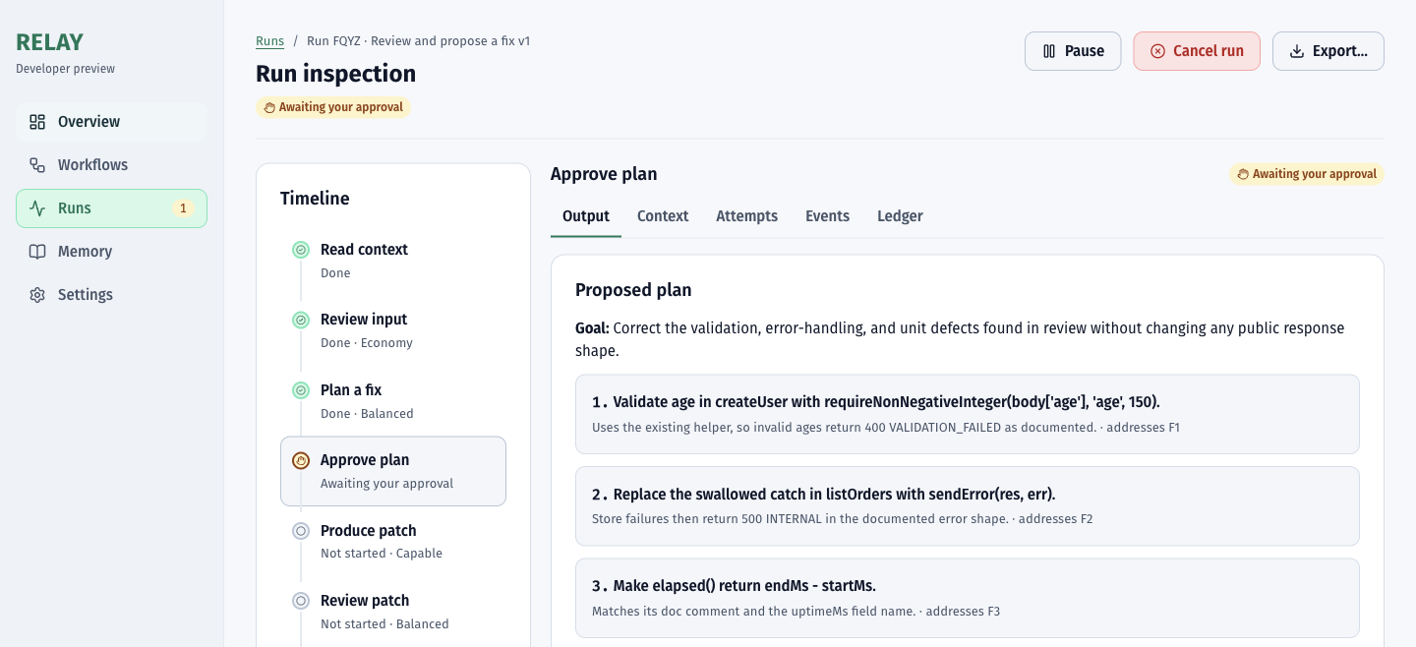
IN THE APP
06 / 22
You approve the plan before any code is written.
Each step of the plan names the finding it fixes, the files it may change and its sources.
Notes:
This is the approval screen. The plan is concrete: each item names the finding it fixes and the files it's allowed to touch.
From here you can pause the run, cancel it, or export it. Approval is tied to this exact version of the plan, so if the plan changes, you approve again.

Slide 7
07 / 22
SAFE BY DESIGN
Relay never edits
your project files.
You get a report and a proposed patch. You review it and apply it yourself.
Notes:
This is the most important design rule: Relay never edits your project files.
What you get is a report and a proposed patch. You review the patch and apply it yourself, with your normal tools and your normal code review.
So the worst case is a bad suggestion, not a broken codebase.

Slide 8
08 / 22
COST YOU CAN SEE
Every call is checked before it is sent.
Relay reserves the most a call could cost and refuses any call that would go over your budget.
Budgets
Honest numbers
No surprise retries
Per run and per project per month. Raise them in place when a run pauses.
Exact costs when known; otherwise shown as ~$0.06 (estimated) , never “unknown”.
A request that may have been charged is never re-sent without you.
Notes:
Now cost. Before every single call, Relay reserves the most that call could cost. If that would go over your budget, the call is never sent.
- Budgets are set per run and per project per month. If a run hits its limit it pauses, and you can raise the limit in place.
- The numbers are honest. When we know the exact cost, we show it. When we can't, we show an estimate, marked as an estimate, and never "unknown".
- There are no surprise retries. A request that may already have been charged is never re-sent without you.

Slide 9
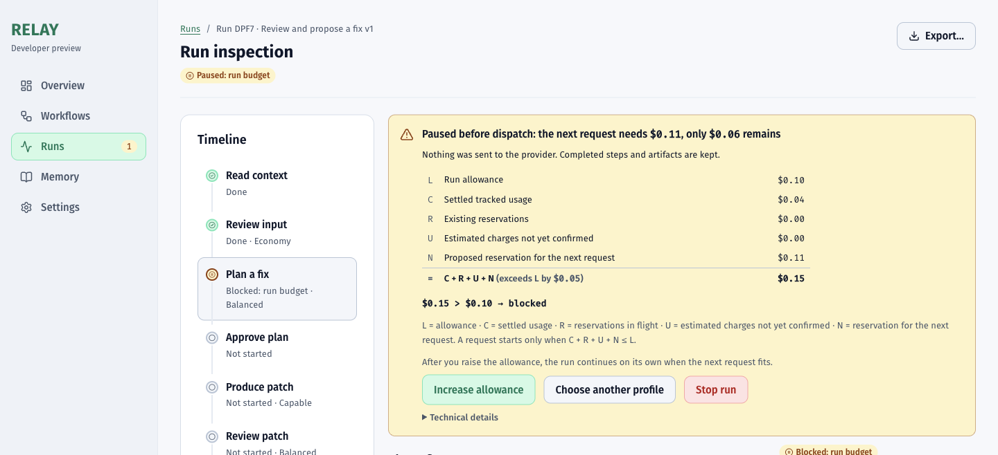
IN THE APP
09 / 22
Stopped before it overspends — with the math.
The next request needed $0.11 and only $0.06 remained, so nothing was sent.
Notes:
Here's a budget pause. The next request needed 11 cents and only 6 cents remained, so nothing was sent.
What matters is that it shows the math. You can see the allowance, what's already been used, what's reserved, and the formula. A finance person can check this line by line.
You then choose: raise the allowance, switch to a cheaper model profile, or stop. Every finished step is kept either way.

Slide 10
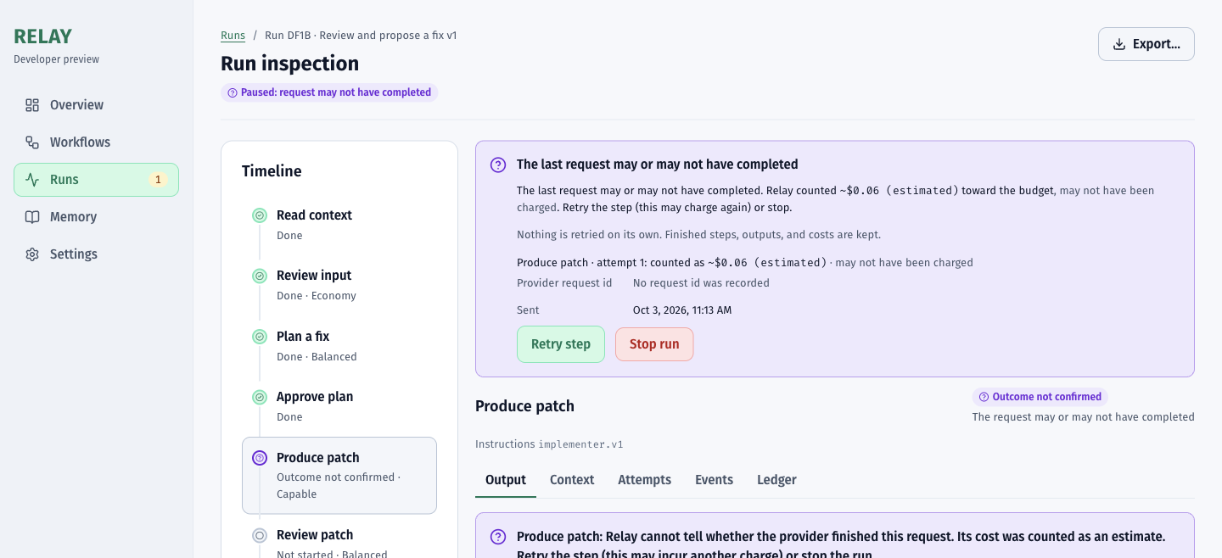
IN THE APP
10 / 22
Uncertain cost? An honest estimate, never “unknown”.
Counted as ~$0.06 (estimated), may not have been charged. Retry or stop — never retried on its own.
Notes:
Sometimes the network drops in the middle of a request, and nobody knows whether the provider finished it.
Most tools either hide that or quietly retry it, and quietly retrying can mean paying twice.
Relay counts it as an estimate, here about 6 cents, notes that it may not have been charged, and asks you to retry the step or stop. It never retries on its own.

Slide 11
11 / 22
YOUR DATA STAYS YOURS
Only what you pick leaves your Mac.
Stored locally
You choose files
Secrets blocked
Keys protected
Projects, runs, history and memory live on your computer.
Each run lists exactly which files and providers receive context.
Key and credential files are refused; files that look like they hold a key need your OK.
API keys sit in the macOS Keychain and never reach logs, exports or the UI.
Notes:
On data: only what you pick leaves your Mac.
- Projects, runs, history and memory are stored locally on your computer.
- For each run you choose the files. The run records exactly which files went to which provider.
- Key and credential files are blocked outright. Files that look like they contain a key need your OK.
- API keys live in the macOS Keychain. They never appear in logs, exports or the interface.

Slide 12
12 / 22
BRING YOUR OWN KEY
Your providers. Your contracts.
Companies plug in their own keys and pay providers directly. Relay adds the control, not a markup.
Anthropic
OpenAI
Gemini
Claude models
GPT models
Google models
Notes:
The business model is simple: bring your own key.
Relay works with Anthropic, OpenAI and Google Gemini. Companies plug in their own keys and pay the providers directly, under the contracts and data terms they already have.
Relay adds the control, not a markup on tokens.

Slide 13
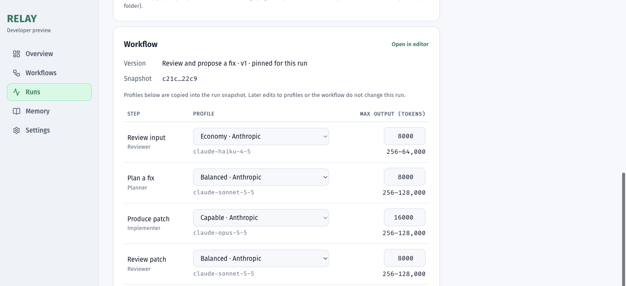
IN THE APP
13 / 22
Pick a model and an output limit for every step.
Each step can use a different provider and model, with a sensible default limit.
Notes:
When you start a run, you pick a model and an output limit for each step.
Each step comes with a sensible default, so most people never touch these boxes. A team that wants tight control can set every one of them.

Slide 14
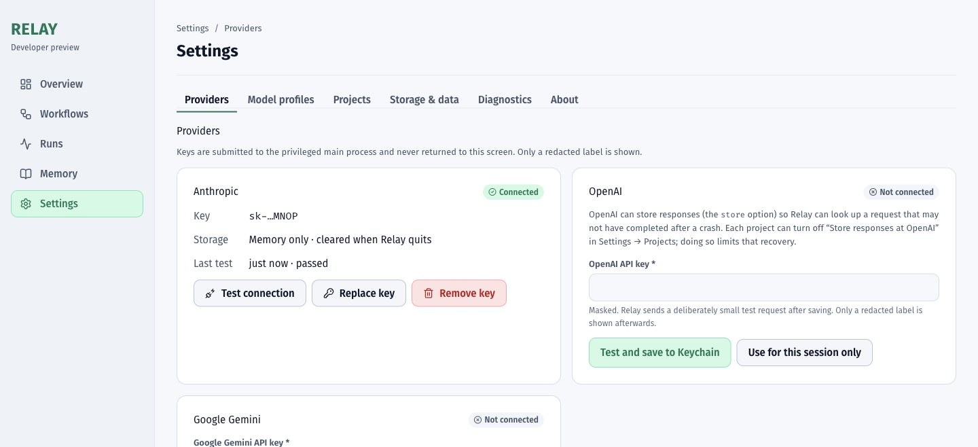
IN THE APP
14 / 22
Connect your own providers in a minute.
Keys are tested, stored in the macOS Keychain, and only a redacted label is ever shown.
Notes:
Connecting a provider takes about a minute. You paste a key and Relay tests it with a tiny request, then stores it in the Keychain.
From then on you only ever see a redacted label like this one. You can test, replace or remove the key at any time.

Slide 15
15 / 22
ALWAYS IN CONTROL
Pause, export, recover — at any point.
Pause & resume
Export anytime
Crash recovery
Backups
Stops after the current request and picks up exactly where it left off.
Save everything finished so far, even mid-run.
A crash or quit leaves runs safe and resumable.
Daily automatic backups, one-click restore.
Notes:
You're always in control of a running job.
- Pause stops after the current request and later resumes exactly where it left off.
- Export saves everything finished so far, even in the middle of a run.
- Crash recovery: if the app crashes or the laptop restarts, runs are kept safe and can be resumed.
- Backups: daily automatic backups, with a one-click restore.

Slide 16
16 / 22
PROJECT MEMORY
It learns your project's rules — only with your approval.
— Approved rules are reused in future runs.
— Runs suggest new rules; nothing is added automatically.
— Every rule has a source, a history and a review date.
Notes:
Relay also learns your project's rules, but only with your approval.
When a run finds something worth remembering, like "this project validates input with this helper", it suggests a rule. Nothing is added automatically.
Approved rules are reused in future runs, and every rule keeps its source, its history and a review date.

Slide 17
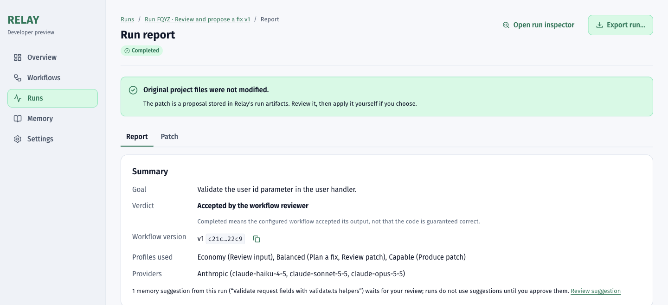
IN THE APP
17 / 22
Every run ends in a clear report.
Findings, approvals, revisions, limitations and the tracked cost — exportable as Markdown.
Notes:
Every run ends in a clear report: the goal, the verdict, which models were used, the findings, what was approved, any limitations, and the tracked cost. It exports as Markdown, so it can go straight into a ticket or a pull request.
And the green banner at the top is the promise from earlier: "Original project files were not modified."

Slide 18
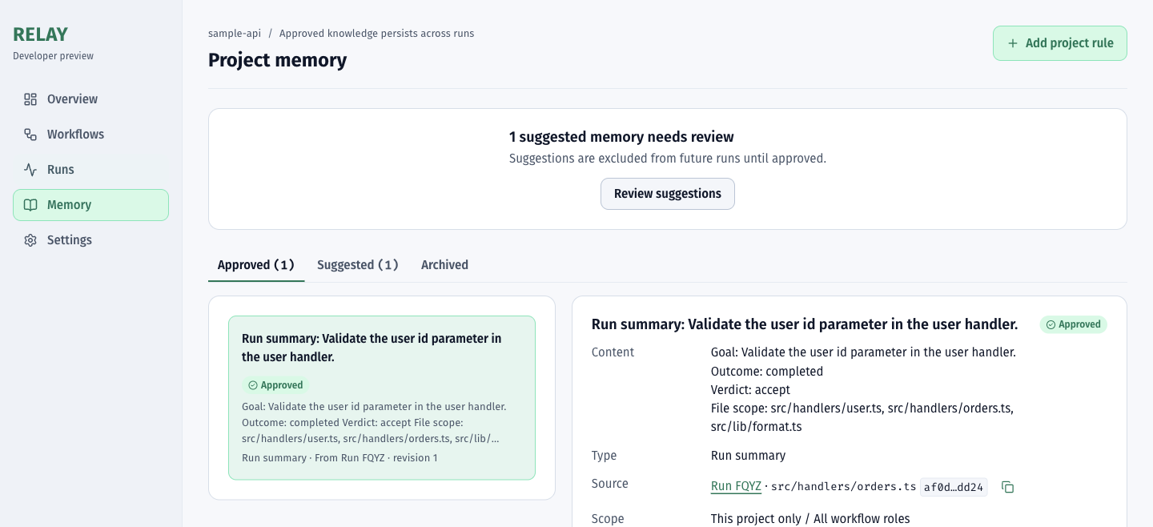
IN THE APP
18 / 22
Project memory you can see and control.
Approved rules with their source, scope, history and review date. Suggestions wait for you.
Notes:
This is project memory. You see the approved rules with their source and scope. Suggestions wait in their own tab until someone reviews them, and they're kept out of future runs until they're approved.

Slide 19
19 / 22
BUILT TO BE TRUSTED
Tested like it handles money. Because it does.
3,656
120
43
0
automated unit tests
integration tests, incl. crash recovery
end-to-end tests of the real app
secrets found by the release secret scan
Independent security, money, UI and resilience audits, each followed by fixes and a bug hunt.
Notes:
We built and tested Relay like it handles money, because it does.
- More than 3,600 automated unit tests.
- 120 integration tests, including crash recovery.
- 43 end-to-end tests that drive the real desktop app.
- Zero secrets found by the release scan.
It has also been through separate security, money, UI and resilience audits, each followed by fixes and a bug hunt.

Slide 20
20 / 22
WHO IT IS FOR
Teams that already pay for AI and want it predictable.
Engineering leads
Developers
Budget owners
Need AI help their team can audit and approve.
Want a reviewed plan and a clean patch, not a chat transcript.
Need hard spending limits and a ledger they can export.
Notes:
Relay is for teams that already pay for AI and want it to be predictable.
- Engineering leads need AI help their team can audit and approve.
- Developers want a reviewed plan and a clean patch, not a chat transcript.
- Budget owners need hard spending limits and a ledger they can export.

Slide 21
21 / 22
WHERE WE ARE
Prototype complete. Next: real-world proof.
— Done: full workflow, desktop app, packaging, audits.
— Next: live run against all three providers.
— Next: signed macOS build and first pilot teams.
Notes:
Here's where we are, honestly.
The prototype is complete: the full workflow, the desktop app, packaging, and the audits.
Next is real-world proof:
- a live run against all three providers;
- a signed macOS build;
- our first pilot teams.

Slide 22
22 / 22
THANK YOU
Let's run it
on your code.
Looking for pilot teams. Questions?
Relay · AI on your code, with the brakes on
Notes:
That's Relay: AI on your code, with the brakes on.
We're looking for pilot teams. If you have a codebase and an AI bill you'd like to make predictable, let's talk.
Questions?

