Slide 1

Celular Llamadas
ID_822130
By: Jhoan David Gruezo Gutierrez

Slide 2
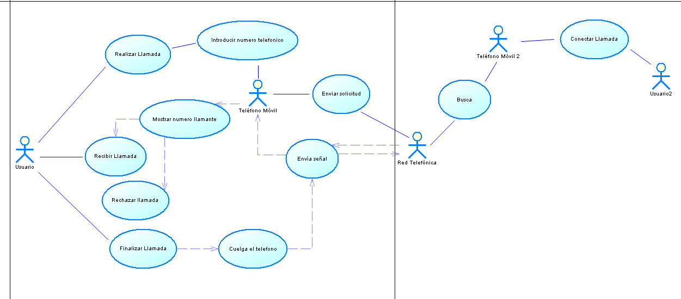

Slide 3
