Slide 1
NBA Case Study
Popularity vs Profitability

Slide 2
Choices MAde
Find historic data for all sources.
Focus on team granularity.
Build a prototype end to end (scrapping to viz) not ready for production.
Leave deployment, industrialisation and data fetching from live sources (ticket marketplace, social media feeds, etc,..) for later.

Slide 3
Scrapped Data Sources
Name | Granularity | Frequency | Historic | Historic fetch method | Source
Revenue data | Team | yearly | 2012-202 | wayback machine | http://www.forbes.com/nba-valuations/list/
Attendance data | Team | yearly | 2001-2020 | url parameter | http://www.espn.com/nba/attendance/
Facebook data | Team | daily | 2013-09-20 to Present | Available on main url | https://www.trackalytics.com/facebook/fanpage/losangeleslakers/
Twitter data | Team | daily | 2014-06-12 to Present | Available on main url | https://www.trackalytics.com/twitter/profile/@Lakers/
Attendance and score per game | Team | daily | 2004-2020 | url parameter | https://www.basketball-reference.com/leagues/NBA_2015_games-december.html
Payroll data | Team | yearly | 200-2019 | url parameter | https://hoopshype.com/salaries/2017-2018/

Slide 4
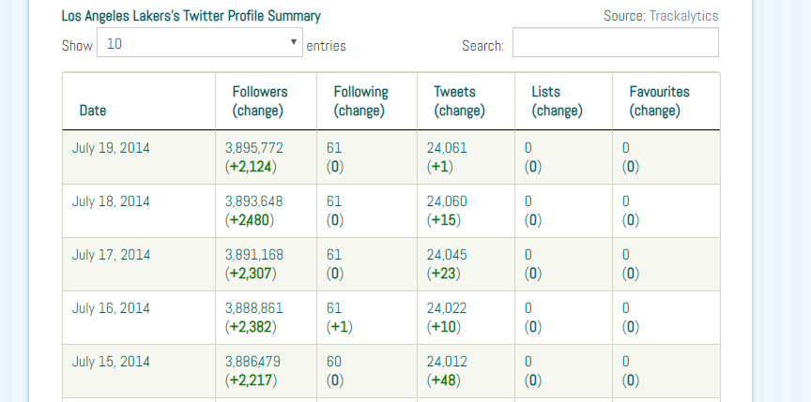
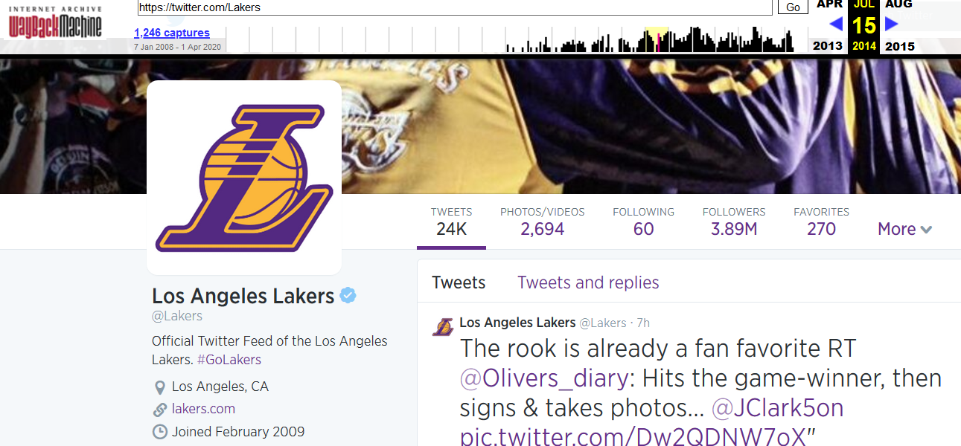
Data Checks
Social media
Trackalytics data vs wayback machine of facebook/Twitter page
Attendance
Attendance numbers against stadium capacity
Some numbers are greater than stadium capacity, potential explanation (although it’s for football): https://www.lsureveille.com/sports/football-attendance-numbers-exceed-capacity-in-tiger-stadium/article_377a3665-66bd-5907-abe7-1ab261cf57b5.html

Slide 5




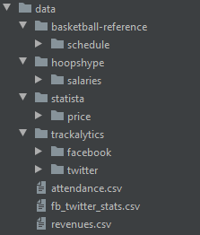
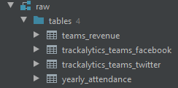

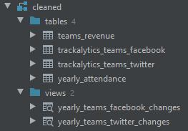

Data Pipeline for Case study

Slide 6
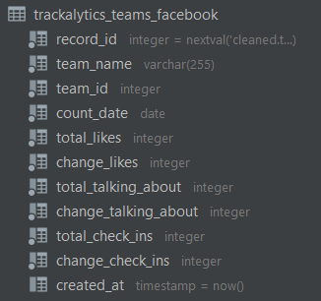
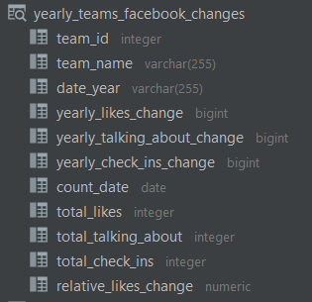


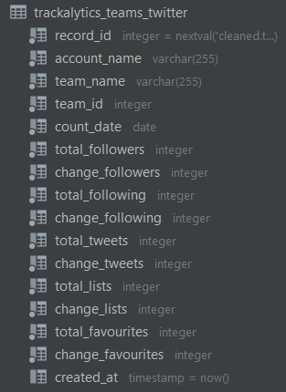
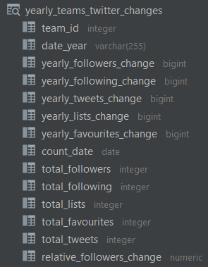
Data transformation
Aggregate Twitter and Facebook daily change data.
Get total likes and followers at end of each year.
Compute percentgage change of total likes and followers each year.

Slide 7
Planned additional datasources
NBA teams yearly standings
NBA players social media fb likes and followers historic
NBA players data (Team, stats, injuries, …)
Instagram historic data
Fetch social media accounts data via API
Socio economic data about states (population, income per capita,…)
Maybe popularity of NFL or NBL in the state ( Fans might be geared towards one sport or the other depending on the strenght of the franchise within the state)
Stadium capacity and date of construction
Maybe Google trends with team as topic

Slide 8
Improvements
Dockerize or deploy to e.g AWS with Terraform
Automate pipeline
Improve database update strategy
Historize raw files
…

Slide 9
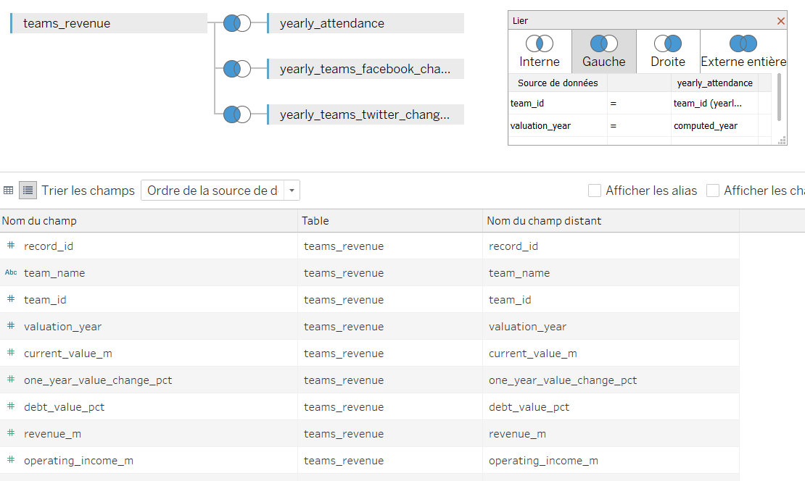
Dataset for basic analysis

Slide 10
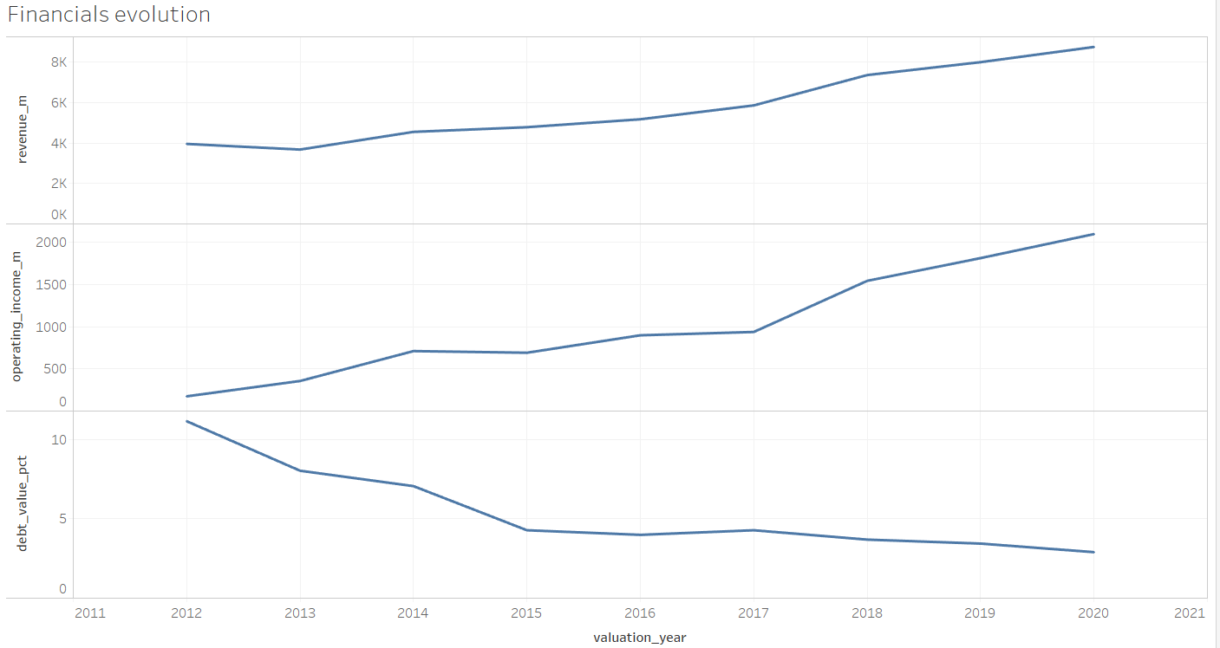
Basic analyis: financial evolution

Slide 11
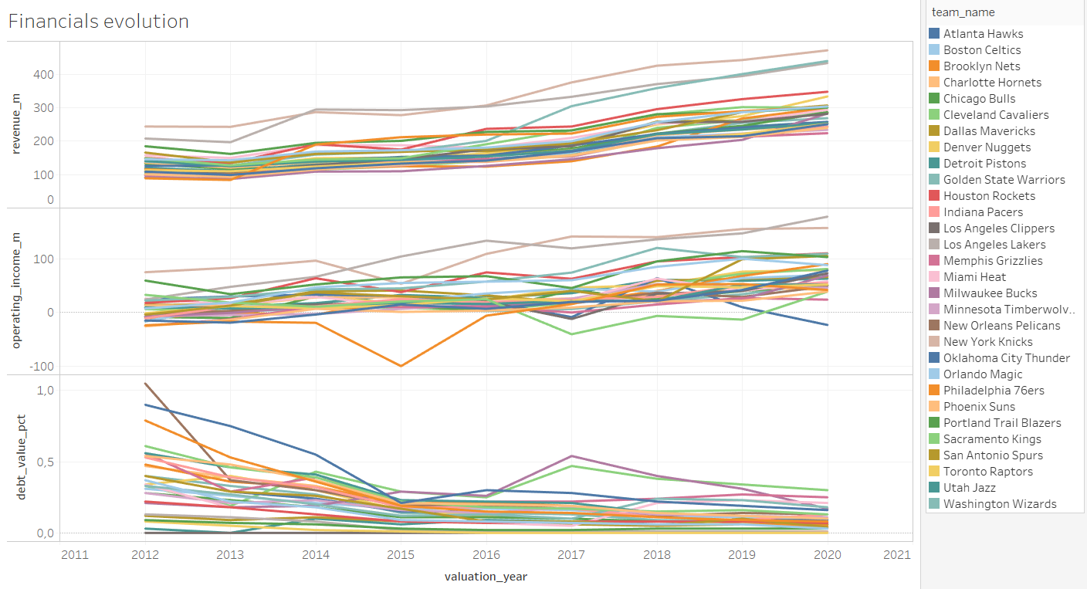
Basic analyis: financial evolution

Slide 12
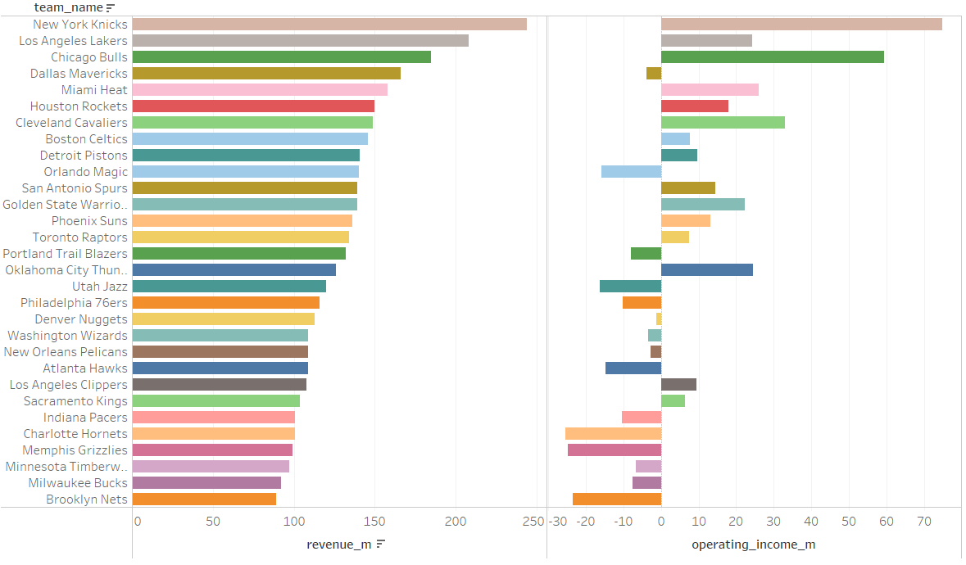
Basic analyis: financial Snapshot 2012

Slide 13
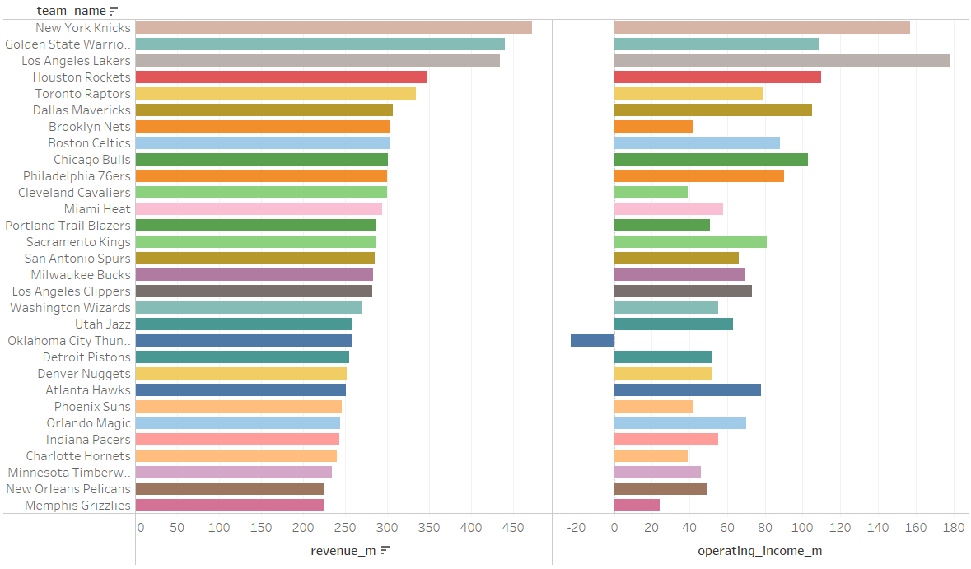
Basic analyis: financial Snapshot 2020

Slide 14
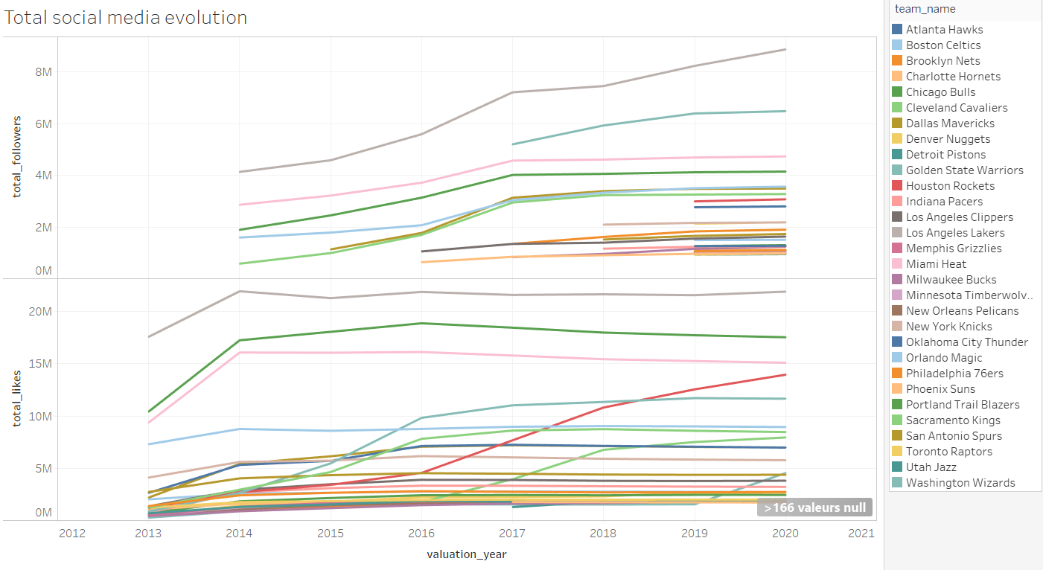
Basic analyis: social media total evolution

Slide 15
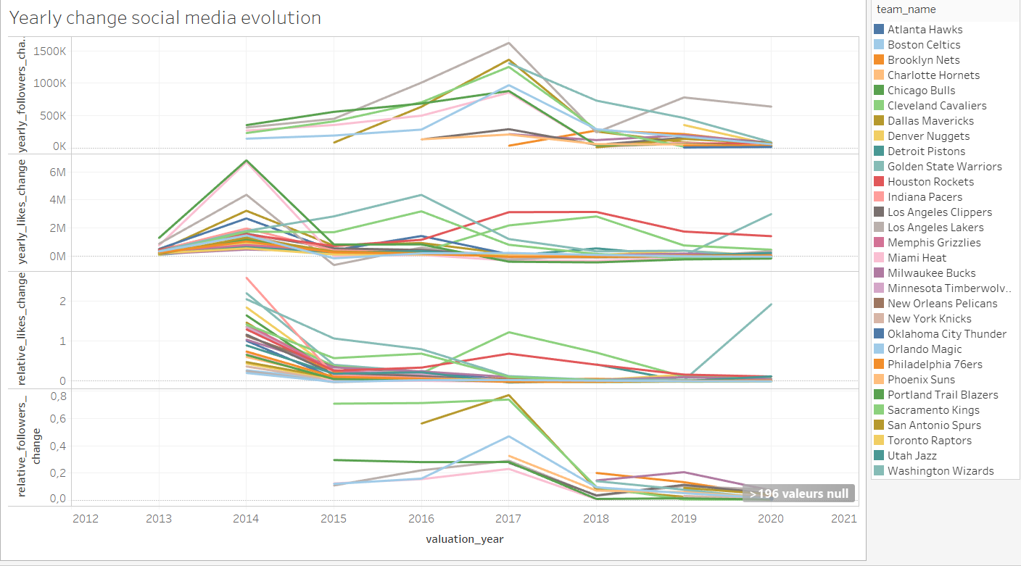
Basic analyis: social media Yearly change evolution

Slide 16
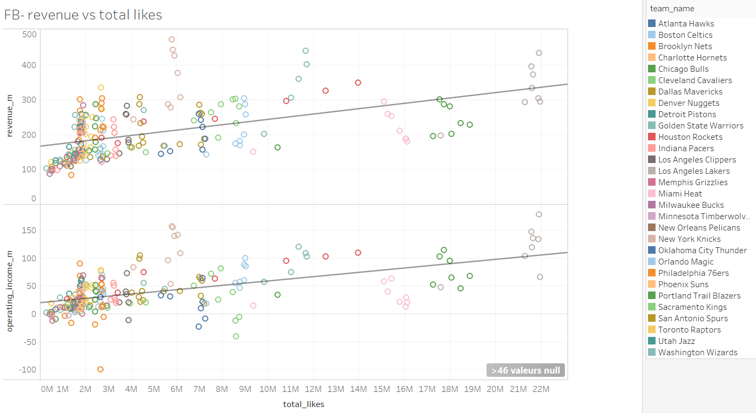
Basic analyis: revenue vs total FB likes

Slide 17
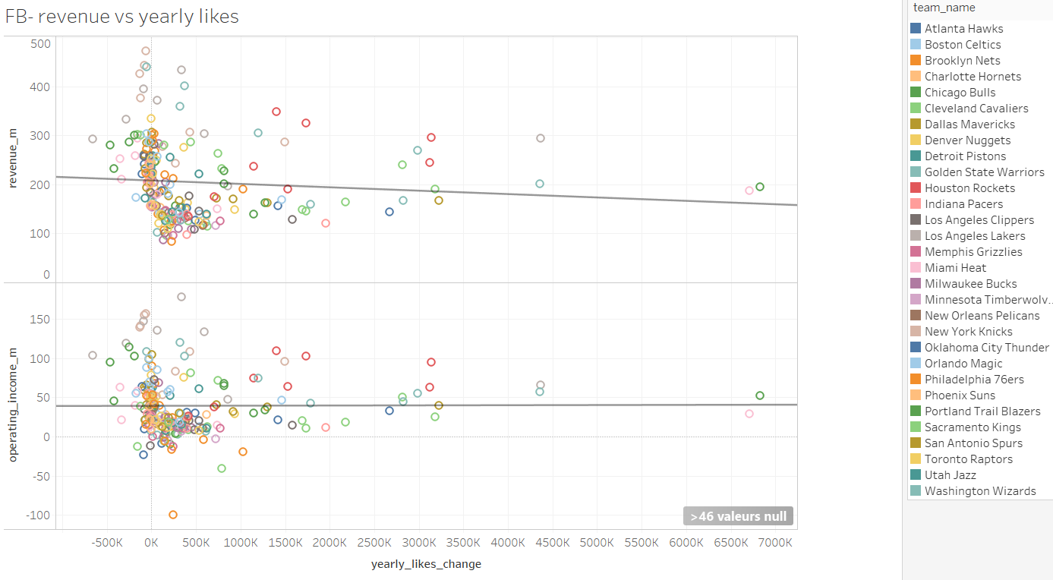
Basic analyis: revenue vs yearly FB like change

Slide 18
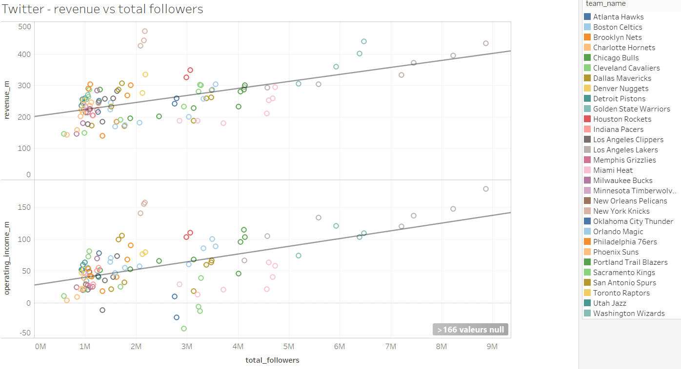
Basic analyis: revenue vs total twitter followers

Slide 19
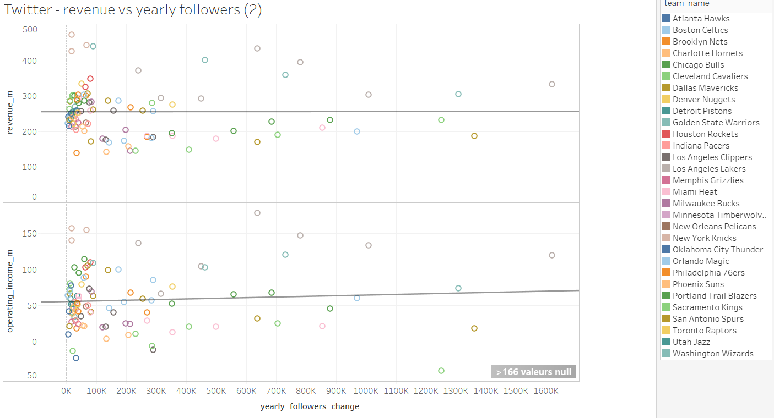
Basic analyis: revenue vs yearly twitter followers change

