Slide 1
特徵工程

Slide 2
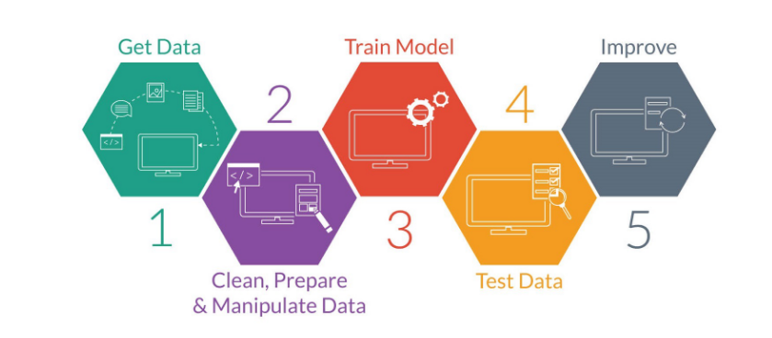
https://blog.techbridge.cc/2017/11/24/python-data-science-and-machine-learning-scikit-learn-basic-tutorial/

Slide 3
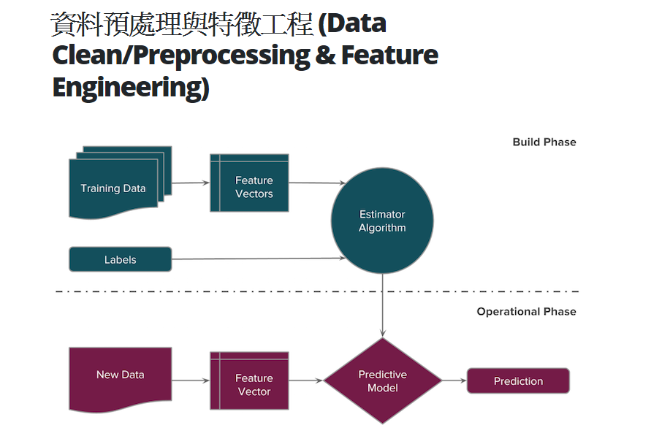
https://blog.techbridge.cc/2017/11/24/python-data-science-and-machine-learning-scikit-learn-basic-tutorial/

Slide 4
FEATURE SELECTION: METHODS
FILTER METHODS
WRAPPER METHODS
EMBEDDED METHODS

Slide 5
FILTER METHODS
Rely on the characteristics of the data (feature characteristics)
Do not use machine learning algorithms
Model agnostic
Tend to be less computationally expensive
Usually give lower prediction performance than a wrapper methods
Are very well suited for a quick screen and removal of irrelevant features

Slide 6
FILTER METHODS | RANKING CRITERIA
Feature scores on various statistical tests:
Chi-square | Fisher Score
Univariate parametric tests (anova)
Mutual information
Variance
Constant features
Quasi-constant features

Slide 7
WRAPPER METHODS
Use predictive machine learning models to score the feature subset
Train a new model on each feature subset
Tend to be very computationally expensive
Usually provide the best performing feature subset for a given machine learning algorithm
They may not produce the best feature combination for a different machine
learning model

Slide 8
WRAPPER METHODS
Evaluate the features in the light of a specific machine learning algorithm
Evaluate subsets of variables
Detect interactions between variables
Find the optimal feature subset for the desired classifier

Slide 9
WRAPPER METHODS | PROCEDURE
Search for a subset of features
Build a machine learning model on the selected feature subset
Evaluate model performance
Repeat ➢
How to search for the subset of features?
How to stop the search?

Slide 10
WRAPPER METHODS | SUMMARY
Better predictive accuracy than filter methods
Best performing feature subset for the predefined classifier
Computationally expensive
Stopping criteria is relatively arbitrary

Slide 11
EMBEDDED METHODS
Perform feature selection as part of the model construction process
Consider the interaction between features and models
They are less computationally expensive than wrapper methods, because they fit the machine learning model only once.

Slide 12
Embedded Methods
LASSO
Tree importance
Regression coefficients

