Slide 2
BINARY NUMBERS ADDITION
ICT 9 - Computer Systems Servicing

Slide 3
Get the value of-
11011=
110111=
100011=
11100011=
1001100=
11001100=

Slide 4
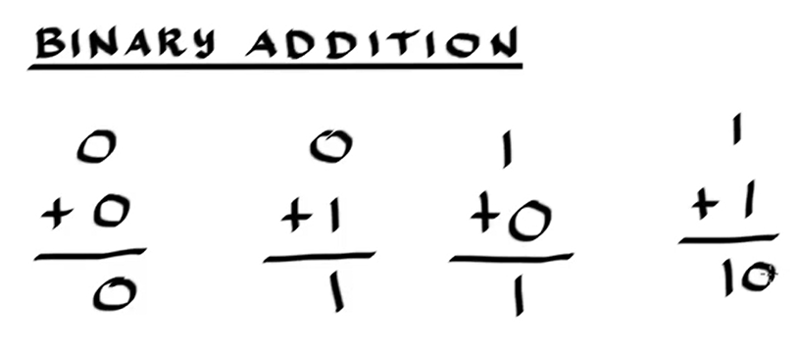

Slide 5
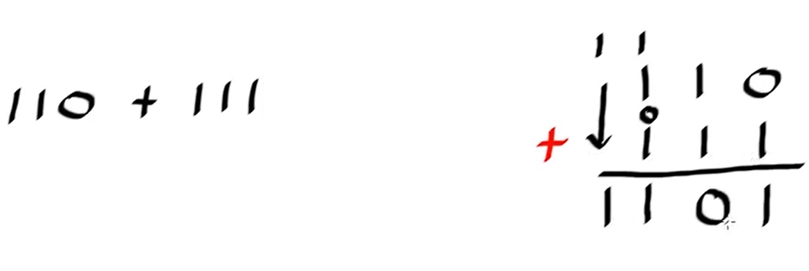
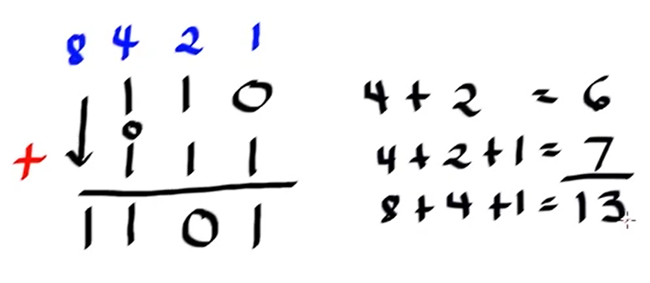

Slide 6
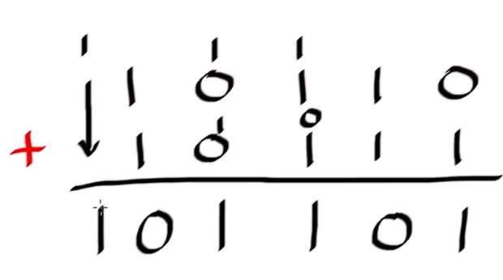
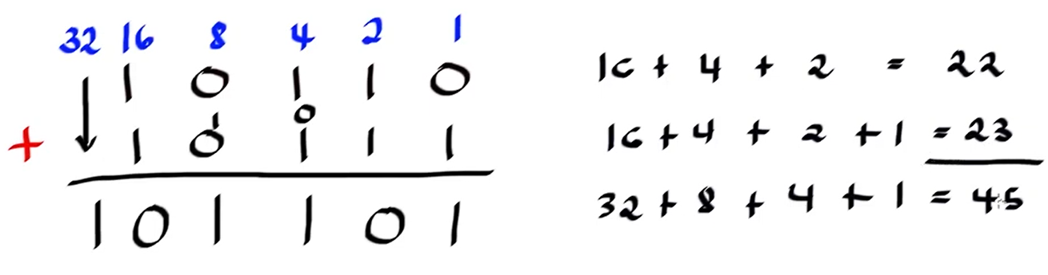

Slide 7
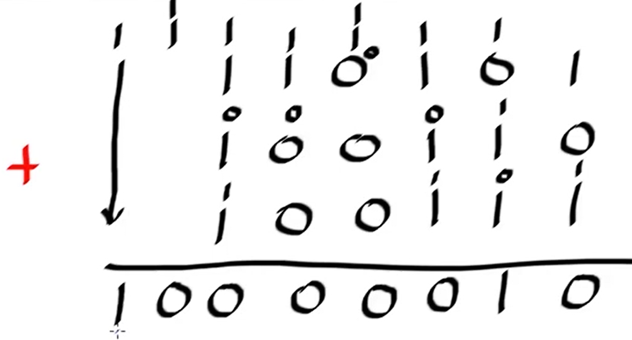
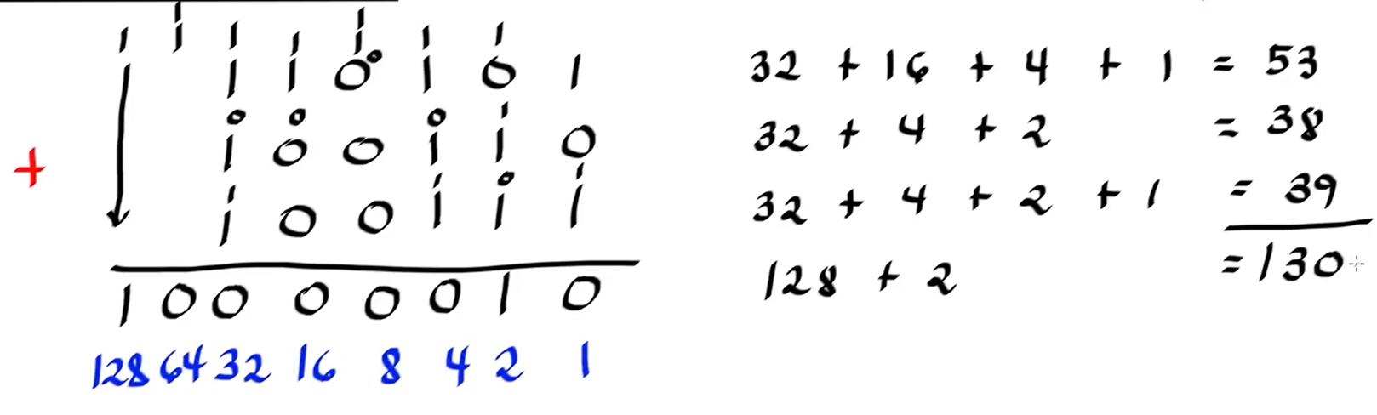

Slide 8
Appetizer #8: Add the binary numbers-
111010 + 111001=
2.110011 + 110110=
3.100001 + 111000=
4.10011 + 1100=
5.11100 + 11000=
6. 11100 + 1100=

Slide 9
Appetizer #6: Convert bytes into KB, MB, GB, TB and PB
250GB to KB
10TB to B
1024KB to PB
5GB to KB
2048MB to TB

Slide 10
Appetizer #7: Convert the equivalent value of the following-
Example: 2¹⁰= 1,024KB
2²⁵= 6. 2¹¹=
2⁸= 7. 2⁴⁰=
2³²= 8. 2³⁷=
2¹⁸= 9. 2⁴⁵=
2⁵⁰= 10. 2⁵=

Slide 11
Thank You
for Learning
Teacher Mavic

Slide 12
BINARY NUMBERS subtraction
ICT 9 - Computer Systems Servicing

Slide 13
BINARY NUMBERS multiplication
ICT 9 - Computer Systems Servicing

Slide 14
BINARY NUMBERS division
ICT 9 - Computer Systems Servicing

