Slide 1
WebConX AI Executive Brief
Executive audience | Faster service resolution, safer operations, clearer client experience
Executive View
Operational Outcome
Why It Matters
The assistant shortens turnaround for routine automation requests.
Users receive clearer next steps when information is missing.
High-risk actions keep explicit human confirmation.
Search, export, update, and retirement workflows use one consistent service pattern.
The platform handles duplicate names and folder context more reliably.
Responses stay business-friendly even when requests are informal.
Lower support effort
Better client confidence
More predictable service quality

Slide 2




Executive Framing
The experience is designed to improve service speed and governance together, not trade one for the other.
Fast
Safe
Clear
Consistent
Common requests
Controlled actions
Readable replies
Shared runtime
Faster resolution
Stronger control
Better client experience
Scalable model
Routine requests move faster because the platform recognizes the common patterns immediately.
That improves response time without adding more manual triage.
Sensitive actions such as deletion remain governed by confirmation and application rules.
The AI improves guidance, not authority.
People can ask naturally and still get a clear, business-readable answer.
That lowers friction for self-service usage.
One service pattern supports multiple workflows.

Slide 3
Service Scenarios
From an executive lens, the value comes from faster handling of the most common client requests.
Find
Share
Locate the right automation asset quickly
Useful when stakeholders know only part of the name or project
Provide an export in the requested format
Reduces manual handoff and speeds client follow-through
Change
Retire
Apply requested revisions with visible confirmation
Supports ongoing maintenance without a heavy support loop
Review before removing outdated assets
Helps prevent avoidable operational loss

Slide 4


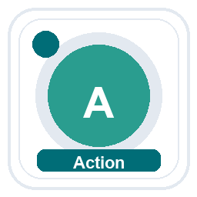

End-to-End Flowchart
One operating pattern handles search, download, delete, and update from request intake through user-ready response.
Request Intake
Intent Identification
Business Action
Structured Result
Clear Response
Request Intake
Intent Identification
Business Action
Structured Result
Clear Response
shared runtime
shared runtime
shared runtime
shared runtime
User asks in natural language
History keeps follow-up context
Deterministic parser first
LLM gate only for ambiguous phrasing
Search, download, delete, or update
Database and file operations stay deterministic
Status, tables, suggestions, download metadata
Delete stays confirmation-first
LLM rewrites output for readability
Business intent is preserved
Operation lanes
Search
Download
Delete
Update
Find the right test case quickly
Deliver the script in the requested format
Require review before permanent removal
Apply controlled changes with before/after feedback

Slide 5
Governance View
The assistant strengthens front-end experience while core platform rules still govern the action itself.
Control Points
Business Benefits
Executive Outcome
Application logic still decides the final action.
Deletion remains confirmation-first.
Folder context reduces the risk of acting on the wrong asset when names repeat.
Less rework from misunderstood requests
More predictable service delivery
Higher confidence in self-service interactions
A more polished client-facing support layer
Faster handling of common operational work
A credible foundation for broader AI-assisted service offerings

Slide 6
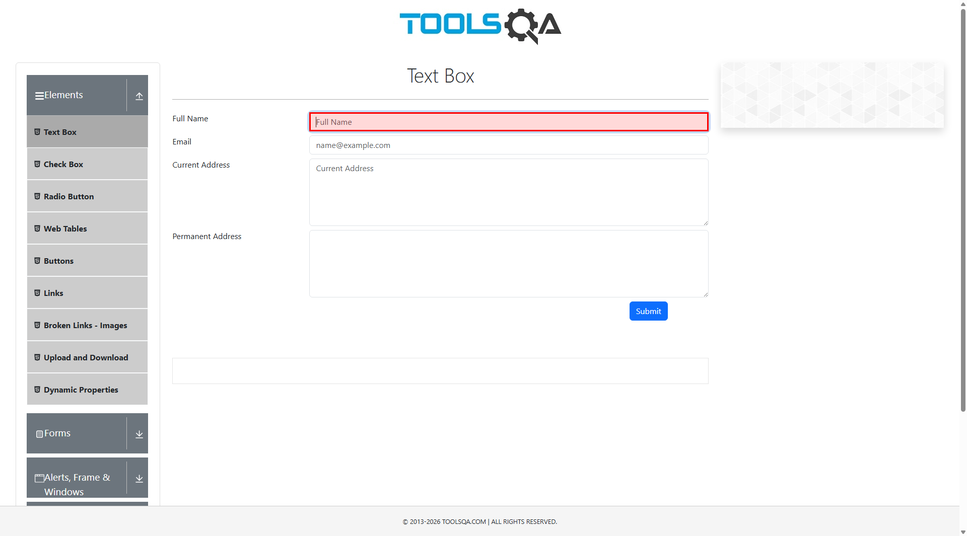
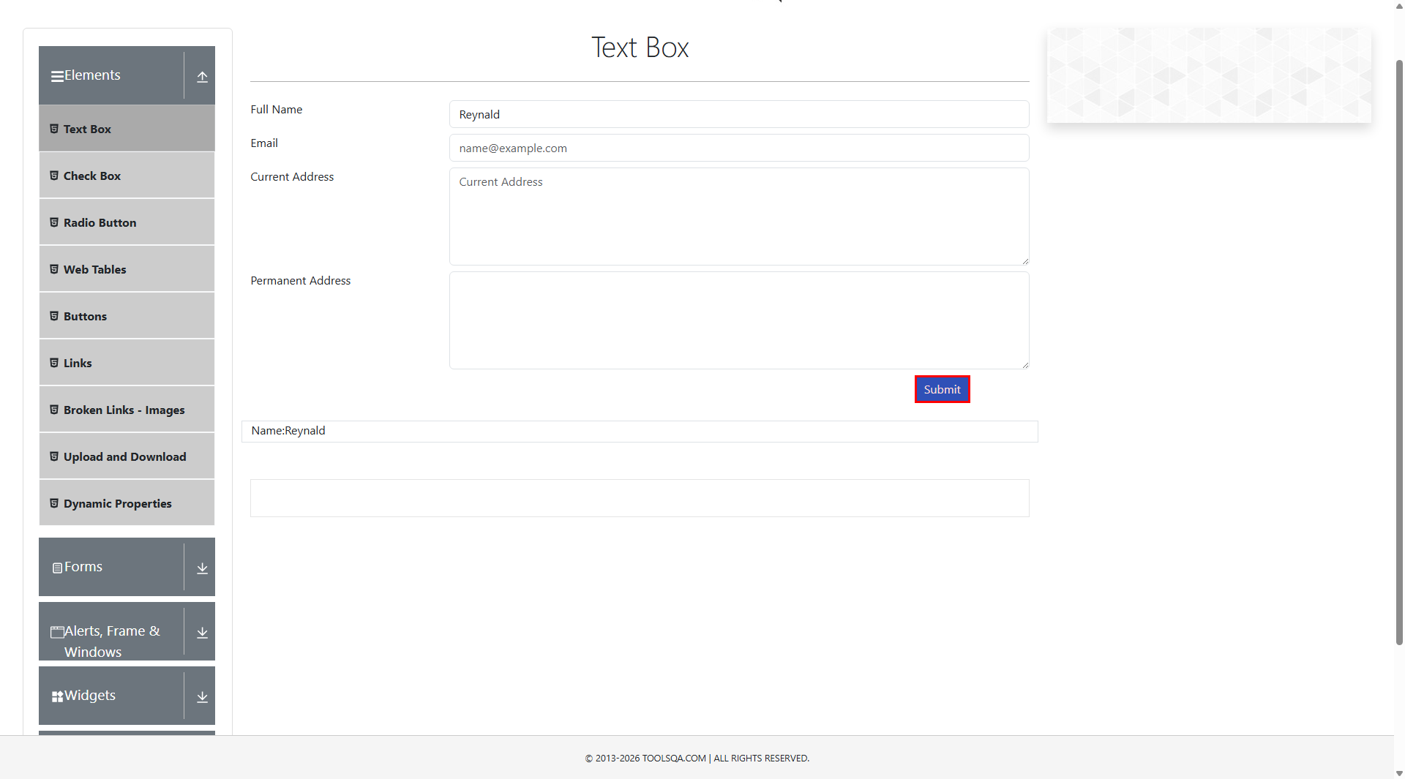
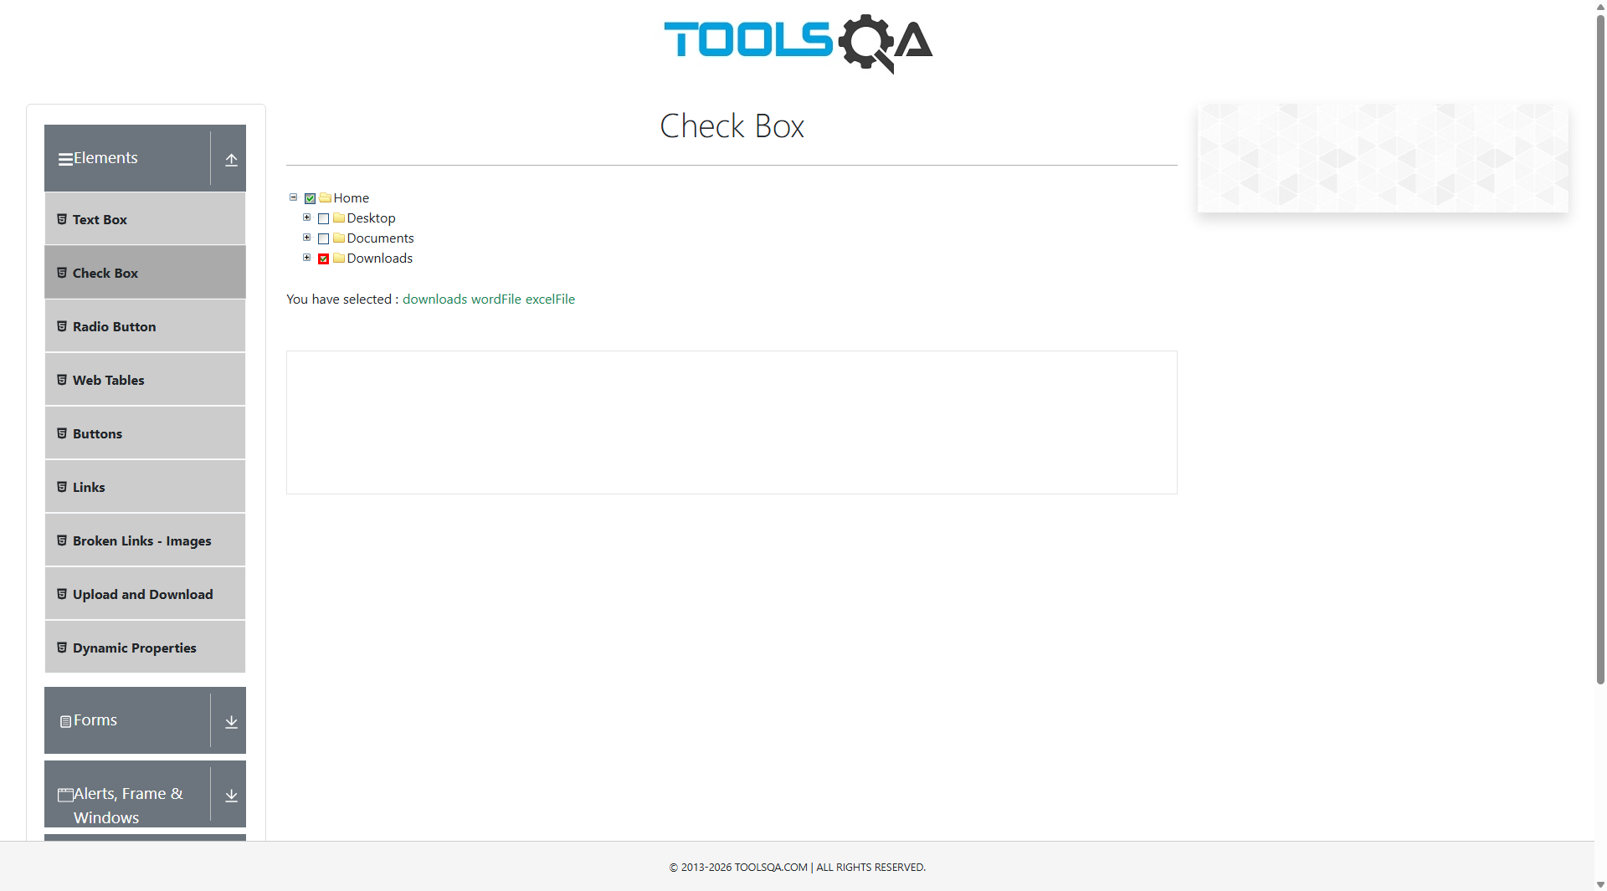
Product UI In Context
Real screenshots from the automation flow make the assistant story concrete: data entry, navigation, and resulting state are all visible in the product itself.
Capture
Progress
Result
The workflow begins inside the real application UI, not in a synthetic demo state.
Recorded interaction shows typed values and action execution as the script advances.
The final state provides visible evidence that the underlying workflow completed successfully.
These screenshots come directly from the recorded run artifacts in logs/screenshots, so the deck ends with product evidence rather than abstract architecture alone.

