Slide 1
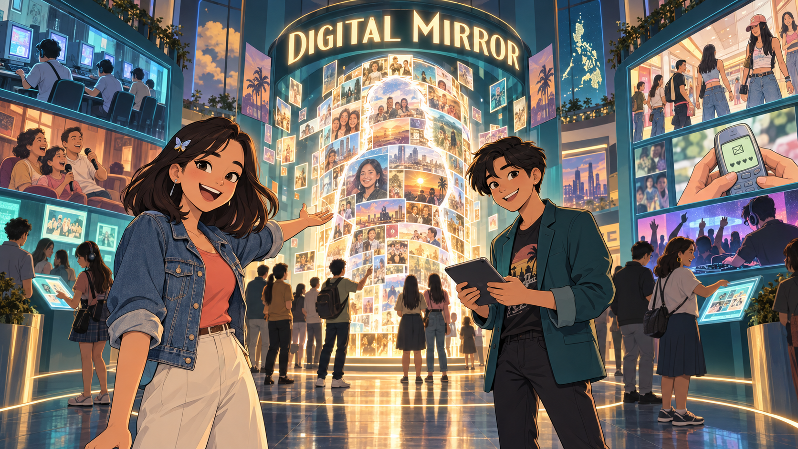
DIGITAL MIRROR
A Filipino 2000s story worth preserving
Before the feed, there was the Friendster testi.
Notes:
Good day. We are pitching Digital Mirror, a visual museum about Filipino popular culture from 2000 to 2010. This was the decade when a Friendster testimonial could strengthen a friendship, end a friendship, or reveal that your friend only knew three adjectives: nice, funny, and approachable. We want to preserve more than objects. We want to preserve how television, fashion, performance, places, daily routines, technology, and globalization shaped Filipino identity. With your support, these memories become an interactive public experience rather than a folder called old pics final final two.

Slide 2
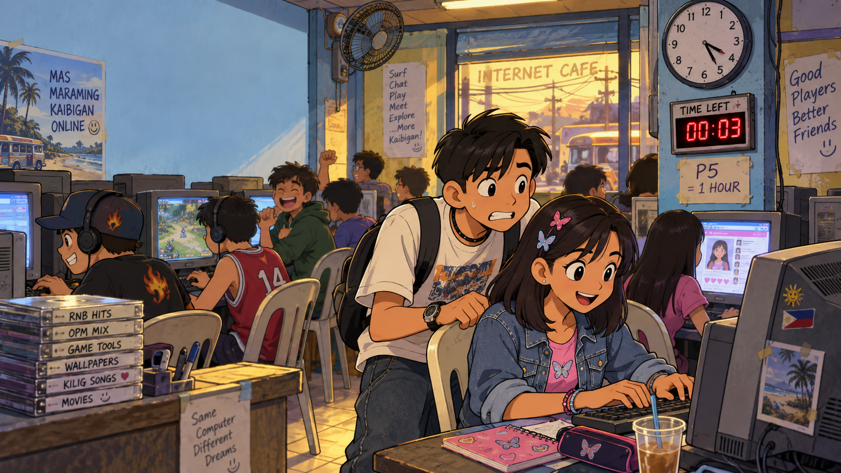
THE MEMORY GAP
We remember the feeling. The context is fading.
Three minutes left. Save the project!
Notes:
The challenge is not that people forgot the 2000s. We remember very specific things. We remember television theme songs, unlimited texting, computer shops, videoke, and hairstyles that required commitment and possibly industrial equipment. What disappears is the connection between those memories and the larger cultural changes. Why did Friendster affect belonging? Why did malls and call-center districts change social space and time? Why did Korean, Taiwanese, Japanese, American, and European influences feel local after Filipinos adapted them? Digital Mirror gives those memories a structure, so nostalgia becomes cultural understanding.

Slide 3
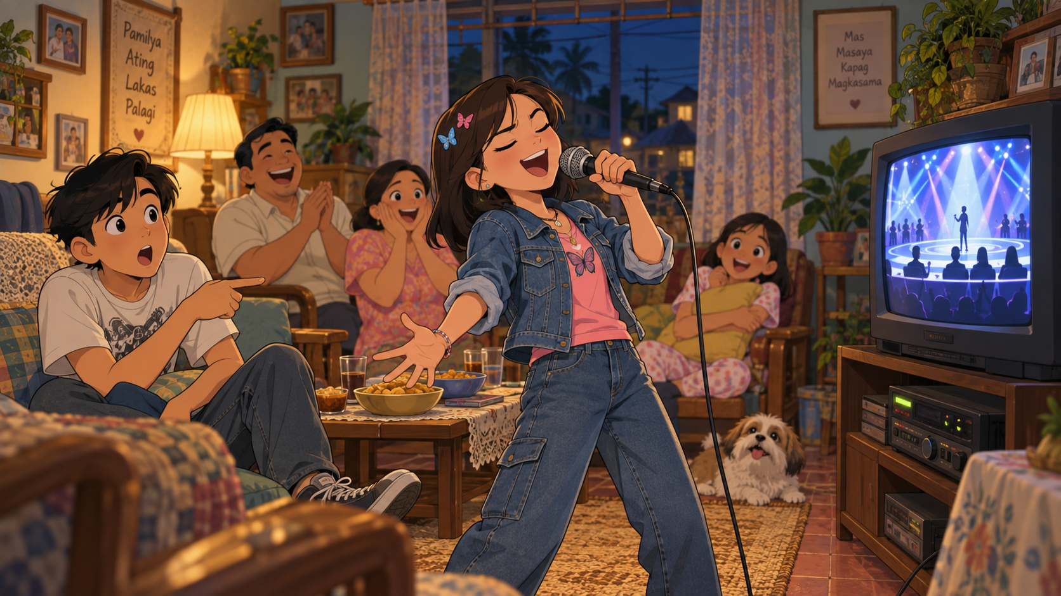
FEELINGS & PERFORMANCE
Television, videoke, and belonging filled the room
Confidence: 100%. Pitch accuracy: classified.
Notes:
Our museum uses seven lenses from the source material. Feelings covers excitement, kilig, belonging, and shared memories. Body and self-image examines fashion, hair, beauty, and identity. Performance includes karaoke, school competitions, bands, television, and audience participation. Space moves between malls, coffee shops, call-center districts, computer shops, and online communities. Time studies primetime routines, night shifts, and late-night unli-text. Technology follows phones, Friendster, cameras, gaming, and early online video. Globalization shows how Filipinos adapted influences from East Asia, the United States, and Europe. The galleries work together like one large mirror.

Slide 4
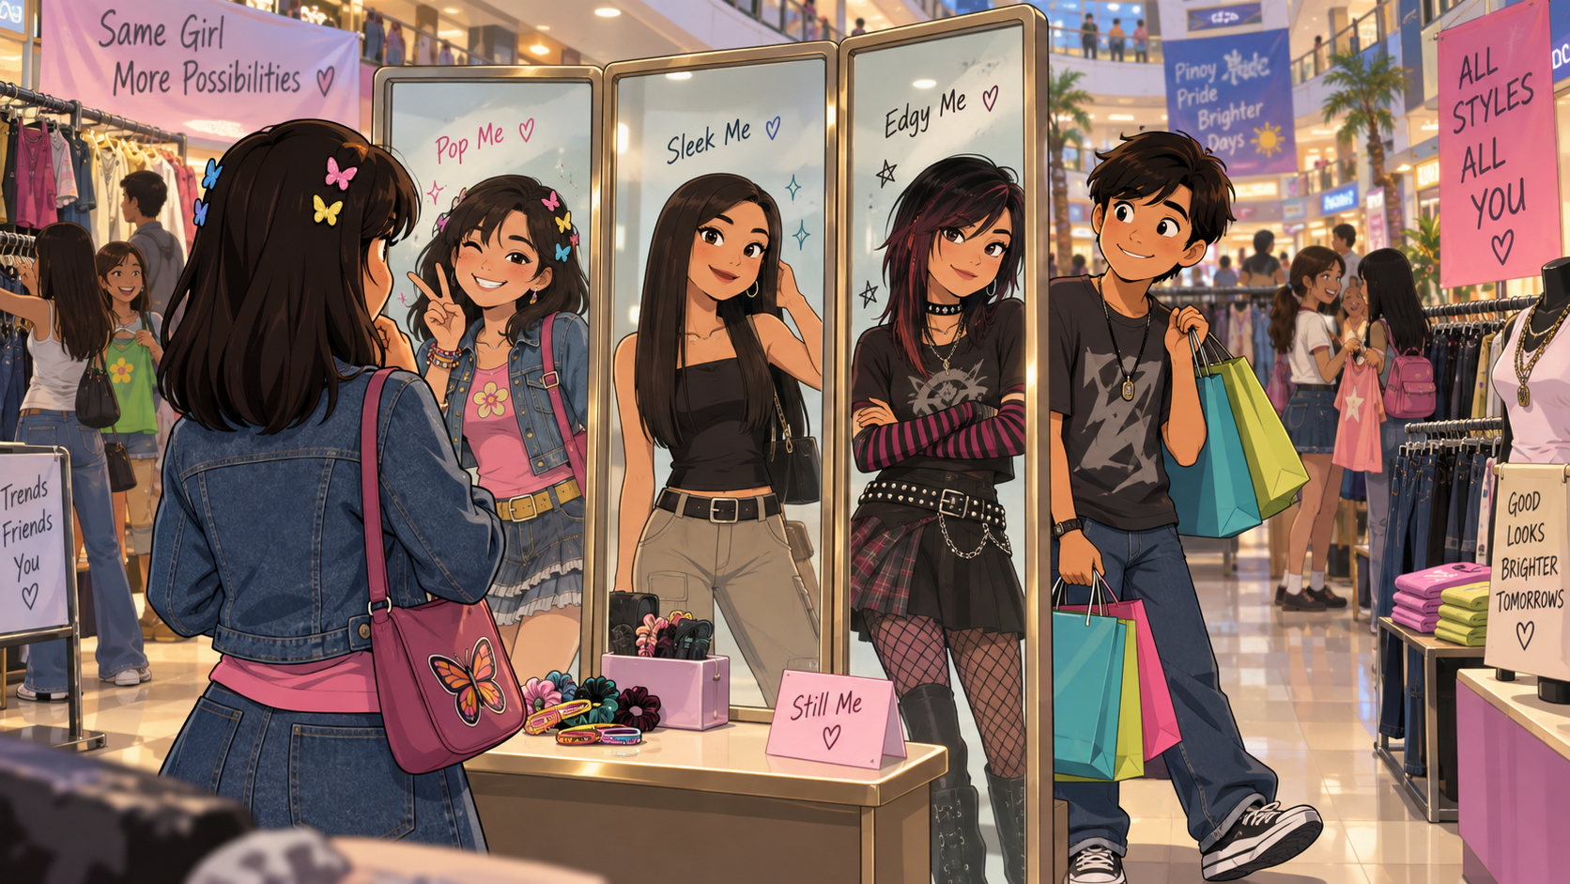
BODY & SELF-IMAGE
Fashion became a way to test who we could be
One person. Three hairstyles. Zero regrets.
Notes:
The experience follows five steps. Visitors enter through a digital mirror that asks what shaped them. They choose a memory category, then interact with sound, images, prompts, and comparisons. Next, they contribute a short story or voice memory. The final screen creates a personal culture mirror that they can share. This is important because museums usually speak to visitors. Digital Mirror also listens. And yes, we will apply moderation, because the internet taught us one thing before anything else: never leave an open text box completely unattended.

Slide 5
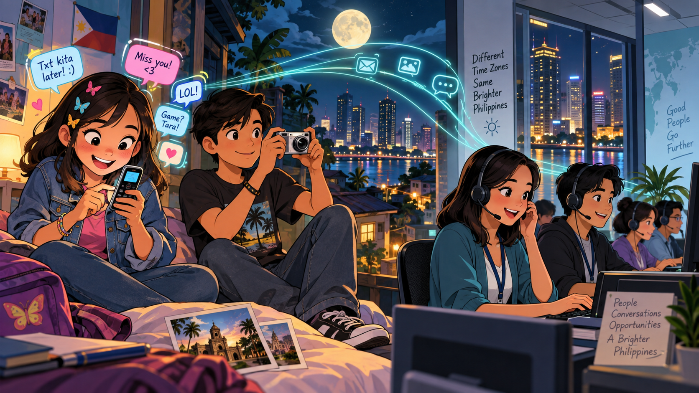
SPACE, TIME & TECHNOLOGY
Unli-text nights met a newly global workday
Good morning, Manila. Good evening, client.
Notes:
These exhibits make the museum memorable. The Friendster booth asks visitors to write a testimonial for their younger self, then connects that performance of identity to today’s social media. The computer-shop countdown recreates the very specific stress of having twelve minutes left, an unsaved assignment, and someone shouting that it is their turn. The kilig room explores how Asian dramas changed emotion, language, and fandom. The videoke meter rewards participation rather than pitch, which is both culturally accurate and merciful. Humor gets people inside; interpretation gives the experience lasting value.

Slide 6
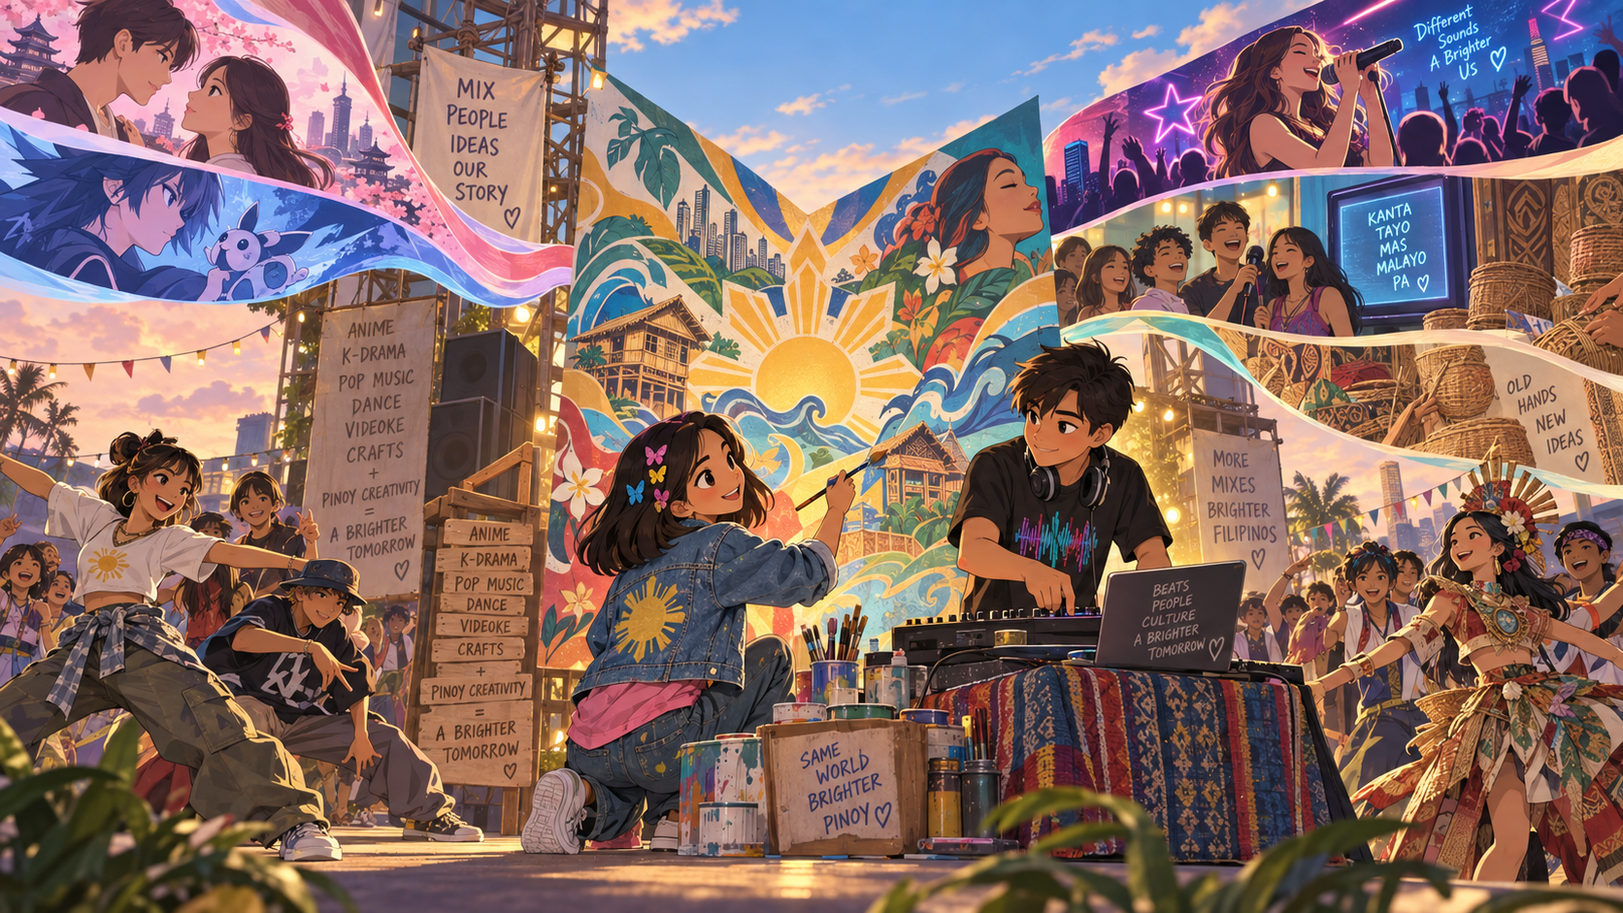
GLOBAL INFLUENCE, FILIPINO REMIX
Imported media became material for local creativity
We did not just copy culture. We remixed it.
Notes:
Our tone matters. We are not building a lecture with neon wallpaper. We use humor because recognition creates attention. A visitor laughs at the computer-shop timer, then learns how paid access shaped time, friendship, and digital literacy. A Friendster testimonial looks simple, but it reveals early public identity management. The familiar line nice, funny, approachable becomes evidence of how young Filipinos learned to present themselves online. The joke opens the door. The interpretation makes sponsors part of something worth remembering, discussing, and sharing.

Slide 7
A MUSEUM THAT LISTENS BACK
Visitors recognize, interact, contribute, and reflect
Your memory is part of the collection.
Notes:
Digital Mirror reaches several audiences without diluting the idea. Students gain a research experience that feels discoverable. Millennials recognize their own memories and contribute context. Families compare generations. Educators gain material organized through clear cultural lenses. Creative communities can add local perspectives. Sponsors receive meaningful visibility around culture, learning, and digital access. The project avoids treating 2000 to 2010 as one identical national experience. Instead, it invites people to compare what they remember, where they lived, and which technologies they could access.

Slide 8
WHO ENTERS THE MIRROR?
Students, families, educators, and creative communities
Different memories. One shared conversation.
Notes:
Sponsors fund cultural preservation, but they also receive practical value. The project creates visible brand presence at entry, within selected galleries, in launch materials, and in the final project report. We will measure visits, exhibit completion, submitted stories, and audience feedback. Sponsor visibility will remain clear without turning the museum into an advertisement. Visitor stories and personal information require consent and careful handling. That balance matters. People should remember who helped build the museum, not feel that the museum followed them home with a sales notification.

Slide 9
THE PILOT
Seven galleries, three interactions, twenty living stories
Small enough to prove. Strong enough to grow.
Notes:
We propose a focused pilot rather than an oversized first build. The pilot delivers a responsive web museum, seven galleries, three interactive experiences, twenty curated memory stories, a public launch, and a sponsor report. Our proposed funding allocation places thirty-five percent in experience and development, twenty-five percent in content and research, twenty percent in visual and audio production, twelve percent in launch and outreach, and eight percent in accessibility and contingency. These percentages guide planning; final amounts will follow the sponsor scope and procurement requirements. A pilot lets us test, measure, improve, and expand responsibly.

Slide 10
FUND THE MIRROR
Help turn nostalgia into a public cultural archive
Nice. Funny. Approachable. Finally archived.
Notes:
We are asking you to fund the Digital Mirror pilot. Your support will turn a decade of Filipino memories into a museum that people can enter, question, and continue. The project combines research with humor, participation, and accessible digital design. It preserves the emotional texture of the 2000s while explaining how culture shaped bodies, spaces, routines, technology, and identity. We have the concept, the content structure, and a focused pilot plan. With your investment, the mirror becomes public. And finally, nice, funny, approachable can receive the archive it has always deserved. Thank you.

