Slide 1
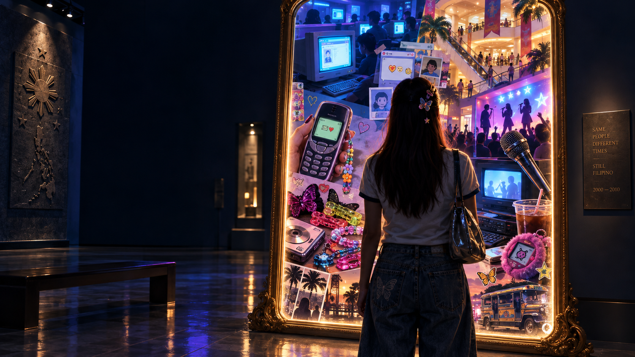
DIGITAL
MIRROR
A living visual museum of Filipino popular culture, 2000–2010
Sponsor pitch • 10-minute presentation
We saved the Friendster testimonials.
Now let us save what they meant.
Notes:
Good day. We are pitching Digital Mirror, a visual museum about Filipino popular culture from 2000 to 2010. This was the decade when a Friendster testimonial could strengthen a friendship, end a friendship, or reveal that your friend only knew three adjectives: nice, funny, and approachable. We want to preserve more than objects. We want to preserve how television, fashion, performance, places, daily routines, technology, and globalization shaped Filipino identity. With your support, these memories become an interactive public experience rather than a folder called old pics final final two.

Slide 2
The memory gap
A generation remembers the feeling, but the cultural context is disappearing
We remember…
But memory alone cannot explain
the PBB theme song
unli-text after midnight
how media shaped feelings
how fashion shaped self-image
how new spaces changed behavior
how technology changed relationships
how global culture became Filipino
one paid hour at the computer shop
rebonded hair surviving humidity
videoke confidence at 2% accuracy
Digital Mirror connects the joke to the meaning.
DIGITAL MIRROR • SPONSOR PITCH
02
Notes:
The challenge is not that people forgot the 2000s. We remember very specific things. We remember television theme songs, unlimited texting, computer shops, videoke, and hairstyles that required commitment and possibly industrial equipment. What disappears is the connection between those memories and the larger cultural changes. Why did Friendster affect belonging? Why did malls and call-center districts change social space and time? Why did Korean, Taiwanese, Japanese, American, and European influences feel local after Filipinos adapted them? Digital Mirror gives those memories a structure, so nostalgia becomes cultural understanding.

Slide 3
Seven views of one decade
Each gallery reflects a different way popular culture shaped everyday life
01
02
03
04
FEELINGS
SELF-IMAGE
PERFORMANCE
SPACE
kilig, belonging, excitement
fashion, hair, confidence
singing, dance, television
malls, cafes, internet shops
05
06
07
TIME
TECHNOLOGY
GLOBALIZATION
primetime, night shifts, unli-text
SMS, Friendster, cameras
Asian and Western influences
DIGITAL MIRROR • SPONSOR PITCH
03
Notes:
Our museum uses seven lenses from the source material. Feelings covers excitement, kilig, belonging, and shared memories. Body and self-image examines fashion, hair, beauty, and identity. Performance includes karaoke, school competitions, bands, television, and audience participation. Space moves between malls, coffee shops, call-center districts, computer shops, and online communities. Time studies primetime routines, night shifts, and late-night unli-text. Technology follows phones, Friendster, cameras, gaming, and early online video. Globalization shows how Filipinos adapted influences from East Asia, the United States, and Europe. The galleries work together like one large mirror.

Slide 4
The visitor experience
A five-step journey from recognition to contribution
1
ENTER
A glowing mirror asks: “What made you, you?”
A museum
that listens
back
2
CHOOSE
Pick a memory: TV, fashion, music, place, or technology
3
INTERACT
Hear, compare, remix, and respond to an exhibit
Visitors leave
with a memory
and add one.
4
CONTRIBUTE
Add a short story, photo caption, or voice memory
5
REFLECT
Receive a personal “culture mirror” to share
DIGITAL MIRROR • SPONSOR PITCH
04
Notes:
The experience follows five steps. Visitors enter through a digital mirror that asks what shaped them. They choose a memory category, then interact with sound, images, prompts, and comparisons. Next, they contribute a short story or voice memory. The final screen creates a personal culture mirror that they can share. This is important because museums usually speak to visitors. Digital Mirror also listens. And yes, we will apply moderation, because the internet taught us one thing before anything else: never leave an open text box completely unattended.

Slide 5
Signature exhibits
Four interactive moments that turn familiar memories into cultural evidence
FRIENDSTER TESTIMONIAL BOOTH
COMPUTER SHOP COUNTDOWN
Write a testimonial for your 2005 self. Then compare how online identity changed.
A timer recreates the pressure of 12 minutes left and no saved school project.
KILIG TRANSLATION ROOM
VIDEOKE CONFIDENCE METER
Visitors map how Taiwanese and Korean dramas shaped emotion, language, and fandom.
The system measures participation, not pitch. Democracy survives another chorus.
DIGITAL MIRROR • SPONSOR PITCH
05
Notes:
These exhibits make the museum memorable. The Friendster booth asks visitors to write a testimonial for their younger self, then connects that performance of identity to today’s social media. The computer-shop countdown recreates the very specific stress of having twelve minutes left, an unsaved assignment, and someone shouting that it is their turn. The kilig room explores how Asian dramas changed emotion, language, and fandom. The videoke meter rewards participation rather than pitch, which is both culturally accurate and merciful. Humor gets people inside; interpretation gives the experience lasting value.

Slide 6
A museum people will quote
Humor creates recognition; reflection creates value
“You were not offline.
You were waiting for your turn.”
FRIENDSTER
TESTIMONIAL
“Nice, funny, approachable.
Stay who you are.
Thanks for the testi.”
Computer shops turned limited access into shared time, multiplayer friendships, and digital literacy.
Translation: early public identity management.
The laugh opens the door. The exhibit explains why the memory matters.
DIGITAL MIRROR • SPONSOR PITCH
06
Notes:
Our tone matters. We are not building a lecture with neon wallpaper. We use humor because recognition creates attention. A visitor laughs at the computer-shop timer, then learns how paid access shaped time, friendship, and digital literacy. A Friendster testimonial looks simple, but it reveals early public identity management. The familiar line nice, funny, approachable becomes evidence of how young Filipinos learned to present themselves online. The joke opens the door. The interpretation makes sponsors part of something worth remembering, discussing, and sharing.

Slide 7
Who enters the mirror
The concept connects generations instead of serving one nostalgia audience
STUDENTS
MILLENNIALS
FAMILIES
A research experience that feels like discovery
Recognition, memory, and a chance to contribute
Stories that move between parents and children
EDUCATORS
CREATIVE COMMUNITIES
SPONSORS
Material organized through seven cultural lenses
A platform for local stories and interpretation
Visible support for culture, education, and digital access
One decade. Different memories. A shared Filipino conversation.
DIGITAL MIRROR • SPONSOR PITCH
07
Notes:
Digital Mirror reaches several audiences without diluting the idea. Students gain a research experience that feels discoverable. Millennials recognize their own memories and contribute context. Families compare generations. Educators gain material organized through clear cultural lenses. Creative communities can add local perspectives. Sponsors receive meaningful visibility around culture, learning, and digital access. The project avoids treating 2000 to 2010 as one identical national experience. Instead, it invites people to compare what they remember, where they lived, and which technologies they could access.

Slide 8
Sponsor value
Funding supports a visible public experience with measurable participation
01
CULTURAL PRESERVATION
Help document ordinary memories before they disappear.
02
YOUTH ENGAGEMENT
Connect research with interaction, humor, and contribution.
03
BRAND PRESENCE
Receive credit at entry, selected galleries, launch materials, and the project report.
04
MEASUREMENT
Track visits, exhibit completion, submitted stories, and audience feedback.
Sponsor recognition remains visible; visitor trust remains protected.
DIGITAL MIRROR • SPONSOR PITCH
08
Notes:
Sponsors fund cultural preservation, but they also receive practical value. The project creates visible brand presence at entry, within selected galleries, in launch materials, and in the final project report. We will measure visits, exhibit completion, submitted stories, and audience feedback. Sponsor visibility will remain clear without turning the museum into an advertisement. Visitor stories and personal information require consent and careful handling. That balance matters. People should remember who helped build the museum, not feel that the museum followed them home with a sales notification.

Slide 9
Pilot plan and funding use
A focused first release proves the experience before expansion
PILOT DELIVERABLES
PROPOSED FUNDING ALLOCATION
01
Responsive web museum
Experience & development
35%
02
Seven themed galleries
Content & research
25%
03
Three interactive experiences
Visual and audio production
04
Twenty curated memory stories
20%
05
One public launch and sponsor report
Launch & community outreach
12%
Accessibility & contingency
8%
Proposed allocation; final amounts follow sponsor scope and procurement.
DIGITAL MIRROR • SPONSOR PITCH
09
Notes:
We propose a focused pilot rather than an oversized first build. The pilot delivers a responsive web museum, seven galleries, three interactive experiences, twenty curated memory stories, a public launch, and a sponsor report. Our proposed funding allocation places thirty-five percent in experience and development, twenty-five percent in content and research, twenty percent in visual and audio production, twelve percent in launch and outreach, and eight percent in accessibility and contingency. These percentages guide planning; final amounts will follow the sponsor scope and procurement requirements. A pilot lets us test, measure, improve, and expand responsibly.

Slide 10
FUND THE MIRROR
Help turn a decade of Filipino memories into a museum people can enter, question, and continue.
SPONSOR THE PILOT
Because “nice, funny, approachable” deserves a proper archive.
DIGITAL MIRROR • VISUAL MUSEUM PITCH
Notes:
We are asking you to fund the Digital Mirror pilot. Your support will turn a decade of Filipino memories into a museum that people can enter, question, and continue. The project combines research with humor, participation, and accessible digital design. It preserves the emotional texture of the 2000s while explaining how culture shaped bodies, spaces, routines, technology, and identity. We have the concept, the content structure, and a focused pilot plan. With your investment, the mirror becomes public. And finally, nice, funny, approachable can receive the archive it has always deserved. Thank you.

