Slide 1



Voronoi-based Nearest Neighbor Search for Multi-Dimensional Uncertain Databases
Peiwu Zhang
Reynold Cheng
Nikos Mamoulis
Yu Tang
University of Hong Kong
Matthias Renz
Andreas Züfle
Tobias Emrich
Munich University

Slide 2
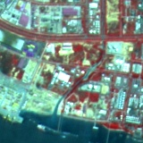
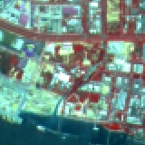


Data Uncertainty
Sensor network: temperature, humidity, wind speed
Satellite images:
location
RF-ID: location

Slide 3
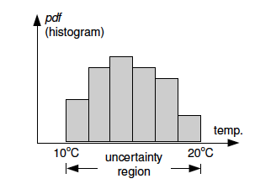
Uncertain Objects [TDRP98, ISSD99, VLDB04]
pdf
3D uncertainty region
2D uncertainty region

Slide 4
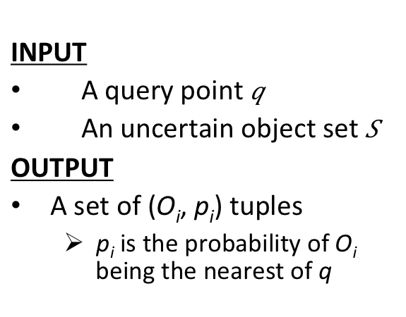
Probabilistic NN Query [TKDE04]
INPUT
A query point $q$
An uncertain object set $S$
OUTPUT
A set of (O_{i}, p_{i}) tuples
p_{i} is the probability of O_{i} being the nearest of q
O₅
O₃
Object Retrieval
15%
O₁
2. Probability
Computation
40%
Step 1 was done by
R-Tree
q
We study
Voronoi-based retrieval
O₄
30%
O₂
15%
O₆

Slide 5
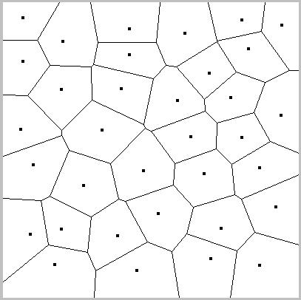
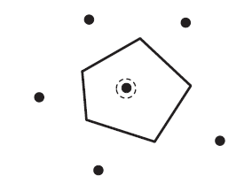
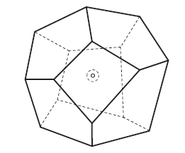
Voronoi Cells (for Point Objects)
Facilitates NN search
p
q
p
q
2D Voronoi diagram
2D Voronoi cell
3D Voronoi cell
Approximation of multi-dimensional Voronoi cell [ICDE98, IJCGA98]

Slide 6
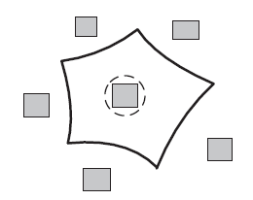
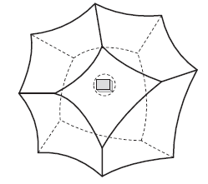
PV-cell (for Uncertain Objects)
Possible Voronoi cell (PV-cell) of object o
Uncertain version of Voronoi cell
Is a region V(o)
for any point p in V(o), o has some chance of being the NN of p.
o
o
2D PV-cell [ICDE10]
3D PV-cell (NEW!)

Slide 7
Answering PNNQ with PV-cells
o
q
o
q
2D PV-cell
3D PV-cell
Object retrieval:
For every V(o) of object o
If q is not in V(o), remove o
Index V(o) for efficient retrieval

Slide 8
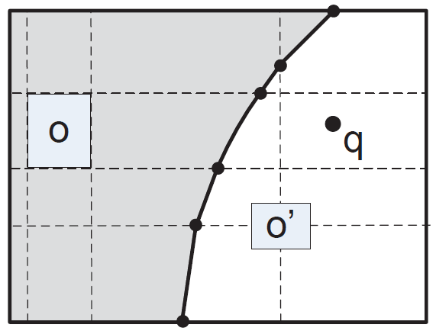
Problems of PV-cells
Edge of V(o)
min
max
Intersection of multi-dim curvilinear edges
Very high computation and storage cost
Impractical to find the exact PV-cell!
Notes:
To compute the equation, we need to partition the space into a number of grids and solve complex equations.

Slide 9
MBR of PV-cell
Can we find the MBR of the PV-cell (M(o))?
q
q
Theorem: There does not exist any polynomial-time algorithm for finding M(o)!
Notes:
To compute the equation, we need to partition the space into a number of grids and solve complex equations.

Slide 10

UBR of PV-cell
For querying purposes, an exact M(o) is not needed.
UBR: Uncertain Bounding Rectangle B(o)
We propose the Shrink-and-Expand (SE) algorithm to efficiently compute B(o).
This B(o) should be very close to M(o).

Slide 11
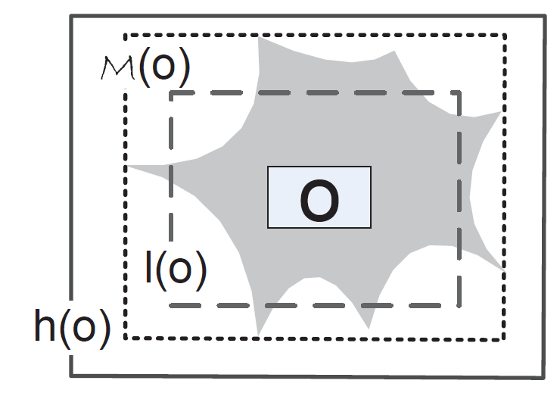
The SE algorithm
We estimate M(o) by constraining it with two rectangles:
Lower bound l(o)
Upper bound h(o)
Notes:
Shrink h(o): pruning regions that are not part of M(o)
Expand l(o): including regions that are inside M(o)

Slide 12
The SE algorithm
h(o): domain of o
Exclude or include?
“Spatial Domination”
l(o): uncertainty region of o
Half-line
Lemma: M(o) ≥ o’s uncertainty region

Slide 13
The SE algorithm
Finding B(o) needs only a logarithmic number of steps.
∆: accuracy of B(o)

Slide 14
The SE algorithm
Exclude or include?
“Spatial Domination”

Slide 15
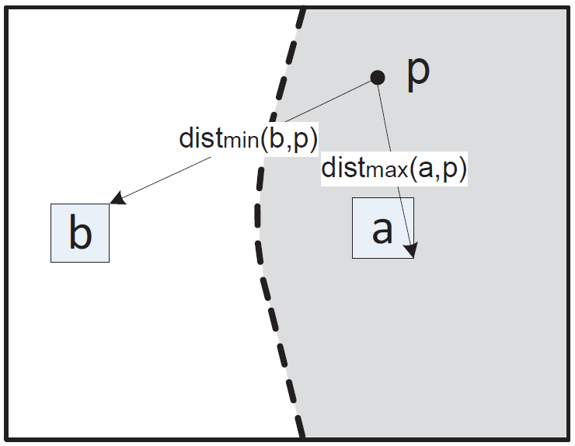
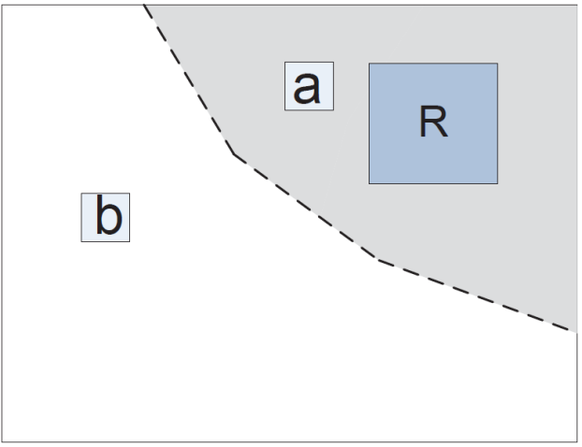
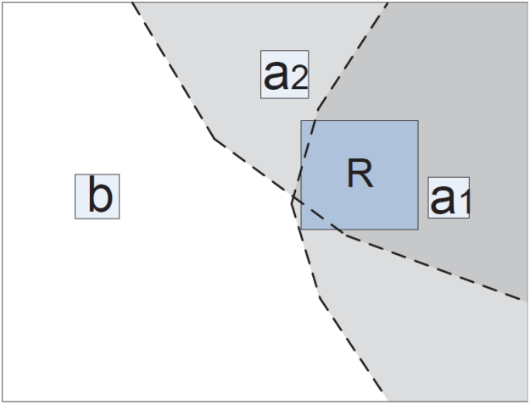
Dominated regions
a dominates b
over p
a dominates b
over R
Set domination: A={a1, a2} dominates b over R
The above concepts enable efficient shrinking and expansion (details in paper).

Slide 16
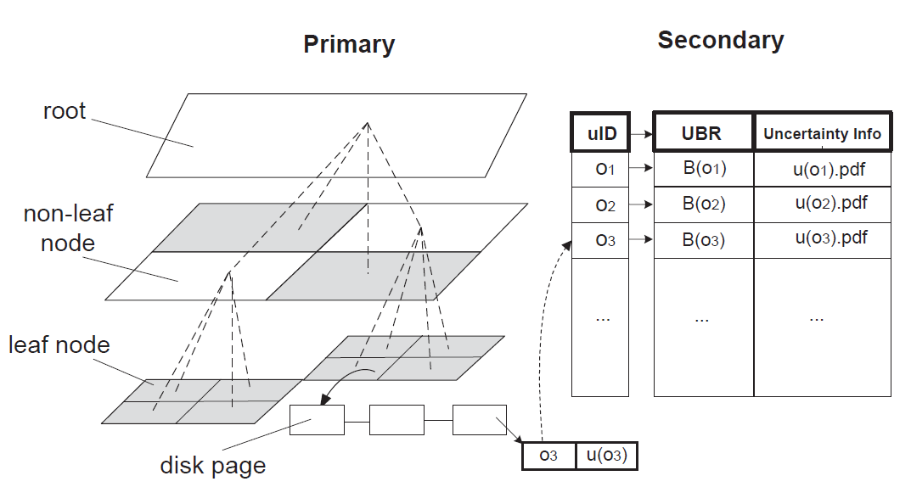
The PV-index
Indexes UBRs for PNNQ
Contain 2^{d} pointers to its children

Slide 17
Querying PV-index
q

Slide 18
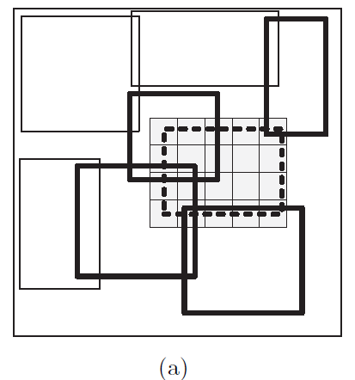
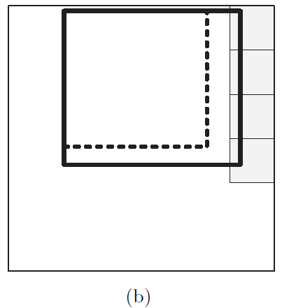
Updating the PV-index
The PV-index supports insertion and deletion
For deletion of object o,
Obtain B(o) from the secondary index
Find the UBRs affected by the deletion of o
Update these new UBRs
Delete o, and insert the updated UBRs to the index
Insertion is managed in a similar manner
Adaptation of SE

Slide 19
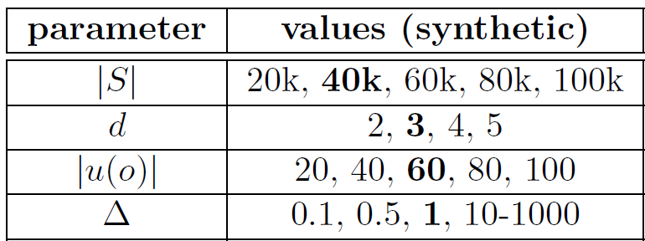
Experiments
Test for both synthetic and real datasets
For synthetic data,
Domain: [0, 10K]^{d}
Objects are uniformly distributed
An uncertainty pdf is represented by 500 points randomly sampled within the region
Dataset size: 0.2 – 1G

Slide 20
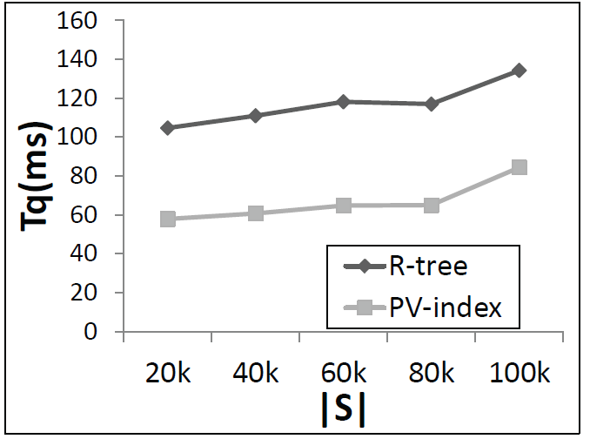
Query Performance Improvement
40% faster

Slide 21
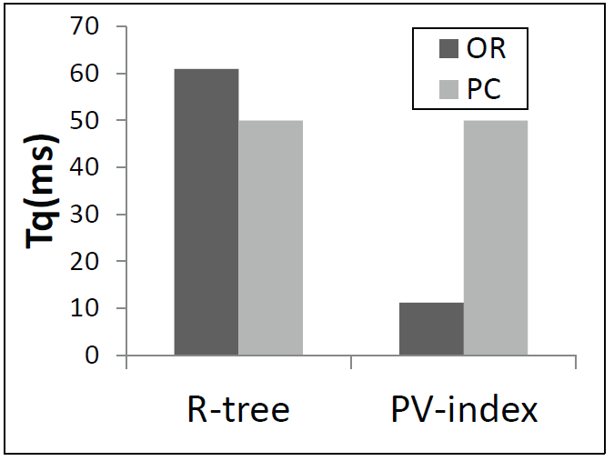
Query Analysis
Object Retrieval
Probability Computation
6 times
improvement

Slide 22
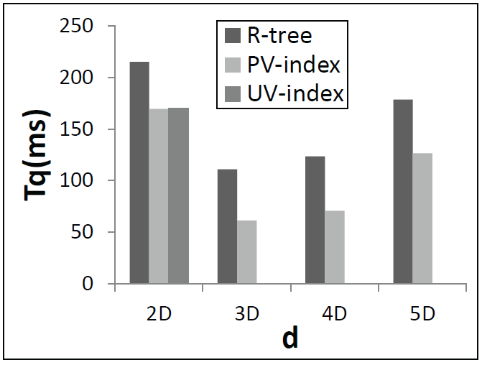
Effect of Dimensionality
UV-index [ICDE10]: for 2D PV-cells only
The construction time of the PV-index is
15 times faster than UV-index

Slide 23
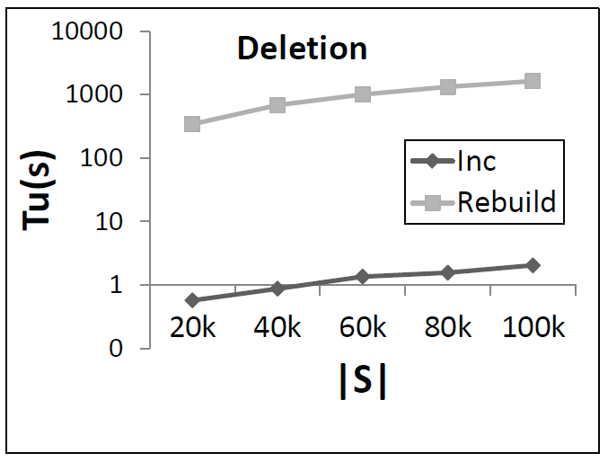
Index Update: Object Deletion
Randomly remove 1K objects from database
2 orders of
Magnitude
faster

Slide 24

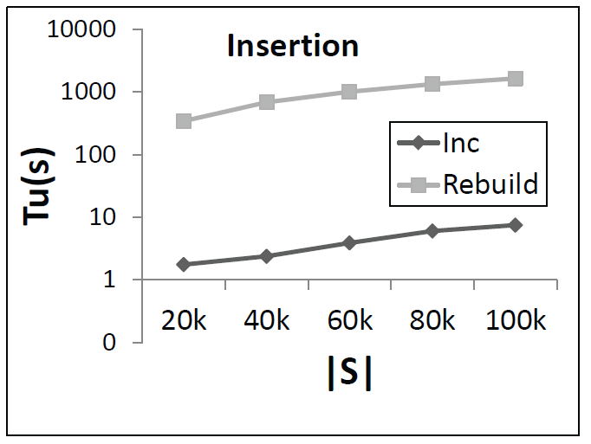
Index Update: Object Insertion
2 orders of
Magnitude
faster

Slide 25
Real Datasets
Roads (30k), rrlines (2D rectangles)
http://www.rtreeportal.org
Airports (3D coordinates of US airports with 10m-uncertainty region)
http://www.ourairports.com/data

Slide 26
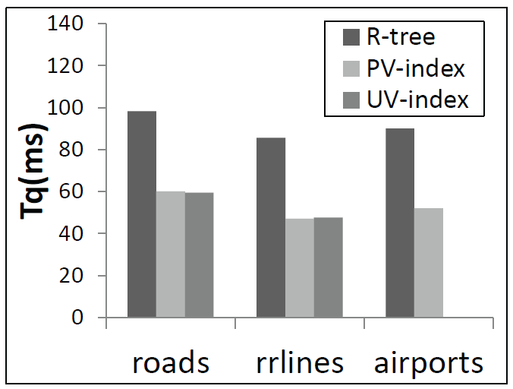
Query Performance
40%
faster
45%
faster

Slide 27
Real datasets: other results
The construction time of the PV-index is 15-25 times faster than UV-index.
Updating the PV-index is over 1000 times faster than rebuilding it.

Slide 28
Related Works
PNNQ evaluation
Object retrieval: R-tree [TKDE04], UV-index [ICDE10]
Probability computation: Verifiers [ICDE08], sampling [DASFAA07]
Voronoi diagram on uncertain data
Uncertain data clustering [ICDM08]
Expected Voronoi diagram [PODS12]
Continuous query over uncertain data [DKE12]
UV-index: PNNQ in 2D space [ICDE10]

Slide 29
Conclusions
PV-cell
Useful for answering PNNQ queries on multi-dimensional objects
The SE algorithm efficiently obtains UBRs
PV-index
Organizes UBRs for efficient PNNQ evaluation.
Enables incremental update

Slide 30
Future Work
Extend PV-index to support other variants of PNNQs, e.g. group NN and reverse NN queries
Study precomputation (e.g., bulkloading and compression) for other uncertainty models

Slide 31
Reference
[TDRP98] P. A. Sistla, O. Wolfson, S. Chamberlain, and S. Dao,“Querying the uncertain position of moving objects,” in Temporal Databases: Research and Practice, 1998.
[SSDBM99] D.Pfoser and C. Jensen, “Capturing the uncertainty of moving-objects representations,” in Proc. SSDBM, 1999.
[VLDB04a] A. Deshpande, C. Guestrin, S. Madden, J. Hellerstein, and W. Hong, “Model-driven data acquisition in sensor networks,” in Proc. VLDB, 2004.
[ICDE06] C. Böhm, A. Pryakhin, and M. Schubert, “The gauss-tree: Efficient object identification in databases of probabilistic feature vectors,” in Proc. ICDE, 2006.
[ICDE07a] V. Ljosa and A. K. Singh, “APLA: Indexing arbitrary probability distributions,” in Proc. ICDE, 2007.
[ICDE07b] J. Chen and R. Cheng, “Efficient evaluation of imprecise location-dependent queries,” in Proc. ICDE, 2007.
[VLDB04b] N. Dalvi and D. Suciu, “Efficient query evaluation on probabilistic databases,” in VLDB, 2004.
[TKDE04] R. Cheng, D.V. Kalashnikov, and S. Prabhakar. Querying imprecise data in moving object environments. Knowledge and Data Engineering, IEEE Transactions on, 16(9):1112–1127, 2004.
[VLDBJ05] A. Deshpande, C. Guestrin, S.R. Madden, J.M. Hellerstein, and W. Hong. Model-based approximate querying in sensor networks. The VLDB journal, 14(4):417–443, 2005.
[TKDE09] M.A. Cheema, X. Lin, W. Wang, W. Zhang, and J. Pei. Probabilistic reverse nearest neighbor queries on uncertain data. IEEE Transactions on Knowledge and Data Engineering, pages 550–564, 2009.
[VLDB11] T. Bernecker, T. Emrich, H.P. Kriegel, M. Renz, S. Zankl, and A. Zufle. Efficient probabilistic reverse nearest neighbor query processing on uncertain data. Proceedings of the VLDB Endowment, 4(10):669–680, 2011.
[CSUR91] F. Aurenhammer. Voronoi diagrams: a survey of a fundamental geometric data structure. ACM Computing Surveys (CSUR), 23(3):345–405, 1991.
[ICDM08] B. Kao, S.D. Lee, D.W. Cheung, W.S. Ho, and KF Chan. Clustering uncertain data using voronoi diagrams. In Data Mining, 2008. ICDM’08. Eighth IEEE International Conference on, pages 333–342. IEEE, 2008.
[PODS12] Pankaj K. Agarwal, Alon Efrat, Swaminathan Sankararaman, and Wuzhou Zhang. Nearest-neighbor searching under uncertainty. In PODS, 2012.
[DKE12] M. Ali, E. Tanin, R. Zhang, and R. Kotagiri. Probabilistic voronoi diagrams for probabilistic moving nearest neighbor queries. Data and Knowledge Engineering (DKE), 2012.
[ICDE10] R. Cheng, X. Xie, M.L. Yiu, J. Chen, and L. Sun. UV-diagram: A Voronoi diagram for uncertain data. In Data Engineering (ICDE), 2010 IEEE 26th International Inproceedings on, pages 796–807. Citeseer, 2010.
[ICDE08] R. Cheng, J. Chen, M. Mokbel, and C.Y. Chow. Probabilistic verifiers: Evaluating constrained nearest-neighbor queries over uncertain data. In Data Engineering, 2008. ICDE 2008. IEEE 24th International Conference on, pages 973–982. IEEE, 2008.
[DASFAA07] H.P. Kriegel, P. Kunath, and M. Renz. Probabilistic nearest-neighbor query on uncertain objects. Advances in databases: concepts, systems and applications, pages 337–348, 2007.
[SIGMOD10] T. Emrich, H.P. Kriegel, P. Kr¨oger, M. Renz, and A. Z¨ufle. Boosting spatial pruning: on optimal pruning of MBRs. In Proceedings of the 2010 international inproceedings on Management of data, pages 39–50. ACM, 2010.
[IJCGA98] J. Vleugels and M. Overmars. Approximating voronoi diagrams of convex sites in any dimension. International Journal of Computational Geometry and Applications, 8(2):201–222, 1998.
[ICDE98] S. Berchtold, B. Ertl, D.A. Keim, H.P. Kriegel, and T. Seidl. Fast nearest neighbor search in high-dimensional space. In Data Engineering, 1998. Proceedings., 14th International Inproceedings on, pages 209–218. IEEE, 1998

Slide 32
Thanks!
Dank!
谢谢!
See you again in the poster session!
Reynold Cheng
Email: ckcheng@cs.hku.hk
URL: http://ww.cs.hku.hk/~ckcheng

Slide 33
Appendix

Slide 34
Outline
Motivation
Related Work
Possible Voronoi cells
PV-index
Experiments
Conclusions

Slide 35
Data Uncertainty
Data Uncertainty
Location-based services (e.g., using GPS, RFID) [TDRP98, SSDBM99]
Natural habitat monitoring with sensor networks [VLDB04a]
Attribute Uncertainty Model
Continuous model [TKDE04, VLDBJ05]
Discrete Model [TKDE09, VLDB11]
We adopt the discrete model and an uncertain object is represented as a rectangular region in our work.

Slide 36
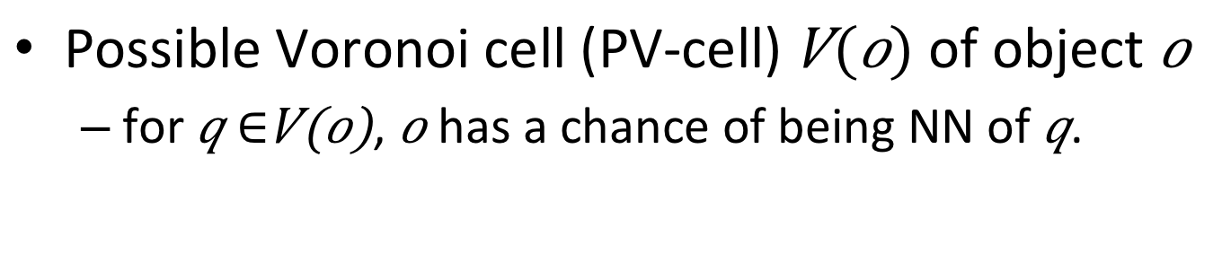
PV-cell (for Uncertain Data)
Possible Voronoi cell (PV-cell) of object
for , has a chance of being NN of .
o
q
o
q
(a) 2D PV-cell
(b) 3D PV-cell
We approximate the PV-cell as its uncertain bounding rectangle (UBR).

Slide 37
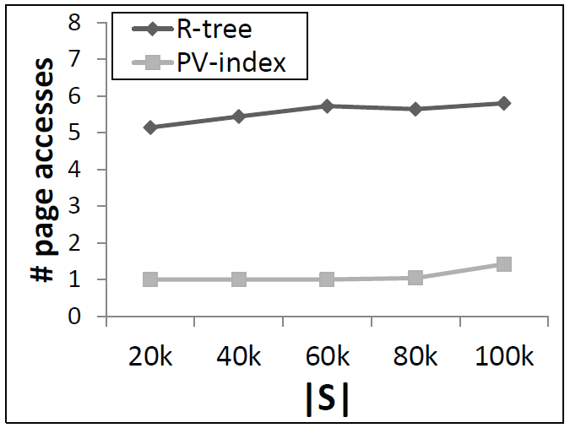
I/O Analysis

