Slide 1


On Incentive-Based Tagging
Xuan S. Yang, Reynold Cheng, Luyi Mo, Ben Kao, David W. Cheung
{xyang2, ckcheng, lymo, kao, dcheung}@cs.hku.hk
The University of Hong Kong

Slide 2
Outline
Introduction
Problem Definition & Solution
Experiments
Conclusions & Future Work

Slide 3

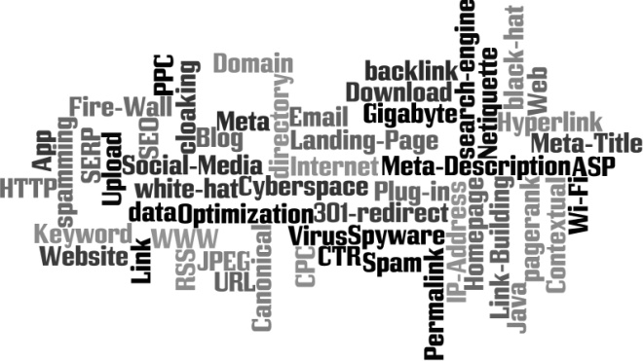

Collaborative Tagging Systems
Example:
Delicious, Flickr
Users / Taggers
Resources
Webpages
Photos
Tags
Descriptive keywords
Post
Non-empty set of tags
Notes:
Now let’s first look at some collaborative tagging systems, such as delicious and flickr.
In these systems, users (or taggers) can describe resources such as webpages and photos with key words which are called tags.

Slide 4
Applications with Tag Data
Search^{[1][2]}
Recommendation^{[3]}
Clustering^{[4]}
Concept Space Learning^{[5]}
[1] Optimizing web search using social annotations. S. Bao et al. WWW’07
[2] Can social bookmarking improve web search? P. Heymann et al. WSDM’08
[3] Structured approach to query recommendation with social annotation data. J. Guo CIKM’10
[4] Clustering the tagged web. D. Ramage et al. WSDM’09
[5] Exploring the value of folksonomies for creating semantic metadata. H. S. Al-Khalifa IJWSIS’07
Notes:
Collaborative tagging data are proven to be useful in many applications, such as:
Keyword search
Recommendation
Webpage clustering
And concept space learning

Slide 5
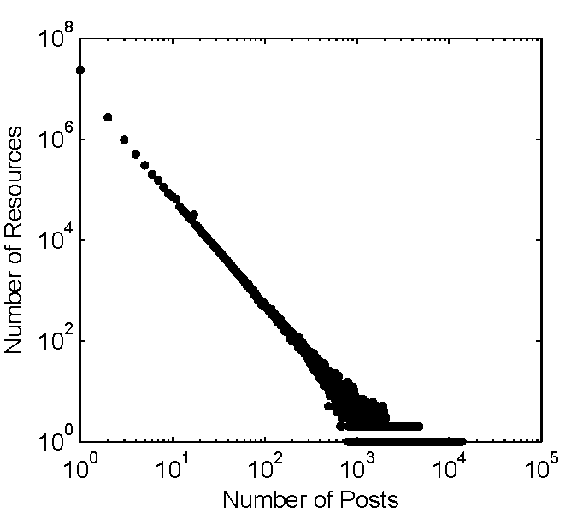
Problem of Collaborative Tagging
Most posts are given to small number of highly popular resources
dataset from delicious^{[6]}
All 30m urls
Over 10m urls are just tagged once
Under-Tagging
39% posts vs. 1% urls
Over-Tagging
[6] Analyzing Social Bookmarking Systems: A del.icio.us Cookbook. ECAI Mining Social Data Workshop. 2008
Notes:
The reasons is that users are free to choose the resources they wish to tag.
So most posts are given to a small number of highly popular resources.
To illustrate this, we analyzed a dataset from delicious.
There are over 30 million websites and their tags during the year 2007 in this dataset.
We found that over 10 million of them are just tagged once.
And 39% of all the posts are given to 1% of the urls.

Slide 6

Under-Tagging
Resources with very few posts have low quality tag data
Low quality of one single post
Irrelevant to the resource
{3dmax}
Not cover all the aspects
{geography, education}
Don’t know which tag is more important
{maps, education}
Improve tag data quality for under-tagged resource by giving it sufficient number of posts

Slide 7
Having a sufficient No. of Posts
All aspects of the resource will be covered
Relative occurrence frequency of tag t can reflect its importance
Irrelevant Tags rarely appear
Important tags occur frequently
Can we always improve tag data quality
by giving more posts to a resource?

Slide 8
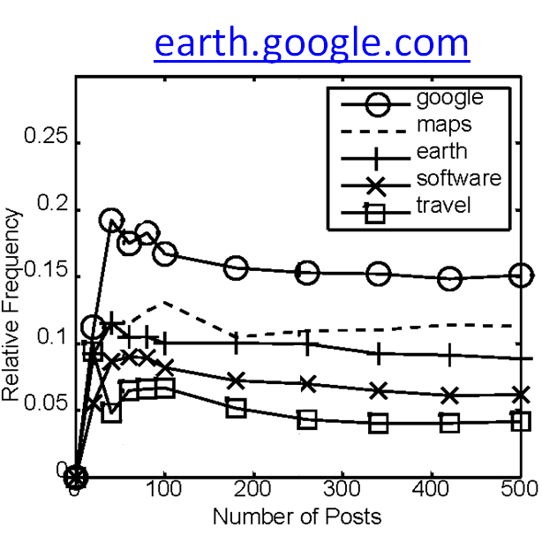
Over-Tagging
Relative Frequency vs. no. of posts
>=250, stable
Tagging Efforts are Wasted!

Slide 9
Incentive-Based Tagging
Guide users’ tagging effort
Reward users for annotating under-tagged resources
Reduce the number of under-tagged resources
Save the tagging efforts wasted in over-tagged resources

Slide 10
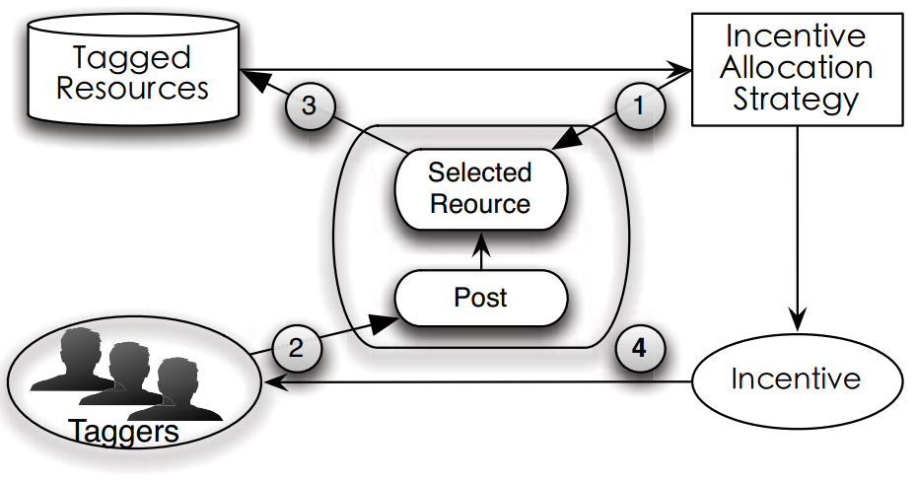
Incentive-Based Tagging (cont’d)
Limited Budget
Incentive Allocation
Objective: Maximize Quality Improvement
Quality Metric
for Tag Data
Selected Resource

Slide 11
Effect of Incentive-Based Tagging
Top-10 Most Similar Query
5,000 tagged resources
Simulation for Physics Experiments
Implemented in Java
www.myphysicslab.com
Tag Data | Top-10 Result
Base Case: 150k Posts From Delicious | 10 Java
150k + 10k more Posts from Delicious | 4 Physics 6 Java
150k + 10k more Posts from incentive-Based Tagging | 9 Physics 1 Simulation
Ideal Case: 2m Posts from Delicious | 10 Physics

Slide 12
Related Work
Tag Recommendation^{[7][8][9]}
Automatically assign tags to resources
Differences:
Machine-Learning Based Methods
Human Labor
[7] Social Tag Prediction. P. Heymann, SIGIR’08
[8] Latent Dirichlet Allocation for Tag Recommendation, R. Krestel, RecSys’09
[9] Learning Optimal Ranking with Tensor Factorization for Tag Recommendation, S. Rendle, KDD’09
Notes:
The important issues of enhancing tag data quality is studied in a number of works.
One approach is tag recommendation, which makes use of machine learning techniques to automatically assign tags to resources.
The difference between our work and tag recommendation is that ours makes use of human efforts to enhance tag data quality.

Slide 13
Related Work (Cont’d)
Data Cleaning under Limited Budget^{[10]}
Similarity:
Improve Data Quality with Human Labor
Opposite Directions:
“-” Remove Uncertainty
“+” Enrich Information
[10] Explore or Exploit? Effective Strategies for Disambiguating Large Databases. R. Cheng VLDB’10
Notes:
Another kind of related work is about data cleaning under limited budget, which use human-labor to reduce uncertainty from a database.
Although both this incentive-based tagging and the work of budget limited data cleansing make use of human-labor to improve data quality,
the approaches are from opposite direction.
The data cleaning work enhances data quality by removing uncertainty, while this work is by enriching the information.

Slide 14
Outline
Introduction
Problem Definition & Solution
Experiments
Conclusions & Future Work
Notes:
Up to now we have discussed the motivation and main idea of our work.
Now let’s look at the problem definition and solutions.

Slide 15

Data Model
Set of Resources
For a specific r_{i}
Post: a set of tags
Post Sequence {p_{i}(k)}
Relative Frequency Distribution (rfd)
After r_{i} has k posts
{maps, education}
Tag | Frequency | Relative Frequency
Maps | 1 | 0.2
Geography | 1 | 0.2
Education | 2 | 0.4
3dmax | 1 | 0.2
{geography, education}
{3dmax}

Slide 16
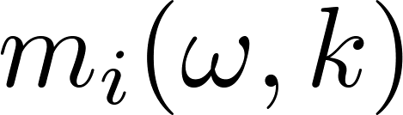


Quality Model: Tagging Stability
Stability of rfd
Average Similarity between ω rfds’, i.e.,
(k-ω+1)-th, …, k-th rfd
Stable point
Threshold
Stable rfd
Notes:
Since our quality metric for tag-data is based on the stability of rfds.
Let’s look at the figure showing the change of rfds’ again.
For a resource r_i, we use F_i(k) to represent its rfd after it has received k posts.
The stability of its rfd after it has got k posts, is essentially the average similarity between the rfds’ within a region [k-w, k]

Slide 17

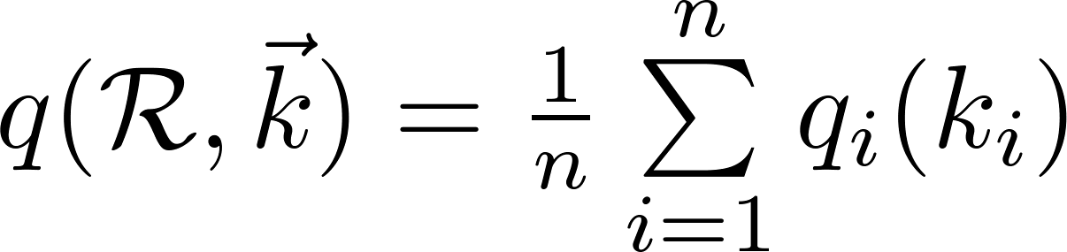
Quality
For one resource r_{i} with k posts
Similarity between its current rfd and its stable rfd
For a set of resources R
Average quality of all the resources

Slide 18


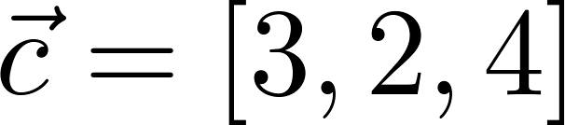


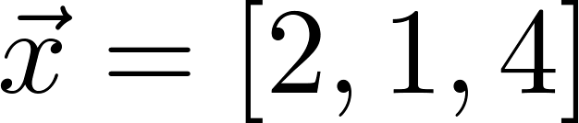

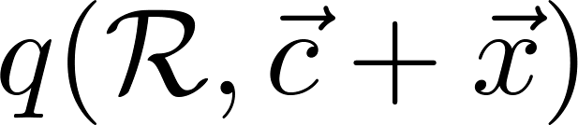
Incentive-Based Tagging
Input
A set of resources
Initial posts
Budget
Output
Incentive assignment
how many new posts should r_{i} get
Objective
Maximize quality
Current
Time
r₁
time
r₂
time
r₃
time
Notes:
Here is the formal definition of incentive-based tagging.
It takes a set of resources, their posts, and a budget as its inputs.
The output will be an incentive assignment over the resources, in order to maximize the quality.
For example, we have 3 resources here, each of them has some posts already, and the budget is 7.
One possible incentive assignment is:
2 more posts for r1
1 more for r2
and 4 more for r3.
After the resources receive the specified number of posts, the new quality of the dataset is what we want to optimized.

Slide 19
Incentive-Based Tagging (cont’d)
Optimal Solution
Dynamic Programming
Best Quality Improvement
Assumption: know the stable rfd & posts in the future
Current
Time
r₁
time
r₂
time
r₃
time
Notes:
The optimal solution for this problem is based on dynamic programming.
However, it assumes to know the posts in the future.

Slide 20
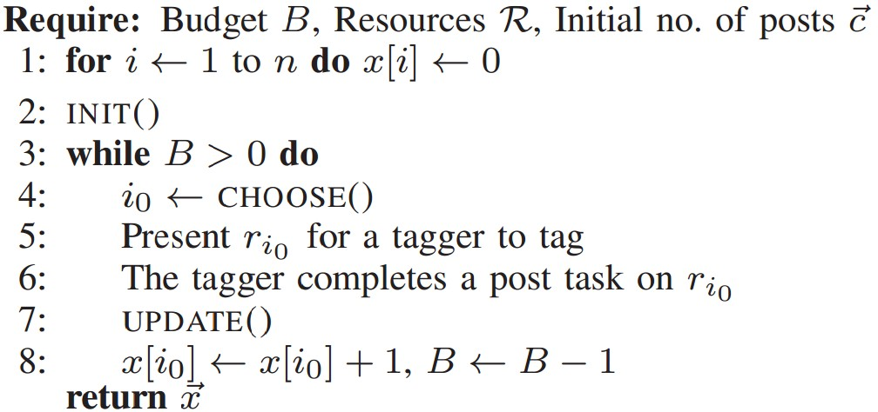
Strategy Framework
Notes:
Practical Strategies

Slide 21
Implementing CHOOSE()
Free Choice (FC)
Users freely decide which resource they want to tag.
Round Robin (RR)
The resources have even chance to get posts.
Notes:
The most intuitive way to realize the choose() function is to let the users freely decide which resource they want to tag, so we call it Free Choice.
This is essentially what traditional collaborative tagging is doing, we’ll see that it is not effective in improving tag data quality.
Another simple way to implement Choose is Round Robin, which gives each resource an equal chance to get posts.
Although it is very simple, it is more effective than Free Choice.

Slide 22

Implementing CHOOSE()
Fewest Post First (FP)
Prioritize Under-Tagged Resources
Most Unstable First (MU)
Resources with unstable rfds’ need more posts
Window size
Hybrid (FP-MU)
r₁
time
r₂
time
r₃
time
Notes:
This slide introduces 3 more complicated strategies.
The first one is called Fewest Post First, which prioritize the under-tagged resources.
For example if we have 3 resources each of them has 3, 2 and 4 posts now, on the next iteration, the algorithm will present r2 to the taggers.
The second one is called Most Unstable First.
The intuition is that, the resources with unstable rfds’ need more posts.
Recall that the definition of stability score depends on a parameter \omega as the window-size.and the stability score for the resources with less than \omega posts is not defined.
If two resources have the same number of posts, the

Slide 23
Outline
Introduction
Problem Definition & Solution
Experiments
Conclusion & Future Work

Slide 24
Setup
Delicious dataset during year 2007
5000 resources
Passed their stable point
Know the entire post sequence
Simulation from Feb. 1 2007
148,471 Posts in total
7% passed stable point
25% under-tagged
(# of Posts < 10)
Simulation Start
r₁
time
r₂
time
r₃
time

Slide 25
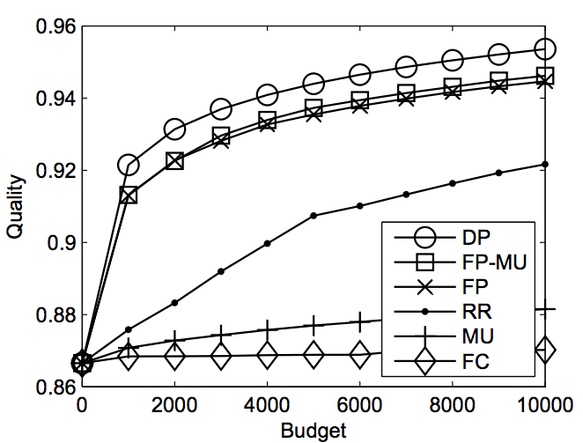
Quality vs. Budget
FP & FP-MU are close to optimal
FC does NOT increase the quality
Budget = 1,000
0.7% more posts comparing with initial no.
6.7% quality improvement
Make all resources reach stable point
FC: over 2 million more posts
FP & FP-MU: 90% saved

Slide 26
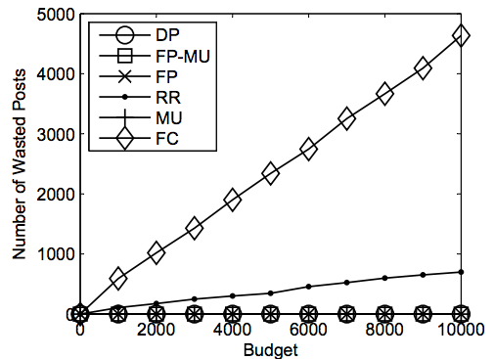
Over-Tagging
Free Choice: 50% posts are over-tagging, wasted
FP, MU and FP-MU: 0%

Slide 27
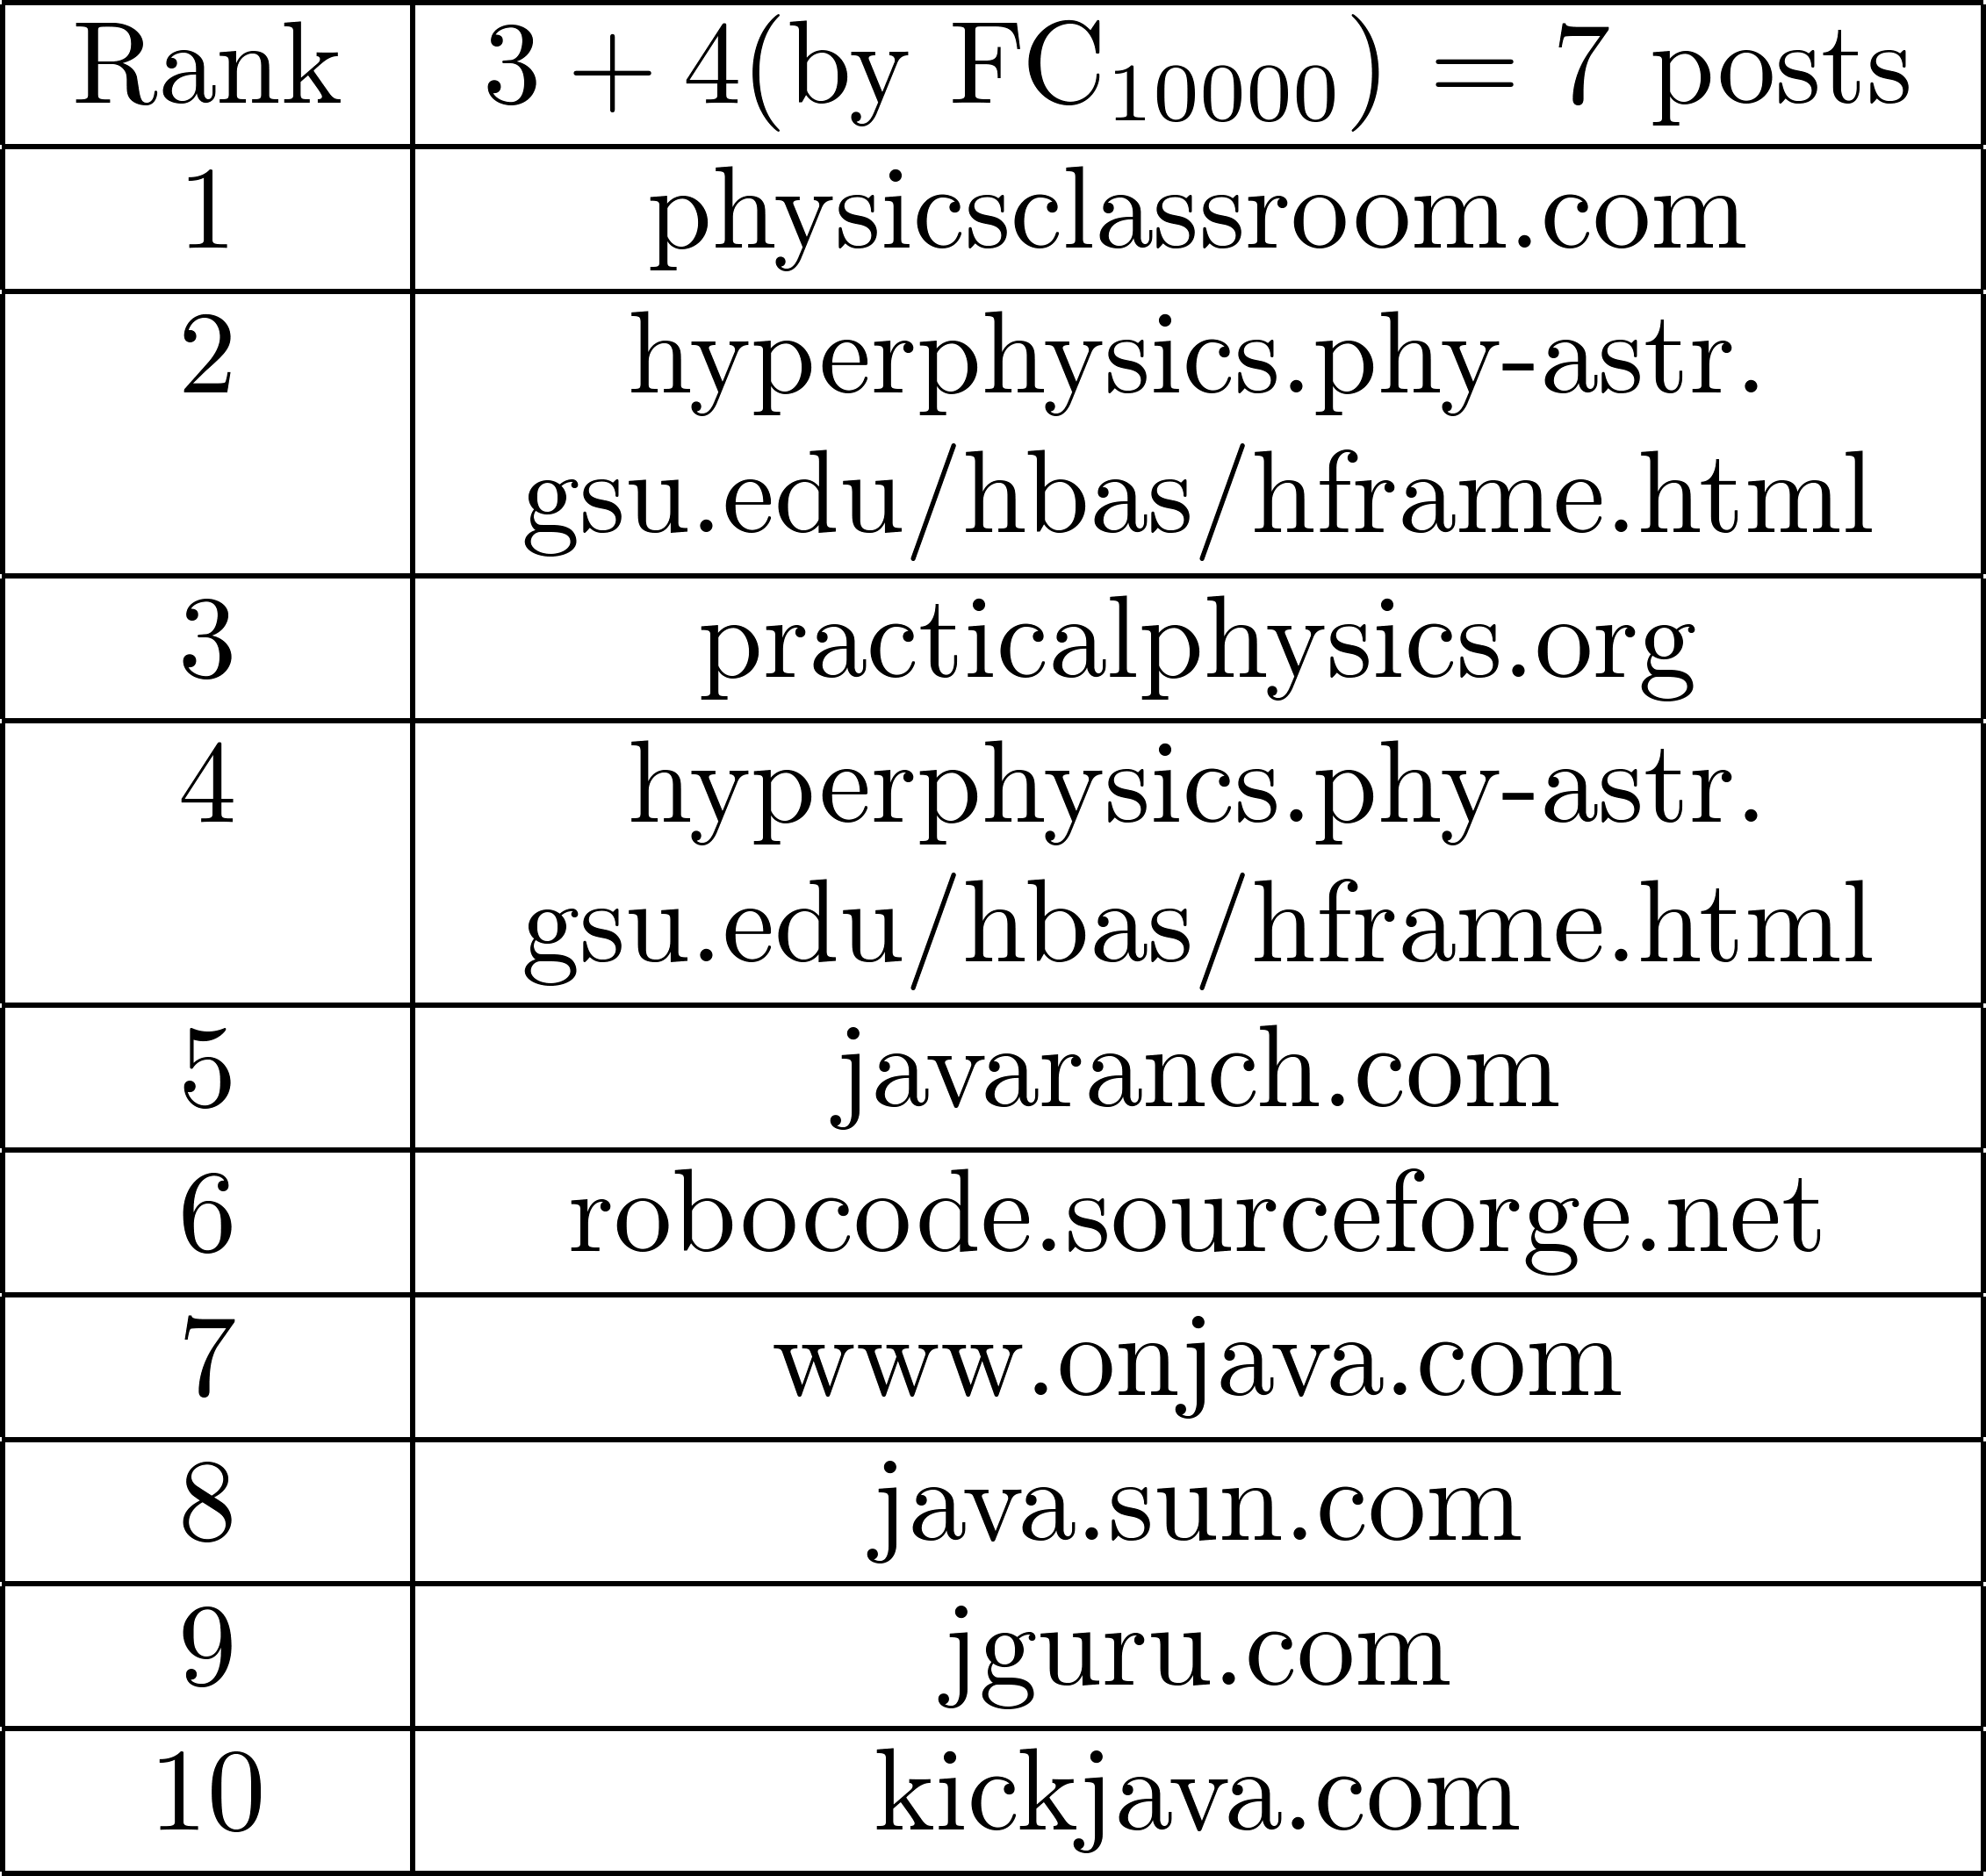

Top-10 Similar Sites (Cont’d)
On Feb. 1 2007
www.myphysicslab.com
3 posts
Top-10 all java related
10,000 more posts by FC
get 4 more posts
4/10 physics related

Slide 28
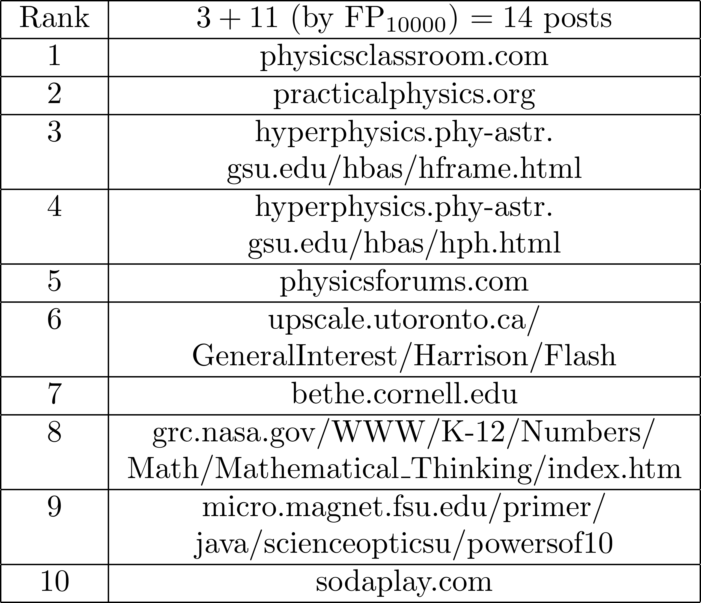
Top-10 Similar Sites (Cont’d)
On Dec. 31 2007
270 Posts
Top-10 all physics related
Perfect Result
10,000 more posts by FP
get 11 more posts
Top 9 physics related
9 included in Perfect Result
Top 6 same order with Perfect Result

Slide 29
Conclusion
Define Tag Data Quality
Problem of Incentive-Based Tagging
Effective Solutions
Improve Data Quality
Improve Quality of Application Results
E.g. Top-k search

Slide 30
Future Work
Different costs of tagging operation
User preference in allocation process
System development

Slide 31
References
[1] Optimizing web search using social annotations. S. Bao et al. WWW’07
[2] Can social bookmarking improve web search? P. Heymann et al. WSDM’08
[3] Structured approach to query recommendation with social annotation data. J. Guo CIKM’10
[4] Clustering the tagged web. D. Ramage et al. WSDM’09
[5] Exploring the value of folksonomies for creating semantic metadata. H. S. Al-Khalifa IJWSIS’07
[6] Analyzing Social Bookmarking Systems: A del.icio.us Cookbook. ECAI Mining Social Data Workshop. 2008
[7] Social Tag Prediction. P. Heymann, SIGIR’08
[8] Latent Dirichlet Allocation for Tag Recommendation, R. Krestel, RecSys’09
[9] Learning Optimal Ranking with Tensor Factorization for Tag Recommendation, S. Rendle, KDD’09
[10] Explore or Exploit? Effective Strategies for Disambiguating Large Databases. R. Cheng VLDB’10

Slide 32
Thank you! Contact Info: Xuan Shawn Yang University of Hong Kong xyang2@cs.hku.hk http://www.cs.hku.hk/~xyang2

Slide 33
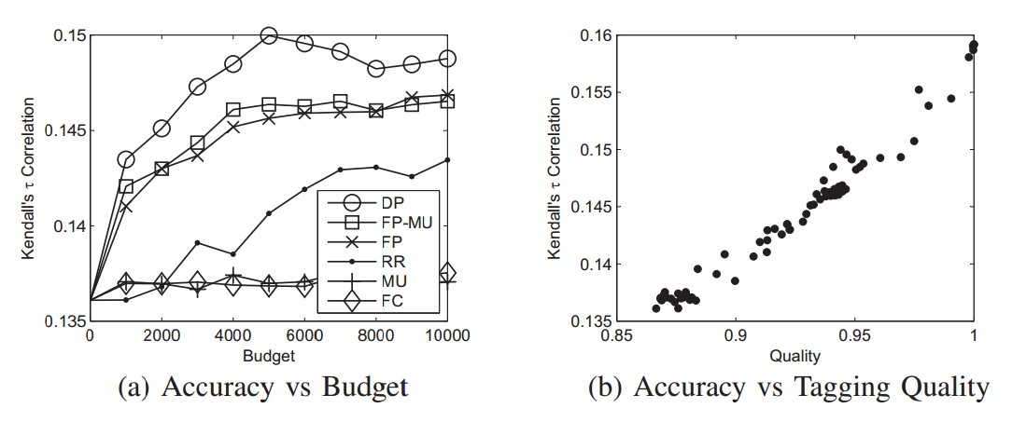
Effectiveness of Quality Metric (Backup)
All-Pair Similarity
Represent each resource by their tags
Calculate the similarity between all pairs of resources
Compare the similarity result with gold standard

Slide 34
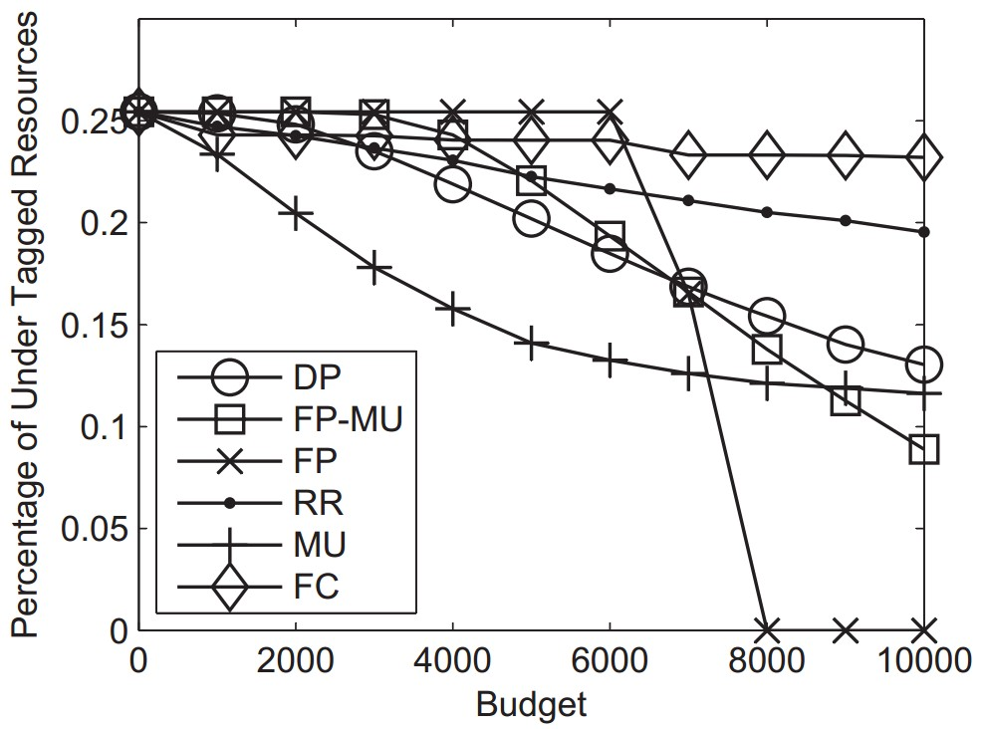
Under-Tagged Resources (Backup)

Slide 35
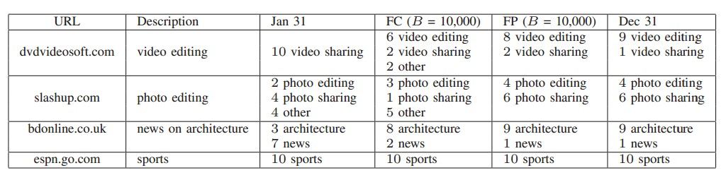
Other Top-10 Similar Sites (Backup)

Slide 36
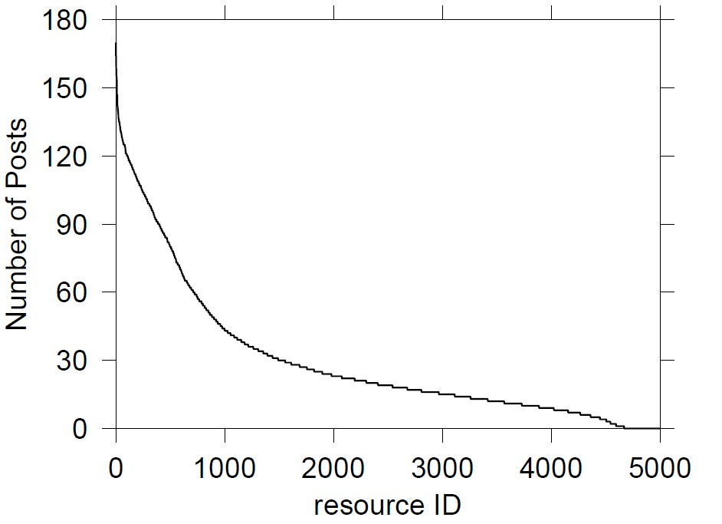
Problem of Collaborative Tagging (Backup)
Most posts are given to small number of highly popular resources
dataset from delicious.com
All 30m urls
39% posts vs. top 1% urls
Over 10m urls are just tagged once
Selected 5000 resources
High Quality Resources
7% passed stable points
50% over-tagging posts
25% under-tagged (< 10 posts)

Slide 37


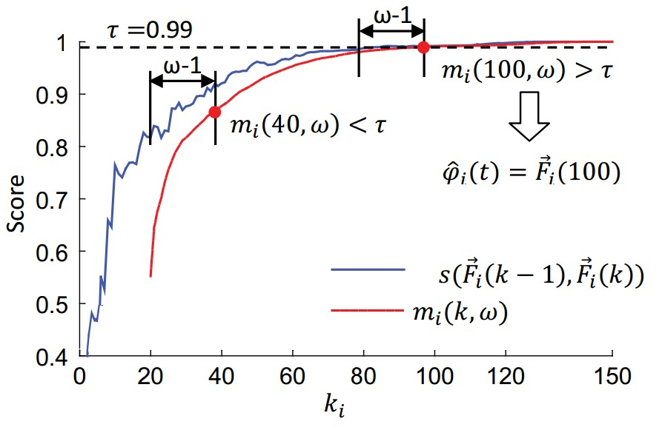
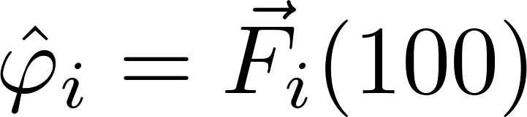
Tagging Stability (Backup)
Example
Window size
Threshold
Stable Point: 100
Stable rfd:

