Slide 1



Cleaning Uncertain Data for Top-k Queries
Luyi Mo, Reynold Cheng, Xiang Li, David Cheung, Xuan Yang
The University of Hong Kong
{lymo, ckcheng, xli, dcheung, xyang2}@cs.hku.hk

Slide 2
Outline
Introduction
Quality Metric for Top-k Queries
  Definition
  Efficient computation
  Results
Cleaning for Top-k Queries
  Definition
  Solutions
  Results
Conclusion

Slide 3
Data Uncertainty
Inherent in various applications
  Location-based services (e.g., using GPS, RFID)
  Natural habitat monitoring with sensor networks
  Data integration

Slide 4
Uncertain Databases
Model data uncertainty
  e.g., tuple t has existential probability e
Enable probabilistic queries
  Produce ambiguous query answers
  e.g., tuple t has probability p for satisfying a query

Slide 5
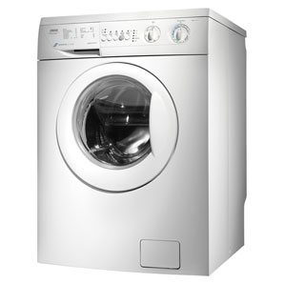
“Cleaning” of Uncertain Data
$$
Query
Query
Uncertain
DB
LESS
Uncertain
DB
Ambiguous
result
LESS ambiguous
result
Fail?
A quality metric to quantify the ambiguity of query results

Slide 6
Example: Sensor Probing
In natural habitat monitoring, sensors are used to track external environment
The system probes from sensors to refresh stale data
Probes may fail due to network reliability problem
Battery and network resources should be optimized

Slide 7
Related Work: Cleaning Uncertain DB
Cleaning for range/max query [Cheng VLDB’08]
Explore and exploit to disambiguating database [Cheng VLDB’10]
  Model different factors of cleaning operations
  Consider no probabilistic model or query
Probing from stream source [Chen SSDBM’08]
  Range query
Improve integration quality by user feedback [Keulen VLDBJ’09]
Analyze sensitivity of answer to input data [Kanagal SIGMOD’11]
We consider uncertain data cleaning for
probabilistic top-k queries

Slide 8
Related Work: Top-k Queries
Various query semantics
  U-Topk, U-kRanks [Soliman 07]
  PT-k [Hua 08]
  Global-topk [Zhang 08]
  Expected Rank [Cormode 09]
  ……
Efficient evaluation [Bernecker 10, Yi 08, Li 09, Lian 08]
Cleaning for top-k queries is challenging

Slide 9
Our Contributions
Measure quality of query answer for three top-k queries
  Adopt PWS-quality
  Develop efficient computation for quality score
Clean uncertain data for top-k queries
  Model cost, budget, cleaning successfulness
  Propose cleaning algorithms to attain the highest expected improvement in PWS-quality

Slide 10
Probabilistic Data Model (x-tuple model)
Tuple (t_{i})
Querying Attribute (v_{i})
x-tuple
Existential probability (e_{i})
Sensor ID | Key | Temp. (ºC) | Prob.
S₁ | t₀ | 21 | 0.6
 | t₁ | 32 | 0.4
S₂ | t₂ | 30 | 0.7
 | t₃ | 22 | 0.3
S₃ | t₄ | 25 | 0.4
 | t₅ | 27 | 0.6
S₄ | t₆ | 26 | 1
i-th tuple
x-tuple

Slide 11
Probabilistic Top-k Queries
U-kRanks
  (t₂, t₅)
PT-k (prob. threshold top-k)
  Threshold=0.4
  (t₁, t₂, t₅)
Global-topk
  (t₂, t₅)
No work about how to measure the quality of query answers
  Rank Probability Information (k=2)
Prob. | t₀ | t₁ | t₂ | t₃ | t₄ | t₅ | t₆
Rank-1 | 0 | 0.4 | 0.42 | 0 | 0 | 0.108 | 0.072
Rank-2 | 0 | 0 | 0.28 | 0 | 0.072 | 0.324 | 0.324
Top-2 | 0 | 0.4 | 0.7 | 0 | 0.072 | 0.432 | 0.396

Slide 12
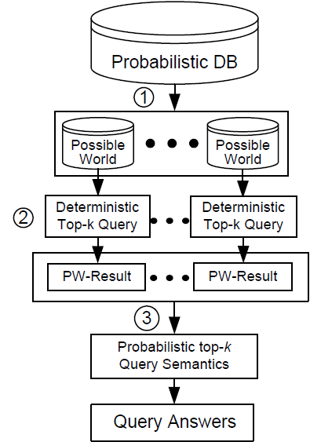
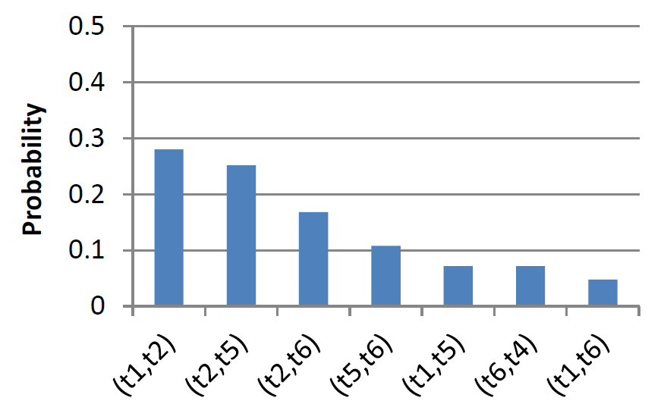
Probabilistic Top-k Queries
  Possible World Results
  0.28
Rank Probability Information
  Possible World Semantics

Slide 13
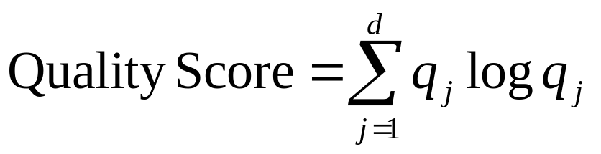
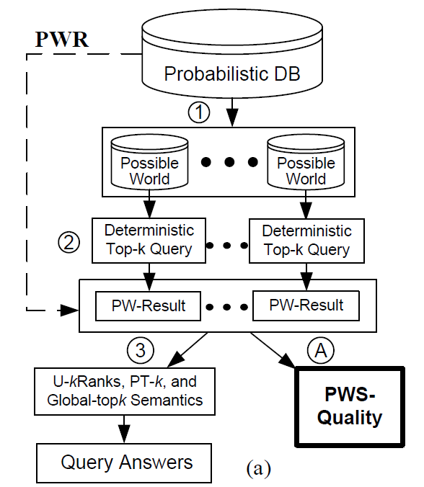

The Possible World Semantics Quality (PWS-Quality) [Cheng VLDB’08]
PWS-quality = -2.55
  Entropy
Expensive to compute!

Slide 14
PWR: Derives PW-Results Directly
No. of distinct pw-results is bounded by n^k
(n is the database size)
Advantage:
  Reduce complexity
Not efficient enough if number of PW-results is large!

Slide 15
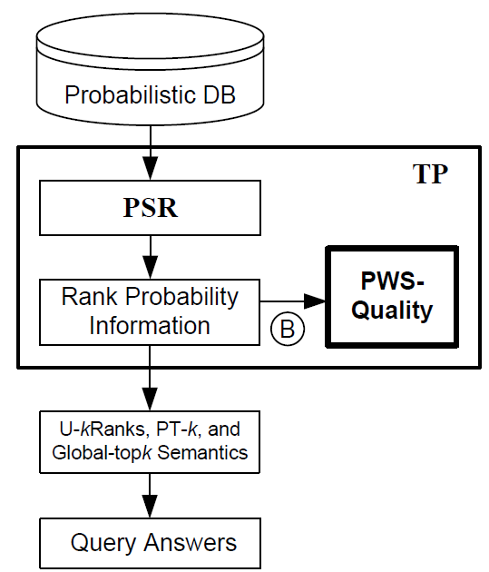
TP: Computation based on Rank Prob.
PSR [Bernecker, TKDE10]
  An efficient solution framework for top-k query evaluation

Slide 16
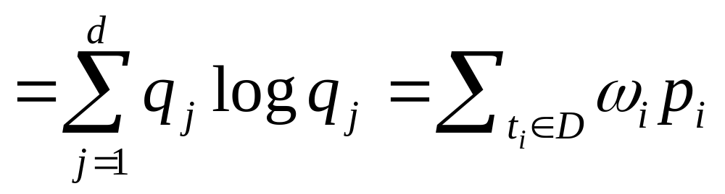

TP: Tuple Form of PWS-Quality
PWS-quality can be expressed by the existential probabilities and top-k probabilities of tuples
where is some function of existential probabilities of tuples in D
PWS-quality

Slide 17


TP: Sharing of Computation Effort
Steps of TP:
  O(nk) for PSR [Bernecker, TKDE10] to compute all
  O(n) for an incremental method to compute all
Rank prob. information can be shared by query and quality evaluation!
Rank Probability Information

Slide 18
Experiment Setup
Size of DB | 5 K x-tuples, 50 K tuples (synthetic) 4,999 x-tuples, 10,037 tuples (Netflix movie ratings)
Prob. distributions | Gaussian (variance = 100) Mean of each x-tuple, uniform in [0, 10000]
Top-k Queries | k = 15 Threshold for PT-k = 0.1
By default, results are shown on synthetic data.

Slide 19
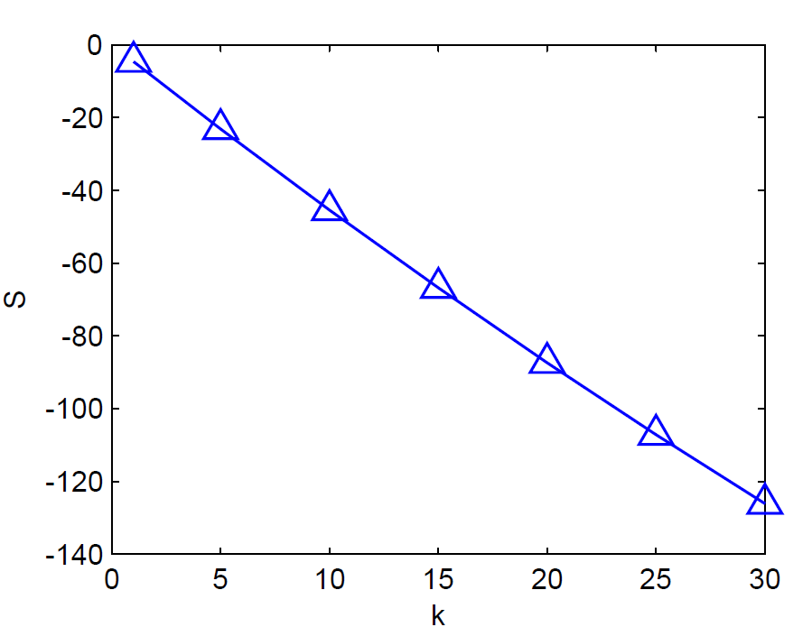
Quality Score vs. k

Slide 20
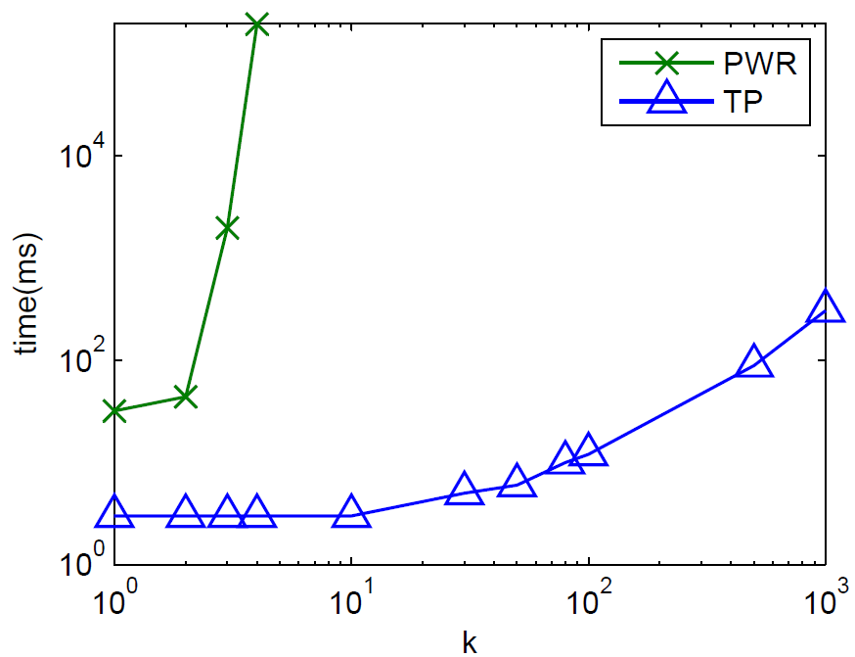
Evaluation Time

Slide 21
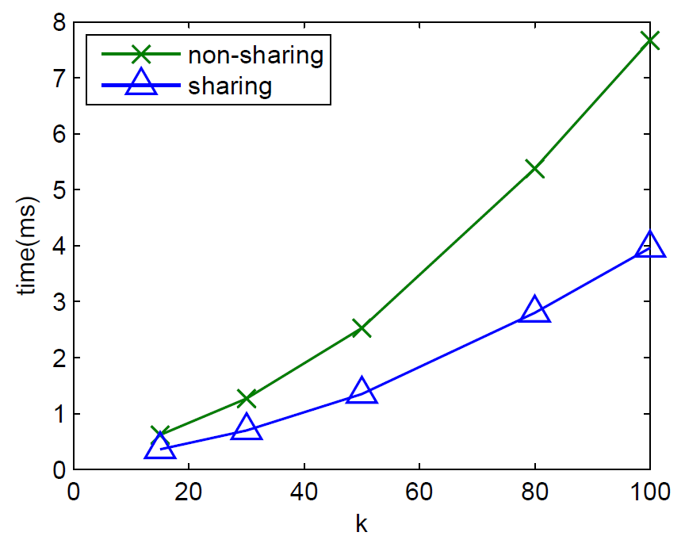
TP: Effect of Sharing (1)
  48%
Query+Quality Time vs. k
Top-k query: PT-k; Non-sharing: rank probability information is recomputed when computing the quality score

Slide 22
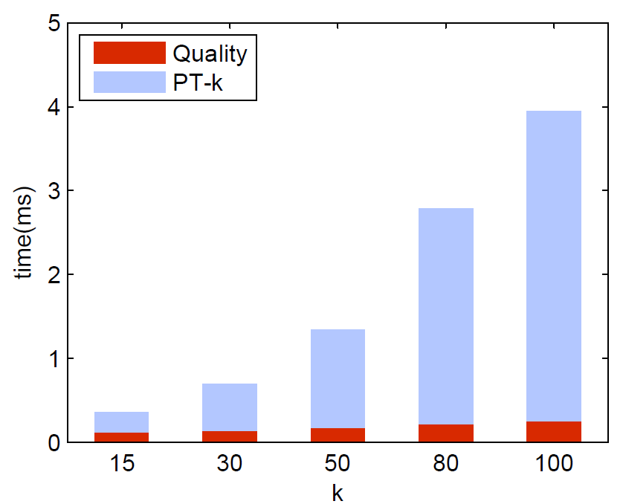
TP: Effect of Sharing (2)
  6.3%
PT-k Time vs. Quality Time (with sharing)

Slide 23
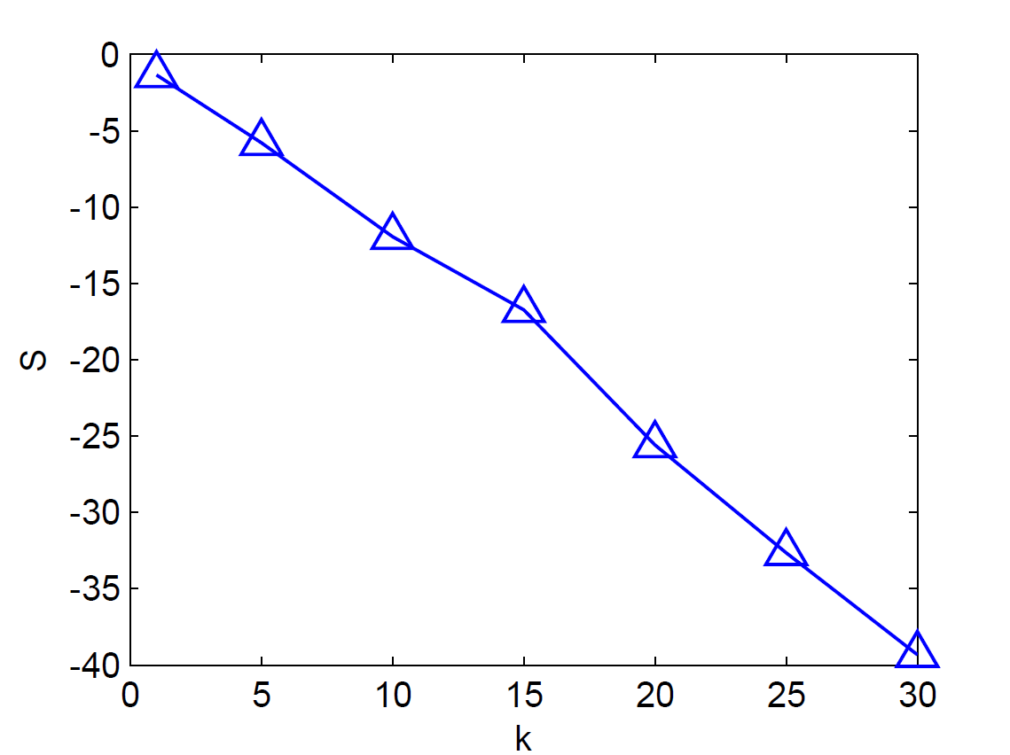
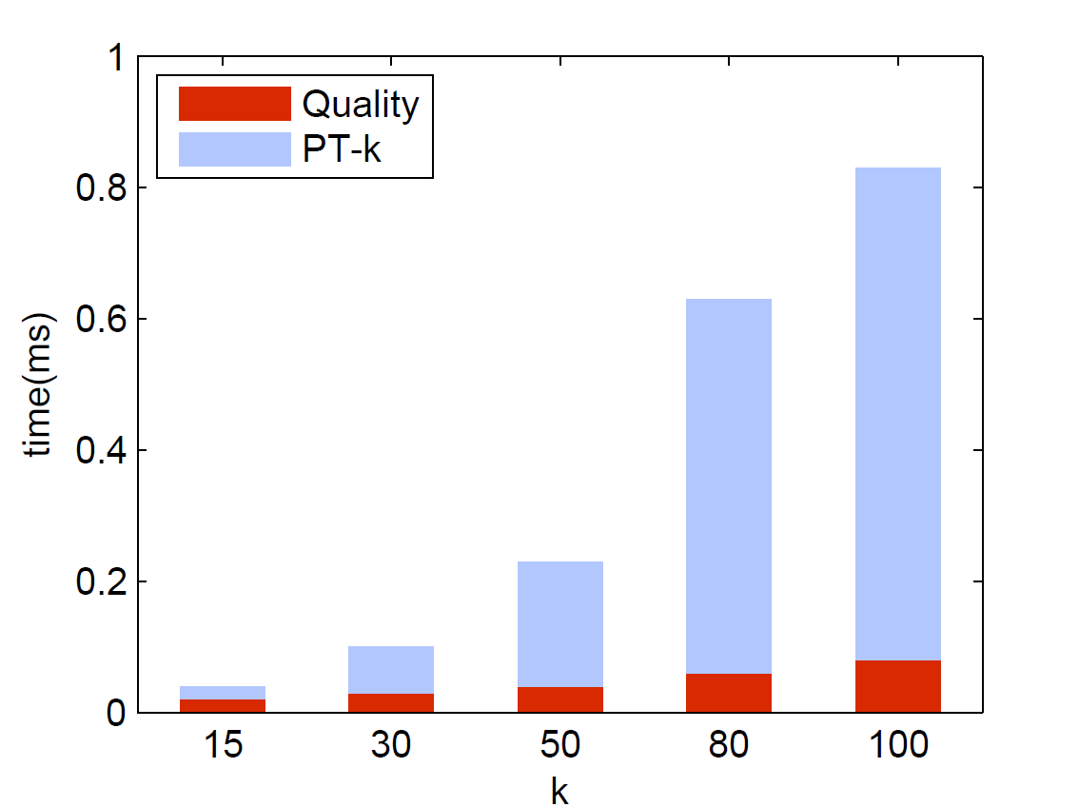
Results on Real Data
Quality Score vs. k
PT-k Time vs. Quality Time (with sharing)
Similar to results on synthetic data

Slide 24
Outline
Introduction
Quality Metric for Top-k Queries
  Definition
  Efficient computation
  Results
Cleaning for Top-k Queries
  Definition
  Solutions
  Results
Conclusion

Slide 25
Example
Cost Cleaning may require resources
Sensor ID | Key | Temp. (ºC) | Prob. | Sc-prob.
S₁ | t₀ | 21 | 0.6 | 0.8
 | t₁ | 32 | 0.4
S₂ | t₂ | 30 | 0.7 | 0.3
 | t₃ | 22 | 0.3
S₃ | t₄ | 25 | 0.4 | 0.7
 | t₅ | 27 | 0.6
S₄ | t₆ | 26 | 1 | 0.6
Limited budget A budget (e.g., $12) restricts the no. of cleaning actions
$3
Successfulness Cleaning action has a successful cleaning probability (sc-prob)
$9
Objective Optimize the quality improvement after cleaning
$11
$1
Cleaning plan Which x-tuples should be cleaned? How many times the cleaning actions should be performed?
Sensor Readings

Slide 26
Cleaning Model
D: uncertain database, a set of x-tuples
τ_{l} : the l-th x-tuple
c_{l} : cost of cleaning τ_{l} once
p_{l} : successful probability of cleaning actions on τ_{l}
B : cleaning budget
(X, M) : cleaning plan to clean τ_{l} for M_{l} times, where τ_{l} is in X

Slide 27
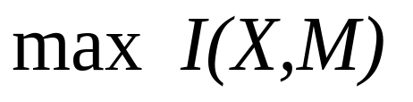
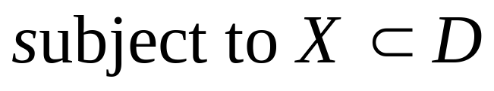
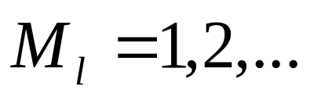
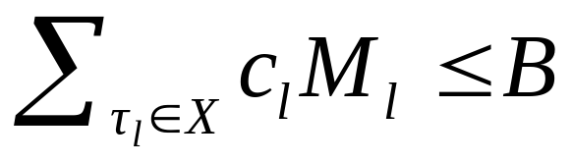
An Optimization Problem
I(X,M) : expected quality improvement of (X,M)
Budget constraint
Challenges:
Computation of I(X,M) is nontrivial
number of possible cleaning plans may be exponential

Slide 28
Expected Quality Improvement
Given a cleaning plan
Sensor ID | Sc-prob. | Key | Temp. (ºC) | Prob. | Top-k Prob.
S₁ | 0.8 | t₀ | 21 | 0.6 | 0
 |  | t₁ | 32 | 0.4 | 0.4
S₂ | 0.3 | t₂ | 30 | 0.7 | 0.7
 |  | t₃ | 22 | 0.3 | 0
S₃ | 0.7 | t₄ | 25 | 0.4 | 0.072
 |  | t₅ | 27 | 0.6 | 0.432
S₄ | 0.6 | t₆ | 26 | 1 | 0.396
PWS-quality = -1.85
PWS-quality = -2.55
Clean
S₃ once
1
0.72
No. of possible cleaned results is exponential!
0.18
Expected quality of cleaning x-tuple S₃:
= 0.7 * (0.4 * -1.85 + 0.6 * -1.85) + (1-0.7) * -2.55 = -2.06
Cleaning on S₃ is successful
Cleaning on S₃ fails

Slide 29
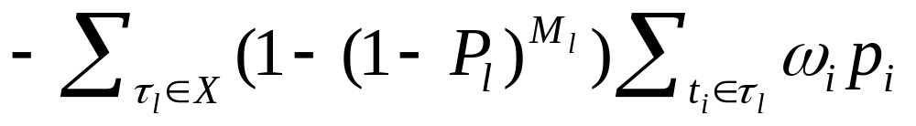
Efficient Expected Quality Improvement Evaluation
Given a cleaning plan (X,M) and the tuple form of PWS-quality, the expected quality improvement can be computed in linear time of |X|

Slide 30
Cleaning Algorithms
Optimal solution:
  Variant of knapsack problem
  DP (dynamic programming)
Heuristics:
  RandU (x-tuples have equal prob. to clean)
  RandP (x-tuples with higher top-k prob. also have higher prob. to clean)
  Greedy (select x-tuples with largest marginal expect quality improvement to clean)

Slide 31
Experiment Setup
Size of DB | 5 K x-tuples, 50 K tuples (synthetic) 4,999 x-tuples, 10,037 tuples (Netflix movie ratings)
Prob. distributions | Gaussian (variance = 100)
Top-k Queries | k = 15 Threshold for PT-k = 0.1
Cleaning cost | Uniform in [1,10]
Sc-probability | Uniform in [0,1]
Resource budget | 100
Results are shown on synthetic data.

Slide 32
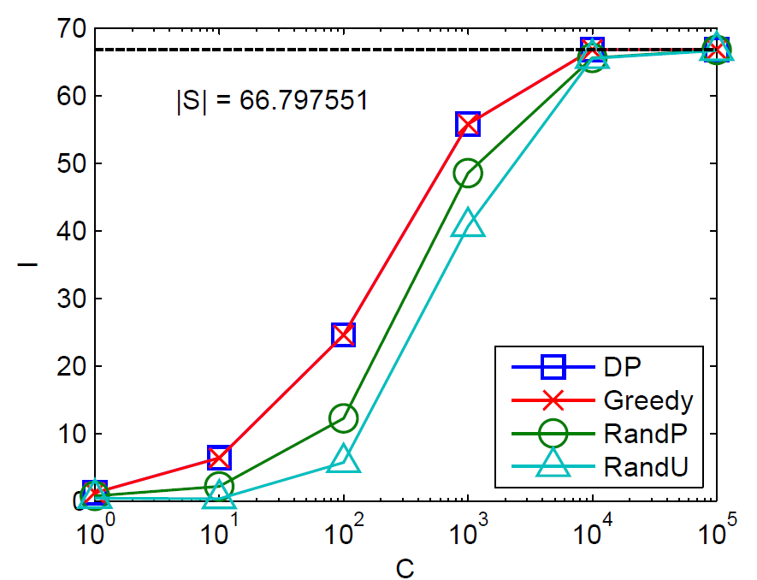
Effectiveness of Cleaning Algorithms
I(X,M)
Budget
Improvement vs. Budget

Slide 33
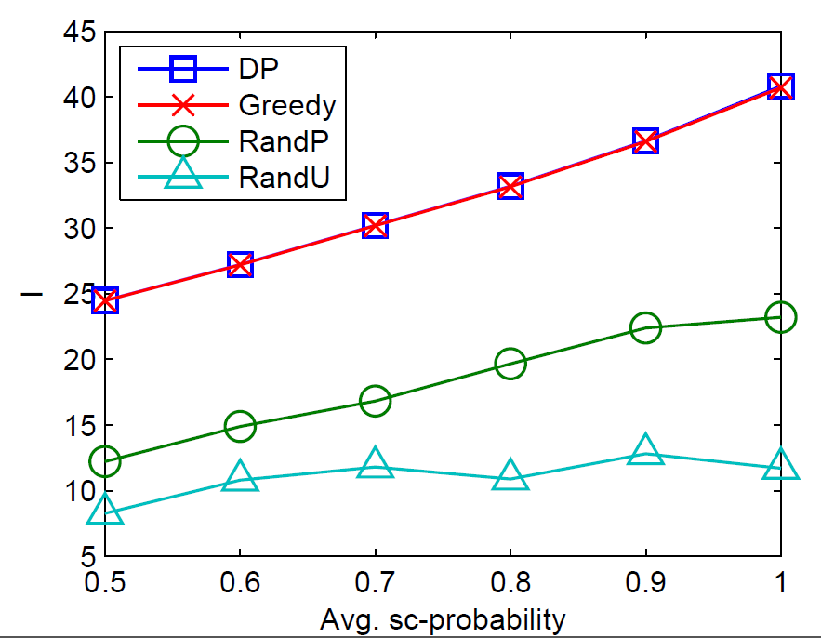
Effect of Avg. sc-probability
I(X,M)

Slide 34
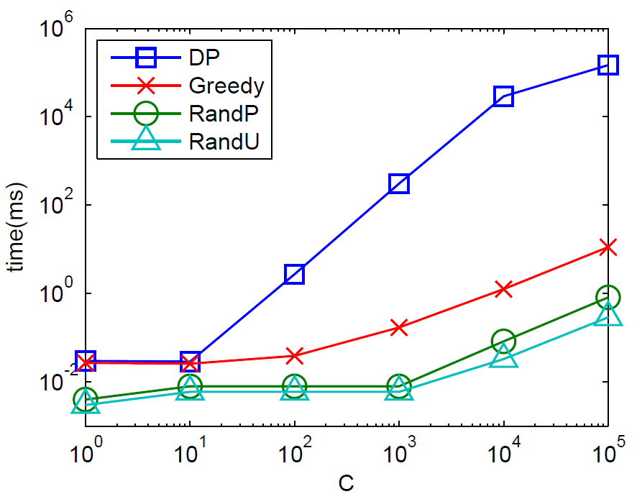
Efficiency on Budget
  10000x
Budget

Slide 35
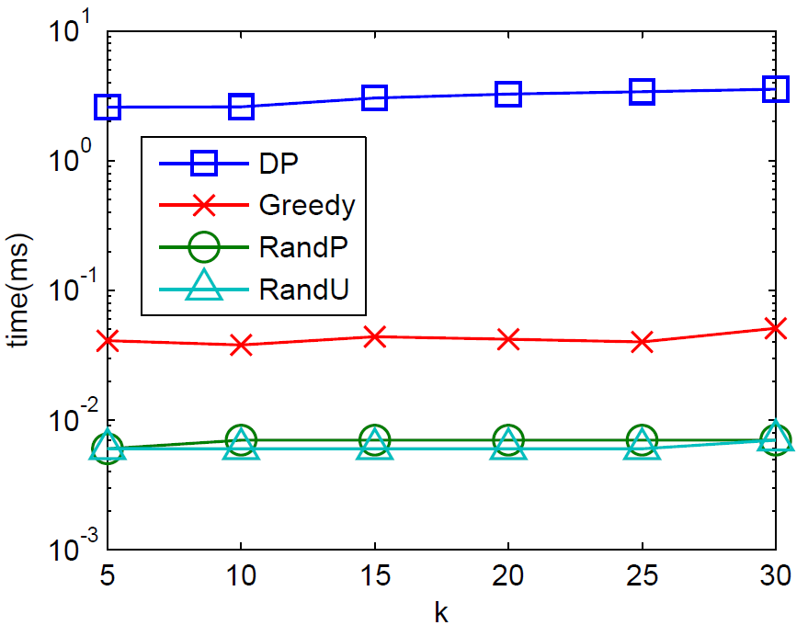
Efficiency on k
  100x

Slide 36
Conclusion
Efficient computation of PWS-quality for probabilistic top-k query
Cleaning probabilistic database under limited budget
  Model cleaning operations
  Develop optimal and efficient cleaning algorithms for top-k queries
Future work
  Study other probabilistic data model
  Support other top-k queries, skyline queries, etc.

Slide 37
Thank you!
Contact Info:
Luyi Mo
University of Hong Kong lymo@cs.hku.hk http://www.cs.hku.hk/~lymo

Slide 38
Reference
[Soliman 07] M. A. Soliman, I. F. Ilyas, and K. C.-C. Chang, “Top-k query processing in uncertain databases,” in ICDE, 2007
[Hua 08] M. Hua, J. Pei, W. Zhang, and X. Lin, “Ranking queries on uncertain data: a probabilistic threshold approach,” in SIGMOD, 2008
[Yi 08] K. Yi, F. Li, G. Kollios, and D. Srivastava, “Efﬁcient processing of top-k queries in uncertain databases with x-relations,” TKDE, 2008
[Zhang 08] X. Zhang and J. Chomicki, “On the semantics and evaluation of top-k queries in probabilistic databases,” in ICDE Workshop, 2008
[Cormode 09] G. Cormode, F. Li, and K. Yi, “Semantics of ranking queries for probabilistic data and expected ranks,” in ICDE, 2009
[Bernecker 10] T. Bernecker, H. Kriegel, N. Mamoulis, M. Renz, and A. Zueﬂe, “Scalable probabilistic similarity ranking in uncertain databases,” TKDE, 2010
[Cheng 08] R. Cheng, J. Chen, and X. Xie, “Cleaning uncertain data with quality guarantees,” 2008
[Li 09] J. Li, B. Saha, and A. Deshpande, “A uniﬁed approach to ranking in probabilistic databases,” 2009
[Lian 08] X. Lian and L. Chen, “Probabilistic ranked queries in uncertain databases,” in EDBT08
[Keulen 09] M. van Keulen and A. de Keijzer, “Qualitative effects of knowledge rules and user feedback in probabilistic data integration,” The VLDB Journal, 2009
[Kanagal 11] B. Kanagal, J. Li, and A. Deshpande, “Sensitivity analysis and explanations for robust query evaluation in probabilistic databases,” in SIGMOD, 2011
[Cheng 10] R. Cheng, E. Lo, X. S. Yang, M.-H. Luk, X. Li, and X. Xie, “Explore or exploit? effective strategies for disambiguating large databases,” 2010
[Chen 08] J. Chen and R. Cheng, “Quality-aware probing of uncertain data with resource constraints,” in SSDBM, 2008
[Cheng04] R. Cheng, Y. Xia, S. Prabhakar, R. Shah, and J. S. Vitter. Efficient indexing methods for probabilistic threshold queries over uncertain data. In VLDB, 2004.
[Tao05]Y. Tao, R. Cheng, X. Xiao, W. K. Ngai, B. Kao, and S. Prabhakar. Indexing multi-dimensional uncertain data with arbitrary probability density functions. In VLDB, 2005.

Slide 39
Related Works
Data Models
Independent tuple/attribute uncertainty [Barbara92]
x-tuple (ULDB) [Benjelloun06]
Graphical model [Sen07]
Categorical uncertain data [Singh07]
World-set descriptor sets [Antova08]
Query Evaluation
Probabilistic Query Classification [Cheng 03]
Efficiency of query evaluation [Dalvi04]
Range queries [Cheng04,Tao05,Cheng07]
MIN/MAX [Cheng03,Deshpande04]
Top-k query evaluation [Soliman07,Re07,Yi08, Bernecker 10,Li 09,Lian 08]

Slide 40
Related Works
Quality metric for uncertain DB
Result probability > threshold [Cheng04, Desphande04]
PWS-quality (Possible World Semantics Quality) [Cheng 08]
Number of alternatives (non-prob. DB) [Cheng 10]

Slide 41
Example: PT-k
Sensor ID | Key | Temp. (ºC) | Prob.
S₁ | t₀ | 21 | 0.6
 | t₁ | 32 | 0.4
S₂ | t₂ | 30 | 0.7
 | t₃ | 22 | 0.3
S₃ | t₄ | 25 | 0.4
 | t₅ | 27 | 0.6
S₄ | t₆ | 26 | 1
Return sensors which have at least 40% to yield 2 highest temperature
PT-k with k = 2, T = 0.4
  PW-Results
  Result Prob.
  <S1, 32> 0.4
  <S2, 30> 0.7
  <S3, 27> 0.432

Slide 42
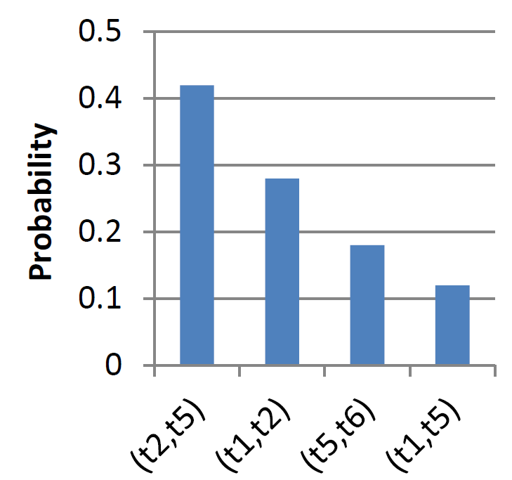
Example: cleaning objective
Sensor ID | Key | Temp. (ºC) | Prob.
S₁ | t₀ | 21 | 0.6
 | t₁ | 32 | 0.4
S₂ | t₂ | 30 | 0.7
 | t₃ | 22 | 0.3
S₃ | t₄ | 25 | 0.4
 | t₅ | 27 | 0.6
S₄ | t₆ | 26 | 1
Return sensors which yield 2 highest temperature
The database may be cleaned by probing the sensors to attain its latest reading
1
Suppose we clean sensor S₃.
PWS-quality = -2.55
PWS-quality=-1.85

Slide 43
Example: PT-k
PWS-quality = -2.55
  Result Prob.
  <S1, 32> 0.4
  <S2, 30> 0.7
  <S3, 27> 0.432
PWS-quality=-1.85
  Result Prob.
  <S1, 32> 0.4
  <S2, 30> 0.7
  <S3, 27> 0.72

Slide 44
The Possible World Semantics Quality (PWS-Quality) [Cheng 08]
Expensive to compute!
PWS-quality = -2.55
  Entropy
PWS-quality=-1.85
  If some uncertainty of the DB is removed

Slide 45

PWR: PW-Results Derivation and Probability Computation
Derivation O(n^k)
  Enumerate all combinations with exactly k tuples
  When tuples are pre-sorted → pruning techniques
Probability Computation O(n)
  If the pw-result is given,
τ
tuples exist in pw-result
tuples with high score do not exist in pw-result

Slide 46

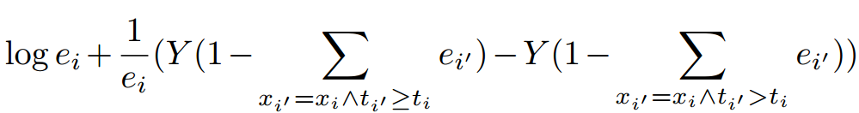
TP: Tuple Form of PWS-Quality
PWS-quality can be expressed by the existential probabilities and top-k probabilities of tuples
where is some function of existential probabilities of tuples in the same x-tuple with and ranked higher
PWS-quality

Slide 47
TP: Example
0.4
0.7
0.432
0.396
0.072
0
0
t₁ | t₂ | t₅ | t₆ | t₄ | t₃ | t₀
-2.43
-1.26
-1.62
0
0
early stop
Quality score = -2.55

Slide 48
Results on Real Data
Quality Score vs. k

Slide 49
Results on Real Data
Quality and Query Evaluation Time with Sharing

Slide 50
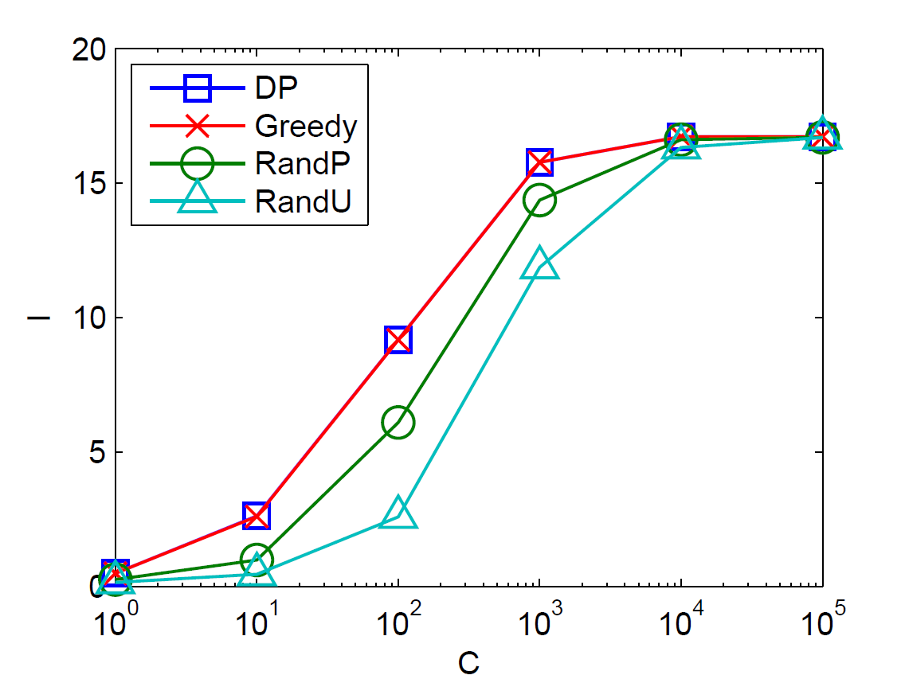
Results on Real Data

Slide 51
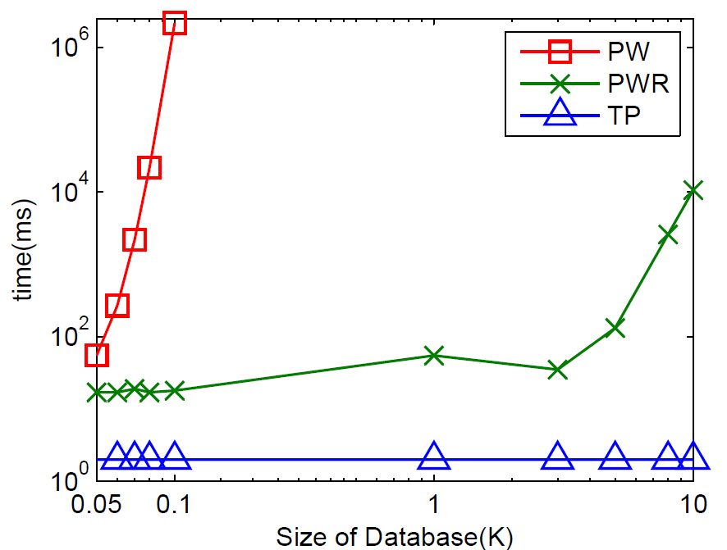
Comparison with PW

Slide 52
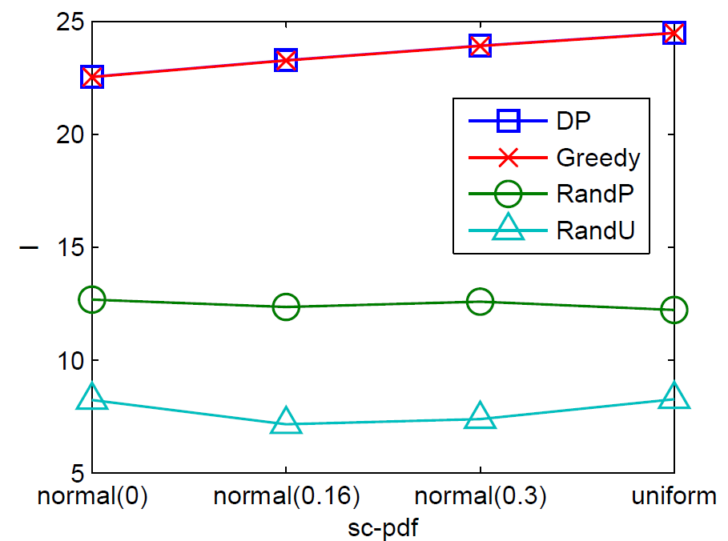
Effect of sc-pdf (Cleaning Algorithms)

Slide 53
Effect of Avg. sc-probability (Cleaning Algorithms)

Slide 54
Efficiency on k (Cleaning Algorithms)

