Slide 1
On Link-based Similarity Join
VLDB 2011
Presenter: Reynold Cheng
Department of Computer Science
The University of Hong Kong
ckcheng@cs.hku.hk
A joint work with:
Liwen Sun, Xiang Li, David Cheung (University of Hong Kong)
Jiawei Han (University of Illinois Urbana Champaign)

Slide 2



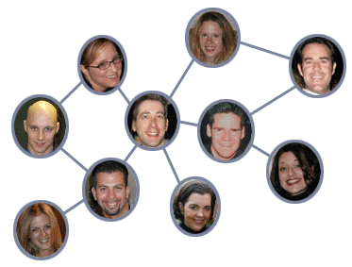
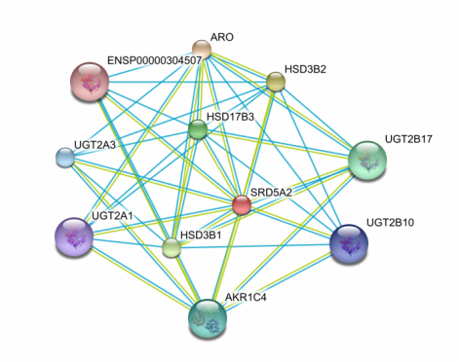
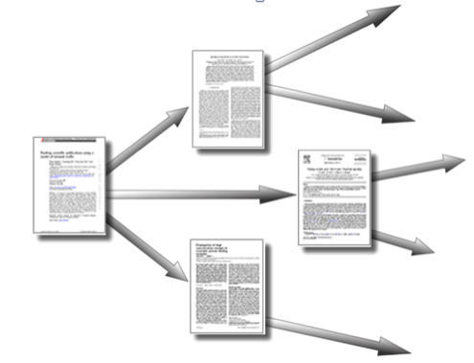
Graph applications
Social networks
Bibliographic networks
Coauthor/citation relationships
Biological databases
Protein-protein interaction
link prediction, recommendation,
spam detection,...

Slide 3
Link-based Similarity (LS)
Similarity between a node pair based on links
Personalized PageRank
[Widom, WWW’03][Fogara, Inter. Math’05]
SimRank
[Lizorkin, VLDBJ’10] [Li, SDM’10]
Discounted Hitting Times
[Sarkar, KDD’10]

Slide 4
Similarity Join
Similarity join: discovers relationship between two sets of objects based on some similarity function
Extensively studied in:
high dim. data [Boehm, SIGMOD’01] [Dittrich, KDD’01]
sets/strings [Arasu, VLDB’06] [Xiao, WWW’08]
Similarity join for graphs: use shortest-path distance for road network and graph pattern matching [Sankaranarayanan, GIS’06; Zou, VLDB’09]

Slide 5
Link-based Similarity Join (LS-Join)
LS-Join: Given two subsets of nodes P and Q in a graph and a LS measure S, return k pairs of nodes, with the highest values of S.

Slide 6
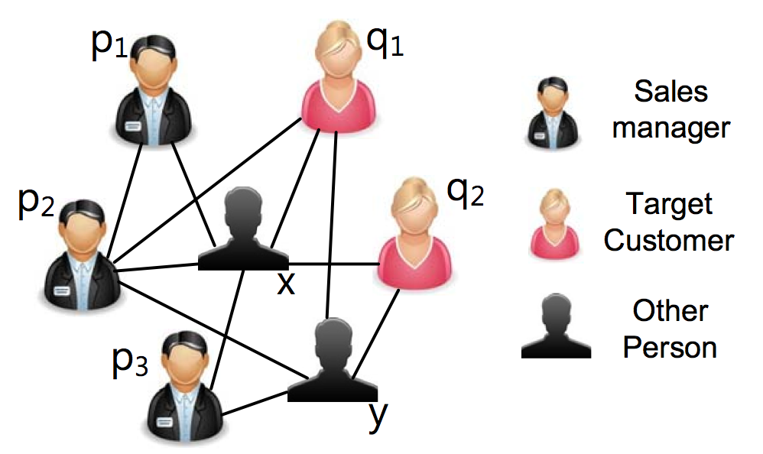
LS-Join and Promotion Strategies
Find the top-k closest (Sales, Customer) from a social network, using PageRank
In a citation network, find top-k similar pairs of papers from the DB and AI communities
Top-1 LS-Join on Sales, Customer
Notes:
Strong connection between p2 and q1 -- they not only know each other, but also have two common friends: x, y.

Slide 7

More about LS measures
A LS measure often involves random walk
Let be a probabilistic measure between u and v
Personalized PageRank (PPR)
: prob. a surfer from u visits v at i-th step
SimRank (SR)
: prob. 2 surfers from u and v first meet at i-th step
Discounted Hitting Time (DHT)
: prob. a surfer from u first visits v at i-th step
can be expensive to compute

Slide 8
Challenge of Evaluating LS-Join
Let S(u,v) be the similarity between u and v based on a LS measure
A simple algorithm:
For each node pair and , compute S(p, q)
Return the k pairs with the highest S(p,q)
Drawback:
S(p,q) is expensive to compute
S(p,q) of a non-answer pair is also evaluated
Can we have a better solution?

Slide 9
LS-Join Algorithms
Iterative Deepening Join (IDJ)
An algorithm for computing any given LS measure
Customization of IDJ for:
Personalized PageRank (PPR)
SimRank (SR)

Slide 10
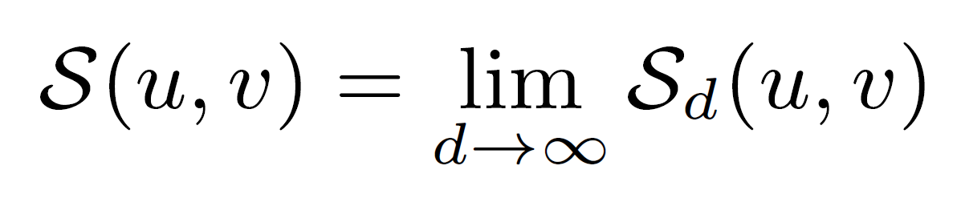
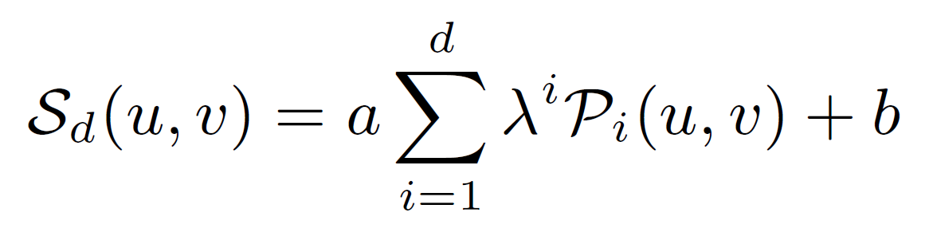
e-function: A general form of S(u,v)
depth
S(u,v) has a general form called e-function
where
a, b: real-valued constants; a>0
: decay factor; 0 < <1
: prob. measure
e.g., for PPR:
: prob. a surfer from u visits v at i-th step
a = 1- ; b = 0
Practically, we approximate S(u,v) by some d
Notes:
Mention ed-function???

Slide 11
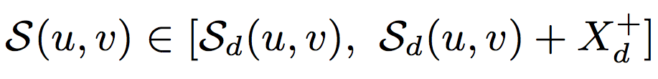
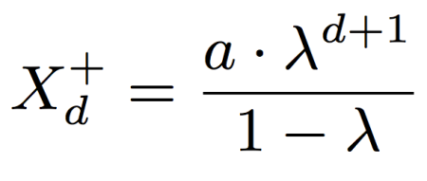
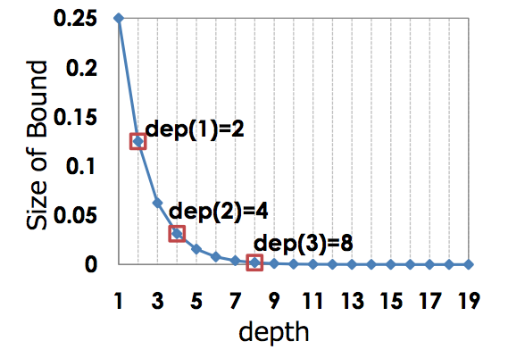
Properties of e-function
where
Observations
This bound decreases exponentially with d
At small d, S_{d}(u,v) is cheap to compute; it only needs short random walks

Slide 12
Iterative Deepening Join (IDJ)
At iteration i, compute the bound of S(u,v), where d=2^{i}
As d increases, the bound shrinks and converges to S(u,v)
Compute the bound more frequently at small depths
Higher pruning power
The bound is cheaper to compute
Conversely, spend less effort for large d

Slide 13
IDJ Example: find the top-1 pair
Iteration 1: d = 2.
Compute S₂: Perform 2 steps of random walks
graph space
Prune nodes using bounds

Slide 14
IDJ Example: find the top-1 pair
Iteration 2: d = 4.
Compute S₄:
Perform 4 steps of random walks
graph space
Prune nodes using bounds

Slide 15
IDJ Example: find the top-1 pair
Compute S₈:
Perform 8 steps of random walks
Iteration 3: d = 8.
graph space
Compute actual score S;
Return top-1 pair

Slide 16
Remarks on IDJ
IDJ is inspired by the Iterative Deepening Depth-First Search
Search a small scope at early iterations for efficient pruning
Exponentially expand the search scope
Space efficient
only store the states of one random surfer at a time
Use a small heap to track the top-k candidate pairs
IDJ computes many S_{d}(u,v)’s, which is expensive when d is large.
Can we achieve better pruning for PPR and SR?
Notes:
the classical state-space search strategy:

Slide 17
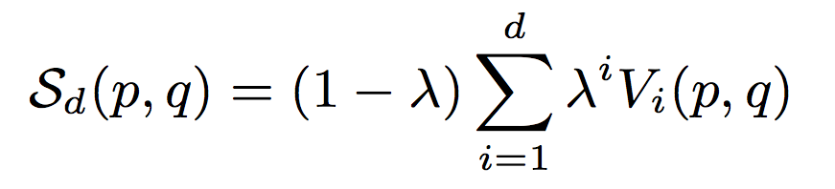
Customization for PPR
Personalized PageRank
V_{i}(p,q): prob. a random surfer from p visits q at the i-th step.

Slide 18
Customization for PPR
Upper-Bound for PPR
V_{i}(p,Q): prob. a random surfer from p visits any node in Q at the i-th step.
V_{i}(p,q) ≤ V_{i}(p,Q), since .
Replace V_{i}(p,q) with V_{i}(p,Q) and obtain an upper-bound of S_{d}(p,q).
How to obtain V_{i}(p, Q) efficiently?
Take nodes in Q as start points, and perform backward random walks

Slide 19
Example: Compute V₂(p, Q)
Normal (forward) random walk
P
Q
1/10
1/2
1/5
1/2
1/2
1/5
1/5
1/5
1/5
1/10
V2( , Q ) = 1/10 + 1/10 = 1/5

Slide 20
Example: Compute V₂(p, Q)
Normal (forward) random walk
P
Q
1/5
1/5
1
1/5
1/5
1
1/5
1/5
1/5
V2( , Q ) = 1/10 + 1/10 = 1/5
V2( , Q ) = 1/5 + 1/5 = 2/5

Slide 21
Example: Compute V₂(p, Q)
Normal (forward) random walk
backward random walk
P
Q
P
Q
1/5
1/5
1/2
2/5
1/5
1
1/5
2/5
V2( , Q ) = 1/10 + 1/10 = 1/5
Benefit
Compute V₂(p, Q) for all p in P by
ONE ROUND of random walks
– O(|P|) improvement!
V2( , Q ) = 1/5 + 1/5 = 2/5

Slide 22
Customization for SR (Sketch)
SR is more difficult to handle than PPR
SR involves computing prob. that two random surfers first meet at the i-th iteration
Computing P_{i}(p,q) and S_{d}(u,v) can be very costly
Idea: prune node pairs without evaluating P_{i}.
Pr(“first meet”) ≤ Pr(“meet”)
Pr(“meet”) is much cheaper to derive
Further speed up by backward random walk

Slide 23
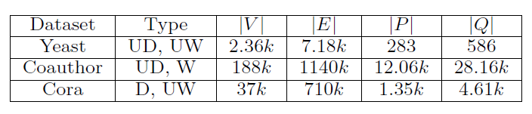
Experiments
Data set
Yeast: protein-protein interaction graph
Coauthor: graph extracted from DBLP
Cora: citation graph
Default value
k = 50

Slide 24
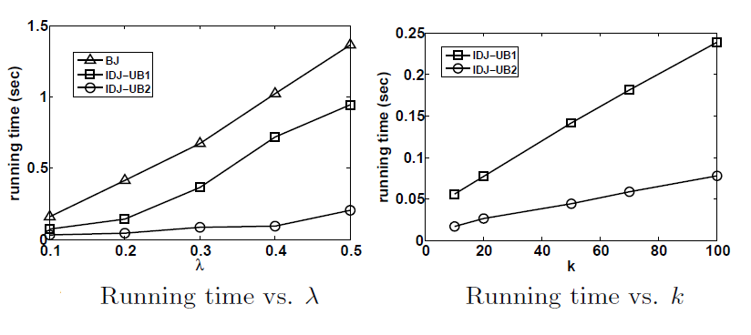
PPR on Yeast

Slide 25
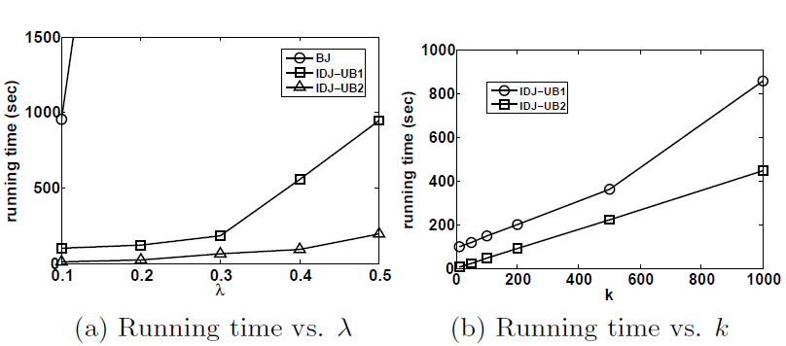
PPR on Coauthor

Slide 26
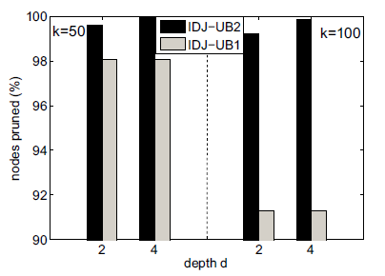
Performance Analysis
PPR on Coauthor

Slide 27
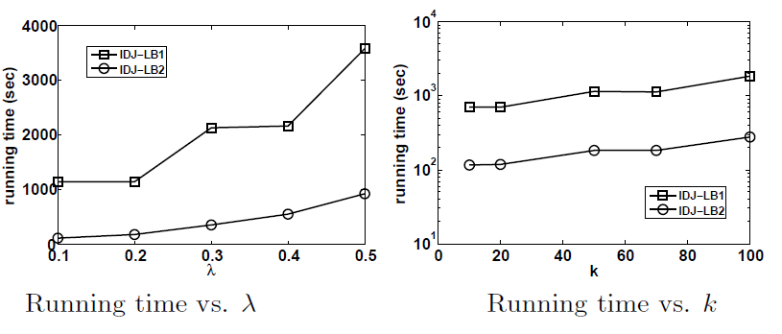
SR on Cora

Slide 28
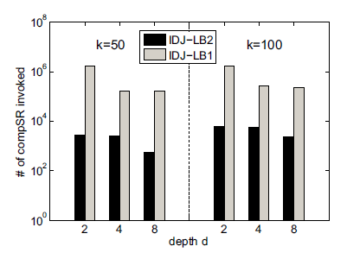
Performance Analysis
SR on Cora
SR in Cora

Slide 29
Conclusions
The LS-join is a similarity join for graph applications
The e-function captures random-walk LS measures
We develop two LS-join algorithms
IDJ for any e-function
Customized and faster algorithms for PPR and SR

Slide 30
Thank you! Reynold Cheng University of Hong Kong ckcheng@cs.hku.hk http://www.cs.hku.hk/~ckcheng

Slide 31
Future Work
Examine other link-based similarity measures
Consider content- and link- similarity together
Develop indexes and distributed algorithms

Slide 32
References
J. Sankaranarayanan et al. Distance join queries on spatial networks. In GIS, pages 211–218, 2006.
L. Zou et al. Distance-join: pattern match query in a large graph database. PVLDB, 2(1):886–897, 2009.
J. Dittrich et al. GESS: a scalable similarity-join algorithm for mining large data sets in high dimensional spaces. In KDD, pages 47–56, 2001.
A. Arasu, V. Ganti, and R. Kaushik. Efficient exact set-similarity joins. In VLDB, pages 918–929, 2006.
C. Boehm et al. Epsilon grid order: An algorithm for the similarity join on massive high-dimensional data. In SIGMOD, pages 379–388, 2001.
C. Xiao et al. Efficient similarity joins for near duplicate detection. In WWW, pages 131–140, 2008.
G. Jeh and J. Widom. Scaling personalized web search. In WWW, pages 271–279, 2003.
D. Lizorkin, P. Velikhov, M. Grinev, and D. Turdakov. Accuracy estimate and optimization techniques for simrank computation. VLDBJ, 19:45–66, 2010.
P. Li et al. Fast single-pair simrank computation. In SDM, pages 571–582, 2010.
D. Fogaras and B. R´acz. Scaling link-based similarity search. In WWW, pages 641–650, 2005.
P. Sarkar and A. Moore. Fast nearest neighbor search in disk-resident graphs. In KDD, pp. 513–522, 2010.

Slide 33
Related works
Similarity Join
Finds relationship among 2 sets of objects
Set/string data
[Arasu et al. VLDB’06] [Xiao et al. WWW’08]
High dimensional database
[Boehm et al. SIGMOD’01] [Dittrich et al. KDD’01]

Slide 34
Link-based Similarity Join (LS-Join)
Given two subsets of nodes P and Q in a graph and a link-based similarity measure S (e.g., SimRank), return k pairs of nodes, one from each set, with the highest S scores.

Slide 35
Other Applications of LS-Join
Citation network analysis
In the citation network, find top-k similar pairs of papers from AI & DB
Link prediction
Predict future friendships between individuals from two communities, e.g.,CS-Dept@HKU and CS-Dept@UIUC.
Notes:
Useful to scientists interested in cross-disciplinary work in AI and DB

Slide 36
The e_{d}-Function
A unified function for a broad class of random-walk-based similarity metrics
a, b: real-valued constants, with a>0
: decay factor; 0 < <1
: a random walk based probability of the i-th step
e-Function

Slide 37
Examples of e-function
Personalized PageRank (PPR)
: prob. A surfer from u visits v at i-th step
a = 1- ; b = 0
SimRank (SR)
: prob. 2 surfers from u and v first meet at i-th step
a = 1; b = 0
Discounted Hitting Time (DHT)
: prob. a surfer from u first visits v at i-th step
a = 1; b = 1

Slide 38
Remarks
IDJ is inspired by the classical search strategy: Iterative Deepening Depth-First Search
Only search a small scope at early iterations
Prune nodes quickly
Exponentially expand the search scope
The bounds are refined and more nodes can be pruned
Space efficient
only store the states of one random surfer at a time
Use a small heap to track the top-k candidate pairs

Slide 39
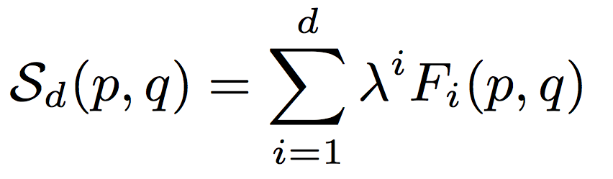
Customization for SimRank (SR)
SimRank
F_{i}(p,q): the probability that two random surfers first meet at the i-th step.

Slide 40
Customization for SR
SR is more difficult to handle than PPR
SR involves two random surfers.
Computing F_{i}(p,q) is even more costly!
We try to prune node pairs without evaluating F_{i}.
Upper bound
Idea: Pr(“first meet”) <= Pr(“meet”)
And Pr(“meet”) can be much cheaper to derive
Further speed up…
Using backward random walk!

