Slide 1

Optimizing Plurality for Human Intelligence Tasks
Luyi Mo
University of Hong Kong
Joint work with
Reynold Cheng, Ben Kao, Xuan Yang, Chenghui Ren, Siyu Lei, David Cheung, and Eric Lo

Slide 2
Outline
Introduction
Problem Definition & Solution for Multiple Choice Questions
Experiments
Extension to Other HIT Types
Conclusions

Slide 3
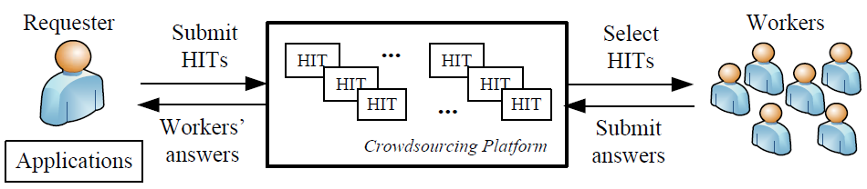
Crowdsourcing Systems
Harness human effort to solve problems
Examples:
Amazon Mechanical Turk (AMT), CrowdFlower
HITs: Human Intelligence Tasks
Entity resolution, sort and join, filtering, tagging
$$

Slide 4


Plurality of HITs
Imperfect answers from a single worker
make careless mistakes
misinterpret the HIT requirement
Specify sufficient plurality of a HIT (number of workers required to perform that HIT)
Combined answer
HIT result
HIT

Slide 5
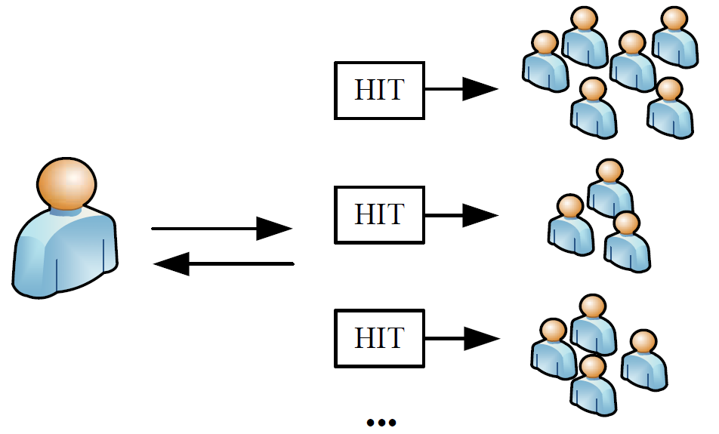

Plurality Assignment Problem (PAP)
Plurality has to be limited
A HIT is associated with a cost
Requester has limited budget
Requester requires time to verify HIT results
$$
PAP:
wisely assign the right pluralities to various HITs to achieve overall high-quality results
Budget
$$
$$

Slide 6
Our Goal
Manually assigning pluralities is tedious if not infeasible
AMT on 28th October, 2012
90,000 HITs submitted by Top-10 requesters
Algorithms for automating the process of plurality assignment are needed!

Slide 7
Related Work (1)
Designing HIT questions
Human-assisted graph search ^{[1]}
Entity resolution ^{[2] [3]}
Identifying entity with maximum value ^{[4]}
Data filtering ^{[5]} / data labeling ^{[6]}
We consider how to obtain high-quality results for HITs
[1] Human-assisted graph search: it’s okay to ask questions. A. Parameswaran et al. VLDB’11
[2] CrowdER: crowdsourcing entity resolution. J. Wang et al. VLDB’12
[3] Question selection for crowd entity resolution. S. Whang et al. Stanford TechReport, 2012
[4] So who won? Dynamic max discovery with the crowd. S. guo et al. SIGMOD’12
[5] Crowdscreen: Algorithms for filtering data with humans. A. Parameswaran et al. SIGMOD’12
[6] Active learning for crowd-sourced databases. B. Mozafari et al. Technical Report, 2012

Slide 8
Related Work (2)
Determining Plurality
Minimum plurality of an multiple choice question (MCQ) to satisfy user-given threshold ^{[7] [8]}
We study plurality assignment to a set of different HITs
Assigning specific workers to perform specific binary questions ^{[9]}
We study properties of HITs, and the relationship between HIT cost and quality.
[7] CDAS: A crowdsourcing data analytics system. X. Liu et al. VLDB’12
[8] Automan: A platform for integrating human-based and digital computation. D. Barowy et al. OOPSLA’12
[9] Whom to ask? Jury selection for decision making tasks on micro-blog services. C. Cao et al. VLDB’12

Slide 9
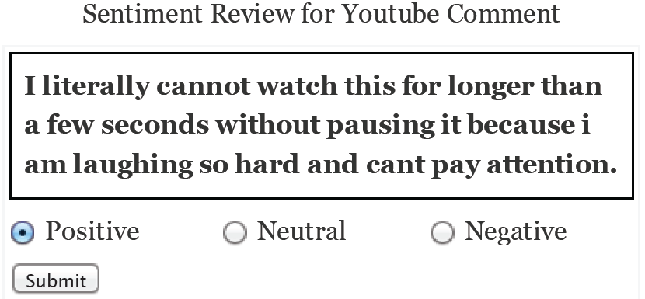
Multiple Choice Questions (MCQs)
Most popular type
AMT on 28th Oct, 2012
About three quarters of HITs are MCQs
Examples
Sentiment analysis, categorizing objects, assigning rating scores, etc.

Slide 10
Data Model
Set of HITs
For each HIT
contains a single MCQ
plurality (i.e., workers are needed)
cost (i.e., units of reward are given for completing )

Slide 11
Quality Model
Capture the goodness of HIT result’s for
MCQ quality
likelihood that the result is correct after it has been performed by k workers
Factors that affect MCQ quality
plurality: k
Worker’s accuracy (or accuracy):
probability that a randomly-chosen worker provides a correct answer for
estimated from similar HITs whose true answer is known

Slide 12
Problem Definition
Input
budget
Set of HITs
Output
pluralities for every HITs
Objective
maximize overall average quality

Slide 13
Solutions
Optimal Solution
Dynamic Programming
Not efficient for HIT sets that contain thousands of HITs
60,000 HITs extracted from AMT
Execution time: 10 hours

Slide 14
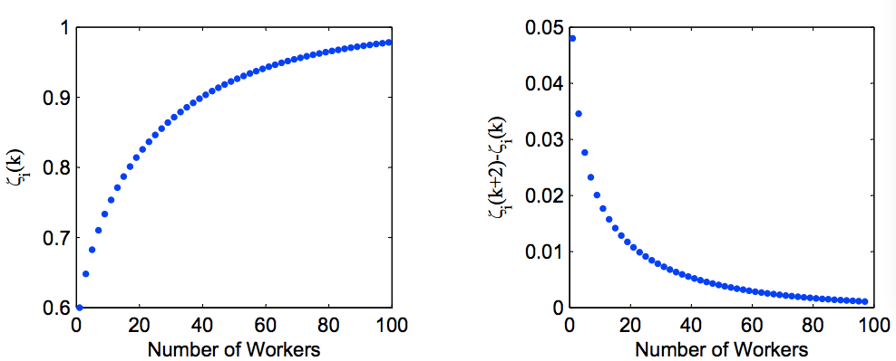
Greedy: 2-approximate algorithm
Properties of MCQ quality function
Monotonicity
Diminishing return
PAP is approximable for HITs with these two properties
Greedy
Select the “best” HIT and increase its plurality until budget is exhausted
Selection criteria: the one with largest marginal gain
Theoretical approximation ratio = 2
quality
increasing rate

Slide 15
Grouping techniques
Observations
Many HITs submitted by the same requesters are given the same cost and of very similar nature
Intuition
Group HITs of the same cost and quality function
More or less the same plurality for HITs in one group
Main idea
Select a “representative HIT” from each group
Evaluate its plurality by DP or Greedy
Deduce each HIT’s plurality from the representative HIT

Slide 16
Experiments
Synthetic
Generated based on the extraction of an AMT requester’s HITs information on Oct 28th, 2012
Statistics
67,075 HITs
12 groups (same cost and accuracy)
Costs vary from $0.08 to $0.24
Accuracy of each group is randomly selected from [0.5, 1]

Slide 17
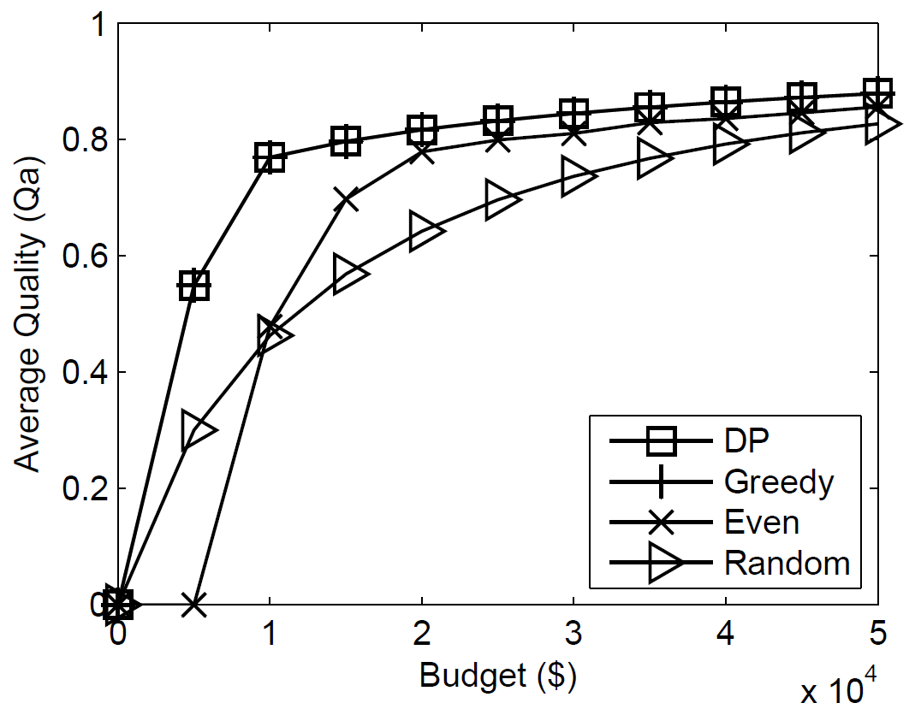
Effectiveness
Competitors
Random: arbitrarily pick a HIT to increase its plurality until budget is exhausted
Even: divide the budget evenly across all HITs
5%
20%
Greedy is close-to-optimal in practice
3 per HIT

Slide 18
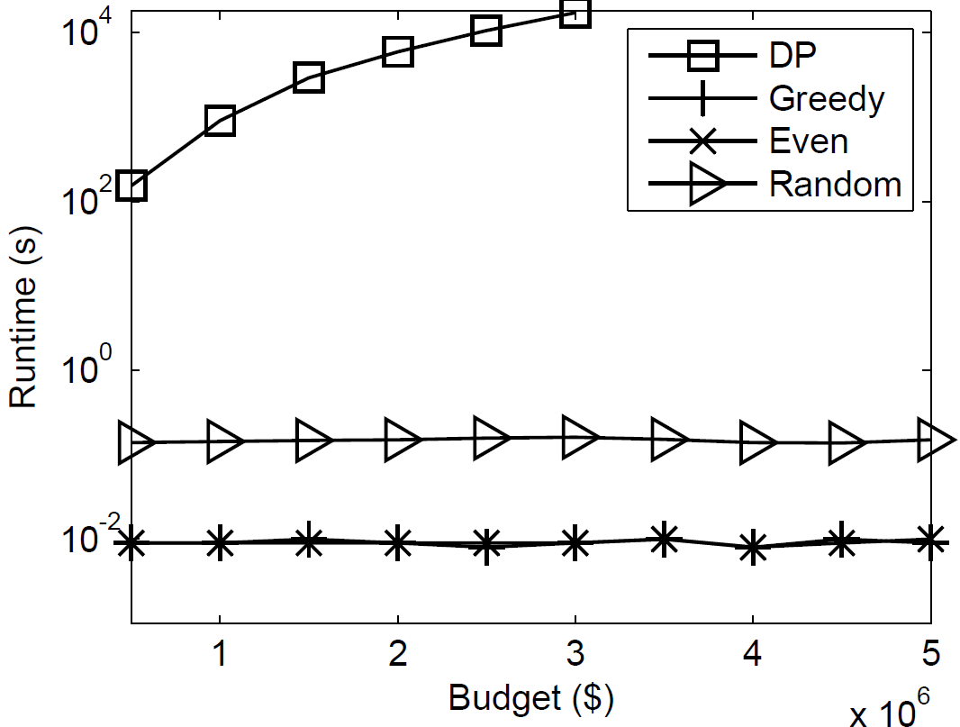
Performance (1)
DP and Greedy are implemented using grouping techniques
Greedy is efficient!
1,000x
10,000x

Slide 19
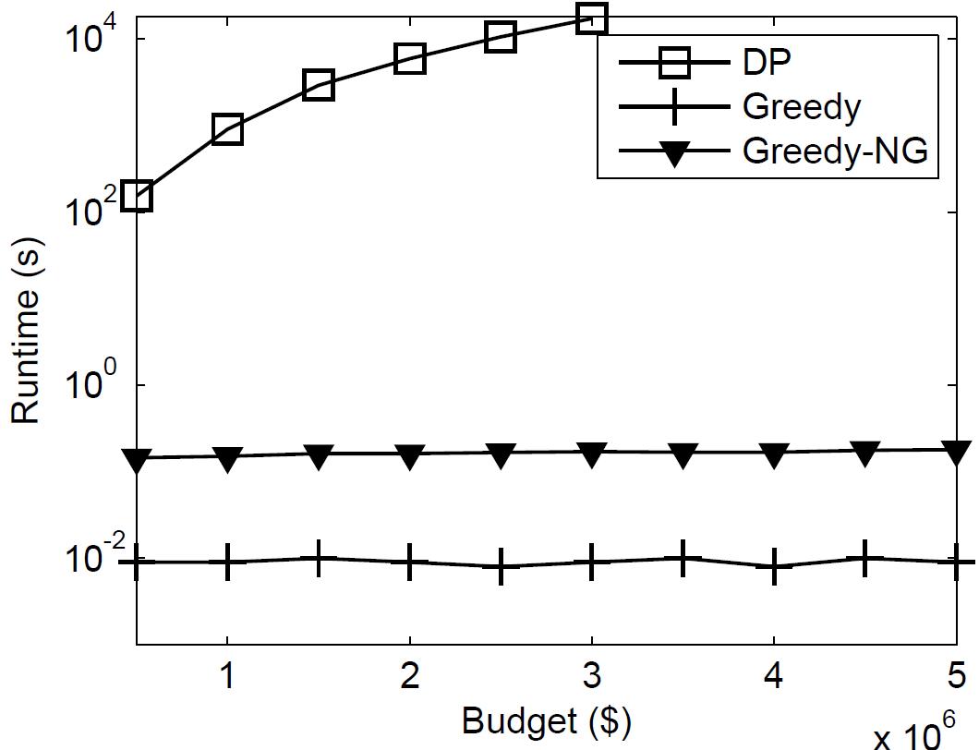
Performance (2)
Grouping techniques
20 times faster than non-group solutions
12 groups vs. 60,000 HITs

Slide 20
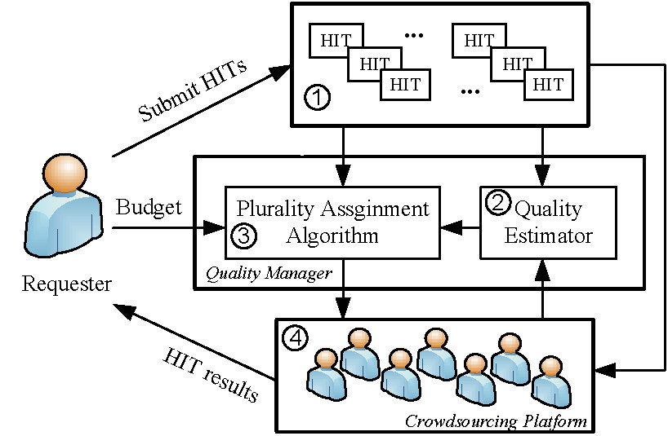
Other HIT Types
Examples
Enumeration Query
Tagging Query
Solution framework
Quality estimator
Derive
accuracy in MCQ
PA algorithm
Greedy for HITs demonstrate
monotonicity and diminishing return

Slide 21
Enumeration Query
Objective
obtain a complete set of distinct elements for a set query
Quality function from [10]
Satisfy monotonicity and diminishing return
Greedy can be applied
[10] Crowdsourced Enumeration Queries. MJ Franklin et al. ICDE’13

Slide 22
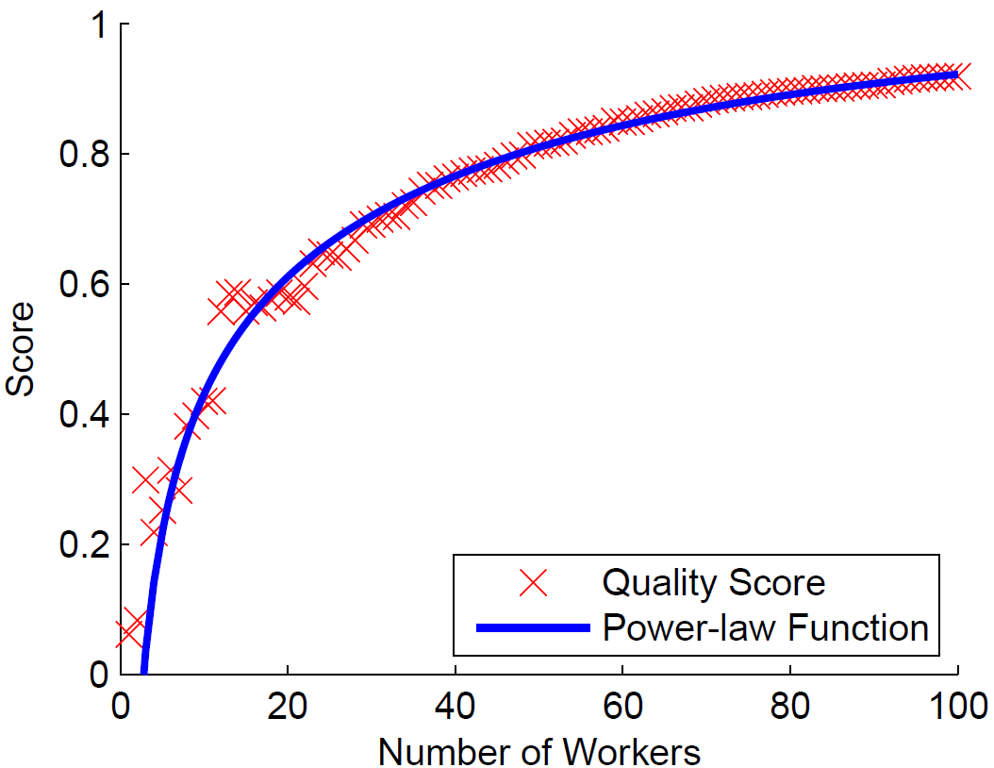
Tagging Query
Objective
obtain keywords (or tags) that best describe an object
Empirical results from [11]
Power-law relationship with number of workers’ answers
[11] On Incentive-based Tagging. X. Yang et al. ICDE’13

Slide 23
Conclusions
Problem of setting plurality for HITs
Develop effective and efficient plurality algorithms for HITs whose quality demonstrates monotonicity and diminishing return
Future work
Study the extensions to support other kinds of HITs (i.e. Enumeration Query and Tagging Query)

Slide 24
Thank you! Contact Info: Luyi Mo University of Hong Kong lymo@cs.hku.hk http://www.cs.hku.hk/~lymo

Slide 25
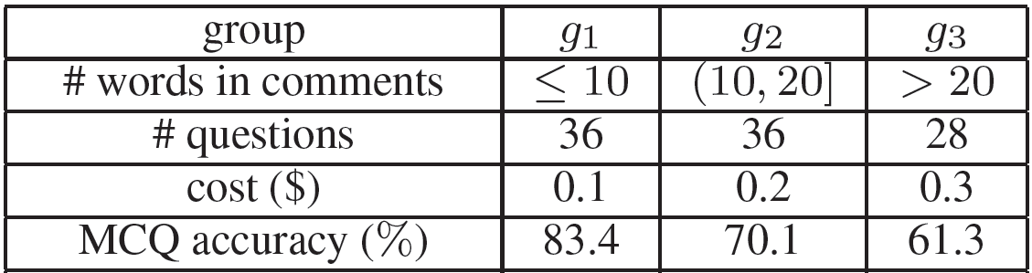
Results on Real Data
MCQs
Sentiment analysis (positive, neutral, negative) for 100 comments extracted from Youtube videos
25 answers collected per MCQ
Statistics
Similar trends to that of synthetic data in effectiveness and performance analysis

Slide 26
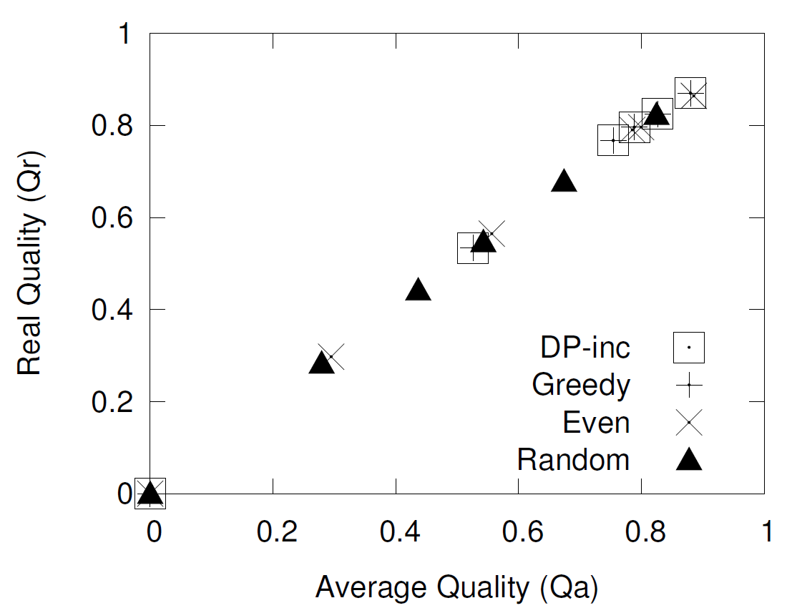
Results on Real Data (2)
Correlation between the MCQ quality and Real quality
Real quality: goodness of answers obtained from workers after the MCQ reached the assigned plurality
Correlation is over 99.8%
MCQ quality is a good indicator

