Slide 1

Probabilistic Verifiers:
Evaluating Constrained Nearest-Neighbor Queries over Uncertain Data
IEEE ICDE 2008
Reynold Cheng
Hong Kong Polytechnic University
csckcheng@comp.polyu.edu.hk
http://www.comp.polyu.edu.hk/~csckcheng
Jinchuan Chen (csjcchen@comp.polyu.edu.hk)
Hong Kong Polytechnic University
Mohamed Mokbel, Chi-Yin Chow ({mokbel,cchow}@cs.umn.edu)
The University of Minnesota-Twin Cities

Slide 2

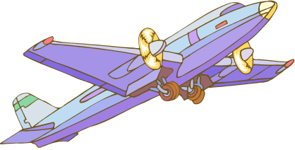


Location and Sensor Applications
Find a cab closest to my current location.
What is the region that gives max temperature?
GPS
sensor
network
Service
Provider
RF-ID
Notes:
Positioning technologies like GPS, GSM, RF-ID and WiFi have developed rapidly in recent years.
They allow locations of users to be decided, and enable a new class of applications know as Location-based-service.
Examples:
A moving object database monitors locations of mobile devices
An air-conditioning system uses temperature sensors to adjust the temperature of each room
Sensors are used to detect if hazardous materials are present and how they are spreading

Slide 3
Data Uncertainty
Measurement error [TDRP98, ISSD99]
Sampling error [TDRP98, ISSD99]
Network latency [TKDE04]
Manually injected by users to protect location privacy [PET06,VLDB06]

Slide 4
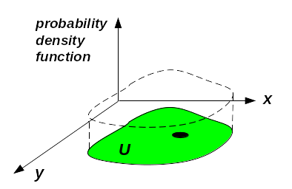
Attribute Uncertainty Model
[TDRP98, ISSD99,VLDB04b]
pdf
(pdf)
y
Uncertainty region
We represent an uncertainty pdf as a histogram

Slide 5
Probabilistic Nearest Neighbor Query (PNN) [TKDE04]
INPUT
A query point called q
A set of n objects X₁,X₂,…, X_{n} with uncertainty regions and pdfs
OUTPUT
A set of (X_{i},p_{i}) tuples
  p_{i} is the non-zero probability (qualification probability) that X_{i} is the nearest neighbor of q
Notes:
Prior work addresses range queries over a limited model of uncertainty (normal distribution and straight line movement). Here we illustrate a more difficult query, involving interaction between objects to derive a result (nearest neighbor).

Slide 6
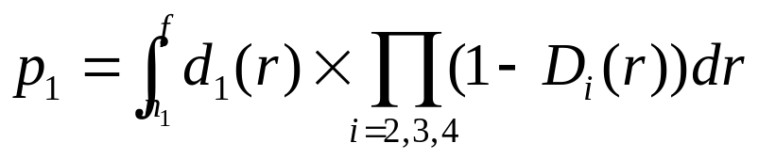
Basic Solution [TKDE04]
d_{i}(r): distance pdf of X_{i} from q
D_{i}(r): distance cdf of X_{i} from q
n_{i}: smallest distance of X_{i} from q
f: shortest max distance of all objects from q
X₅
X₃
f
X₁
n₁
q
X₄
X₂
X₆
Notes:
Once we know these values of these functions from the particular uncertainty model (line uncertainty and free-moving uncertainty), we can plug in the values to this algorithm and compute the probabilities.
As an illustration, we briefly describe how these four parameters are derived for free-moving uncertainty.

Slide 7
2 Assumptions
A user only needs answers with confidence higher than some threshold
Approximation of qualification probabilities is allowed

Slide 8
Constrained Probabilistic
Nearest-Neighbor Query (C-PNN)
Denote
  p_{i}.l: lower bound of p_{i}
  p_{i}.u: upper bound of p_{i}
  P: Probability threshold
  ∆: Tolerance
Given (P, ∆), return a set {X_{i}}:
  p_{i}.u ≥ P, and
  p_{i}.l ≥ P, or p_{i}.u – p_{i}.l ≤ ∆

Slide 9
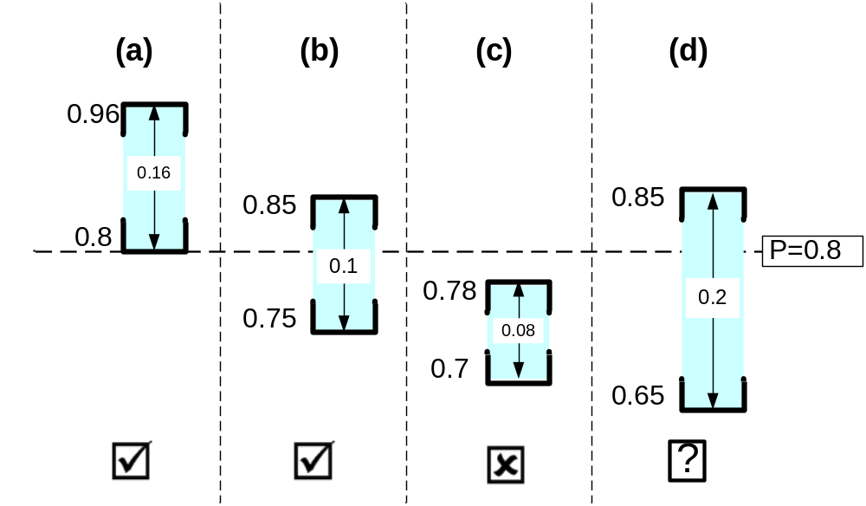
Illustrating C-PNN (with P=0.8, ∆=0.15)
p_{i}.u
P=0.8
P=0.8
p_{i}.l
To be refined

Slide 10
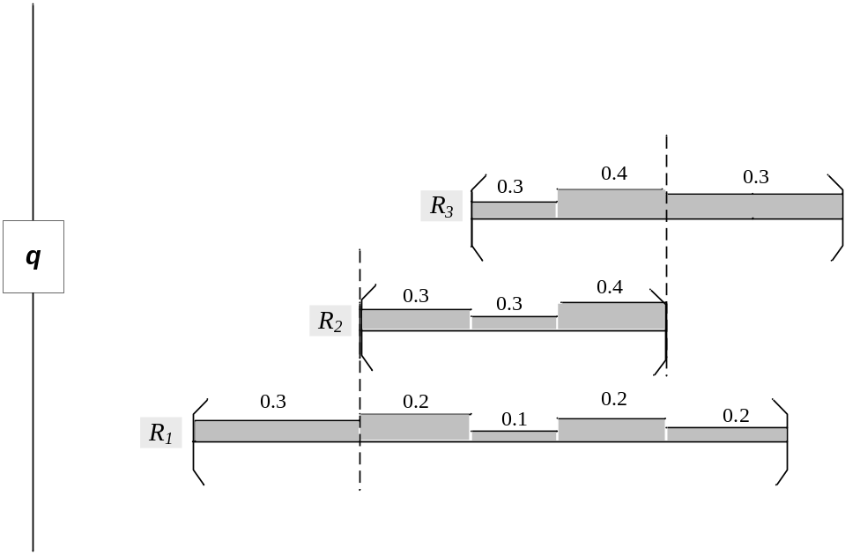
Intuition
If [p_{i}.l, p_{i}.u] is known, whether X_{i} satisfies C-PNN can be computed without knowing p_{i}.
p₃.u ≤ 1-0.3
p₁.l ≥ 0.3
Compute [p_{i}.l,p_{i}.u] for any distance pdf

Slide 11
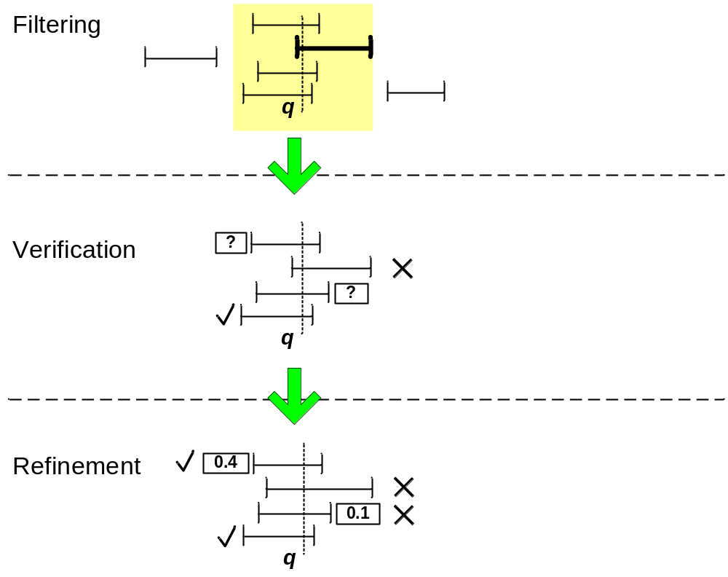
Solution Framework

Slide 12
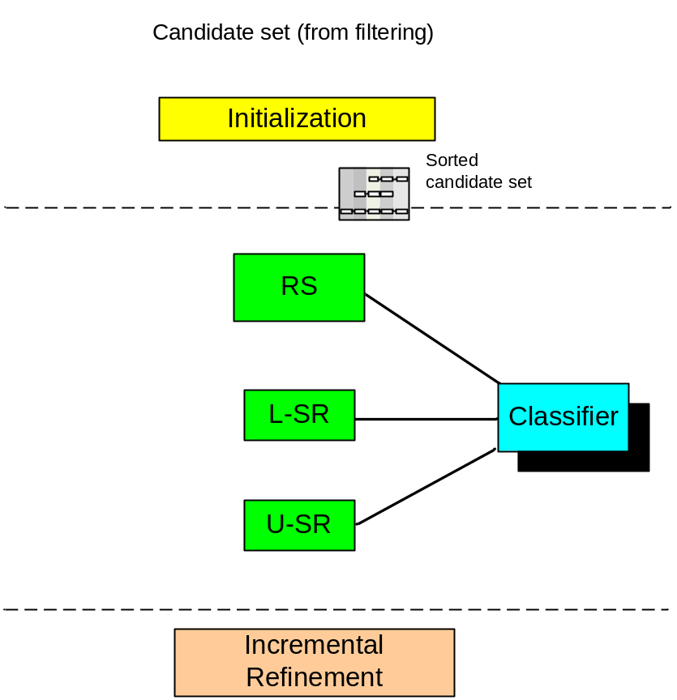
Probabilistic Verifiers
Test if X_{i} satisfies, or fails the query
In ascending order of computational complexity
X_{i}
User

Slide 13
Example: P=0.5,Δ=0.15
Candidates (After filtering)
1
Classifier
A
1
0.4
0
0.4
0
Incremental Refinement
1
Verifier
0.6
0.48
B
0.3
?
0.13
1
0.3
0.35
0
0.54
C
0.14
✓
1
0.4

Slide 14
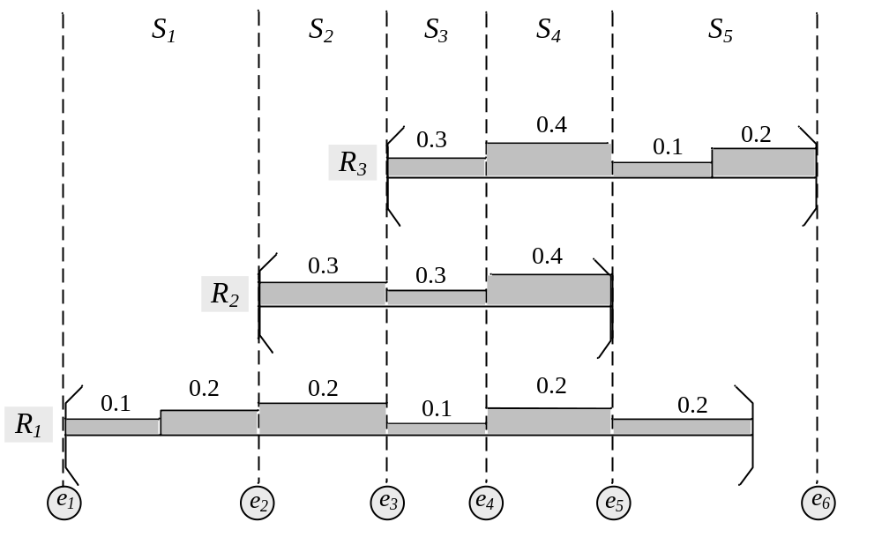
Partitioning uncertainty pdfs into subregions
Notes:
Generally explain the subregions. Next, we show how to generate these subregions based on the query point and the uncertain data objects.

Slide 15
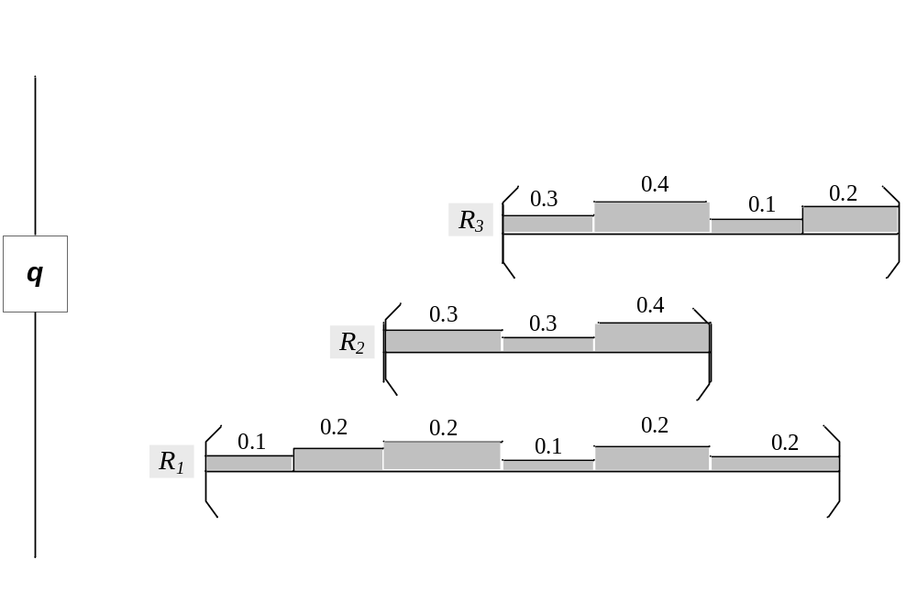
End-Points
S1
S2
S3
S4
S5
f
e1
e2
e3
e4
e5
e6
Notes:
The end-points include:
All near points
The minimum and maximum of far points
The point which the distance pdf changes
Then the subregions are formed by the adjacent pairs of end-points.

Slide 16
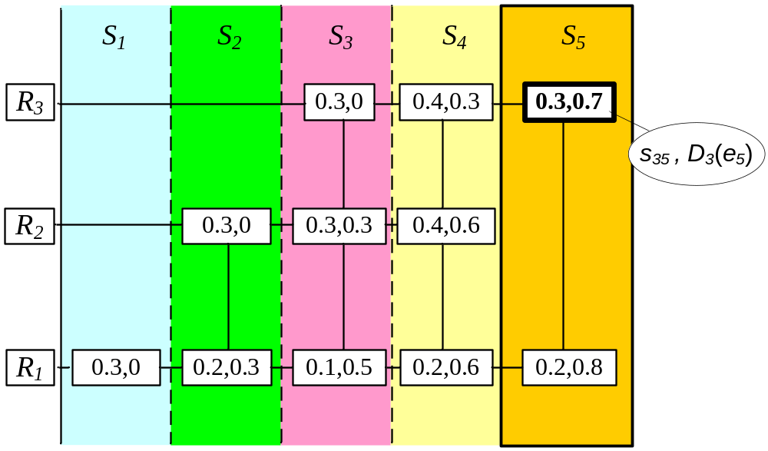
Subregion Data Structure

Slide 17
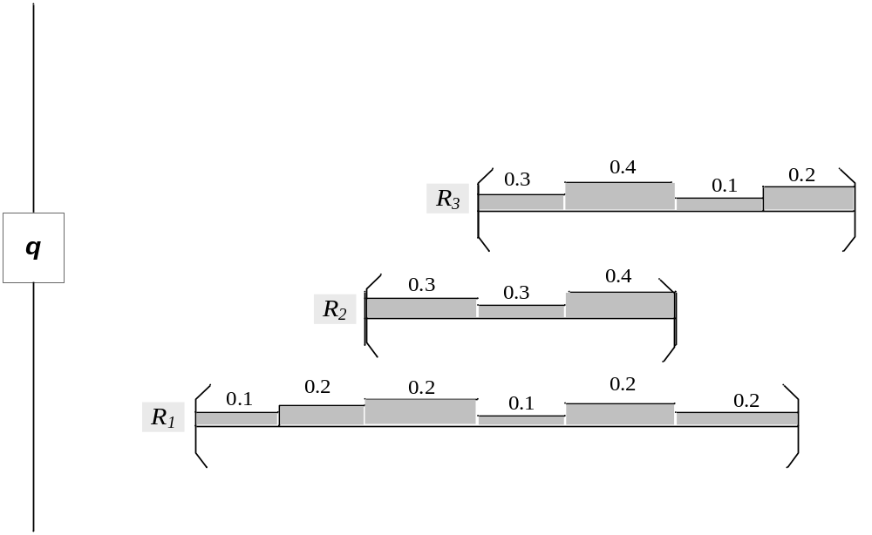
Rightmost-Subregion (RS) Verifier
X₃ has no chance to be the nearest neighbor when R₂ > f₂.
p₃ ≤ 1-0.3=0.7
p₁ ≤ 1-0.2=0.8

Slide 18
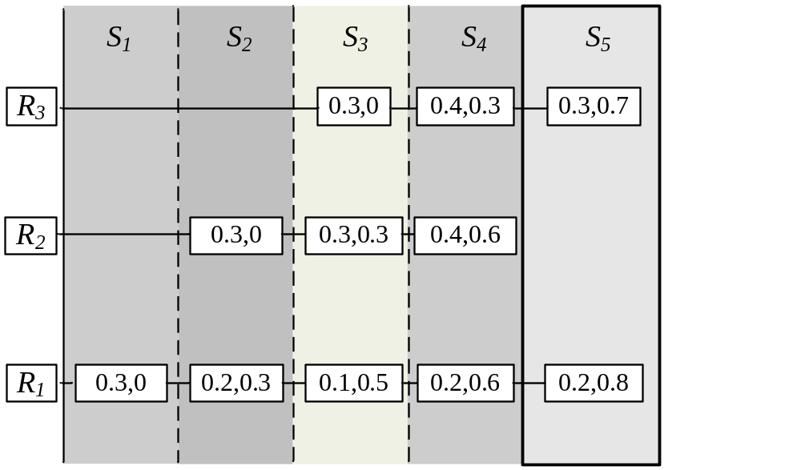
RS Verifier
p₃ ≤ 0.7
p₁ ≤ 0.8

Slide 19
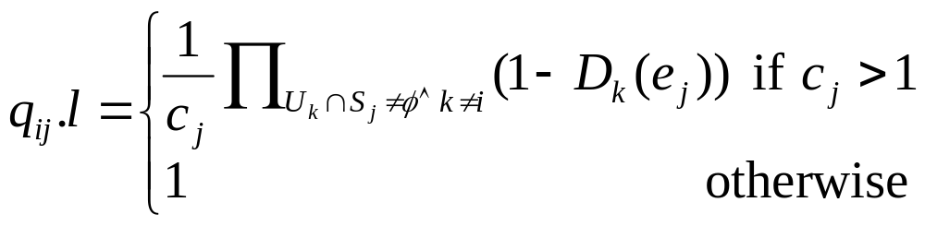
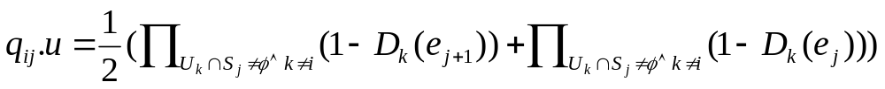
L-SR and U-SR Verifiers
No. of objects in subregion S_{j}
Qualifcation prob. of X_{i} in subregion S_{j}

Slide 20
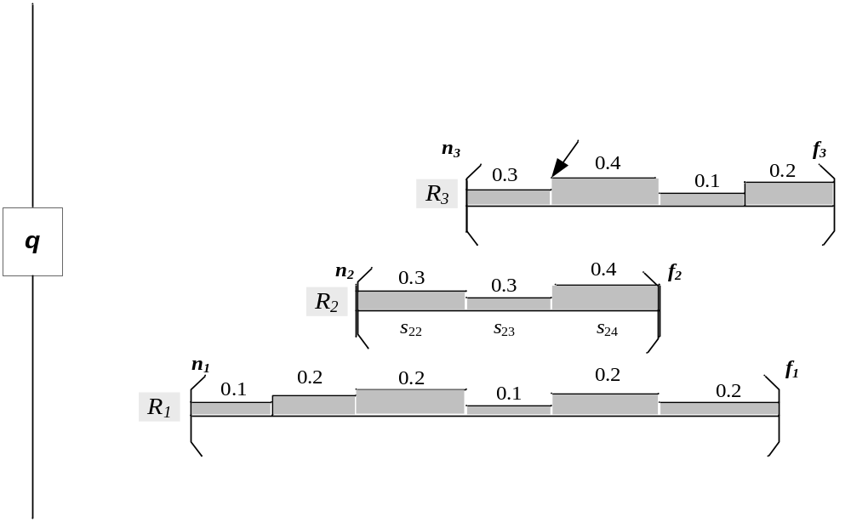
L-SR and U-SR Verifiers
S3
e3
e4
q13 =1 if both R2 and R3 are larger than e4
q13 =0 if either R2 or R3 are smaller than e3
q13 =1/3 if both R2 or R3 are insider S3
Notes:
There are lots of combinations for the values of other objects, e.g. R2 and R3. The value of q_ij will be more precise if more combinations are included into the calculation. It is not possible to consider all the combinations. We bound the value of q_ij by choosing a small part of combinations which are easy to handle and contribute an important part to q_ij.

Slide 21
Complexity of Verifiers
Algorithm | Qualification Prob. Bound | Cost
RS | Upper | O(|C|)
L-SR | Lower | O(|C|M)
U-SR | Upper | O(|C|M)
|C|=no. of candidates with non-zero prob.
M= no. of subregions

Slide 22

Incremental Refinement
[p₂.l, p₂.u] = [q₂₁.l,q₂₁.u]*0.3 + [q₂₂.l,q₂₂.u]* 0.3 + [q₂₃.l,q₂₃.u] * 0.4
[p₂.l, p₂.u] = q₂₁* 0.3 + q₂₂* 0.3 + [q₂₃.l,q₂₃.u] * 0.4
p₂ = q₂₁* 0.3 + q₂₂* 0.3 + q₂₃* 0.4
[p₂.l, p₂.u] = q₂₁*0.3 + [q₂₂.l,q₂₂.u]* 0.3 + [q₂₃.l,q₂₃.u] * 0.4
Notes:
We can decompose the refinement of qualification probability into a series of probability calculations inside subregions.
Once we have computed the probability qij for subregion Sj , we collapse [qij .l, qij.u] into a single value qij , update the probability bound [pi.l, pi.u], and test this new bound with classifier. We repeat this process with another subregion until we can classify the object.
For example, after calculating the exact values of q11 and q12, we may find R1 could be rejected and the refinement process is finished.

Slide 23
Experiment Setup
Uncertain Object DB | Long Beach (53k) (http://www.census.gov/geo/www/tiger/)
Uncertainty pdf | Uniform (default) Gaussian (μ: center, σ: 1/6 of range)
Size of R-Tree/PTI Node | 4kbytes
Threshold (P) | 0.3
Delta (∆) | 0.01

Slide 24
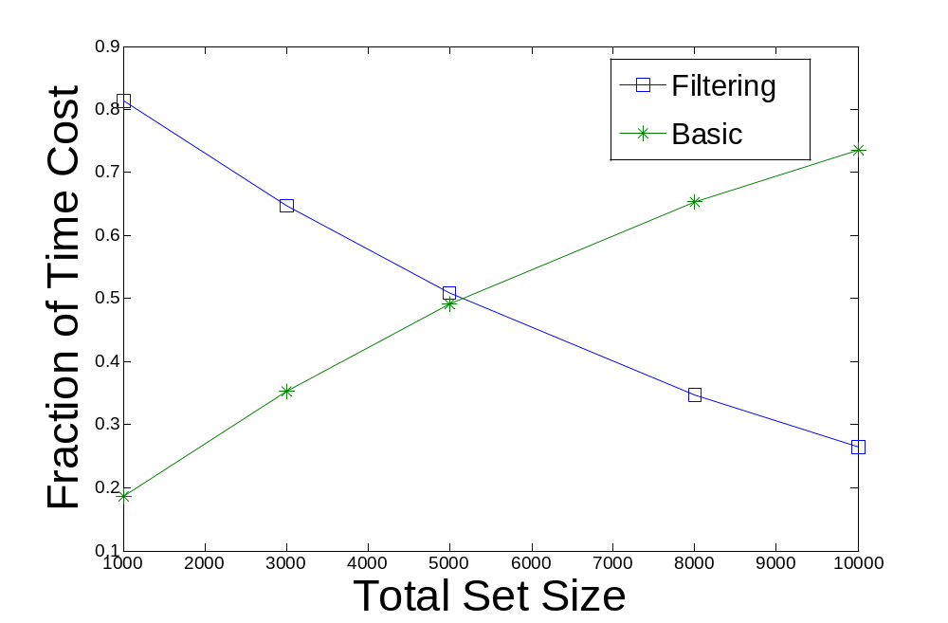
1. Effect of Filtering
Notes:
The fraction of total time spent in these two operations on synthetic data sets with different candidate set sizes. As the total table size |T| increases, the time spent on the Basic solution increases more than filtering, and so its running time starts to dominate the filtering time when the candidate set
size is larger than 5000. As we will show next, other methods can alleviate this problem.

Slide 25
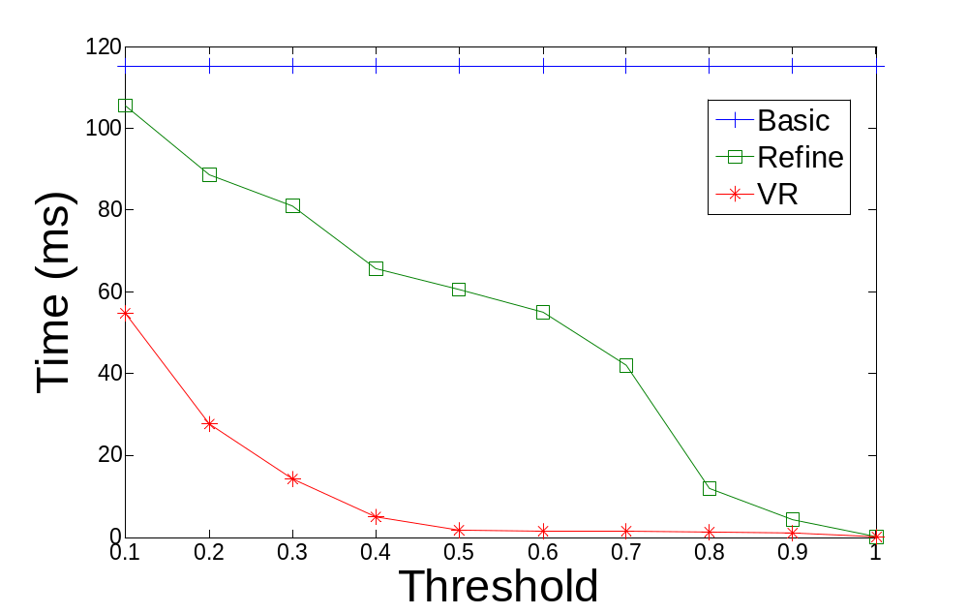
2. Effect of Verification
5 times
40 times
Notes:
We compare the time required by the three evaluation strategies under a wide range of values of P. Both Refine and VR perform better than Basic. At P = 0.3, for instance, the costs for Refine and VR are 80% and 16% of Basic respectively. The reason is that both techniques allow query processing to be finished once all objects have been determined, without waiting for the exact qualification probabilities to be computed. For large values of P, most objects can be classified as fail quickly when their upper probability bounds are detected to be lower than P. Moreover, VR is consistently better than Refine; it is five times faster than Refine at P = 0.3, and 40 times faster at P = 0.7.
This can be explained by next figure.

Slide 26
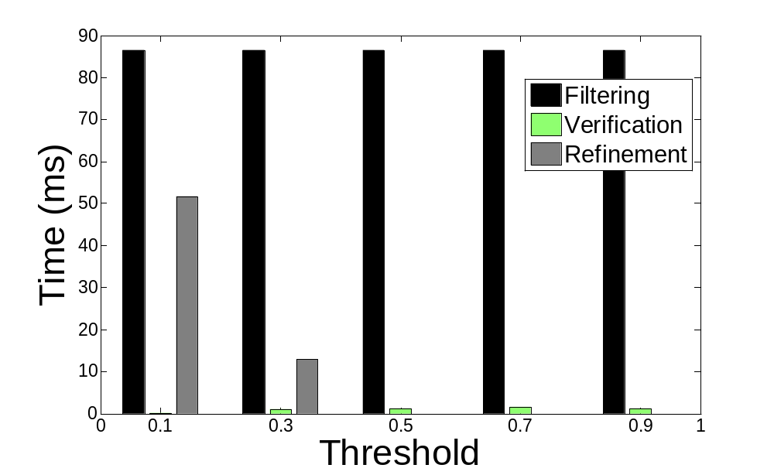
2. Analysis of VR
Notes:
it shows the execution time of filtering, verification and refinement for VR. While the filtering time is fixed, the refinement time decreases with P. The verification takes only 1ms on average, and it significantly reduces the number of objects to be refined. In fact, when P > 0.3, no more qualification probabilities need to be computed. Thus, VR produces a better performance than Refine.

Slide 27
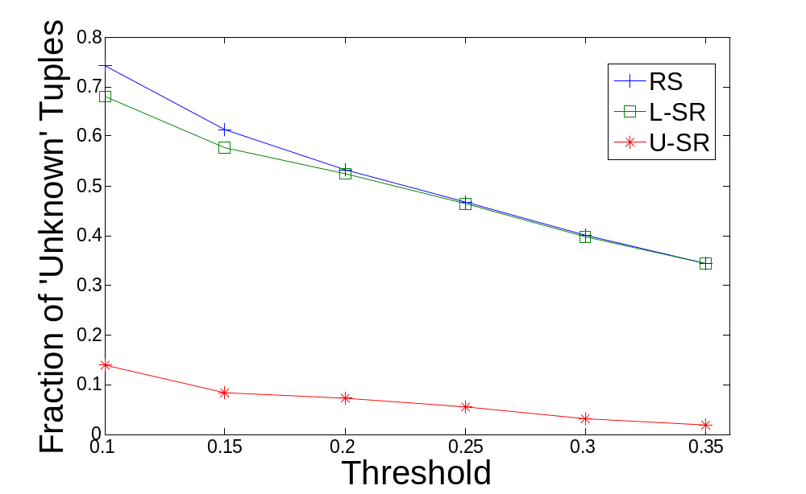
3. Effect of Threshold
Notes:
The above figure shows the fraction of objects labeled unknown after the execution of verifiers in the order: {RS, L-SR, U-SR}. This fraction reflects the amount of work needed to finish the query. At P = 0.1, about 75% of unknown objects remain after the RS is finished; 7% more objects are removed by L-SR; 15% unknown objects are left after the U-SR is executed. When P is large, RS and U-SR perform better, since they reduce upper probability bounds, so that the objects have a higher chance of being labeled as fail. L-SR works better for small P (as seen from the gap between the RS and L-SR curves). L-SR increases the lower probability bound, so that an object is easier to be classified as satisfy at small P. In this experiment, U-SR performs better than L-SR. This is because the candidate set size is large
(about 96 objects), so that the probabilities of the objects are generally quite small. Since U-SR reduces their upper probability bounds, they are relatively easy to be verified as fail, compared with L-SR, which attempts to raise their lower probability bounds.

Slide 28
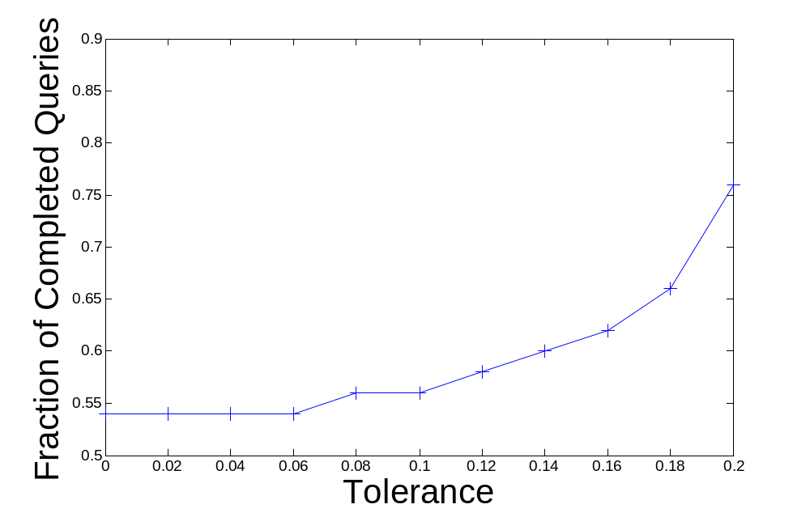
4. Effect of Tolerance
Notes:
Now, we measure the fraction of queries finished after verification under different tolerance. This figure shows that as Δ increases from 0 to 0.2, more queries are completed. When Δ = 0.16, about 10% more queries will be completed than when Δ = 0. Thus, the use of tolerance can improve query performance.

Slide 29
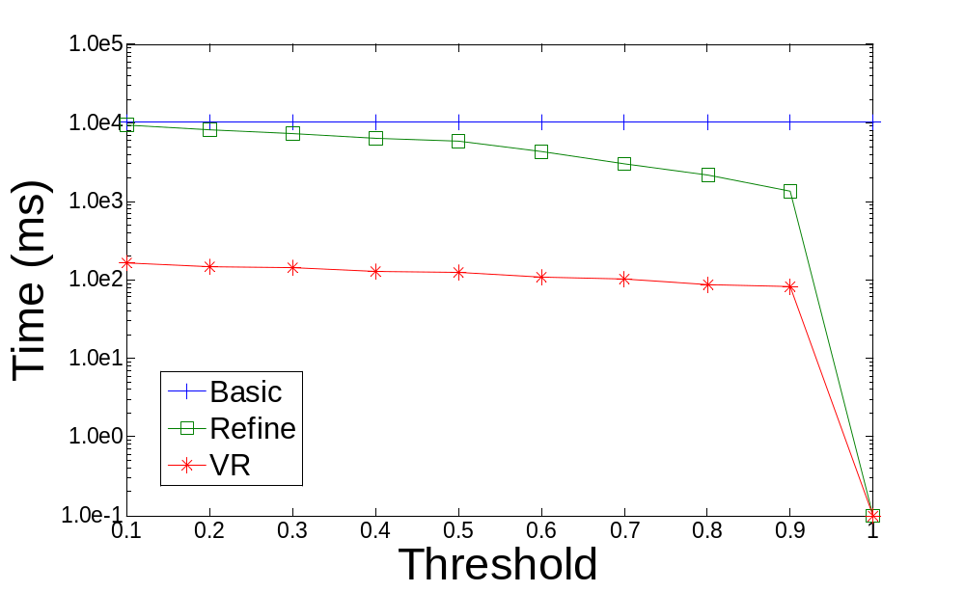
5. Gaussian pdf
Notes:
Finally, we examine the effect of using a Gaussian distribution as the uncertainty pdf for each object. Each Gaussian pdf, approximated by a 300-bar histogram, has a mean at the center of its range, and a standard deviation of 1/6 of the width of the uncertainty region. Figure 14 shows the time drawn in log scale. VR again outperforms the other two methods. The saving is more significant than when uniform pdf is used. This is because the probability evaluation of Gaussian pdf is expensive, but this operation can be effectively avoided by the verifiers. This experiment shows that our method also works well with Gaussian pdf. The little time cost for both Refine and VR at threshold P = 1 is due to the fact that only one candidate, if any, can satisfy the query at P = 1. By checking against these conditions, both methods can accept or reject candidate objects with ease.

Slide 30
Related Works
PNNQ
  R-tree based [TKDE04]
  Monte-Carlo based [DASFAA07]
  Line-approximation of uncertainty pdf [ICDE07b]
Range Queries [DPD99, ISSD99, VLDB04a, VLDB05, ICDE07a]
Top-k Queries [ICDE07c, ICDE08b, ICDE08c]
Skylines [VLDB07] and reverse skylines [SIGMOD08]
Identification in uncertain biometric database [ICDE06]

Slide 31
Other Uncertainty Models
Probabilistic Database: each tuple is augmented with a probability value (tuple uncertainty)
  Dalvi & Suciu [VLDB04b,ICDE07d] studied efficient query operator evaluation with ranked results.
  [VLDB06, ICDE08b] combined the attribute and tuple uncertainty models.
A large branch of work deals with fuzzy modeling [IGP06].
Notes:
Acyclic data structure (Hung,Getoor & Subrahmanian) [ICDE03]

Slide 32
References
[TKDE04] R. Cheng, D. V. Kalashnikov, and S. Prabhakar. Querying imprecise data in moving object environments. IEEE TKDE, 16(9), Sept. 2004.
[SIGMOD03] R. Cheng, D. Kalashnikov, and S. Prabhakar, “Evaluating probabilistic queries over imprecise data,” in Proc. ACM SIGMOD, 2003.
[DASFAA07] H. Kriegel, P. Kunath, and M. Renz, “Probabilistic nearest-neighbor query on uncertain objects,” in DASFAA, 2007.
[ICDE06]C. Bohm, A. Pryakhin, and M. Schubert, “The gauss-tree: Efficient object identification in databases of probabilistic feature vectors,” in Proc. ICDE, 2006.
[ICDE07a] J. Chen and R. Cheng, “Efficient evaluation of imprecise locationdependent queries,” in Proc. ICDE, 2007.
[IDG06] J. Galindo, A. Urrutia and M. Piattini. Fuzzy Databases: Modeling, Design, and Implementation. Ideas Group Publishing, 2006.
[ICDE08b[ M. Hua, J. Pei, X. Lin and W. Zhang. Efficiently Answering Probabilistic Threshold Top-k Queries on Uncertain Data, ICDE 2008.
[SIGMOD08] X. Lian and L. Chen. Monochromatic and bichromatic reverse skyline search over uncertain databases. In Proc. SIGMOD, 2008.
[ICDE08c] K. Yi, F. Li, D. Srivastava, and G. Kollios. Efficient processing of top-k queries in uncertain databases. In Proc. ICDE, 2008.

Slide 33
References
[VLDB05]Y. Tao, R. Cheng, X. Xiao, W. K. Ngai, B. Kao, and S. Prabhakar, “Indexing multi-dimensional uncertain data with arbitrary probability density functions,” in Proc. VLDB, 2005
[VLDB04b] N. Dalvi and D. Suciu. Efficient Query Evaluation on Probabilistic Databases. VLDB 2004.
[ICDE07d] Chris Re, Nilesh Dalvi, Dan Suciu. Efficient Top-k Query Evaluation on Probabilistic Data. ICDE, 2007
[VLDB04c] A. Deshpande, C. Guestrin, S. Madden, J. Hellerstein and W. Hong. Model-Driven Data Acquisition in Sensor Networks. In VLDB, 2004.
[VLDB06] O. Mar, A. Sarma, A. Halevy, and J. Widom. ULDBs: databases with uncertainty and lineage. In VLDB, 2006.
[ICDE07b] V. Ljosa and A. K. Singh. APLA: Indexing arbitrary probability distributions. In Proc. ICDE, 2007.
[ADI00] Y. Manolopoulos, Y. Theodoridis, and V. J. Tsotras. Chapter 4: Access methods for intervals. In Advanced Database Indexing, Kluwer, 2000.
[VLDB07] J. Pei, B. Jiang, X. Lin, and Y. Yuan. Probabilistic skylines on uncertain data. In Proc. VLDB, 2007.
[DPD99] O. Wolfson, P. Sistla, S. Chamberlain, and Y. Yesha. Updating and querying databases that track mobile units. Distributed and Parallel Databases, 7(3), 1999.
[ISSD99] D. Pfoser and C. S. Jensen. Capturing the Uncertainty of Moving-Object Representations, in Proc. of the Sixth International Symposium on Spatio Databases, Hong Kong, July 20-23, 1999, pp. 111-132.
[ICDE08a] Singh et al. Database support for pdf attributes. In Proc. ICDE, 2008.
[ICDE07c] M. Soliman, I. Ilyas, and K. Chang. Top-k query processing in uncertain databases. In ICDE, 2007.

Slide 34
Conclusions
To avoid expensive evaluation of PNNQ, we propose the notion of constrained PNNQ (P, ∆).
We present a framework which gradually refines the bounds of qualification probabilities.
  RS, L-SR, and U-SR verifiers
  Incremental Refinement
The method deals with arbitrary uncertainty pdf

