Slide 1
Very Large Database Conference 2008
Cleaning Uncertain Data with Quality Guarantees
Dr. Reynold Cheng
Department of Computer Science
The University of Hong Kong
ckcheng@cs.hku.hk
http://www.cs.hku.hk/~ckcheng/
A joint work with:
Jinchuan Chen (Hong Kong Polytechnic University)
Xike Xie (University of Hong Kong)
Notes:
Add our email addresses

Slide 2
Data Uncertainty
Inherent in various applications
  Natural habitat monitoring with sensor networks
  Location-based services (e.g., using GPS, RFID)
  Biomedical and biometric databases
  Data integration

Slide 3
Uncertain Databases
Treat uncertainty as “first-class citizen”
Model data uncertainty
  e.g., tuple t has existential probability e
Enable probabilistic queries
  Produce ambiguous query answers
  e.g., tuple t has probability p for satisfying a query

Slide 4
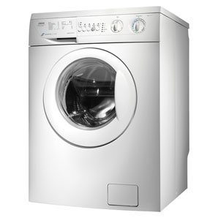
“Cleaning” of Uncertain Data
$$
Query
Query
Uncertain
DB
LESS
Uncertain
DB
Ambiguous
result
LESS ambiguous
result

Slide 5
Example 1: Sensor Probing
In natural habitat monitoring, sensors are used to track external environment
The system probes from sensors to refresh stale data
Battery and network resources should be optimized

Slide 6
Example 2: Data Integration
Key | Product ID | Price ($) | Prob.
a1 | a | 120 | 0.7
a2 | a | 80 | 0.3
b1 | b | 110 | 0.6
b2 | b | 90 | 0.4
c1 | c | 140 | 0.5
c2 | c | 110 | 0.3
c3 | c | 100 | 0.2
d1 | d | 10 | 1
The price of product c is a distribution
Product Quotations
Notes:
What is (IDi, vi, ei, xi)?

Slide 7
Example 2: Data Integration
Key | Product ID | Price ($) | Prob.
a1 | a | 120 | 0.7
a2 | a | 80 | 0.3
b1 | b | 110 | 0.6
b2 | b | 90 | 0.4
c1 | c | 140 | 0.5
c2 | c | 110 | 0.3
c3 | c | 100 | 0.2
d1 | d | 10 | 1
Return tuples whose prices are in [$100, $110]?
Possible-World results:
({b1,c2}, 0.18), ({b1,c3}, 0.12), ({b1},0.3), ({c2},0.12), ({c3}, 0.08), ({Φ},0.2)
The database may be cleaned by clarifying with the data sources.
Suppose we clean products a and c.

Slide 8
Example 2: Data Integration
Cleaned Table
Return tuples whose prices are in [$100, $110]?
Key | Product ID | Price ($) | Prob.
a2 | a | 80 | 1
b1 | b | 110 | 0.6
b2 | b | 90 | 0.4
c3 | c | 100 | 1
d1 | d | 10 | 1
New result:
({b1,c3}, 0.6), (c3, 0.4)
How much better?
The old result is:
({b1,c2}, 0.18), ({b1,c3}, 0.12), ({b1},0.3), ({c2},0.12), ({c3}, 0.08), ({Φ},0.2)
Cleaning is subject to budget limitation!

Slide 9
Related Work: Uncertain Databases
Data Models
Independent tuple/attribute uncertainty [Barbara92]
x-tuple (ULDB) [Benjelloun06]
Graphical model [Sen07]
Categorical uncertain data [Singh07]
World-set descriptor sets [Antova08]
Query Evaluation
Efficiency of query evaluation [Dalvi04]
Top-k query evaluation [Soliman07,Re07,Yi08]
Storing information extraction models [Sarawagi06]
Continuous queries on data streams [Jin08]
Notes:
Should have a better explanation on each related work.

Slide 10
Related Work: Location and Sensor uncertainty
Uncertainty models
Continuous uncertainty (pdf + range) [Sistla98,Pfoser99,Cheng03]
Tuple uncertainty and continuous pdf attributes [Singh08]
Sensor correlation models [Desphande04, Wang08]
Query Evaluation and Indexing
Probabilistic query classification [Cheng03]
Range queries [Sistla98, Pfoser99,Cheng04b,Tao05,Tao07,Cheng07]
Nearest-neighbor [Cheng04a,Kriegel07,Ljosa06,Cheng08,Beskales08]
MIN/MAX [Cheng03,Deshpande04]
Skylines [Pei07]
Reverse skylines [Lian08]
Object Identification [Bohm06]

Slide 11
Related Work: Cleaning Uncertain Data
Quality metrics of uncertain data
  Result probability > threshold [Cheng04, Desphande04]
  Top-k queries: fraction of true top-k values in results [Silberstein06]
  AVG/MIN/MAX [Cheng03]
  Reliability (Non-prob. DB) [Rougemont95, Gradel98]
Probing from stream sources [Olston03,Desphande04,Liu05,Chen08]
Cleaning dirty data with integrity constraints [Andritsos06]
Detection/merging of duplicate tuples [Khoussainova06]
Conditioning of probabilistic DB [Koch08]

Slide 12
Our Contributions
Measure query answer quality
  PWS-quality: suitable for any query
  Efficient computation for range and max queries
Clean uncertain data with limited budget
  Attain the highest gain in PWS-quality

Slide 13
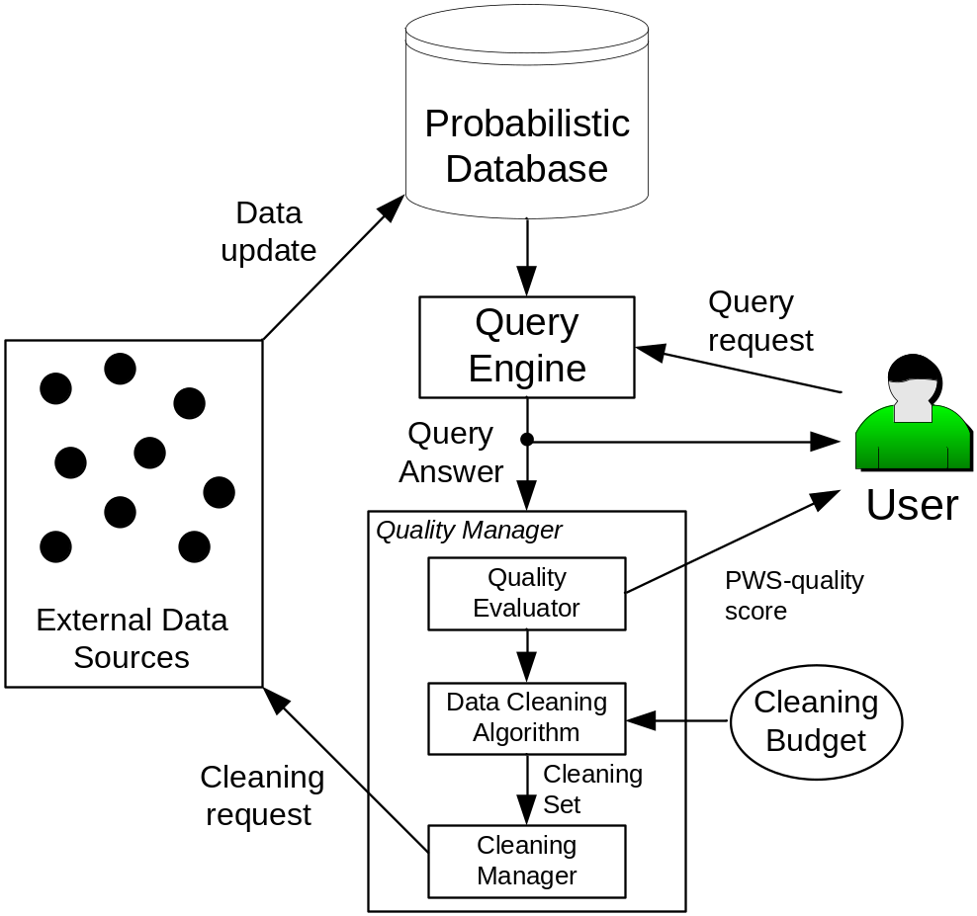
System Architecture

Slide 14
Probabilistic DB Model
Tuple (t_{i})
Querying Attribute (v_{i})
x-tuple
Existential probability (e_{i})
Key | Product ID | Price ($) | Prob.
a1 | a | 120 | 0.7
a2 | a | 80 | 0.3
b1 | b | 110 | 0.6
b2 | b | 90 | 0.4
c1 | c | 140 | 0.5
c2 | c | 110 | 0.3
c3 | c | 100 | 0.2
d1 | d | 10 | 1
i-th tuple
Same
attribute
value
x-tuple
Notes:
What is (IDi, vi, ei, xi)?

Slide 15
Possible World Semantics (PWS)
A probabilistic database is a set of possible worlds
A query algorithm should satisfy PWS
Prob. = 0.6
Key | Product ID | Price ($)
a2 | a | 80
b1 | b | 110
c3 | c | 100
d1 | d | 10
Key | Product ID | Price ($) | Prob.
a2 | a | 80 | 1
b1 | b | 110 | 0.6
b2 | b | 90 | 0.4
c3 | c | 100 | 1
d1 | d | 10 | 1
Prob. = 0.4
Key | Product ID | Price ($)
a2 | a | 80
b2 | b | 90
c3 | c | 100
d1 | d | 10
No. of possible worlds is exponential!

Slide 16

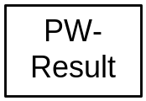

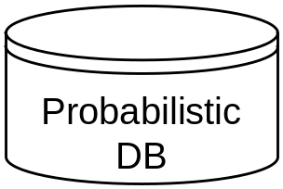
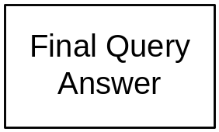
The PWS-Quality
0.18
{b1,c2}, 0.18
- 1.44
0.1
{b1,c3}, 0.2
0.1
(b1, 0.28), (c2,0.18), (c3, 0.2)

Slide 17
PWS-Quality: Intuition
0.3
Which result is clearer?
0.2
0.2
0.1
0.1
0.1
{a2,b1}
{a1,b2,c1}
{b3,c2}
We use entropy to quantify this ambiguity
0.9
0.1
{a1,c1}
{b1}

Slide 18
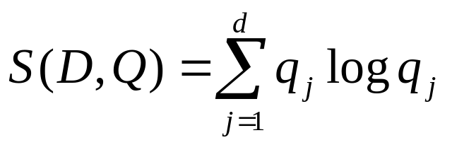
PWS-Quality: Basic Form
Let q_{j} be prob. of getting distinct PW-result r_{j}
The PWS-quality of query Q on database D:
# of distinct pw-results
Measure the entropy of possible worlds
Larger score ➔ better quality (zero for single possible world)
Allow comparing quality among queries
Notes:
What is “d” in the formula? The number of distinct pw-results

Slide 19
Example
PW-result:
  ({b1,c2}, 0.18), ({b1,c3}, 0.12), ({b1},0.3), ({c2},0.12), ({c3}, 0.08), ({Φ},0.2)
  PWS-Quality = - 2.46
PW-result (after cleaning):
  ({b1,c3}, 0.6), ({c3}, 0.4)
  PWS-Quality = - 0.97
Evaluation on possible worlds is expensive
Speed-up possible for PRQ and PMaxQ

Slide 20
PWS-Quality Revisited
0.18
{b1,c2}, 0.18
- 1.44
0.1
{b1,c3}, 0.2
0.1
(b1, 0.28), (c2,0.18), (c3, 0.2)

Slide 21






Probabilistic Range Query (PRQ)
Given a closed interval , where and , a PRQ returns a set of tuples , where is the non-zero probability that .
Key | Product ID | Price ($) | Prob.
a1 | a | 120 | 0.7
a2 | a | 80 | 0.3
b1 | b | 110 | 0.6
b2 | b | 90 | 0.4
c1 | c | 140 | 0.5
c2 | c | 110 | 0.3
c3 | c | 100 | 0.2
d1 | d | 10 | 1
Query range: [100, 110]
Answer:
(b1, 0.6), (c2, 0.3), (c3, 0.2)
Qualification
Probability

Slide 22




Probabilistic Maximum Query (PMaxQ)
A PMaxQ returns a set of tuples , where , the probability of , is the non-zero probability that , where and .
Key | Product ID | Price ($) | Prob.
a1 | a | 120 | 0.7
a2 | a | 80 | 0.3
b1 | b | 110 | 0.6
b2 | b | 90 | 0.4
c1 | c | 140 | 0.5
c2 | c | 110 | 0.3
c3 | c | 100 | 0.2
d1 | d | 10 | 1
Answer:
(c1, 0.5), (a1, 0.35), (b1, 0.09), (c2,0.09),
(c3, 0.024)

Slide 23
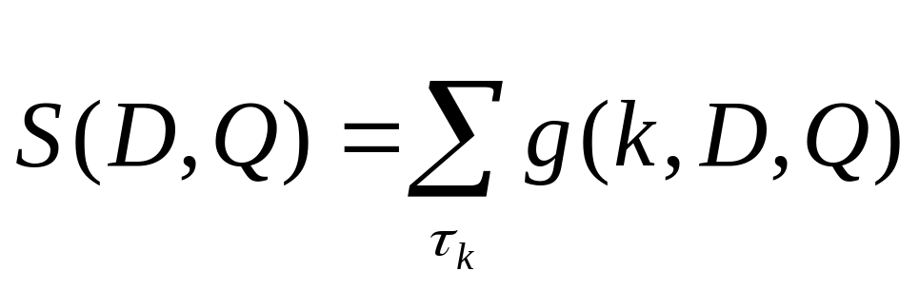
The x-Form of PWS-Quality
The x-form of PWS-Quality:
k-th x-tuple
g(k,D,Q)= func(existential & qualification probs. of tuples in k-th x-tuple)
Only consider x-tuples whose tuples are in query answer
Evaluated by query answer info (not possible worlds)
Notes:
This page contains too much information. You need to discuss PRQ and PMaxQ. Try to prepare more information (or proof skeleton) even though you don’t explain them in details.

Slide 24
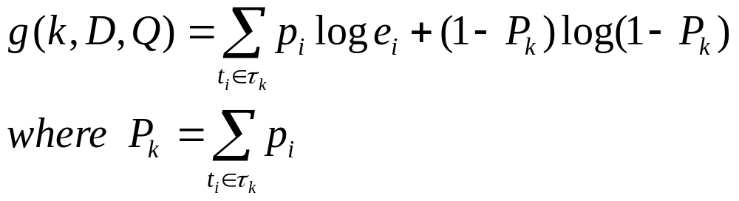
The x-Form of PRQ
Proof Techniques:
Use log(ab) = log a + log b
Exploit p_{i} = sum of probabilities of t_{i} in a set of pw-results
Notes:
This page contains too much information. You need to discuss PRQ and PMaxQ. Try to prepare more information (or proof skeleton) even though you don’t explain them in details.

Slide 25
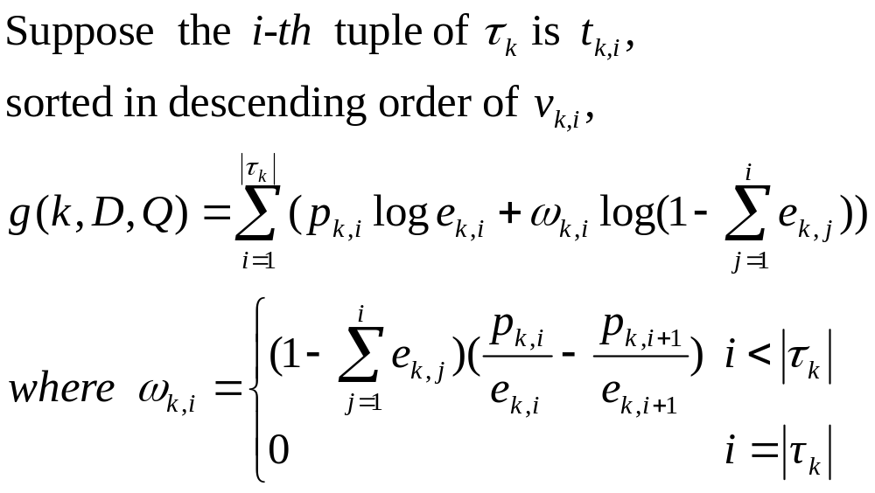
The x-Form of PMaxQ
Notes:
This page contains too much information. You need to discuss PRQ and PMaxQ. Try to prepare more information (or proof skeleton) even though you don’t explain them in details.

Slide 26
Cleaning under Budget Limitation
Key | Product ID | Price ($) | Prob.
a1 | a | 120 | 0.7
a2 | a | 80 | 0.3
b1 | b | 110 | 0.6
b2 | b | 90 | 0.4
c1 | c | 140 | 0.5
c2 | c | 110 | 0.3
c3 | c | 100 | 0.2
d1 | d | 10 | 1
Cleaning may require resources
$3
A budget (e.g., $12) restricts the no. of cleaning actions
$9
Which product(s) should be cleaned?
$11
$0
Product Quotations
(by Automatic Schema Matching)

Slide 27
Expected Quality Computation
Key | Product ID | Price ($) | Prob. | QP
a1 | a | 120 | 0.7 | 0.35
a2 | a | 80 | 0.3 | 0
b1 | b | 110 | 0.6 | 0.09
b2 | b | 90 | 0.4 | 0
c1 | c | 140 | 0.5 | 0.5
c2 | c | 110 | 0.3 | 0.09
c3 | c | 100 | 0.2 | 0.024
d1 | d | 10 | 1 | 0
0.7
0.18
S = -1.17
Clean
c
0.12
Expensive to enumerate and compute!
Expected quality of cleaning x-tuple c:
= 0 × 0.5 + (-1.17) × 0.3 + (-1.17) × 0.2 =- 0.585

Slide 28
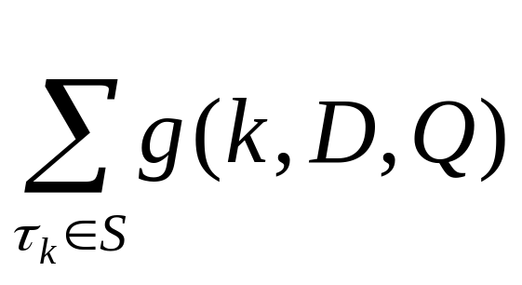
Efficient Evaluation of Expected Quality
Expected quality improvement of cleaning a set S of x-tuples is simply:
Works for both PRQ and PMaxQ

Slide 29
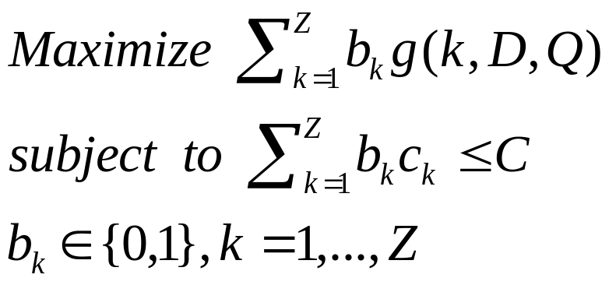
Transformation to 0/1 Knapsack Problem
C: cleaning budget
ck: cost of cleaning k-th x-tuple
Z: no. of x-tuples with tuples p_{i} in (0,1)
Formulate as 0/1 Knapsack:

Slide 30
Selection Heuristics
Optimal Solution
  DP (Dynamic Programming)
Heuristics
  Random
  MaxQP: Select x-tuples with highest qualification prob.
  Greedy: Rank x-tuples with max expected quality improvement per cleaning cost
Notes:
Briefly describe the heuristics

Slide 31
Experiments
Size of DB | 10 K x-tuples, 100 K tuples (synthetic) 4,999 x-tuples, 10,037tuples (Netflix movie ratings)
Prob. distributions | Gaussian (variance = 100)
Cleaning cost | Uniform in [1,10]
Resource Budget | [20,500] default = 30

Slide 32
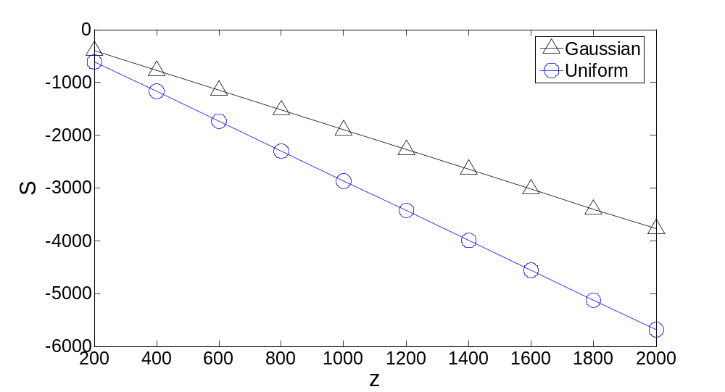
Quality vs. z (PRQ)

Slide 33
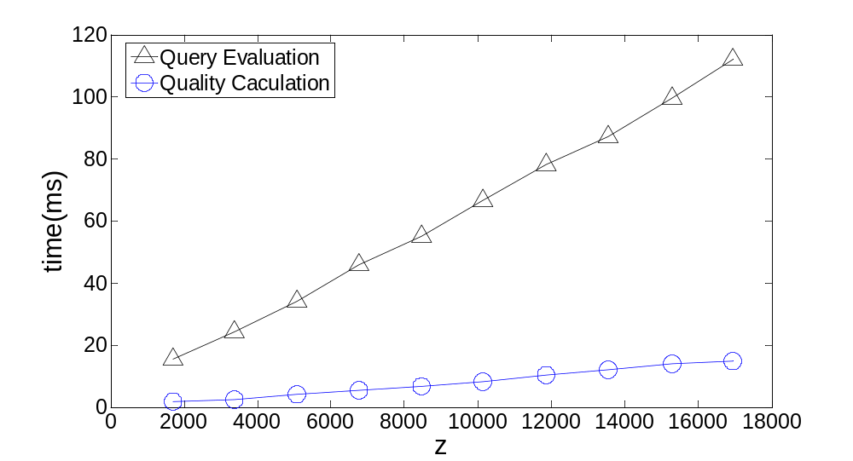
Quality Evaluation Performance (PRQ)

Slide 34
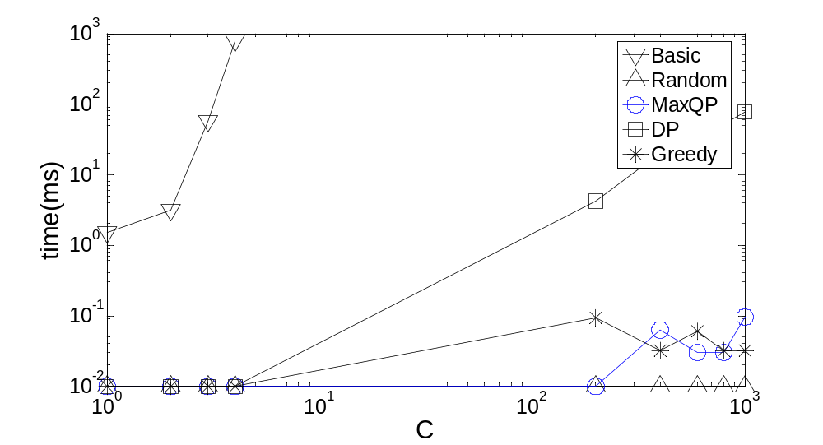
Time for Selecting x-Tuples (PMaxQ)

Slide 35
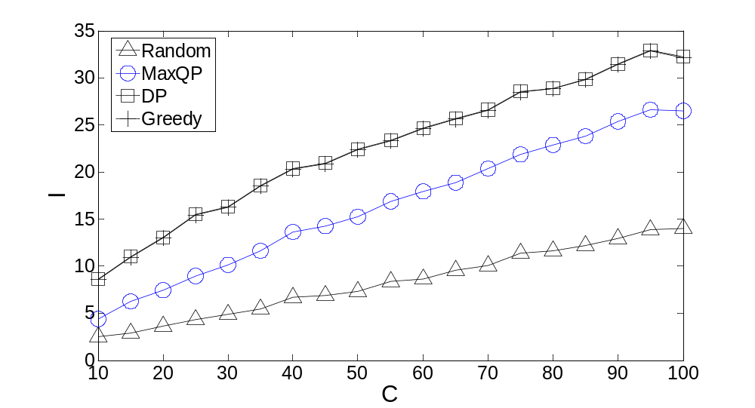
Quality Improvement vs. Budget (PRQ)

Slide 36
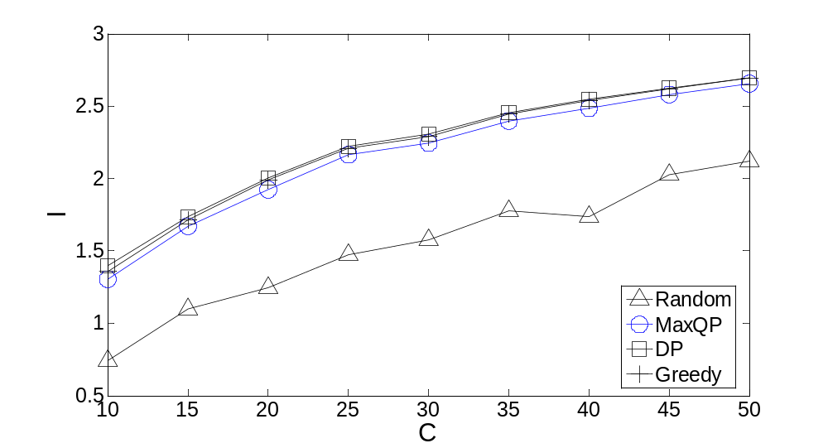
Quality Improvement vs. Budget (PMaxQ)

Slide 37
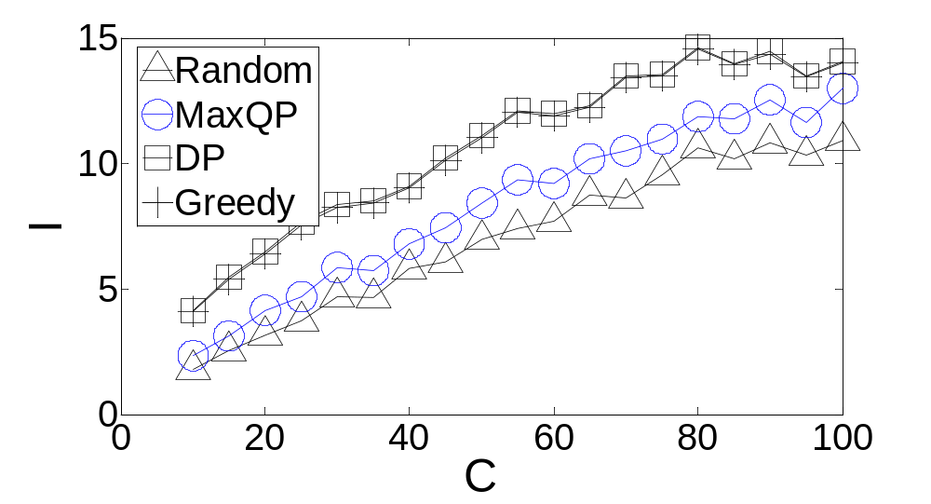
Quality Improvement vs Budget (PRQ;
Real Data)

Slide 38
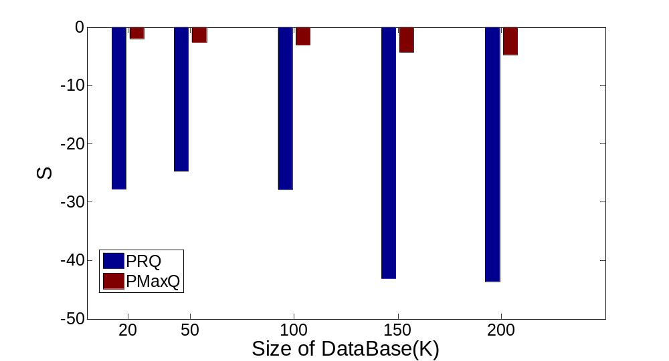
Quality vs. Database Size

Slide 39
Conclusions
PWS-quality
  quantifies query answer ambiguities
  can be efficiently computed for entity queries
We develop optimal and efficient cleaning solutions for PWS-quality
Future work:
  Support other query types
  Consider other cleaning models
Contact Reynold Cheng (ckcheng@cs.hku.hk) for more details

Slide 40
References (Probabilistic Databases)
[Barbara92] D. Barbara, H. Garcia-Molina, and D. Porter. The management of probabilistic data. Volume: 4, Issue: 5, page(s): 487-502, TKDE 1992.
[Dalvi04] N. Dalvi and D. Suciu. Efficient query evaluation on probabilistic databases. In VLDB, 2004
[Agrawal06] P. Agrawal, O. Benjelloun, A. D. Sarma, C. Hayworth, S. Nabar, T. Sugihara, and J. Widom. Trio: A system for data, uncertainty, and lineage. In VLDB, 2006.
[Benjelloun06] O. Benjelloun, A. Sarma, A. Halevy, and J. Widom. ULDBs: Databases with uncertainty and lineage. In VLDB, 2006.
[Soliman07] M. Soliman, I. Ilyas, and K. Chang. Top-k query processing in uncertain databases. In ICDE 2007.
[Re07] C. Re, N. Dalvi, and D. Suciu. Efficient top-k query evaluation on probabilistic data. In ICDE, 2007.
[Sarawagi06] S. Sarawagi. Creating Probabilistic databases with information extraction models. In VLDB 2006.
[Singh07] S. Singh, C. Mayfield, S. Prabhakar, R. Shah and S. Hambrusch. Indexing uncertain categorical data. In ICDE 2007.
[Sen07] P. Sen and A. Deshpande. “Representing and Querying Correlated Tuples in Probabilistic Databases”. In Proc. ICDE, 2007.
[Antova08] L. Antova, T. Jansen, C. Koch, and D. Olteanu. “Fast and Simple Relational Processing of Uncertain Data”. In Proc. ICDE, 2008.
[Yi08] K. Yi, F. Li, D. Srivastava and G. Kollios. Efficient processing of top-k queries in uncertain databases. In ICDE 2008.
[Jin08] Sliding-Window Top-k Queries on Uncertain Streams. C. Jin, K. Yi, L. Chen, J. Yu, X. Lin.

Slide 41
References (Location & Sensor Uncertainty)
[Sistla98] P. A. Sistla, O. Wolfson, S. Chamberlain, and S. Dao. Querying the uncertain position of moving objects. In Temporal Databases: Research and Practice. Springer Verlag, 1998.
[Pfoser99] D. Pfoser and C. Jensen. Capturing the uncertainty of moving-objects representations. In SSDBM, 1999.
[Cheng03] R. Cheng, D. Kalashnikov, and S. Prabhakar. Evaluating probabilistic queries over imprecise data. In Proc. ACM SIGMOD, 2003.
[Cheng04] R. Cheng, Y. Xia, S. Prabhakar, R. Shah, and J. S. Vitter. Efficient indexing methods for probabilistic threshold queries over uncertain data. In VLDB, 2004.
[Desphande04] A. Deshpande, C. Guestrin, S. Madden, J. Hellerstein, and W. Hong. Model-driven data acquisition in sensor networks. In VLDB, 2004.
[Tao05]Y. Tao, R. Cheng, X. Xiao, W. K. Ngai, B. Kao, and S. Prabhakar. Indexing multi-dimensional uncertain data with arbitrary probability density functions. In VLDB, 2005.
[Pei07] J. Pei, B. Jiang, X. Lin, and Y. Yuan. Probabilistic skylines on uncertain data. In VLDB, 2007.
[ICDE06] A. Silberstein, R. Braynard, C. Ellis, K. Munagala, and J. Yang. A sampling-based approach to optimizing top-k queries in sensor networks. In ICDE, 2006.
[Kriegel07] H. Kriegel, P. Kunath, and M. Renz. Probabilistic nearest-neighbor query on uncertain objects. In DASFAA, 2007.
[Ljosa07] V. Ljosa and A. K. Singh, “APLA: Indexing arbitrary probability distributions,” in Proc. ICDE, 2007.
[Cheng08] R. Cheng, J. Chen, M. Mokbel, and C. Chow. Probabilistic verifiers: Evaluating constrained nearest-neighbor queries over uncertain data. In ICDE, 2008.
[Singh08] S. Singh et al. Database support for pdf attributes. In ICDE 2008.
[Lian08] X. Lian and L. Chen. Monochromatic and bichromatic reverse skyline search over uncertain databases. In SIGMOD, 2008.
[Beskales08] Efficient Search for the Top-k Probable Nearest Neighbors in Uncertain Databases. George Beskales, Mohamed A. Soliman, Ihab F. Ilyas. In VLDB 2008.
[Wang08] BayesStore: Managing Large, Uncertain Data Repositories with Probabilistic Graphical Models. D. Wang, E. Michelakis, M. Garofalakis, J. Hellerstein. In VLDB, 2008.

Slide 42
Related Work
(Uncertain Data Cleaning)
[Rougemont95] M. de Rougemont. The reliability of queries. In PODS, 1995.
[Gradel98] E. Gradel, Y. Gurevich, and C. Hirsch. The complexity of query reliability. In PODS, 1998.
[Olston03] C. Olston, J. Jiang, and J. Widom. Adaptive filters for continuous queries over distributed data streams. In SIGMOD, 2003
[Liu05] Z. Liu, K. Sia, and J. Cho. Cost-efficient processing of min/max queries over distributed sensors with uncertainty. In ACM SAC, 2005.
[Silberstein06] A sampling-based approach to optimizing top-k queries in sensor networks. In ICDE 2006.
[Andritsos06] P. Andritsos, A. Fuxman, and R. Miller. Clean answers over dirty databases: A probabilistic approach. In ICDE, 2006.
[Chen08] J. Chen and R. Cheng. Quality-aware probing of uncertain data with resource constraints. In SSDBM, 2008.
[Koch08] Conditioning Probabilistic Databases. Christoph Koch and Dan Olteanu.

Slide 43
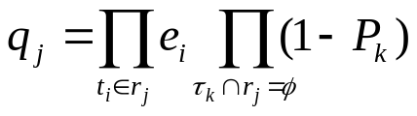

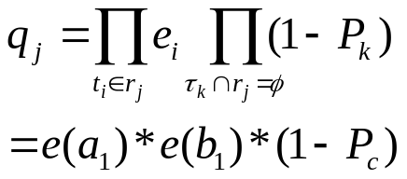

Deriving the x-Form of PRQ (1)
Key | Product ID | Price ($) | Prob.
a1 | a | 120 | 0.7
a2 | a | 80 | 0.3
b1 | b | 110 | 0.6
b2 | b | 90 | 0.4
c1 | c | 140 | 0.5
c2 | c | 110 | 0.3
c3 | c | 100 | 0.2
d1 | d | 10 | 1
query range [100,130]
Possible World j
a | a1 | 80
b | b1 | 110
c | c3 | 100
d | d1 | 10

Slide 44
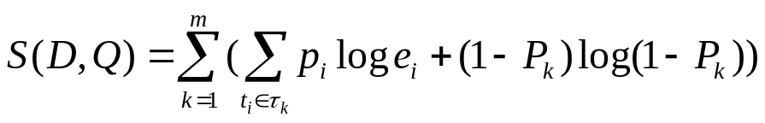
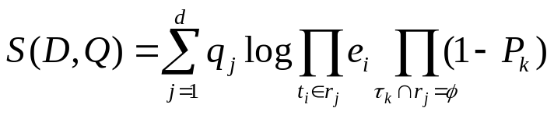
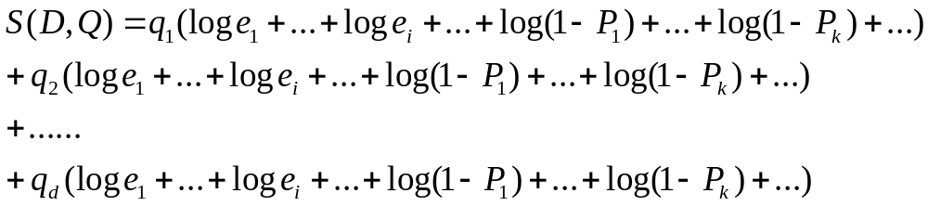
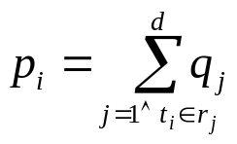
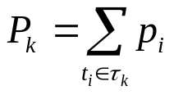


Deriving the x-Form of PRQ (2)

Slide 45
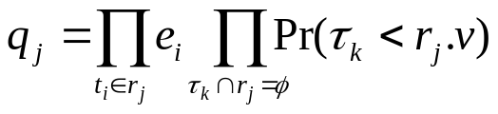
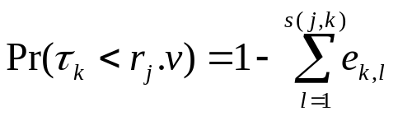


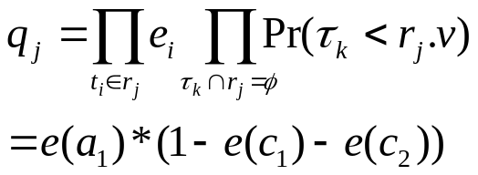

Deriving the x-Form of PMaxQ (summary)
An number in [0, ]
Product ID | Tuple ID | Price ($) | Prob.
a | a1 | 115 | 0.7
a | a2 | 80 | 0.3
b | b1 | 110 | 0.6
b | b2 | 90 | 0.4
c | c1 | 140 | 0.5
c | c2 | 120 | 0.3
c | c3 | 100 | 0.2
d | d1 | 10 | 1

Slide 46
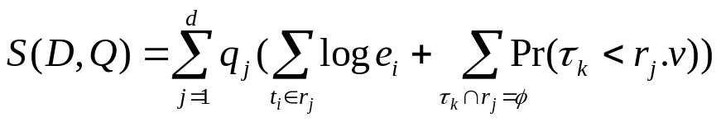
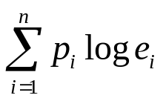
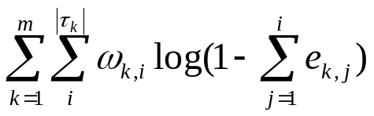
Deriving the x-Form of PMaxQ (summary)
A number in [0, ]
Please see the paper for details.

Slide 47
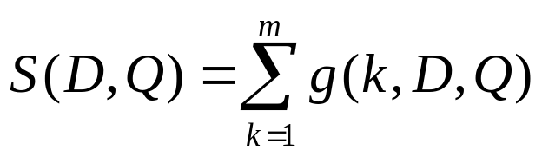
Complexity Analysis
Basic Evaluation
  O(d)
  where d = k^{m}, where each x-tuple contains k tuples
x-Form
  O(|R|), where |R| is the size of result set

Slide 48
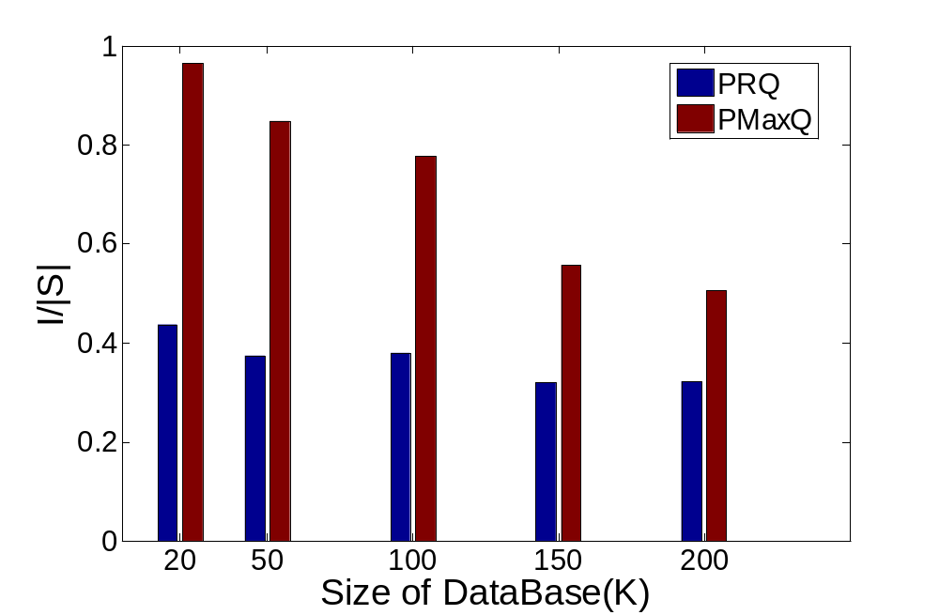
Relative Quality Improvement
(PRQ vs. PMaxQ)

Slide 49
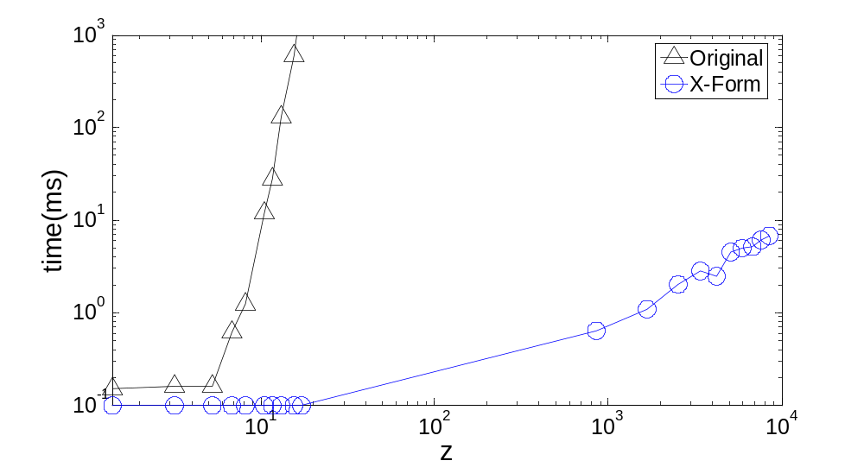
The x-Form (PRQ)

Slide 50
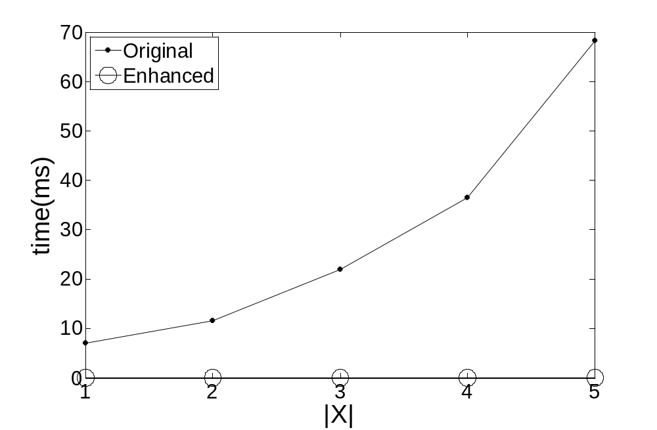
Evaluation Time of Quality Improvement (PMaxQ)

Slide 51
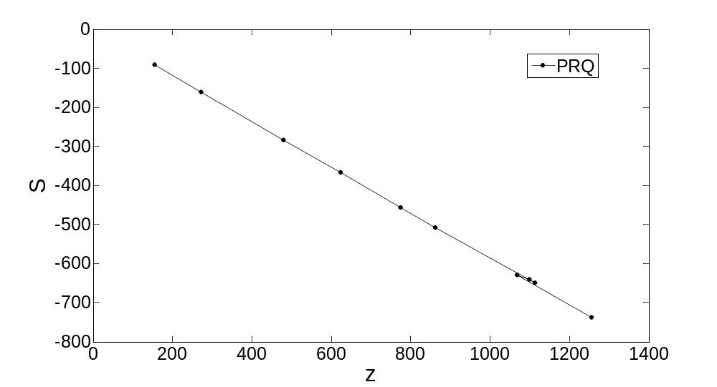
Quality vs. Query answer size (Real Data)

