Slide 1


Reynold Cheng†, Eric Lo‡, Xuan S. Yang†, Ming-Hay Luk‡, Xiang Li†, and Xike Xie†
†: University of Hong Kong
{ckcheng, xyang2, xli, xkxie}@cs.hku.hk
‡: Hong Kong Polytechnic University
{ericlo, csmhluk}@comp.polyu.edu.hk

Slide 2

Outline
Introduction
Solutions
Experiments
Conclusion & Future Work

Slide 3
Outline
Introduction
Solutions
Experiments
Conclusion & Future Work

Slide 4
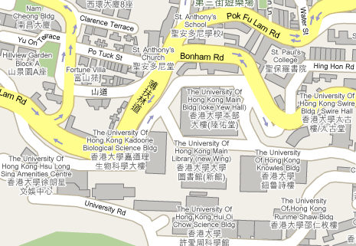

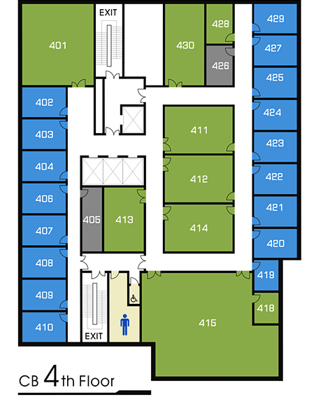


Data Ambiguity
From AddAll.com
Item | Price
Effective C++ in AMAZON | 27.49
 | 30.68
 | 30.99
 | 33.68
n-1 false values
Entity | Val1, Val2, …, Valn
Each entity has a set of possible values
Only one value out of the set is true
  Attribute Uncertainty [N. Dalvi, VLDB’04]
  Set Valued Attribute [J. Pei, VLDB’07]
?
…
Notes:
1 Is the book’s price lower than $30
2 Who is the offender?
3 Where is the person?

Slide 5

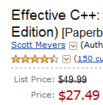


Data Cleaning
Item | Price
Effective C++ in AMAZON | 27.49
 | 30.68
 | 30.99
 | 33.68
Cleaning Information Availability
Cost
One cleaning operation may not be able to remove all false values
  Cleaning probabilistic database
  [R. Cheng, VLDB’08]
Cleaning may fail
…

Slide 6
Data Cleaning Model
Entity | # of false values
T1 | 5
T2 | 3
T3 | 6
T4 | 4
T5 | 1
cost
1
1
1
1
1
sc-prob
0.1
0.4
0.4
0.7
1
Cleaning the entities by the decreasing order of their sc-prob
UNKNOWN sc-prob
KNOWN sc-pdf
# of false values remove
1
1
1
1
1
Cleaning Operation clean(T_{i})
Cost
Successful Cleaning Probability (sc-prob)
Incompleteness
Objective
  Remove as many false values as possible;
  Under a given # of cleaning operations.
Notes:
But we may know some information from the pervious cleaning procedure, which I will introduce later.

Slide 7
Heuristic-Based Algorithms
Random Algorithm
  Randomly choose 1 item to clean
Greedy Algorithm
  p_{i}’ = successes/ trials to estimate p_{i}
  Choose the entity with the highest p_{i}’
ε-Greedy Algorithm
  With probability ε, randomly choose 1 entity;
  Otherwise, same as Greedy Algorithm
Notes:
1 Random: We prefer to clean the entities with a high sc-probability;
2 Greedy Algorithm: The estimation is not precise, can not be trusted with 100% confidence;
3 \epsilon-Greedy Algorithm: hybrid set some confidence of estimated sc-probability; user settled parameter \epsilon.

Slide 8
Outline
Introduction
Solutions
Experiments
Conclusion & Future Work

Slide 9

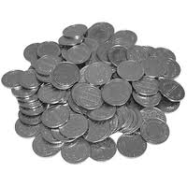


Multi Armed Bandit Problem
p₁, p₂, …, p_{k}
K Slot Machines
Hidden Probabilities
Rewards
Cost & Budget
Objective

Slide 10


Comparison between Cleaning and MAB
Infinite # of Coins
p₁, p₂, …, p_{k}
Entity | # of false values | sc-prob
T1 | 5 | 0.1
T2 | 3 | 0.4
T3 | 6 | 0.4
T4 | 4 | 0.7
T5 | 1 | 1
Cost & Budget
Objective
Remove as many false values as possible
Under a given # of cleaning operations
  Classic MAB Problem [D. Berry, 1985]
  MAB Problem with limited life time [D. Chakrabarti, NIPS’08]

Slide 11
sc-pdf
Don’t know the sc-prob
of each individual entity
Known sc-pdf:
The distribution of sc-prob
Entity | # of false values | sc-prob
T1 | 5 | 0.1
T2 | 3 | 0.4
T3 | 6 | 0.4
T4 | 4 | 0.7
T5 | 1 | 1
freq
2/5
1/5
1/5
1/5
0.1
0.4
0.7
1
sc-prob

Slide 12
Important Notations
Notation | Meaning
T_{i} | Ambiguous Entity
r_{i} | # of false values in T_{i}
p_{i} | sc-probability
clean(T_{i}) | cleaning T_{i}
C | total cleaning budget
R | # of false values removed by an algorithm
ξ(A) | Effectiveness R/C
f | sc-pdf

Slide 13
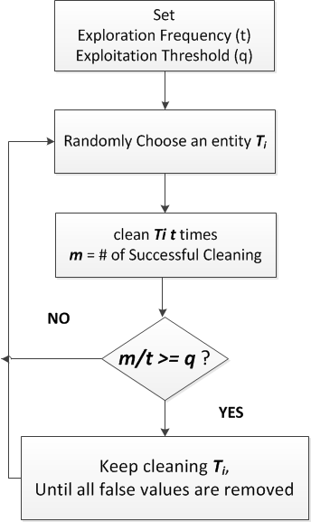
The EE-Algorithm
t = 3
q = 2/3
Entity | # of false values | sc-prob
T1 | 5 | 0.1
T2 | 3 | 0.4
T3 | 6 | 0.4
T4 | 4 | 0.7
T5 | 1 | 1
T2
Trial | m
Fail
1
2
3
0
0
1
1
0
Success
1/3 >= 2/3?

Slide 14
The EE-Algorithm
t = 3
q = 2/3
Entity | # of false values | sc-prob
T1 | 5 | 0.1
T2 | 3 | 0.4
T3 | 6 | 0.4
T4 | 4 | 0.7
T5 | 1 | 1
T4
Trial | m
3
0
2
0
2/3 >= 2/3?
# of remaining false value
2
1
0
Fail
Success

Slide 15

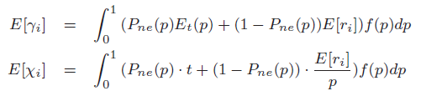
Setting Parameters for EE
Estimation of Cleaning Effectiveness
# of cleaning operations used: χ_{i}
# of false values removed: γ_{i}
P_{ne}(p): an entity with sc-probability p is explored but not exploited
E_{t}(p): the expected number of false values removed from an entity with sc-probability p after exploration and before exploitation

Slide 16
Setting Parameters for EE
Finding the Best Parameters
  Bound Explore Frequent with E[ri]/E[pi]
  Discretize region [0, 1] with an interval δ
  Find the (t, q) pair which can maximize the estimated cleaning effectiveness

Slide 17
Optimization
Stopping the Exploration Early
  During the explore procedure, if we find m/t must be lower than q then stop exploring.
  d: # of trials in explore phase
  d-m < (1-q)*t

Slide 18
Outline
Introduction
Solutions
Experiments
Conclusion & Future Work

Slide 19





Experiments
Dataset
  Movie Dataset
  Synthetic Dataset
  Statistics
…
Dataset | # of entities | Avg # of false values | sc-pdf | Default Budget
Movie | 4,999 | 1 | Uniform | 5,000
Synthetic | 50,000 | 9.5 | Uniform Normal | 10,000

Slide 20
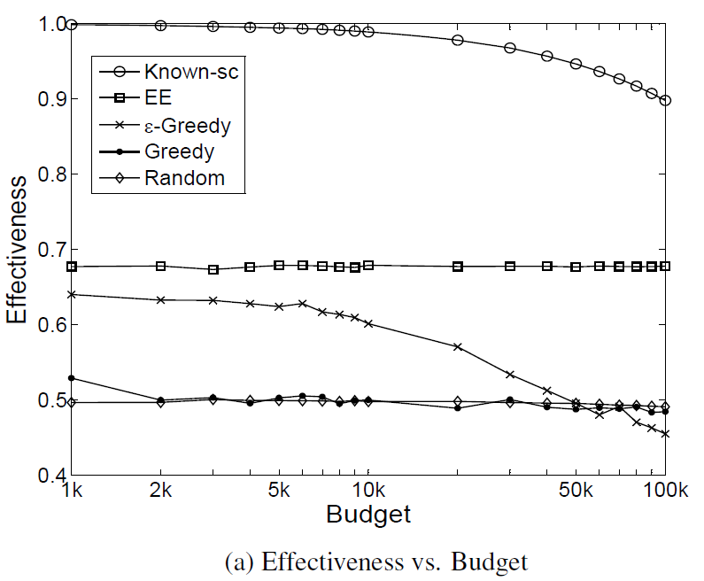
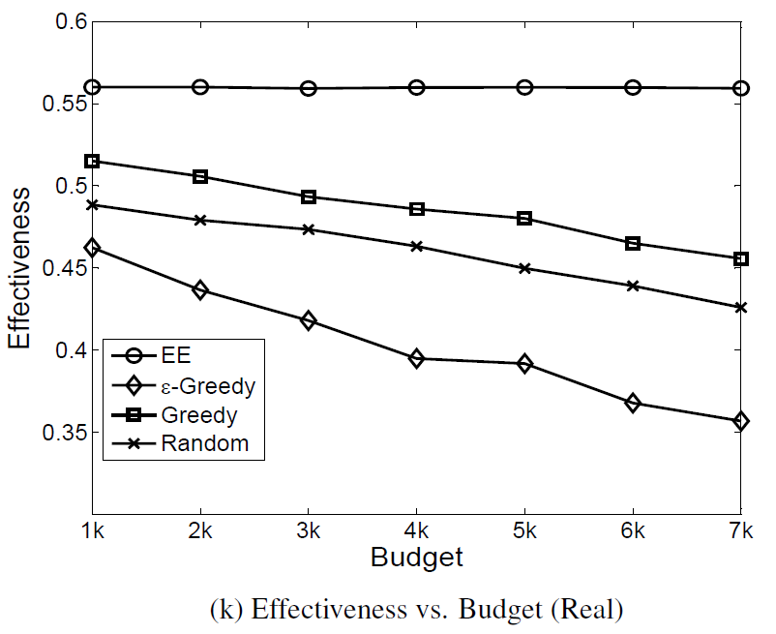
Effectiveness vs. Budget
Notes:
Synthetic Data:
When the sc-pdf is known to the algorithm -> highest effectiveness
Except for that one, EE gave the highest effectiveness & quite stable
\epsilon-Greedy is the third highest one, but it is not that stable, as the budget goes bigger, the effectiveness drops significantly.
Random algorithm and Greedy algorithm perform worst.

Slide 21
Summary of Other Results
Different SC-pdf
  Uniform
  Gaussian(0.5, 0.13), (0.5, 0.1667), (0.5, 0.3)
Different average number of false values
  2, 4.5, 7, 9.5
Effectiveness of t and q
Time Efficiency

Slide 22
Outline
Introduction
Solutions
Experiments
Conclusion & Future Work

Slide 23
Conclusions
We identify a realistic problem of removing data ambiguity under a tight cleaning budget,
We borrow the idea of the Multi-Armed-Bandit (MAB) problem, and develop the Explore-Exploit (EE) algorithm
Detailed experiments show that the EE perform better than simple variants of Greedy heuristics
We are studying the problem in a more complex setting, e.g., the cost of removing ambiguity varies across different entities

Slide 24
References
[N. Dalvi, VLDB’04]: N. Dalvi and D. Suciu. Efficient query evaluation on probabilistic databases. In VLDB, 2004.
[J. Pei, VLDB’07]: J. Pei, B. Jiang, X. Lin, and Y. Yuan. Probabilistic skylines on uncertain data. In VLDB, 2007.
[A. Deshpande, VLDB’04]: A. Deshpande, C. Guestrin, S. Madden, J. Hellerstein, and W. Hong. Model-driven data acquisition in sensor networks. In VLDB, 2004.
[R. Cheng, VLDB’08]: R. Cheng, J. Chen, and X. Xie. Cleaning uncertain data with quality guarantees. VLDB, 2008.
[D. Berry, 1985]: D. Berry and B. Fristedt. Bandit Problems: Sequential Allocation of Experiments. Chapman and Hall, 1985.
[D. Chakrabarti, NIPS’08]: D. Chakrabarti, R. Kumar, F. Radlinski, and E. Upfal. Mortal Multi-Armed Bandits. In NIPS, 2008.

Slide 25

Shawn Yang
xyang2@cs.hku.hk

Slide 26
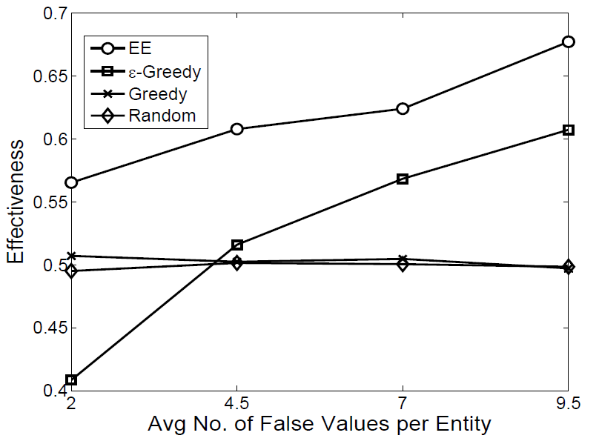
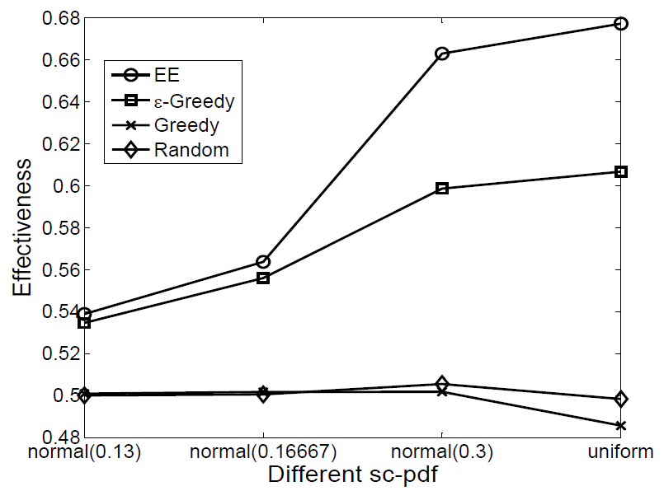
Effectiveness vs.
Dataset Characteristics

Slide 27
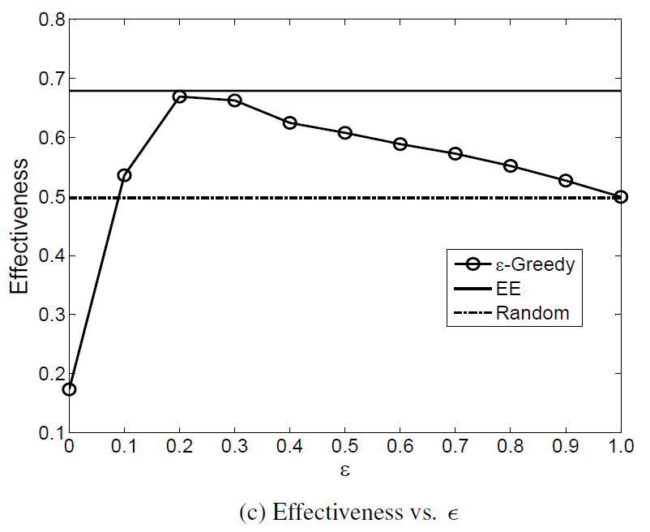
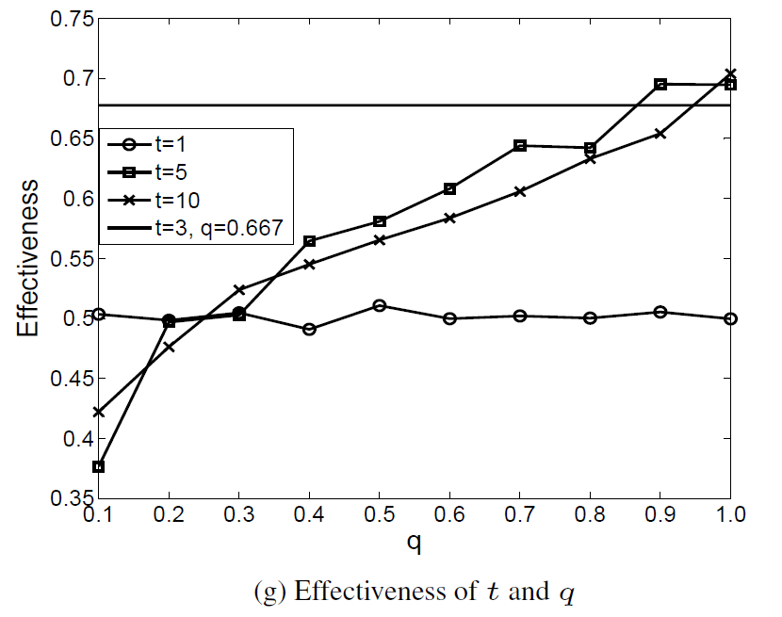
Effect of Parameters

Slide 28
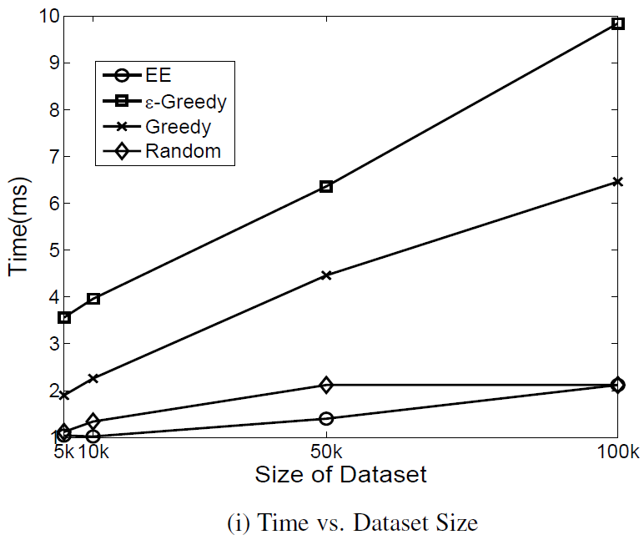
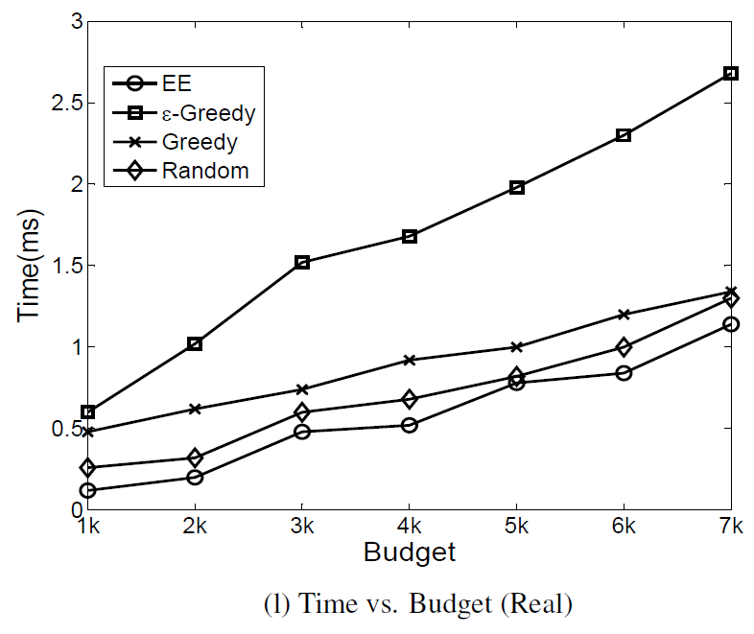
Time Efficiency

Slide 29
Conclusions
Build the ambiguity and cleaning model to describe the disambiguating procedure
An algorithm framework of exploring and exploit, and the estimation of cleaning effectiveness with proof
A concrete solution based on the framework

Slide 30
Future work
Unknown sc-pdf;
Different Cost;
Multiple Removal of the false values;
Calculation of the parameters (tmax, qmax);

