Slide 1





Discovering Meta-Paths in Large
Heterogeneous Information Network
Changping Meng (Purdue University)
Reynold Cheng (University of Hong Kong)
Silviu Maniu (Noah's Ark Lab, Huawei Technologies)
Pierre Senellart (Télécom ParisTech)
Wangda Zhang (University of Hong Kong)

Slide 2
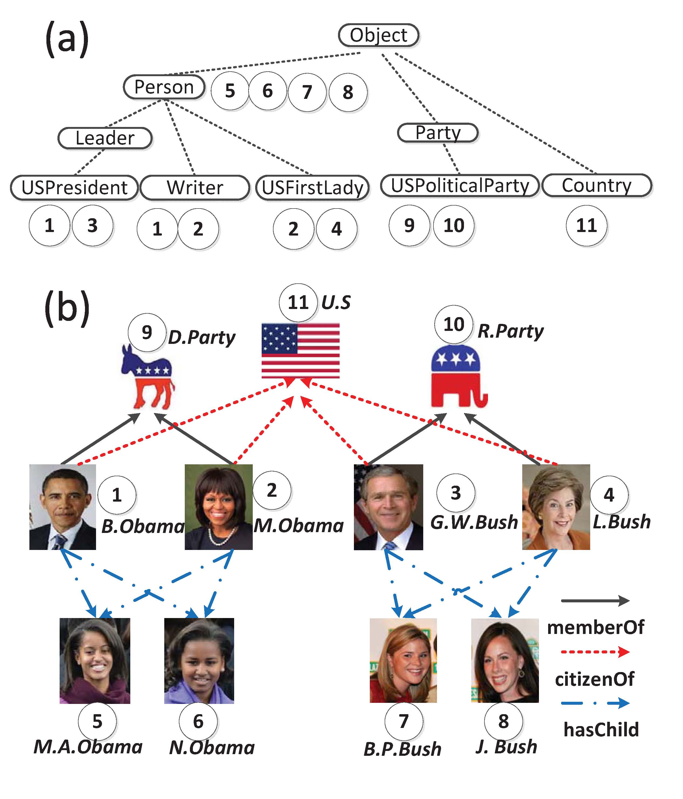
Introduction
Heterogeneous Information Network (HIN)
modeled in a directed graph
citizenOf
hasChild
Notes:
Class hierarchy
Node numbers

Slide 3
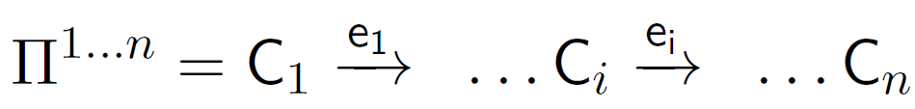
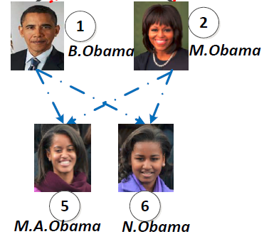

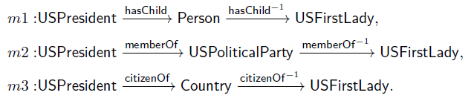
Introduction
Meta path [Han VLDB’11]
A sequence of node class sets connected by edge types
Benefits of Meta Paths
Multi-hop relationships instead of direct links
Combine multiple relationships

Slide 4
Introduction
Similarity score for a node pair following a single meta-path
Path Count(PC) [Han ASONAM’11]
Number of the paths following a given meta-path
Path Constrained Random Walk(PCRW) [Cohen KDD’11]
Transition probability of a random walk following a given meta-path
Similarity score for a node pair following a combination of multiple meta-paths
Aggregate Function F to combine the similarity scores for each single meta path
Notes:
Highlight our propose
Use a same example

Slide 5


Introduction
Applications
1. Query by user’s examples
When user inputs example pairs of similar objects, we could model the user’s preference and find more pairs.
Input:< Barack Obama, Michelle Obama>
Output:
< George Bush, Laura Bush>
< Bill Clinton, Hillary Clinton>

Slide 6
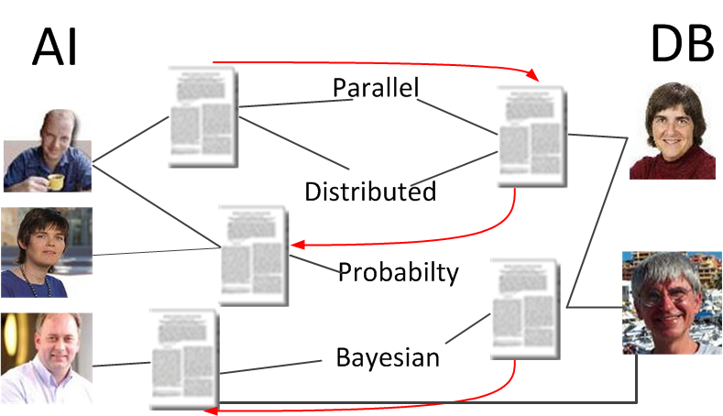

Introduction
Applications
2. Link prediction
Coauthor prediction (Authors from DB and AI to collaborate)
Friendship prediction (Online Social Network)

Slide 7
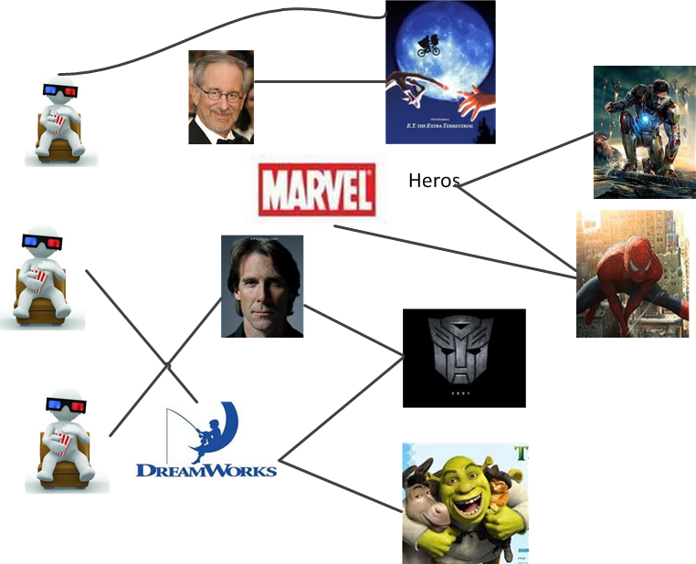
Introduction
Applications
3. Recommendation
Promote Movies for customers
Choose representatives to Political or Commercial negotiations

Slide 8
Existing work
Designed by experts [Han VLDB’11]
Complex to analyze big data
Do not consider user-preference
Enumeration within a given length [Cohen ECML’11]
Max length L is large, redundant (Curse of dimension)
In Yago, L=3, 135 meta-paths . L=4, 2000 meta-paths
L is small, miss some important ones

Slide 9

Problem Definition
Meta Paths Generation
Meta-paths
Example
node pairs
Meta Path
Generation
(B. Obama, M. Obama)
(B. Clinton, H. Clinton)
Knowledge Base
Similarity Function
(Yago)
(Linear Function)
Contributions
Consider the user’s preference: let user input example pairs
Automatically generate meta paths without a max length: heuristic search instead of enumeration
Notes:
Fluent flow

Slide 10


Meta-path Generation
Two Phase Method
Challenge: Each node has many class labels. The number of candidate meta paths grows exponentially with the length.
Meta-paths
Example
node pairs
Link Type
Node Type
Knowledge Base
Similarity Function
First Select Important Meta Path based on Links.
Next Refine the Node types
Notes:
Challenge instead of idea
Why divide

Slide 11
Meta-path Generation
Phase 1: Link-Only Path Generation
Forward Stagewise Path Generation(FSPG): iteratively generate the most related meta-path and update the model
Updated model
Get most related meta-path m
Example Pairs
Model Training
Converge
N
meta-path m
Y
An altered LARS model
FINISH
GreedyTree
Notes:
Principle
Not detail

Slide 12
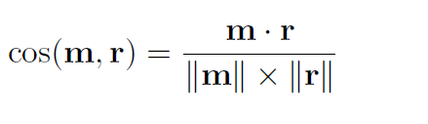
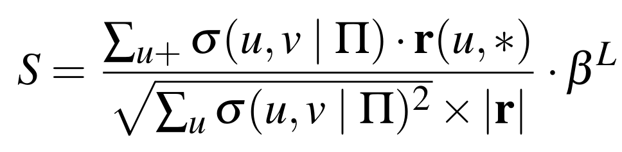
Meta-path Generation
GreedyTree
A tree that greedily expands the node which has the largest priority score
Priority Score : related to the correlation between m and r
m is the meta path, r is the residual vector which evaluates the gap between the truth and current model
Notes:
Introduce GreedyTree in whole structure
Explain m and r
Hide the equation

Slide 13
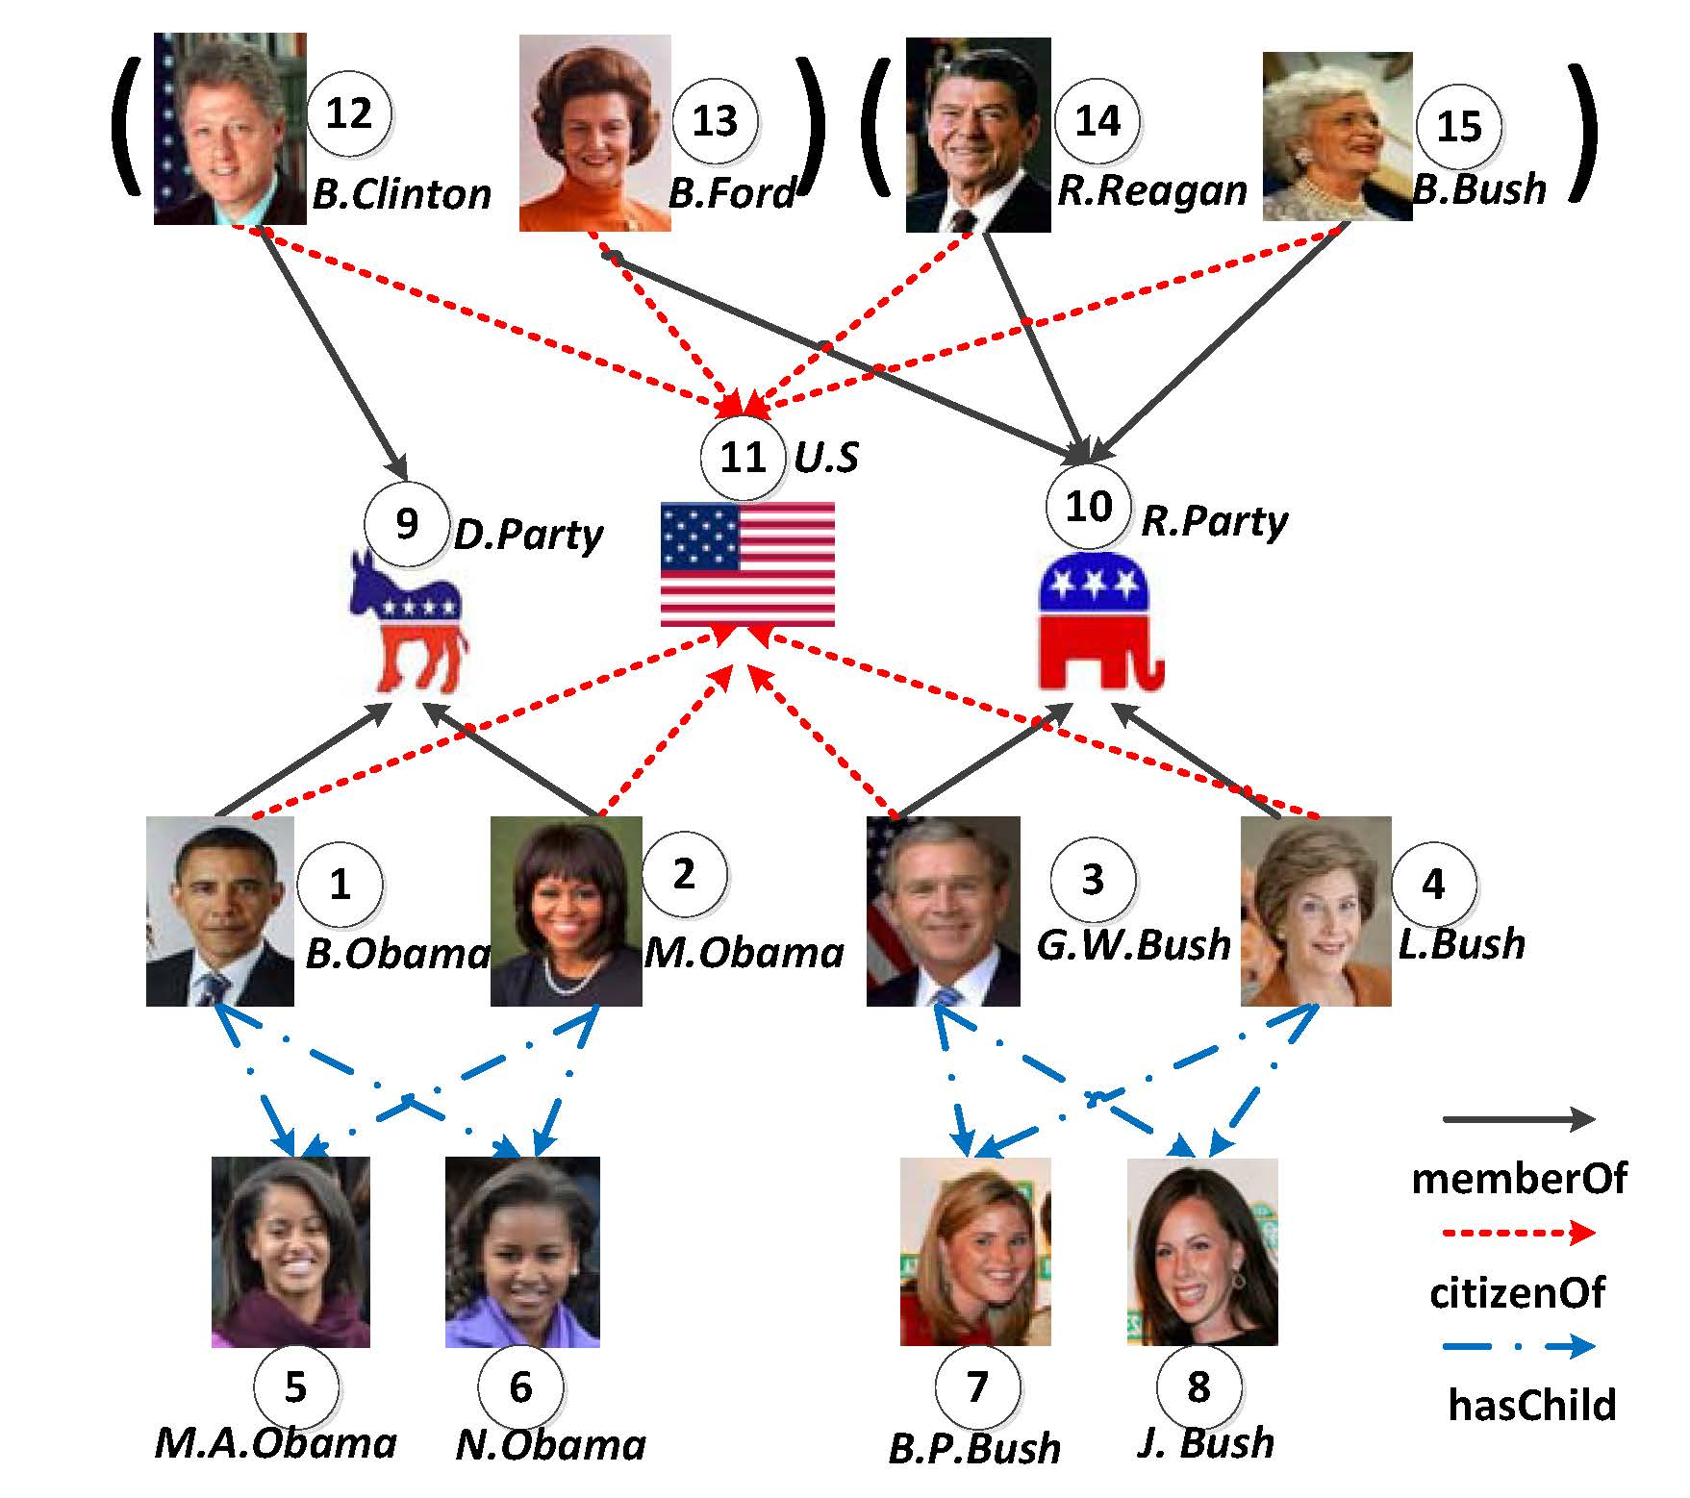
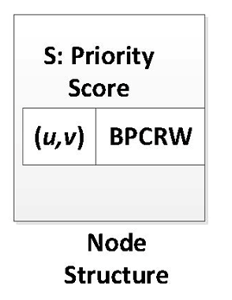
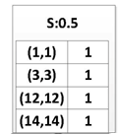
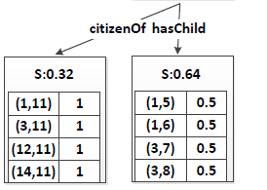
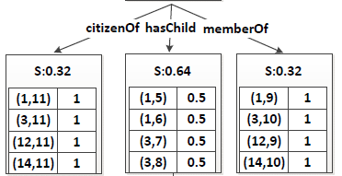
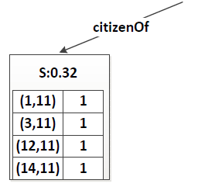
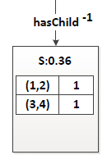
Meta-path Generation
GreedyTree
Notes:
Less detail
Show paths in animation

Slide 14
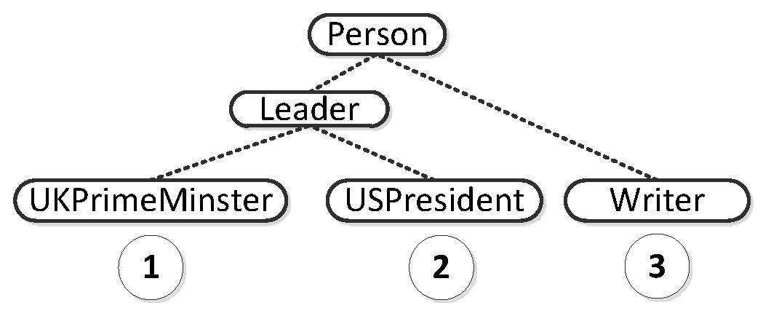
Meta-path Generation
Phase 2: Node Class Generation
Why node classes are needed
A link only meta path may introduce some unrelated result pairs.
is less specific than
Solution 1: Lowest Common Ancestor(LCA)
Record the LCA in the node of GreedyTree
Notes:
Solution 1: existing one instead of solution
Pros and Cons of LCA and TFOF

Slide 15
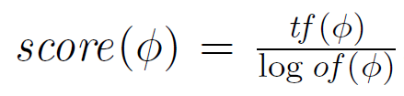



Meta-path Generation
Solution 2: TFOF
tf is the frequency of label in
positive examples. of is the overall count in KB
of can be pre-computed
=2
=42

Slide 16
Other contributions
Similarity score for a node pair following a single meta-path
Path Count(PC) [Han ASONAM’11]
Number of the paths following a given meta-path
Path Constrained Random Walk(PCRW) [Cohen KDD’11]
Transition probability of a random walk following a given meta-path
We propose a general form --Biased Path Constrained Random Walk(BPCRW)
PC [Han ASONAM’11] emphasizes absolute number of paths
PCRW [Cohen KDD’11] emphasizes neighbors of the nodes along the path
BPCRW makes a balance between PC and PCRW
Notes:
Highlight our propose
Use a same example

Slide 17
Experiments
Dataset
DBLP (four areas)
(Database, Data Mining, Articial Intelligence
and Information Retrieval).
14376 papers, 14475 authors, 8920 topics, 20 venues.
Yago
A Knowledge Base derived from Wikipedia, WordNet and GeoNames.
CORE Facts: 2.1 million nodes, 8 million edges, 125 edge types, 0.36 million node types
Link-prediction evaluation
Select n pairs of certain relationships as example pairs
Randomly select another m pairs to predict the links
Notes:
Not the only application—only an evaluation, objective
Can be used in others

Slide 18
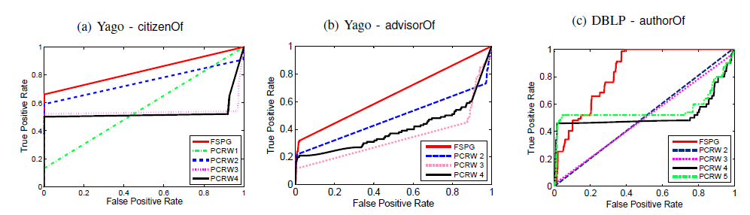
Experiments
Effectiveness
Baseline method: enumerating all meta-paths within a given max length L.
L is small, low recall.
L is large, low precision.
ROC for link prediction
Notes:
Explain ROC- larger area is better

Slide 19
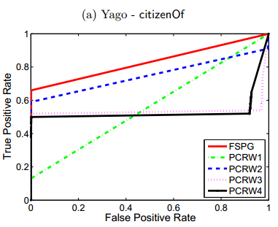
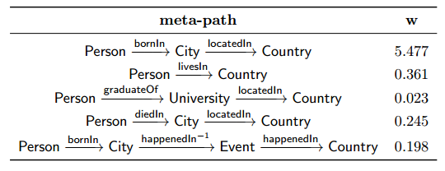
Experiments
Case study- Yago citizenOf
Better than direct link(PCRW 1)
Better than best PCRW 2
Better than PCRW 3,4
5 most relevant meta-paths for citizenOf

Slide 20
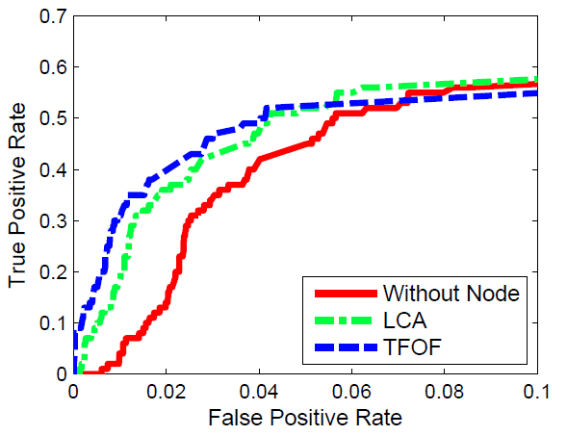
Experiments
Class label selection
The TFOF method of generating class labels is better for high precision queries
LCA is better than TFOF for higher recall rates.

Slide 21
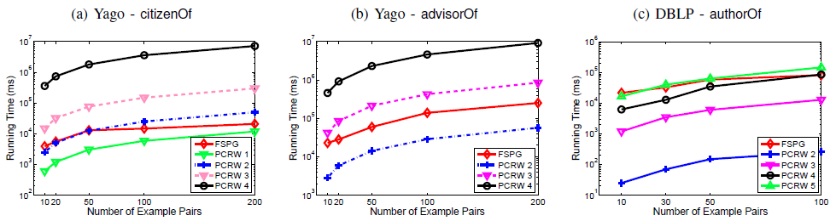
Experiments
Efficiency
In Yago, 2 orders of magnitude better.
In DBLP, the running time is comparable to PCRW 5, but the accuracy is much better.
Running time of FSPG

Slide 22
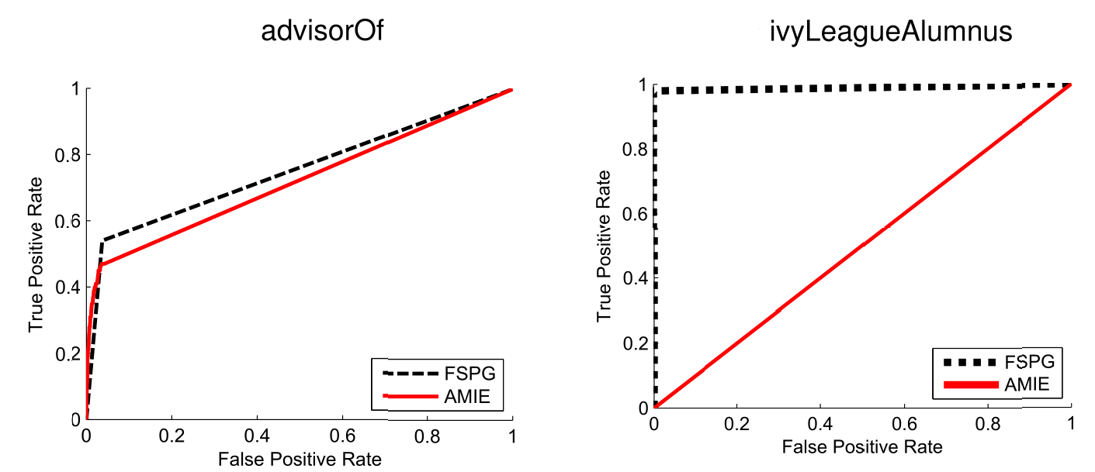
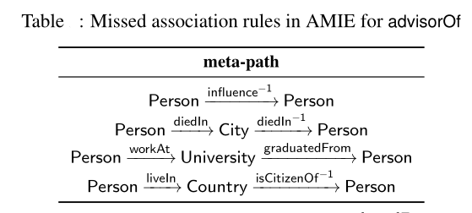
Experiments
Rule mining compared with AMIE (Luis, WWW’13)
AMIE does not consider the hierarchy of node types.
Failed to distinguish Ivy League
alumni from the alumni of any other universities

Slide 23
Conclusion
We examined a novel problem of meta-paths generation which is highly needed to analyze and query KB.
We proposed the FSPG algorithm, and developed GreedyTree to facilitate its execution.

Slide 24
References
[Yu EDBT’13]: ] C. Shi , P. Yu“Relevance Search in Heterogeneous Network” EDBT’13
[Han VLDB’11] Y. Sun, J. Han, X. Yan, P. S. Yu, and T. Wu, “PathSim: Meta Path-Based Top-K Similarity Search in Heterogeneous Information Networks”, VLDB'11
[Han ASONAM’11] Y. Sun, R. Barber, M. Gupta, C. Aggarwal and J. Han, "Co-Author Relationship Prediction in Heterogeneous Bibliographic Networks", ASONAM'11
[Han CIMK’12]Y. Sun, R. Barber, M. Gupta, C. Aggarwal and J. Han, "Meta-Path Selection with User Guided Object Clustering in Heterogeneous Information Networks ", CIKM'12
[Sun VLDB’11]L. Sun, R. Cheng and etc On Link-based Similarity join, VLDB 2011
[Han KDD’12]J. Han, Y. Sun, X. Yan, and P. S. Yu, “Mining Heterogeneous Information Networks“
[Cohen ECML’11]W. Cohen, N. Lao “Relational Retrieval Using a Combination of Path-Constrained Random Walks” ECML 2011
[Weinberger JMLR’09] Weinberger “Distance Metric Learning for Large Margin
Nearest Neighbor Classiﬁcation” Journal of Machine Learning Research 10 (2009) 207-244
[Chopra CVPR’05]S.Chopra “Learning a similarity metric discriminatively, with application of face verification” CVPR 2005

Slide 25
Thank you! Changping Meng meng40@purdue.edu

