Slide 1
Customer Solutions Overview
Team and Projects
07 Jun 2016

Slide 2
Contents
Customer Solutions
Organization
Project Overview
SOJTF-A
CJTF-HOA
CTCs
NGIC
USSTRATCOM
PACOM
8th Army
SOCPAC
USARPAC

Slide 3
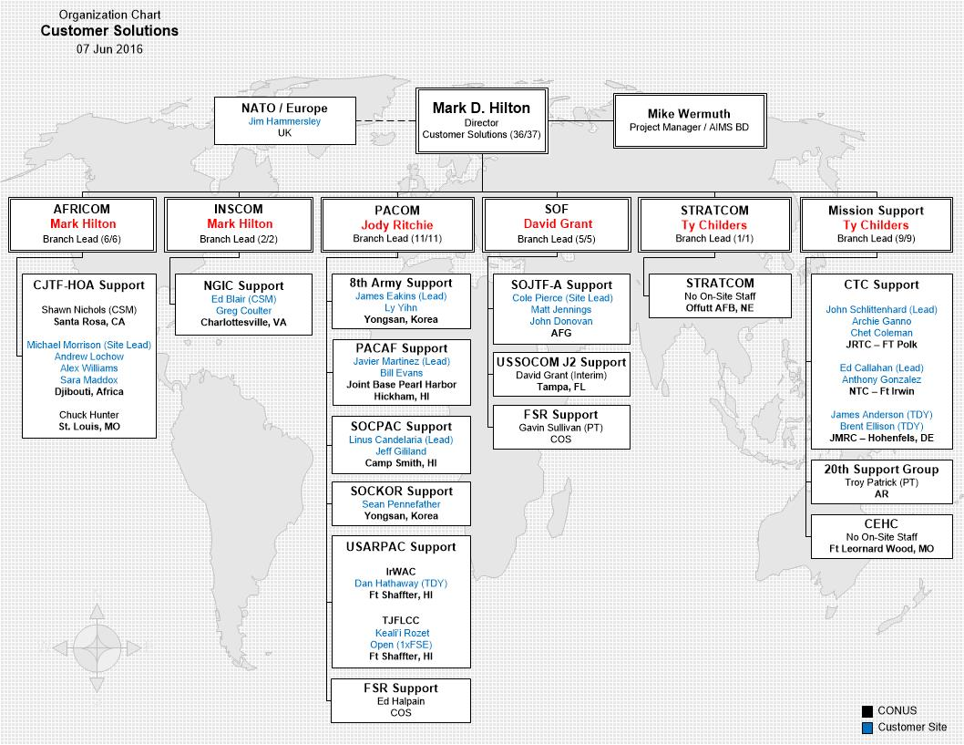

Slide 4
SOJTF-Afghanistan
Executive Summary: Provide CIDNE / WebTAS FSR support to SOJTF-A/NSOCC-A across the Theater of Operations.
Customer POCs:
Customer POCs:
Wyatt Bora, AFRL, CIDNE Program Manager
Email: Wyatt.Bora.1@us.af.mil
Phone: 315.330.4944
LTC Gregory Ford, Deputy J2, NSOCC-A/SOJTF-A
Email: gregory.ford@socom.mil
Phone: DSN: 700-787-3964
LTC Lance Sneed, COR, CJ8 NSOCC-A/SOJTF-A
Email: lance.sneed@socom.mil
Phone: DSN: 700-787-8405
Location(s):
Afghanistan
Version in Use:
CIDNE: 2.3.2, Deployed 24 Sep 2014
WebTAS: 4.1, Deployed 15 Jul 2012
INDURE: 1.3.4.6, Deployed 2 July 2014

Slide 5
NSOCC-A / SOJTF-A
Key Users / Uses
NSOCC-A/SOJTF-A (J2/J3)
SOAGs (ANASOC, ALP, GCPSU)
ISAF SOF APUs, PSUs and TUs
CJSOTF-A (J2/J3/J9)
CMAG-A
JIEDDO, COIC, ORSA
Priority Efforts
Reporting
Data Collection
QA/QC
Collation
ISAF SOF Backlog Reports
RFIs
Training / Mentoring
JOC Support
GTM Route Planning, 7-90 Day SOF Ops Summaries, SIGACT Situational Awareness
Operational Analytics
Notes:
Primary Reporting: Daily SITREPs, INTSUMs, SIGSUMs, HUMSUMs, GRINTSUMs, etc.; SIGACTs, IED Level 1, Patrol Debriefs (Storyboards/OPSUMs)
Increased use of GeoQuest within the NSOCC-A/SOJTF-A in support of daily requirements. This includes using the .cvs conversion tool to create heat maps for the 7-90 day ops summaries and route planning for convoy operations and ground tactical movements.
NSOCC-A = NATO Special Operations Component Command-Afghanistan
SOJTF-A= Special Operations Joint Task Force-Afghanistan
SOAG= Special Operations Advisory Group
ANASOC= Afghan National Army Special Operations Command
GCPSU= General Command Police and Special Unit
CJSOTF-A= Combined Joint Special Operations Task Force-Afghanistan
CMAG-A= Civil Military Advisory Group-Afghanistan
GTM= Ground Tactical Movement
PSU= Provincial Security Unit
TU= Task Unit (Coalition)
APU= Afghan Partnered Units

Slide 6
CJTF-HOA
Executive Summary: Establish and maintain a CIDNE/WebTAS/INDURE enterprise, including on-site support to CJTF-HOA as part of their reporting and analysis framework.
Customer POCs:
Mr. Peter LaMonica, AFRL, Program Manager
Email: peter.lamonica@us.af.mil
Phone: 315.330.4088
LtCol Adisa Hinton, CJTF-HOA, KMO (current)
Email: adisa.a.hinton.mil@mail.mil
Phone: DSN 311.824.4664 or 311.824.4679
MAJ Ofayo Kingsberry, CJTF-HOA, KMO (incoming 11 Oct)
Email: Ofayo.Kingsberry@us.af.mil
Location(s):
Camp Lemonnier, Djibouti
Version in Use:
CIDNE: 2.3.2, Released 28 Aug 2014
WebTAS: 4.3.1.016.11 (Net Launcher), Released Jun 17 2014
INDURE: 1.3.4.6, Released 2 July 2014

Slide 7
CJTF-HOA
Key Users / Uses
J2Country Teams
SA and Analysis (CIDNE)
J3-5-7 Plans, Effects, IO, MISO and Assessments
SA and Analysis (CIDNE)
Regional Engagements
Force Protection
J9 CMO / Civil Affairs
INDURE CA Reporting
FAC
Unclass information sharing with JIIM partners using UIS (INDURE/APAN)
Priority Efforts
System Requirements
CIDNE 2.3.4
Unclassified Information Solution (UIS) effort
Disconnected Reporting
INDURE / APAN
Interfaces
ISM(w/CENTCOM),G-TSCMIS and JLLIS
Assist with CIDNE SOPs
AFRICOM Integration
Notes:
Global – Theater Security Cooperation Management Information System (G-TSCMIS)
Joint Lesson Learned Information System (JLLIS)
MISO- Military Information Support Operations ( replaced PSYOP)
JIIM - Joint, Interagency, Intergovernmental, and Multinational.
FAC – Fusion Action Cell (new functional organization in CJTF-HOA)

Slide 8
Combat Training Centers (CTCs)
Executive Summary: The CTC effort includes system and training support to multiple organizations across the US Army. Year round rotations occur and are supported at all CTC locations. ISS provides server support and troubleshooting as well as systems training on CIDNE and WebTAS applications.
Customer POCs:
Wyatt Bora (AFRL)
Email: wyatt.bora.1@us.af.mil
Phone: 315.330.4944
Major Kristina Cornwell, USCENTCOM CCJ2-OM
Email: kristina.j.cornwell@centcom.mil
Phone: 813.529.2826
Mr. John Skelton (CTC Directorate)
Email: john.d.skelton.civ@mail.mil
Phone: 913.684.7641
Location(s):
Joint Multinational Readiness Center (JMRC), Hohenfels, Germany
Joint Regional Training Center (JRTC), Ft. Polk, LA
National Training Center (NTC), Ft. Irwin, CA
Version in Use:
WebTAS version 4.1
CIDNE 2.1.9.4 – 2.3.2
LTC Boles (JRTC)
Email: charles.r.boles.mil@mail.mil
Phone: 337.531.0147
LTC Remoy (JMRC)
Email: eric.m.remoy.mil@mail.mil
Phone: 01149-9472-83-5177
LTC Allen(NTC)
Email: Daniel.m.allen4.mil@mail.mil
Phone: 760.380.2905

Slide 9
CTCs
Key Users / Uses
Training Centers
Plans and Ops
NTC
JRMC
JRTC
Rotational Units
Priority Efforts
Rotations
Setup / Configuration
Training
System and Data Support
Take Down
Event Tracking
AARs

Slide 10
National Ground Intelligence Center
Executive Summary: Provide WebTAS and CIDNE onsite support and training. Provide field engineering support for the NGIC Counter Insurgency Task Force, Combat Incident Analysis Division and Weapons Technical Intelligence team.
Customer POCs:
Mr. Wyatt Bora, AFRL, PM
E-mail: wyatt.bora.1@us.af.mil
Phone: 315.330.4944
Mr. Paul Warnick, Information Technology Specialist, NGIC
E-mail: paul.m.warnick.civ@mail.mil
Phone: 434.980.7369
Location(s)
NGIC, Charlottesville, VA
Version in Use:
WebTAS 4.3.1, Released June 2014
CIDNE: 2.3.6 AFG, RoAR, World Wide

Slide 11
NGIC
Key Users / Uses
Counter-Insurgent Targeting Program (CITP) – Bill Murray
Combat Incident Analysis Division (CIAD) – Jeff Morgan
Priority Efforts
CITP
CIDNE Upgrades
World-wide NGIC DB
Data transfer
CIAD
Data Ingests
ETL of casualty data

Slide 12
USSTRATCOM
Executive Summary: Update to EXERTAS to ensure compatibility and supportability for STRATCOM. Some improvements and updates will also be added as the customer takes delivery of the updated software and finds improvements that need to be made.
Customer POCs:
Stephen Colenzo
Email: Stephen.Colenzo@us.af.mil
Phone: 315.330.7665
Anthony Johnson DAFC GS-13
Email: johnsoa@stratcom.mil
Phone: (402) 232-5306
David Varner J722 Branch Chief
Email: varnerd@stratcom.mil
Phone: 402 294-7763
Location(s):
STRATCOM HQ
Version in Use:
WebTAS version 4.3.1 (ExerTAS)

Slide 13
USSTRATCOM
Key Users / Uses
J72
Used for training exercises allowing injects to be created and processed to ensure realistic training environment
Priority Efforts
Provide support to ensure any problems that arise with WebTAS are resolved promptly
Develop new software solutions to improve the current capability

Slide 14
PACOM
Executive Summary: ISS is providing training and operations support of CIDNE and WebTAS for PACOM components: 8th Army, SOCPAC and USARPAC.
Customer POCs:
Wyatt Bora, AFRL, CIDNE PM
Email: Wyatt.Bora.1@us.af.mil
Phone: 315.330.4944
Pete LaMonica, CIDNE PMO
Email: Peter.LaMonica@us.af.mil
Phone: 315.330.4088
LTC Gary Bolos, APCFC Dep. Director
Email: gary.bolos.mil@mail.mil
Phone: 808.438.58303
Location(s):
8th Army – Yongsan Garrison Base, Seoul, South Korea
SOCPAC – Camp H.M. Smith, Honolulu, HI
USARPAC – Irregular Warfare Analysis Center (IrWAC) and Theater Joint Land Forces Component Commander Coordination Center (TJFLCC-CC), Ft. Shafter, Honolulu, HI
Version in Use:
USARPAC – CIDNE 2.3.2, WebTAS 4.1 (WebApp) and 4.3
SOCPAC – CIDNE 2.3.2, WebTAS 4.1 (WebApp) and 4.3
8th Army – CIDNE 2.1.10.1.2, WebTAS 4.3
Maj Todd McBride, SOCPAC SOJ66
Email: william.mcbride@pacom.mil
Phone: 808.477.8254
LTC James Parrack, 8th Army G34 Protection
Email: james.c.parrack.mil@mail.mil
Phone: 315.723.2640

Slide 15
8th Army
Key Users / Uses
G9 CMO / Civil Affairs
Provost Marshalls Office (PMO)
G2 / G3
WMD/CBRNE
RFI Management
SA and Analysis
Priority Efforts
System Requirements
CIDNE 2.3.4 RFI Mgmt
Follow-up on Ulchi Freedom Guardian ‘14 success
Integrate into Key Resolve ’15 plans
Establish operational reporting communities
Make info available in SIPR off-Penn
Explore use of INDURE

Slide 16
SOCPAC
Key Users / Uses
J33 (CIDNE, WebTAS, DisOps)
J54 (Country Survey)
Civil Affairs (Emerging Community)
Priority Efforts
Enhancements of Operations, Actions and Activities (OAA) report; J3-directed use AOR-wide
Implementation of DisOps
J3-directed use of Survey AOR-wide
Explore INDURE
Explore ASOMS solutions

Slide 17
USARPAC
Key Users / Uses
Irregular Warfare Analysis Center (IrWAC)
Theater Joint Land Forces Component Commander – Coordination Center (TJFLCC-CC)
Priority Efforts
IrWAC monthly report using WebTAS visuals of CIDNE IED data
Operationalize GO/CC Location report for TJFLCC-CC
Integrate TJFLCC-CC and SOCPAC JOC efforts to feed PACOM JIOC

Slide 18
END OF BRIEF - DISCUSSION
Customer Solutions Overview

