Slide 1
CALICO 2018 ICALL SIG Panel Discussion of Automatic Analysis of CAF A Corpus-Driven Automated Approach to Verb–Noun Miscollocation Extraction
Haiyang Ai, University of Cincinnati
University of Illinois at Urbana–Champaign
May 31, 2018

Slide 2
* We met a problem in our group project.
Notes:
To carry out my goal
Write homework

Slide 3
Collocation
Characteristic co-occurrence of patterns of words, with relative transparency of meaning (Firth, 1957; Halliday, 1966; Sinclair, 1991; Hoey, 1991; Nesselhauf, 2005)
heavy rains, deeply religious, pleasantly surprised
Also called “multiword unit”, “prefabricated patterns”, “formulaic sequences”, “chunks”, “lexical bundles”

Slide 4
L2 Acquisition of Collocation
Necessary component of L2 lexical competence (Laufer & Waldman, 2011)
Indicators of proficiency and fluency (Boers et al, 2006; Dai & Ding, 2010)
Differentiate L2 proficiency levels (Thornbury, 2002)
L2 acquisition is rather slow (Kuiper, Columbus, & Schmitt, 2009; Li & Schmitt, 2010)
Challenging for L2 learners, regardless of years of instruction, L1, or type of the task (Laufer & Waldman, 2011)

Slide 5
Verb–Noun Collocation
Particularly problematic for adult L2 learners
Liu (2002) reported that 87% (233/265) of lexical miscollocations were attributed to V–N pairs.
Typical problem being unconventional choice of verbs (Liu, 2002; Nesselhauf, 2003)
Of the 233 V–N miscollocations in Liu’s study, 93% were due to the misuse of verb collocates.

Slide 6
Major Factors
L1 interference (Nesselhauf, 2005; Yamshita & Jiang, 2010) e.g. chīyào “吃药” -> eat medicine
Familiarity of high frequency verbs (“teddy bear effect”)
Lack of knowledge of collocational restrictions in semantically related lexemes (e.g., synonyms, hypernyms) (Chan & Liou, 2005)
make a mess; do damages -> *do a mistake
Notes:
whereby learners hang on to the use of well-worn and familiar phrases, rather than risking new ones (Fanny Meunier, ‎Gaëtanelle Gilquin, ‎Magali Paquot - 2011).

Slide 7
Motivation
Chance of encountering the same collocation in the same (authentic) texts is very small (Boers & Lindstromberg, 2009)
Deliberate learning of (pre-selected) collocations generates a faster return on investment (Laufer & Girsai, 2008; Peters, 2009, 2012)
An “corpus-driven” approach to automatically extract V–N collocations, identify collocational errors, and provide correction suggestions?
Notes:
Through a combination of techniques in corpus and computational linguistics
Collocational knowledge from a large corpus can be made readily accessible

Slide 8
Previous Work
Collocation Extraction
Statistical models (e.g., Chang et al, 2008; Park et al., 2008)
Dependency parser (Wu et al, 2010)
Collocation Error Detection
Compare to reference corpus (Chang et al., 2008)
Varigate verbal elements (Futagi et al., 2008)
Bilingual dictionaries (Chang et al., 2008)
Collocation Error Correction
Mutual information
Simple frequency metric (Ferraro et al, 2014)
Semantic similarity (Liu et al, 2009)
Collocation cluster, mean reciprocal rank, etc.
Notes:
Collocation Cluster: incorrect collocate with potential correct collocates in the same cluster
Semantic Similarity: incorrect collocate to other potential collocates based on WordNet Distance
MMR: Order suggestions by probability of correctness (Chang et al 2008: 0.66; Wu et al, 2010: 0.518)

Slide 9
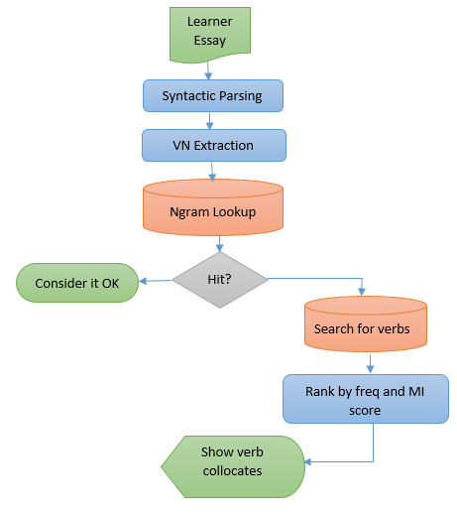
System Architecture

Slide 10
VN Collocation Extraction
Grammatical relations are obtained via a dependency parser (e.g., Stanford Parser, see Chen & Manning, 2014).
Instances of direct objects use are automatically extracted
Direct object (dobj): NP serving as the (accustive) object of the verb
Passive nominal subject (nsubjpass): NP serving as syntactic subject of a passive clause. E.g., The application was finally approved.
Notes:
Take care of instances where verbs and nouns are not immediately adjacent to each other.

Slide 11
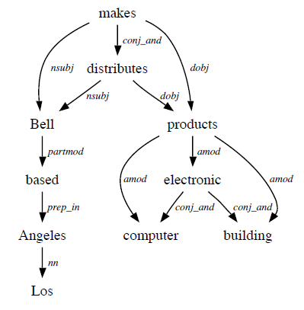
Stanford Dependencies Representation
nsubj(makes-8, Bell-1)
nsubj(distributes-10, Bell-1)
vmod(Bell-1, based-3)
nn(Angeles-6, Los-5)
prep in(based-3, Angeles-6)
root(ROOT-0, makes-8)
conj and(makes-8, distributes-10)
amod(products-16, electronic-11)
conj and(electronic-11, computer-13)
amod(products-16, computer-13)
conj and(electronic-11, building-15)
amod(products-16, building-15)
dobj(makes-8, products-16)
dobj(distributes-10, products-16)
Bell, based in Los Angeles, makes and distributes electronic, computer and building products.
Adapted from de Marneffe and Manning (2008)

Slide 12
VN Collocation Error Detection
Matching against 2-4 ngrams in COCA (Davies, 2009)
Min frequency of 3
About 450m words
All genres
1-gram data used for MI calculation (i.e., frequencies)
Excluded pronouns and demonstratives in object slots
Ngram | Frequency
1-gram | 618,632
2-gram | 6,593,487
3-gram | 11,582,206
4-gram | 8,282,371
Total | 27,076696

Slide 13
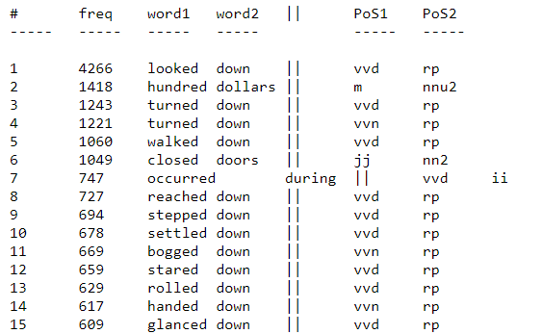
Sample bigram data from COCA corpus
Adapted from https://www.ngrams.info/

Slide 14

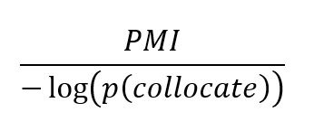
VN Collocation Error Correction
Frequency information (still quite useful)
Pointwise Mutual Information (Church & Hanks, 1989)
Measures of association strength
Asymmetric normalization (NPMIC) (Carlini, Codina-Filba, & Wanner, 2014)
Avoid undue penalization of highly frequent collocates

Slide 15
Live demo aihaiyang.com/software/collocates

Slide 16
Preliminary Results
Analyzed one sample essay from International Corpus of Learner English (<ICLE-BG-SUN-0001.1>)
Detected all four true errors
Some false positives
Error corrections needs refinement
[See spreadsheet analysis]

Slide 17
Discussion
Miscategorization
String extraction problem (Parser error) (Futagi et al, 2008)
Ngram data with minimum occurrences (3 times)
Ngram data with mislabeled POS categories
exercise habit (vv0 + nn)
Collocation error correction
Accuracy, semantic relevance, user interface
What counts as miscollocation?

Slide 18
Pedagogical Implication
Entirely “corpus-driven” and consider all V–N collocations in a text
Targeting problematic V–N collocational issues that are specific to each learner)
Responsive web-based interface
Pedagogical tools for language teachers and learners

Slide 19
Future Directions
To improve accuracy (identification & correction)
To add Ngrams from BNC and GoogleBooks
To implement multiple ranking measures (e.g., semantic similarity, collocation clustering)
To validate the system with L2 writing data
To provide graduated mediation to gauge development
To provide authentic examples using corpus concordances
To include noun-side of collocates (or other types)

Slide 20
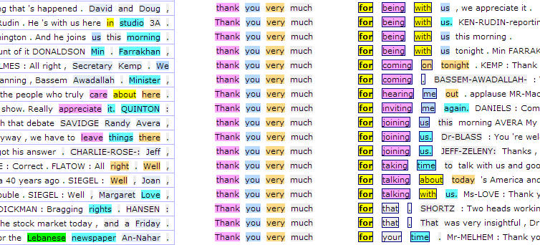
Thank you!

