Slide 1

Simple classifications with SUSY data, and why it’s not so simple
Machine Learning Term Project
Spring 2021
Michael Z Reynolds

Slide 2


Outline
Context: the dataset and why I chose it
My original plan and why I could not do it
What I tried next and what went wrong
What I learned from this project

Slide 3
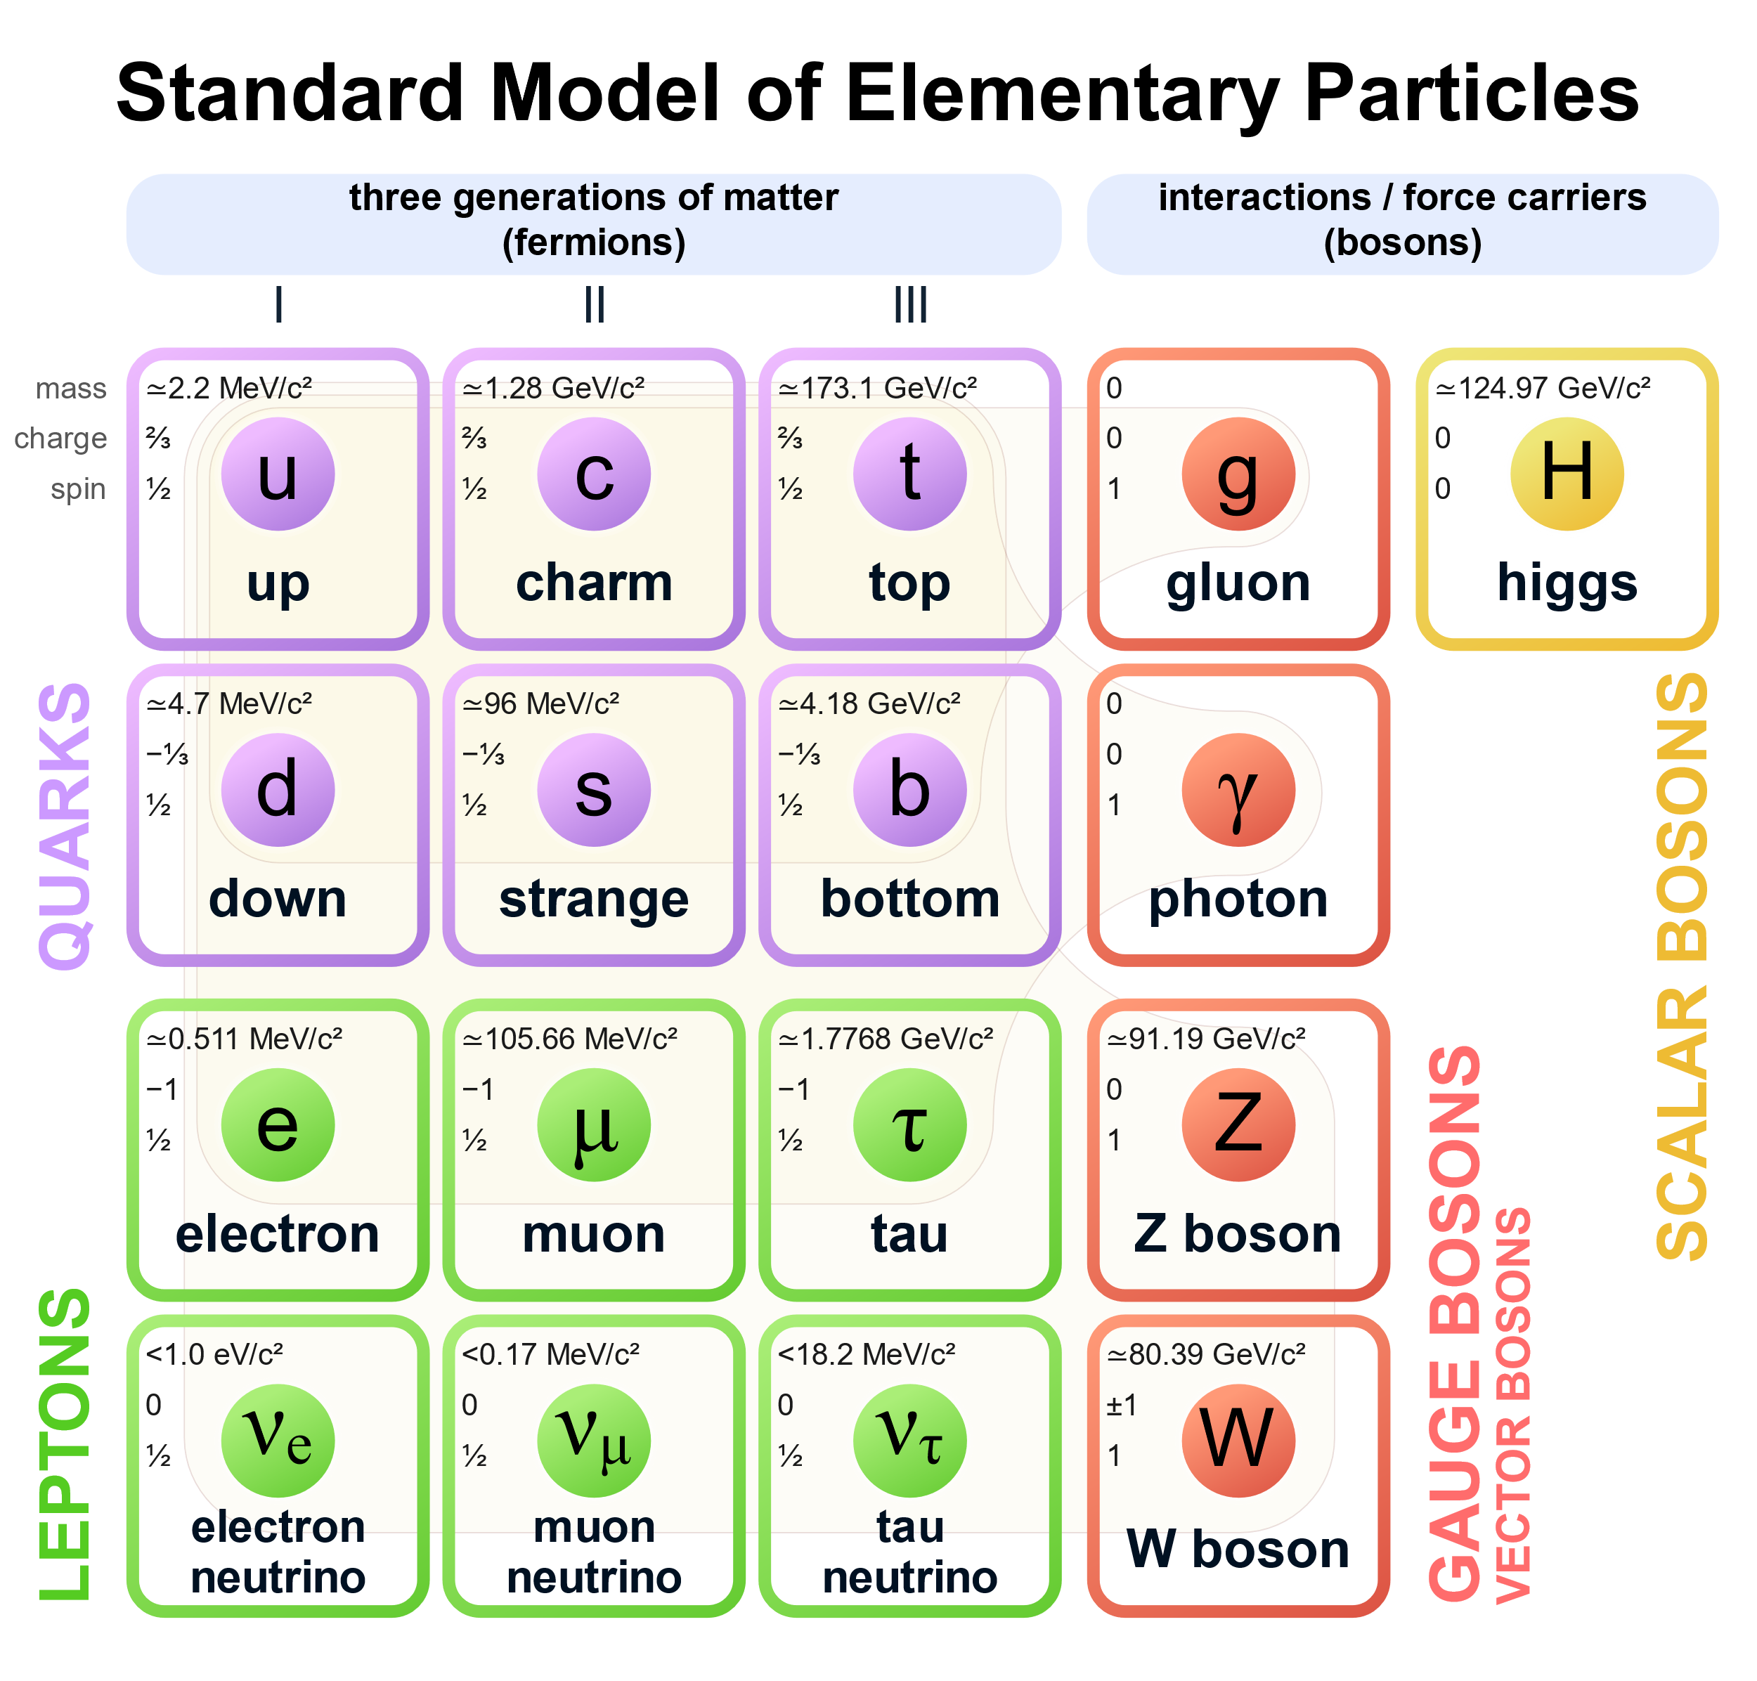
Context: The Dataset
SUSY → SUper SYmmetry: is the ongoing search for super-symmetric particles
5 million events generated by Monte Carlo (MC) simulations of proton collisions
→ Represents decays of particles into two leptons
→ Mass and charge of the particles are not known
There are a total of 18 features:
→ 8 low-level (raw) features
→ 10 high-level features
Reference from our course material:
Baldi, P., P. Sadowski, and D. Whiteson. “Searching for Exotic Particles in High-energy Physics with Deep Learning.” Nature Communications 5 (July 2, 2014)

Slide 4
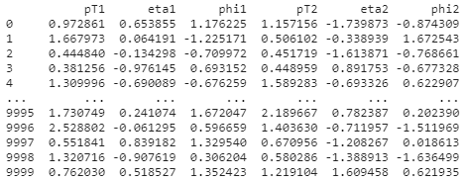
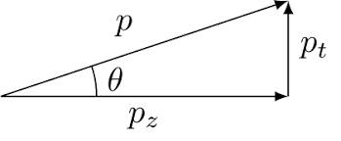
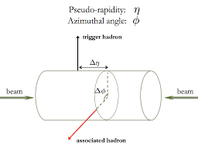
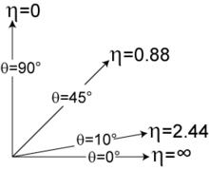
Context: Kinematics
The low-level features:
→ p_{T} (transverse momentum)
→ η (pseudo-rapidity)
→ φ (azimuthal angle)
→ Also 2 for “missing energy”

Slide 5
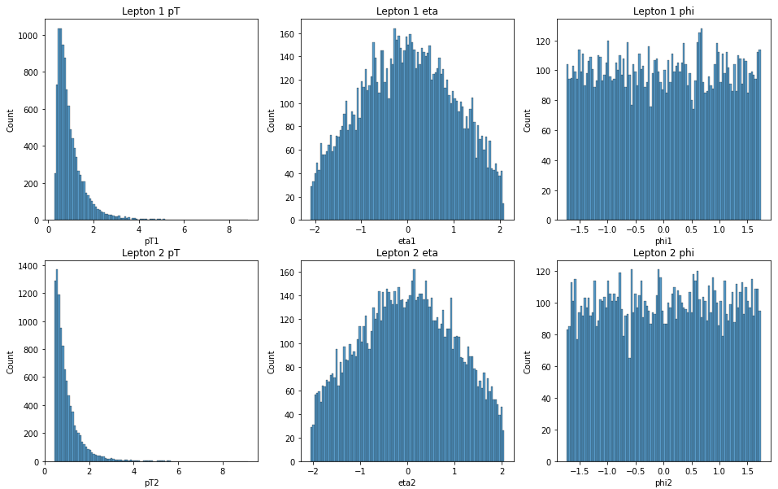
Context: Visualizing
I was trying scatterplots at first, did not look right, so then I realized each feature is a distribution

Slide 6
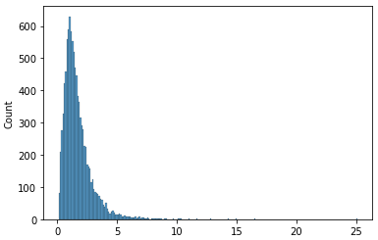
My Original Plan
I chose this data set because it is very close to what I’ll be working with in my dissertation research!
The physics goal is to classify particle events
For E >> m
Code a classifier that would extract particle decays from the total spectrum
Above: total invariant mass spectrum from sample
Would need to subtract out the “combinatorial background” to reveal a mass peak
→ Tried a couple different methods

Slide 7
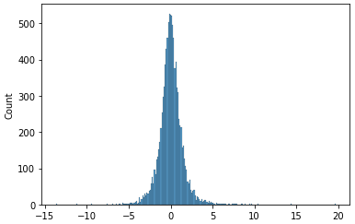

Why I Couldn’t Do It
Turned out to be very difficult with what I had
Background subtraction too complicated
Would need my own high-level features
Not enough information:
Unknown mass (particle ID)
Unknown energy
Unknown charge
Not possible! I did something wrong

Slide 8
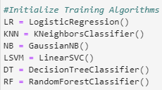


What I Tried Next
Simple classifiers with SKLearn to predict labels → signal or background
All features
Only pT and eta
I felt this was TOO simple

Slide 9
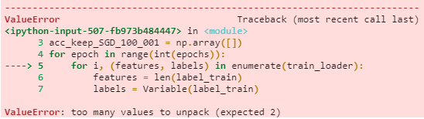
What I Tried Next
Softmax (multinomial logistic) regression in pytorch (from week 6)
This was from an image classifier
I think the features are too different
Tried to troubleshoot, moved on

Slide 10
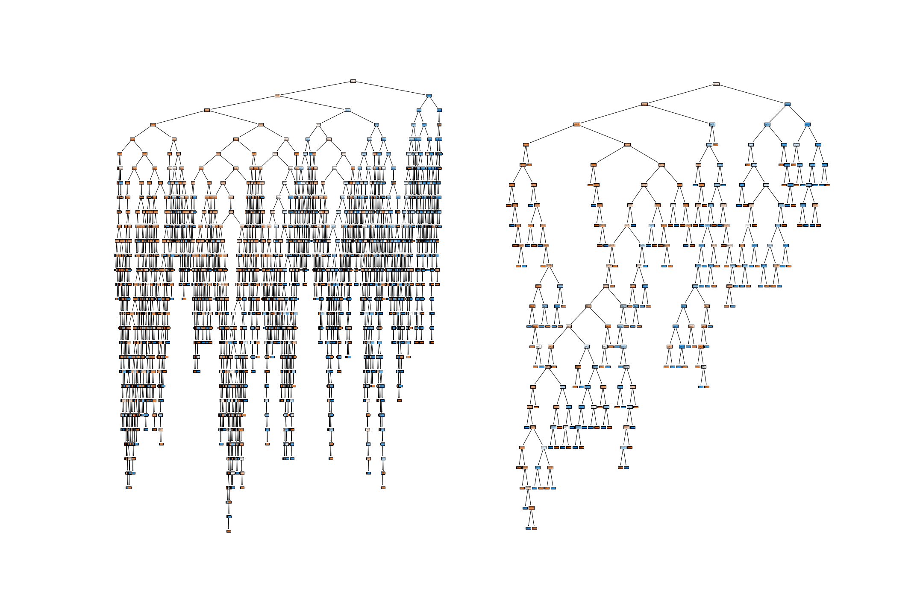
What I Tried Next
CART tree in SKLearn (from week 3) → Can anyone guess if this will work?
This is gini, tried entropy and similar result
TRAIN
TEST

Slide 11
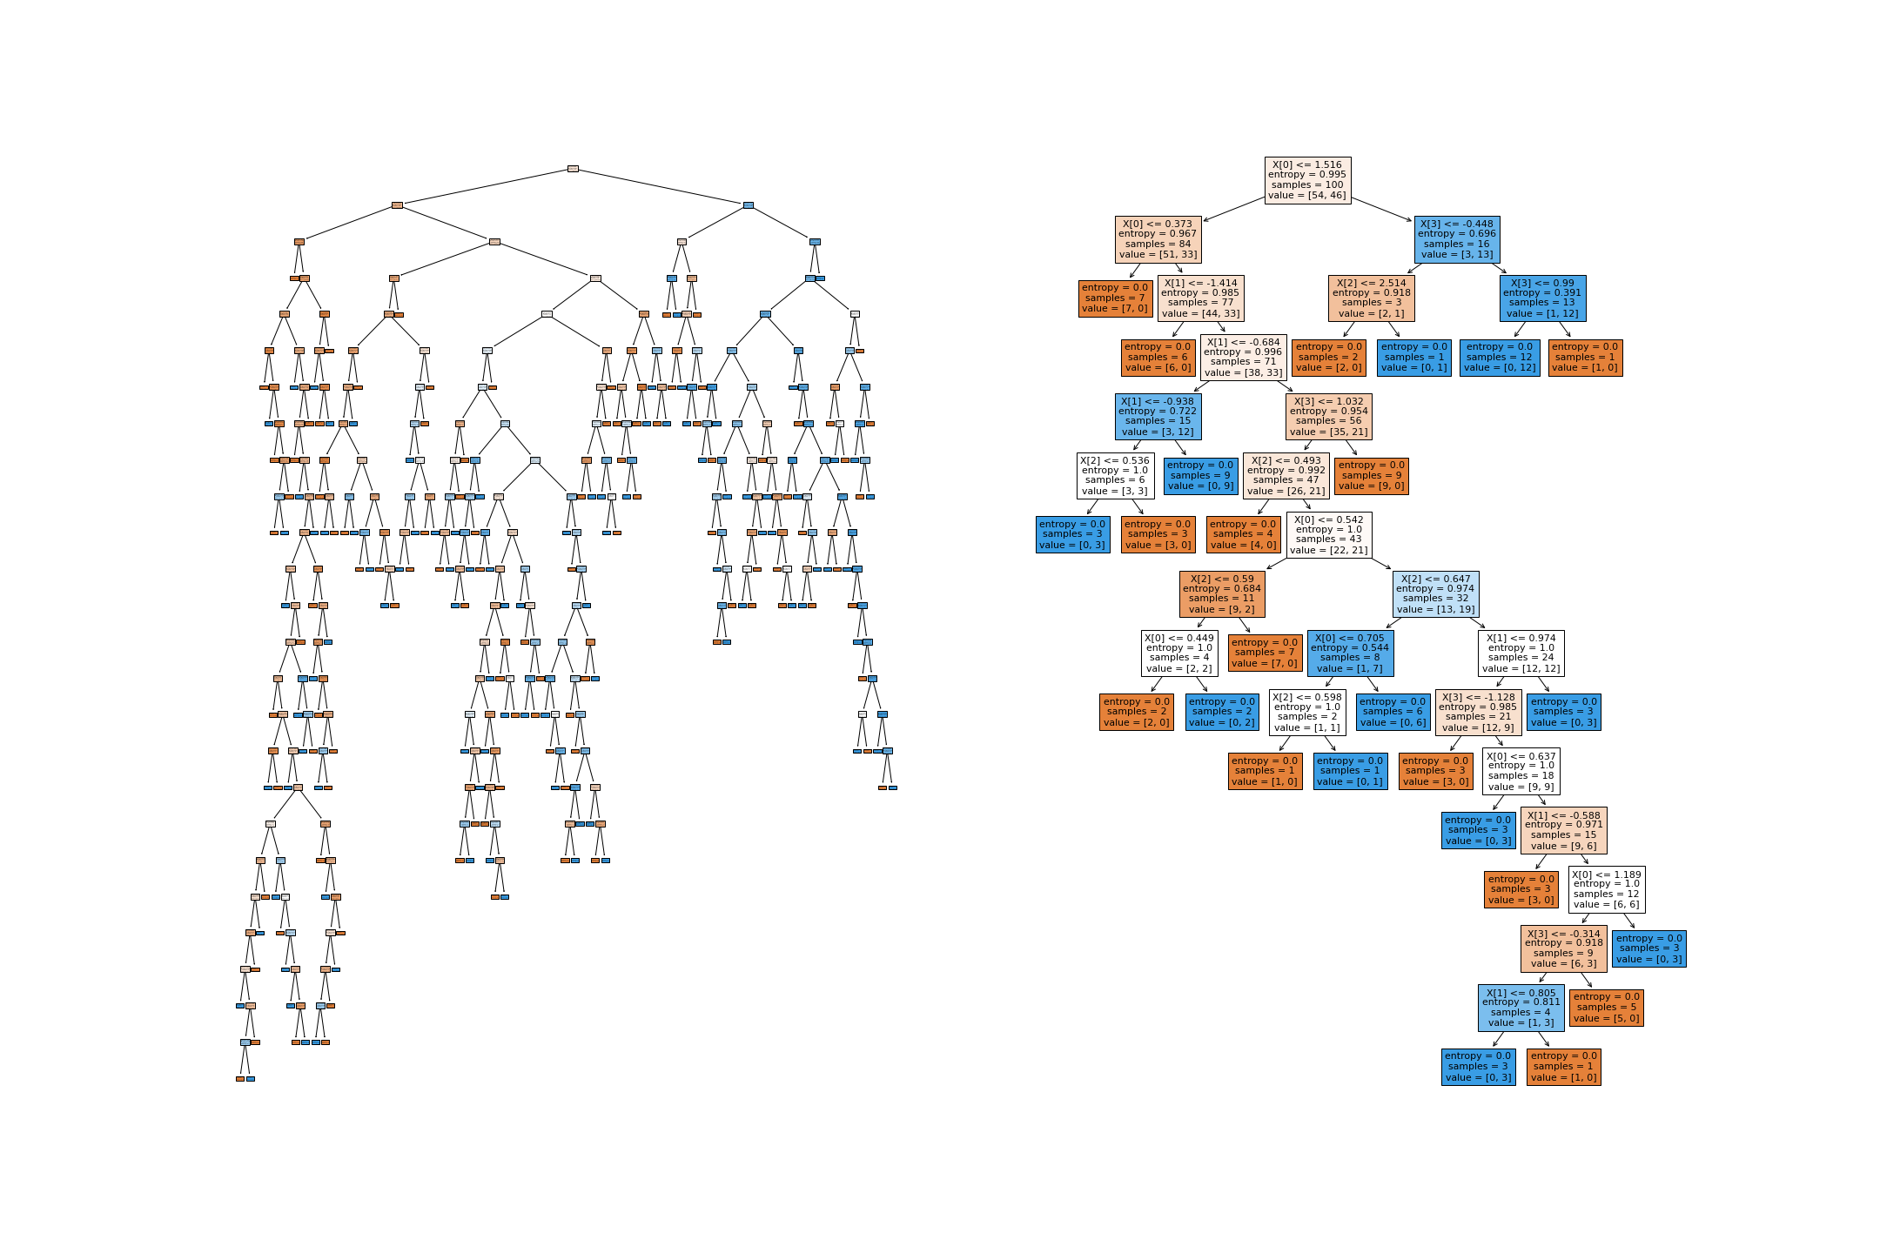
What I Tried Next
How about with less features and smaller sample size→ It’s a little better…
Played around with some other things.
But, by this point I had invested a lot of time, which has run out…
TRAIN
TEST

Slide 12

What I Learned
“If you take on an interesting project with a reasonable approach and things don’t work out, that is ok.”
This course was my first-time using Python
So, I learned A LOT all semester, and with this project
Learned some do’s and don’ts for this kind of data set
Became more familiar with the kind of data I’ll be using in research
Now much more comfortable with data, machine learning, and coding in general
I am interested in continuing this project, would like to develop the classifier I first imagined
NN likely best, will try next
Thank you!

