Slide 1

Syntactical Comparison Xamarin.Android (C#) and Native Android (Java)
Reynaldo Monares
Jr. Mobile App Developer at Tianggee

Slide 2
Syntax Comparison
The syntax between the two environments shared more similarities than differences.

Slide 3
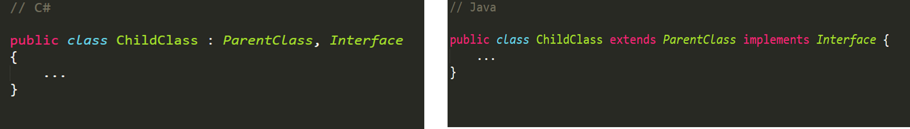
Inheritance
C#
Java

Slide 4
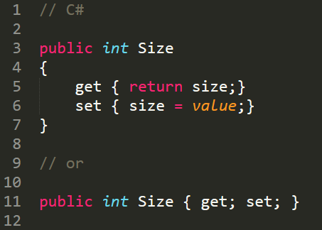
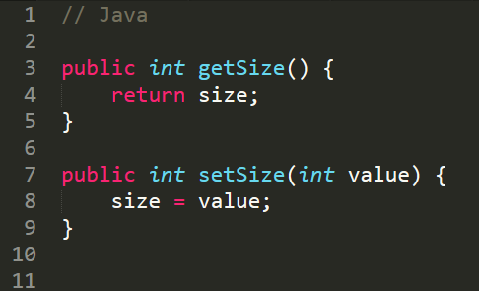
Properties
C#
Java

Slide 5
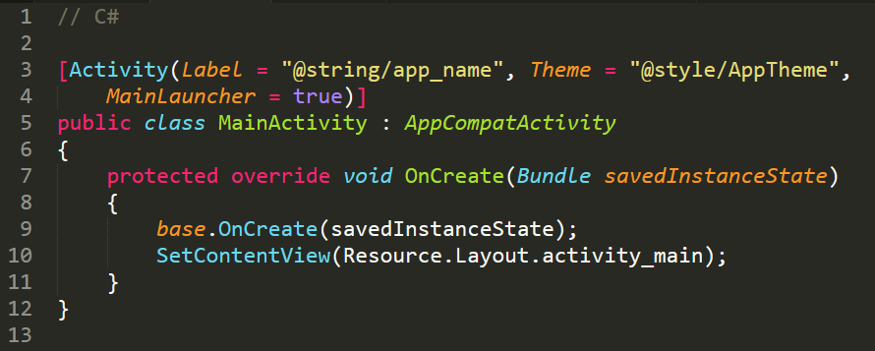
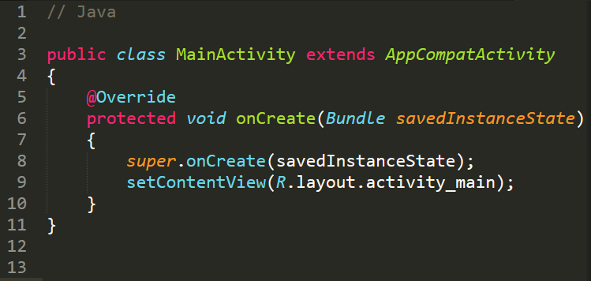
Main Activity
MainActivity.cs
MainActivity.java

Slide 6
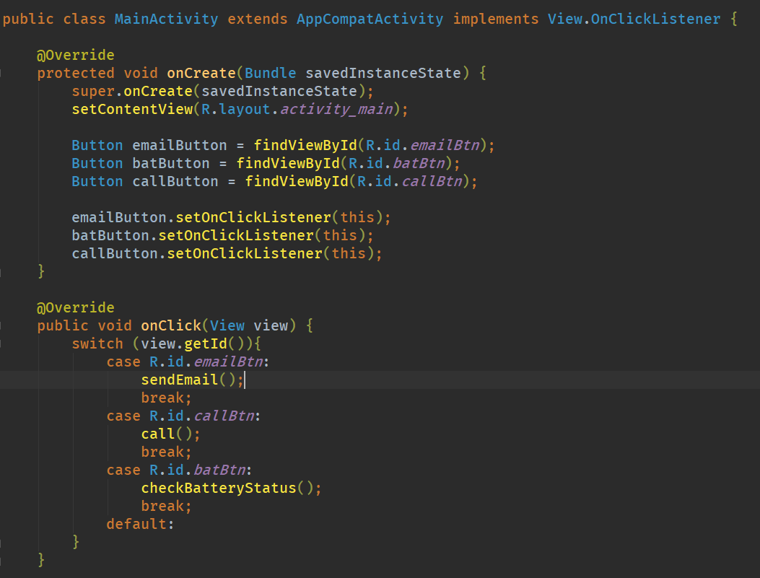
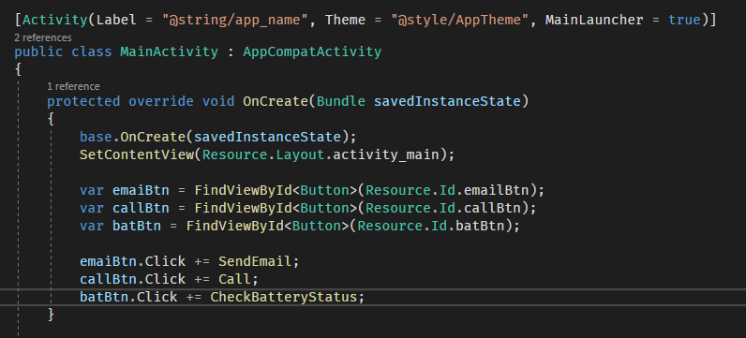
Handling Click Event
Java
C#

Slide 7
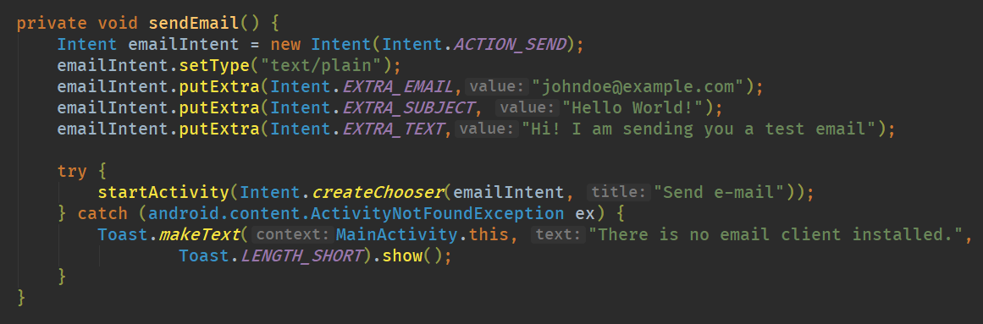
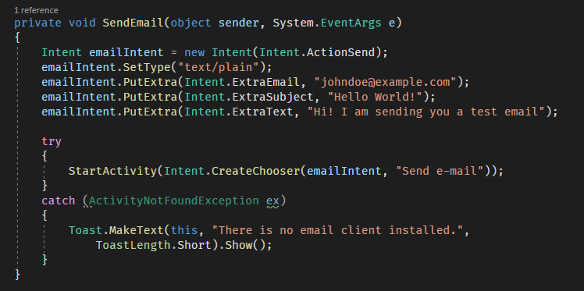
SendEmail Method
Java
C#

Slide 8
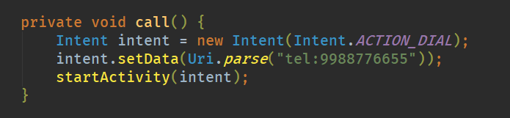
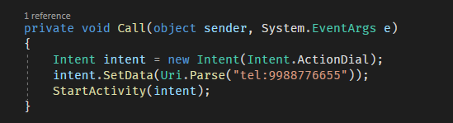
Call Method (Dialer)
Java
C#

Slide 9
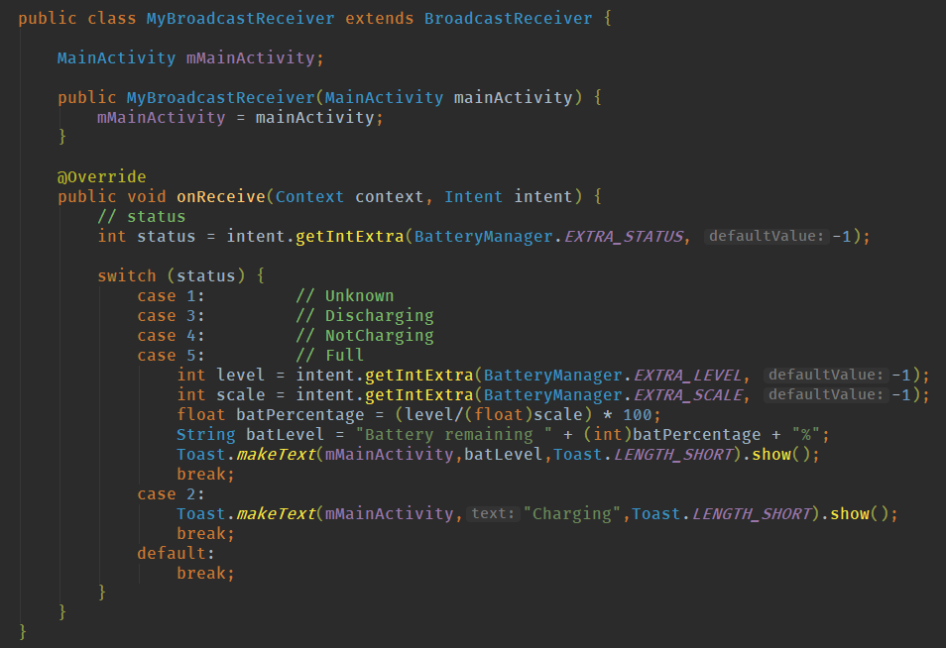
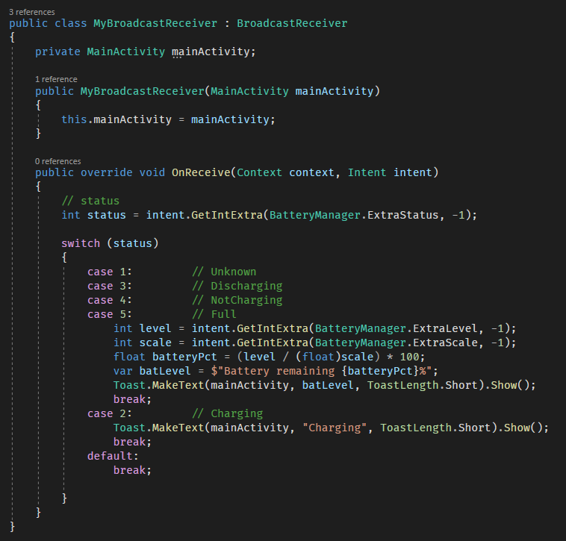
MyBroadcastReceiver class
Java
C#

Slide 10
CheckBatteryStatus Method
Java
C#

Slide 11
DEMO

Slide 12

Questions?

Slide 13
Demo Project at
https://github.com/reynzdev/XamarinJavaAndroidComparison

