Slide 1


Mashwerna
By
Nancy Dayekh & Mhmd-Mahdi Alali

Slide 2
Introduction
Find Your Next Adventure
The Social Way to Travel
Mashwerna
Platform
Mashwerna is a social media platform for travelers, making it easier to share and find new experiences. Users can post reviews, share moments, and connect with other travelers. They can explore recommended destinations, get real-time updates, and join discussions about their trips. Mashwerna also has an admin panel to keep things safe and fun. Admins can moderate content, enforce rules, and manage the platform, ensuring a positive experience for everyone

Slide 3
Similar Apps
Instagram
Although its not a travel app, Instagram is a popular social media platform where travelers share photos and videos of their journeys. Many use it to discover new destinations, follow travel influencers, and connect with other travelers. It has a lot of features that make sharing and discovering travel experiences easy.
Social media
Criteria
Travel & Tourism
Yelp
Yelp is a well-known platform that offers user reviews and ratings for a wide range of local businesses, including restaurants, hotels, and attractions. It allows users to share their experiences, read reviews, and find recommendations

Slide 4
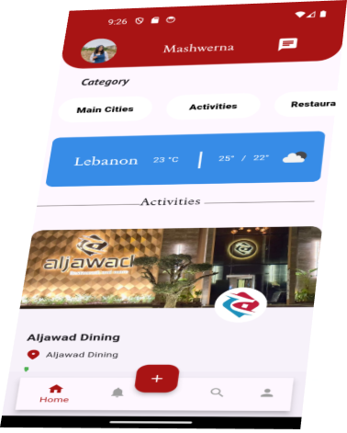
Application
Main Features
Users
Guests
Users have full-access, in addition to what guests can do, they are allowed to:
-create activities
-add comments & ratings
-follow other users
-like & bookmark activities
-chat
Guests have a restricted access to the app they are only allowed to search, view different posts and interactions.

Slide 5
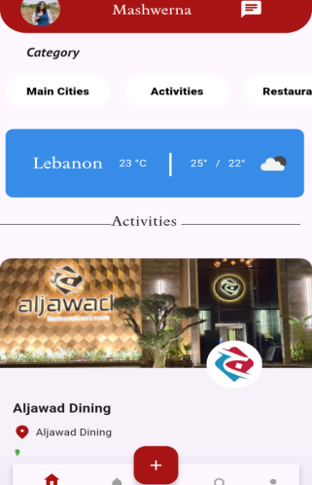
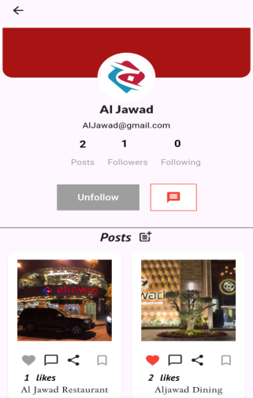
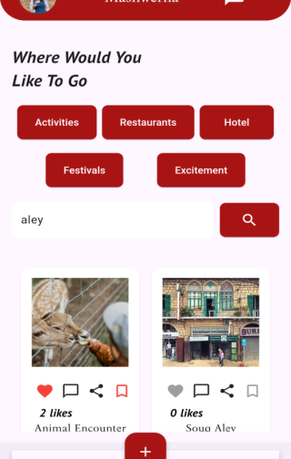
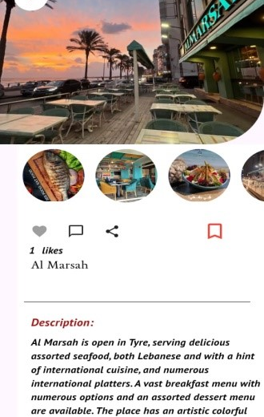
Overview
Home page
User profile
Search
Activity Details
Helps the users browse through activities
Offers different details about the user with the follow and chat functionalities.
Allows searching for activities by city name and with specific filters
Contains the description and pictures with the user interactions (likes ,comments)

Slide 6
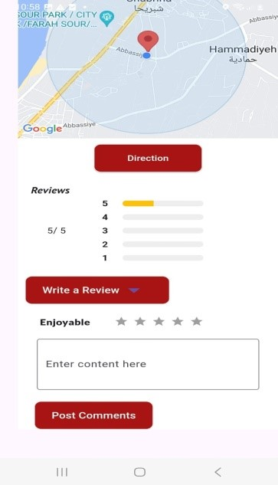
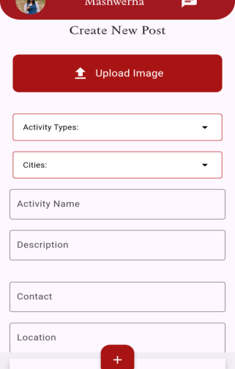
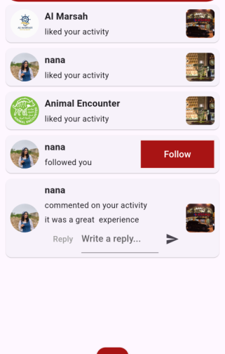
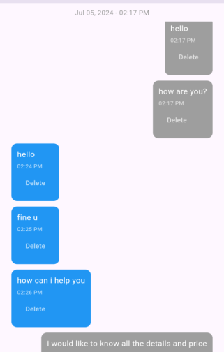
Activity details-2
Create posts
Notifications
Chats
Contains the location and reviews
Allows the making of new activities
All the received notifications from follows , likes , comments …
Users can send messages to each other

Slide 7
Admin Website
Main Features
The admin website is designed to moderate user-generated content and to help manage the application. It has 2 types of users:

Slide 8
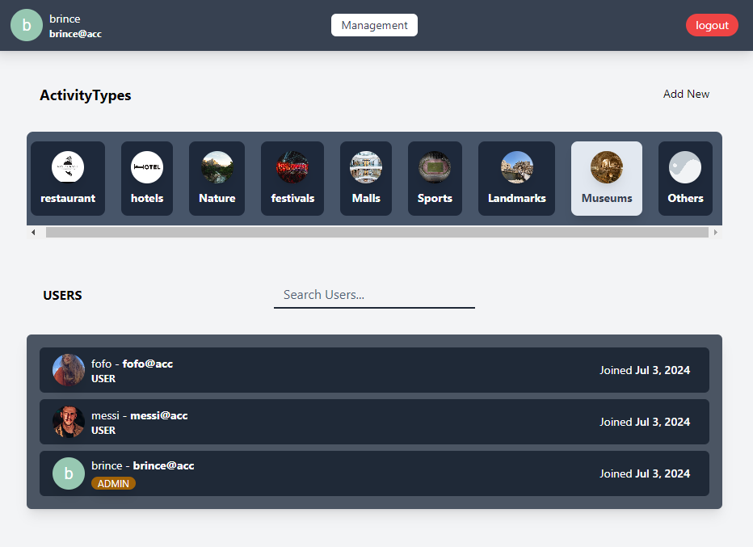
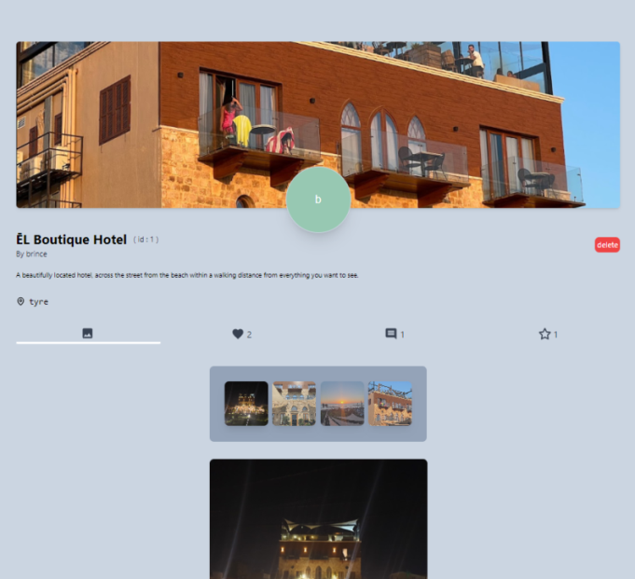
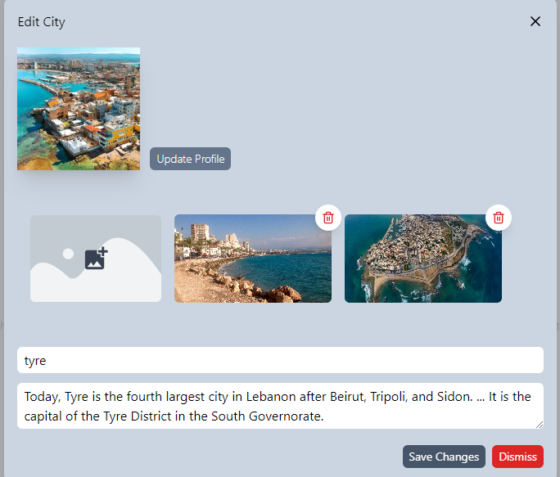
Examples :
01
Admin
-Admins can search and delete activities and normal users.
-They can crud cities and activity types
02
Super Admin
Super Admins have all the above abilities with:
the ability to promote demote users to admins.
Deleting admins.
Activity
Edit City
This page displays all information regarding the activity and its user interactions. Admins are able to delete inappropriate ones.
This page allows the edit of an existing city and addition of city pictures.
Overview

Slide 9
Project Goals
A Genuine Community
Explore & Share
Providing travelers among users with a place to share, chat, discover reviews and information about various destinations.
Allowing users to share their travel experiences, moments, or to introduce their own businesses. And explore others’
Authenticity
Safe Space
Relying only on authentic user reviews & experiences away from sponsorships.
Maintaining a safe and positive environment for user by moderating content.

Slide 10
Implementation
Frontend
React is used, it is a JavaScript library for building user interfaces, especially for single-page applications. Also, TailwindCSS which is a framework for creating custom designs quickly and efficiently.
Mobile
Flutter is a framework that lets you build apps for multiple platforms (like Android, iOS, web, and desktop) using just one codebase with the Dart programming language. This means you write your app's code once, and it works seamlessly across different devices and operating systems.
Backend
Laravel is a PHP web framework used for building web application logic with an elegant syntax, offering features like MVC architecture, routing, Eloquent ORM, and the Blade templating engine.

Slide 11
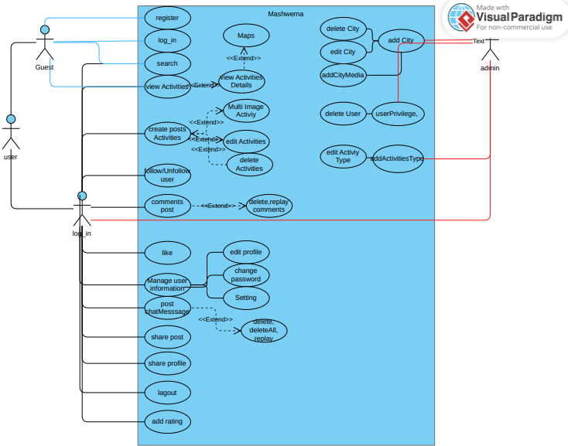
Use Case Diagram

Slide 12
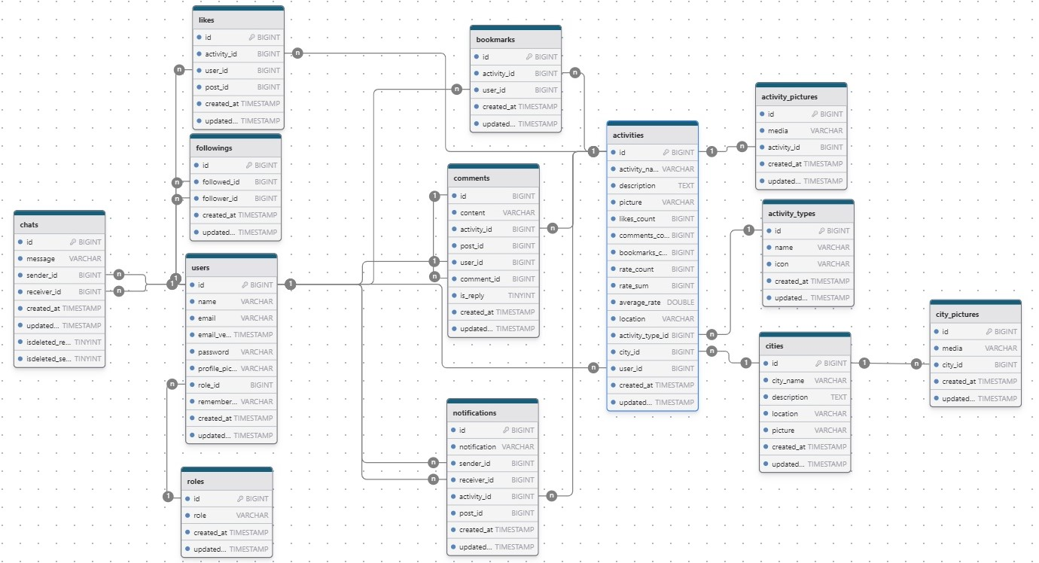
ER Diagram

Slide 13
Conclusion
Social Media
MASHWERNA
Travel
&
Tourism
Mashwerna revolutionizes social media and tourism with authentic engagement and unbiased destination reviews. By fostering meaningful interactions, promoting tourism through a positive, moderated environment, and offering a platform free from sponsorships, Mashwerna creates a vibrant community for authentic adventures and connections. This comprehensive approach ensures that users can enjoy and share genuine experiences within a supportive and safe community, paving the way for a future where every adventure is celebrated and shared authentically.

