Slide 1
Understanding Density Functional Theory (DFT) in Molecular Computational Chemistry
Short Overview with Best Practices and Applications

Slide 2
Introduction to Density Functional Theory (DFT)
What is DFT?
DFT is a computational quantum mechanical method used to study the electronic structure of atoms, molecules, and condensed phases.
It helps predict molecular properties like structure, energy, and reaction mechanisms.
Core Idea: It uses electron density (instead of wavefunctions) to calculate molecular properties.
Focuses on finding the lowest energy configuration of a molecule.
Importance of DFT?
Efficiency: It provides a balance between computation time and result accuracy, making it ideal for large molecular systems.
Applications: Used to predict the behavior of molecules in drug design, materials science (batteries, catalysts), and more.

Slide 3
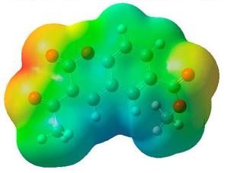

Key Concepts in DFT
Electron Density:
The core of DFT is electron density, a function of three spatial coordinates, which describes the distribution of electrons within a molecule.
Kohn-Sham Equations:
These are a set of mathematical equations used to simplify the complex problem of understanding how electrons behave in atoms and molecules. They introduce fictitious non-interacting electrons and use them to find the most stable arrangement of electrons, which helps to understand and predict the properties of matter at the atomic and molecular scale.
Exchange-Correlation Functional:
An approximation used to describe the remaining electronic energy that's not included in the non-interacting kinetic and electrostatic terms.
Basis Sets:
Basis sets are sets of functions used to describe the wavefunctions of electrons. To simply put, it describes where electrons can be in a molecule.
PBE
B3LYP
B2PLYP
6-311G
6-311G*
6-311+G*

Slide 4

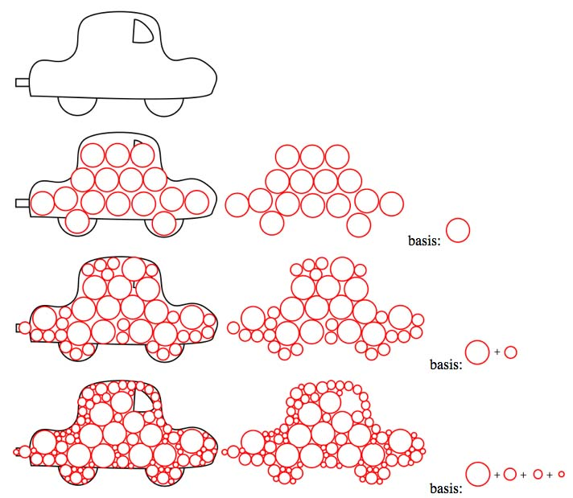
Basis Set (Concept)
Say I have a shape I want to describe, for example a car as in the diagram.
I could describe this shape with a single basis function (a circle).
If I use only one basis function (a circle) of a given size, the shape of the car is not well reproduced.
However, if I allow my circles to vary slightly in size, i.e. if I increase my basis set to two functions I get a better fit, and if I allow even more functions I can describe the shape of the car very well!
If we add too many basis functions the calculation will take too long, so we always have to balance computational difficulty vs the size of the basis set.
https://www.huntresearchgroup.org.uk/teaching/teaching_comp_lab_year2a/4a_pseudo_potentials.html

Slide 5
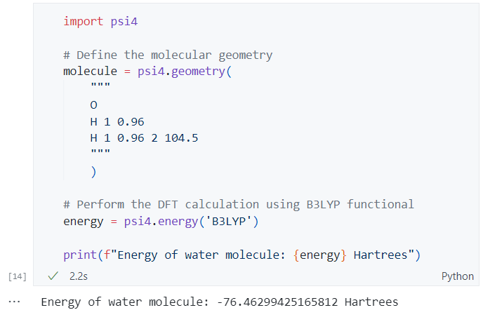
Practical Example 1 – DFT Calculation for a Simple Molecule with Functional
Simple DFT calculation for the water molecule using Python and psi4 package.
Constructing Z-Matrices -> https://gaussian.com/zmat/

Slide 6
Choosing the Right Functional
General-Purpose Functionals:
PBE (Perdew–Burke–Ernzerhof) and B3LYP (Becke 3-Parameter, Lee-Yang-Parr) functionals are widely used for general molecular systems.
Hybrid Functionals:
Include a portion of exact exchange from Hartree-Fock theory, providing higher accuracy for molecular systems, e.g., PBE0, B3LYP-D3.
Double-Hybrid Functionals:
Incorporate both exact exchange and second-order perturbation theory (e.g., B2PLYP), suitable for high-accuracy predictions of reaction energies.

Slide 7
Basis Set Selection
Basis Set Convergence:
Basis sets determine how well the electron density is described.
Larger basis sets such as triple-zeta (TZ) or quadruple-zeta (QZ) provide higher accuracy but are computationally expensive.
Practical Guidance:
For small organic molecules, def2-TZVP is often sufficient and offers good balance.
For systems involving heavy atoms, the use of effective core potentials (ECPs), such as def2-TZVPP, is recommended to reduce computation while incorporating relativistic effects.

Slide 8
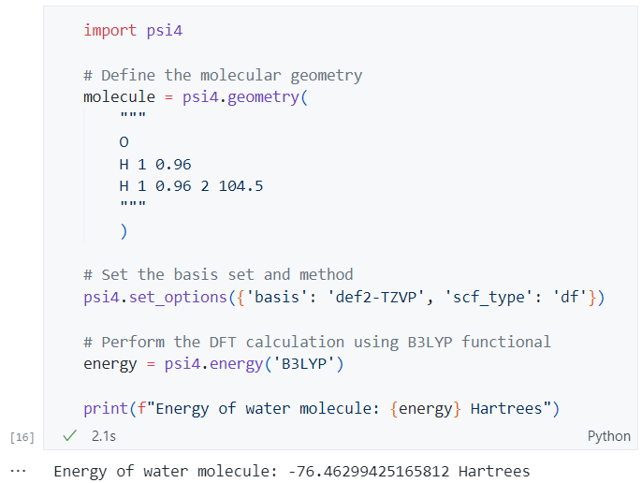
Practical Example 1 – DFT Calculation for a Simple Molecule with Basis Set & Functional
The B3LYP functional and the def2-TZVP basis set offers good accuracy for small molecules.
scf_type parses default DF algorithm for calculation.

Slide 9
Handling Common DFT Errors
Self-Interaction Error (SIE):
Occurs when an electron interacts with itself, leading to over-delocalization of the electron density. Can be reduced using hybrid or range-separated hybrid functionals.
Basis Set Superposition Error (BSSE):
Atoms in a molecule “borrow” basis functions from each other, artificially lowering energy. This can be addressed using the counterpoise correction.
Dispersion Corrections:
Important for modeling long-range interactions (e.g., London dispersion forces, van der Waals etc). Common corrections include D3 or D4.

Slide 10
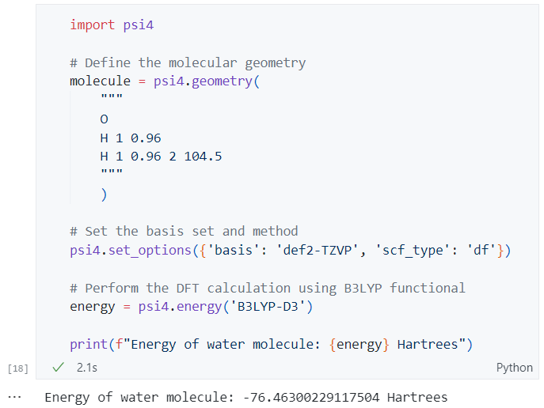
Practical Example 1 – DFT Calculation for a Simple Molecule with Basis Set & Functional Correction
The B3LYP-D3 functional includes dispersion corrections.

Slide 11
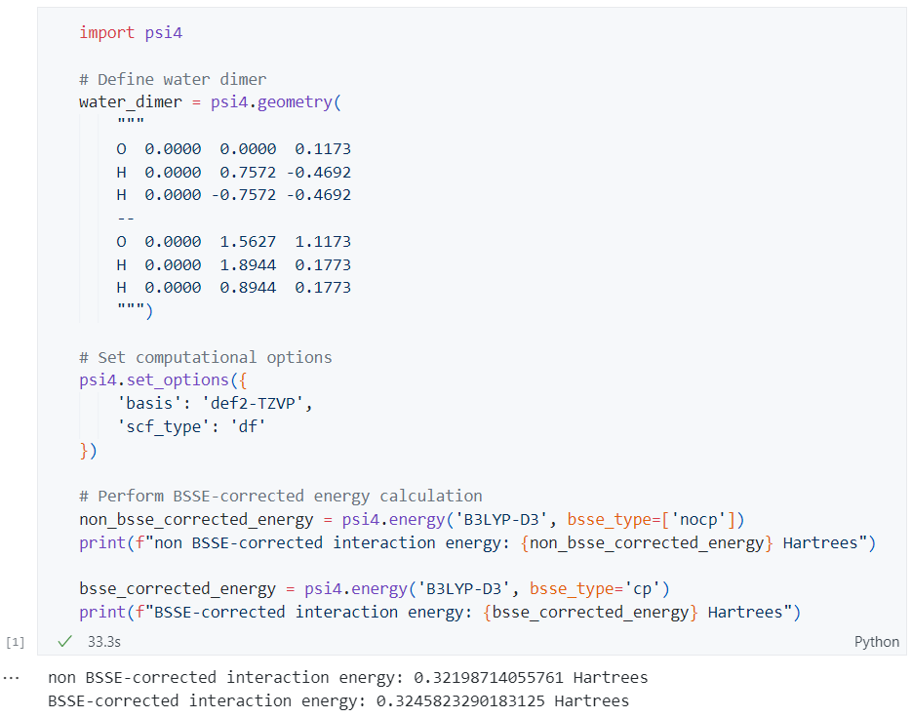
Practical Example 2 – Counterpoise Correction for BSSE
To account for BSSE in a dimer system, we apply the counterpoise method.
This can be easily implemented in Psi4 for a hydrogen bond calculation between two water molecules.

Slide 12
Multi-Level Approaches in DFT
Combining methods:
Use a low-level method (like semi-empirical) for quick structure optimizations, followed by a higher-level method for energy calculations.
This saves time without compromising too much on accuracy.

Slide 13
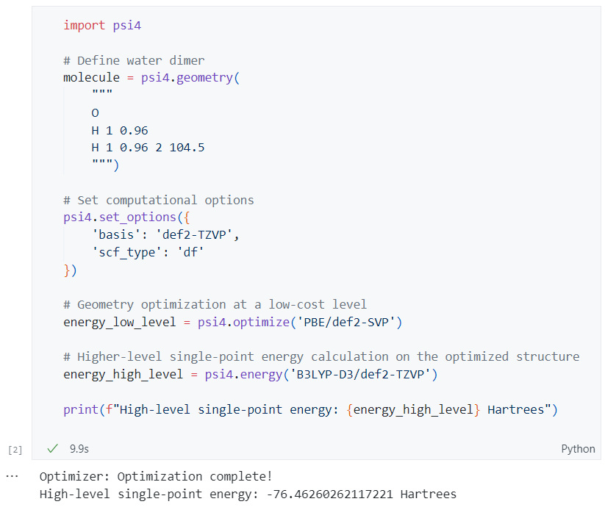
Practical Example 1 – DFT Calculation for a Simple Molecule with Multi-Level Approach
Optimizing geometry with a low-cost functional (e.g., PBE).
Performing single-point energy calculation with a hybrid functional (e.g., B3LYP-D3).

Slide 14
DFT Applications in Research
Materials Science:
DFT is used to model the electronic properties of materials, helping in the design of better catalysts and semiconductors.
Drug Design:
DFT helps simulate the interaction between drug candidates and biological targets, optimizing binding affinities.
Spectroscopy:
Predicts spectral properties (IR, NMR) to assist in the interpretation of experimental data.

Slide 15
Conclusion
Summary:
DFT is a versatile and efficient tool in computational chemistry, offering a balance between computational demand and accuracy.
Selecting appropriate functionals and basis sets, along with correcting common errors (SIE, BSSE), ensures robust results.
Future Directions:
As computational power increases, more accurate functionals like double-hybrids and multi-reference methods will become accessible for larger systems.
Continuous development of improved functionals and error-correction schemes will further reduce the computational cost while improving accuracy.

Slide 16
Questions
1. Which of the following basis sets is typically considered a good balance between computational cost and accuracy for DFT calculations?
6-31G*
STO-3G
def2-TZVP
aug-cc-pVQZ
2. Why is Psi4 often used for quantum chemistry calculations?
It only supports semi-empirical methods.
It provides efficient implementations of both wavefunction theory and DFT methods.
It requires expensive commercial licenses.
It does not allow for customization of molecular geometries.

Slide 17
Questions
3. Which functional is best suited for calculating accurate reaction energies and barrier heights using DFT?
B3LYP
PBE0
STO-3G
B2PLYP-D3
4. What is the primary purpose of adding a dispersion correction (e.g., D3 or D4) in DFT calculations?
To improve the accuracy of the kinetic energy term.
To account for long-range interactions such as London dispersion forces.
To speed up the convergence of the self-consistent field (SCF) method.
To reduce the computational cost of DFT.

Slide 18
Questions
5. Out of following, which python package is used for calculating molecular properties using DFT?
psi4
scikit-learn
pandas
biopython

