Slide 1

Chapter 10

Slide 2
Assets | Liabilities and Equity
Assets: | Liabilities:
 | Equity:
Total Assets | Total Liabilities and Equity
Use of Capital
Source of Capital
Source of Capital

Slide 3

Assets | Liabilities and Equity
Assets: | Liabilities:
Current Assets: | Current Liabilities:
Cash | Accounts Payable
Accounts Receivable | Accruals
Inventory | Notes Payable
Prepaid Expenses | Unearned Revenue
Other Current Assets | Long-Term Liabilities:
Fixed Assets: | Bonds Payable
Net Plant & Equipment | Long-Term Loans
Intangible Assets | Equity:
Investments | Preferred Stocks
Other Fixed Assets | Common stocks (N shares)
 | Retained Earning
Total Assets | Total Liabilities and Equity

Slide 4
Why Do Firms Care About the Cost of Capital?
Firms need capital to invest in projects, expand operations, or refinance obligations.
Available sources of capital
Cost of each source
Debt (Loans or issuing bonds)
Interest Payments
Preferred Stock
Pays Fixed Dividends
Equity (Issuing new shares)
Required Rate of Return
The Weighted Average Cost of Capital (WACC) combines these costs into a single, overall rate that reflects the average cost of raising one dollar of new capital.

Slide 5
Key Considerations in Calculating WACC
Only investor-supplied capital is included.
  This consists of interest-bearing debt, preferred stock, and common equity.
  Excluded: Accounts payable and accruals, because they arise from operations and do not represent funds provided by investors.
Book values, market values, and target weights may differ:
  Book values are historical and may not reflect current economic conditions.
  Market values reflect investors’ current perception and the real-time cost of capital.
  Target values are forward-looking, optimized to minimize WACC and maximize firm value.
Therefore, when estimating WACC, we use target weights based on market values to ensure the discount rate reflects both current conditions and strategic financial planning.

Slide 6
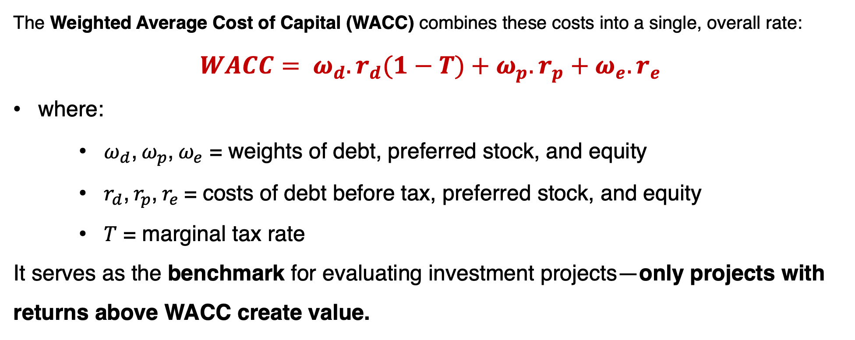
Key Considerations in Calculating WACC
The Weighted Average Cost of Capital (WACC) combines these costs into a single, overall rate:
$$WACC= ω_{d}.r_{d}(1−T)+ω_{p}.r_{p}+ω_{e}.r_{e}$$
where:
    $ω_{d}$, $ω_{p}$, $ω_{e}$ = weights of debt, preferred stock, and equity
    $r_{d}$, $r_{p}$, $r_{e}$= costs of debt before tax, preferred stock, and equity
    $T$ = marginal tax rate
It serves as the benchmark for evaluating investment projects—only projects with returns above WACC create value.

Slide 7

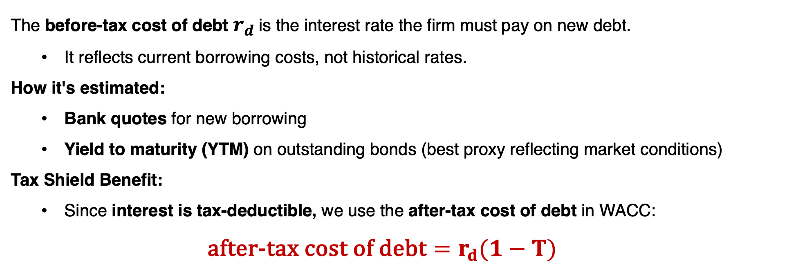
Understanding the Cost of Debt
The before-tax cost of debt $r_{d}$is the interest rate the firm must pay on new debt.
  It reflects current borrowing costs, not historical rates.
How it's estimated:
  Bank quotes for new borrowing
  Yield to maturity (YTM) on outstanding bonds (best proxy reflecting market conditions)
Tax Shield Benefit:
  Since interest is tax-deductible, we use the after-tax cost of debt in WACC:
  $${\text{after}\text{-}\text{tax} \text{cost} \text{of} \text{debt}=r}_{d}(1−T)$$
YTM
$$r_{d}$$
Banks APR

Slide 8

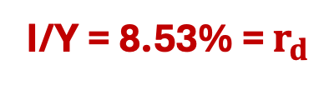
Question-1
A company has outstanding 25-year noncallable bonds with a face value of $1,000, an 10% annual coupon, and a market price of $1,150. If the company was to issue new debt, what would be a reasonable estimate of the interest rate on that debt? If the company’s tax rate is 25%, what is its after-tax cost of debt?
YTM
$${\text{after}\text{−}\text{tax} \text{cost} \text{of} \text{debt}=r}_{d}(1−T)$$
N | I/Y | PV | PMT | FV
25 | ?? | -1150 | 100 | 1,000
I/Y = 8.53% = $r_{d}$
$$\text{after}\text{−}\text{tax} \text{cost} \text{of} \text{debt}=\text{8.53\%} × \left(1−25\%\right)=6.379\%$$

Slide 9
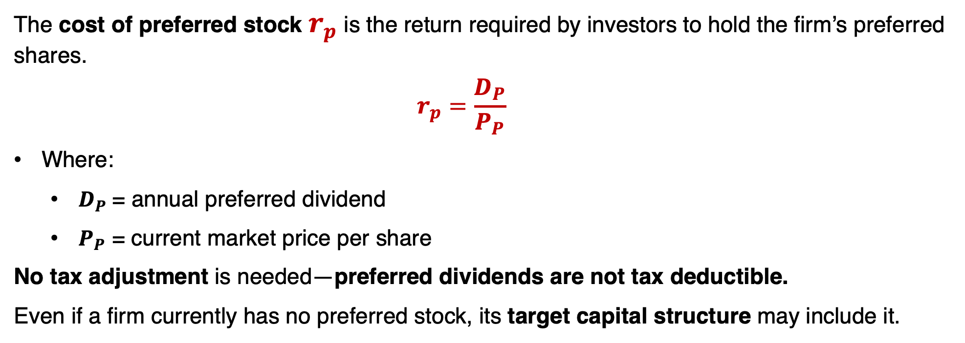
Understanding the Cost of Preferred Stock
The cost of preferred stock $r_{p}$is the return required by investors to hold the firm’s preferred shares.
  $$r_{p}=\frac{D_{P}}{P_{P}}$$
Where:
  $D_{P}$= annual preferred dividend
  $P_{P}$ = current market price per share
No tax adjustment is needed—preferred dividends are not tax deductible.
Even if a firm currently has no preferred stock, its target capital structure may include it.

Slide 10
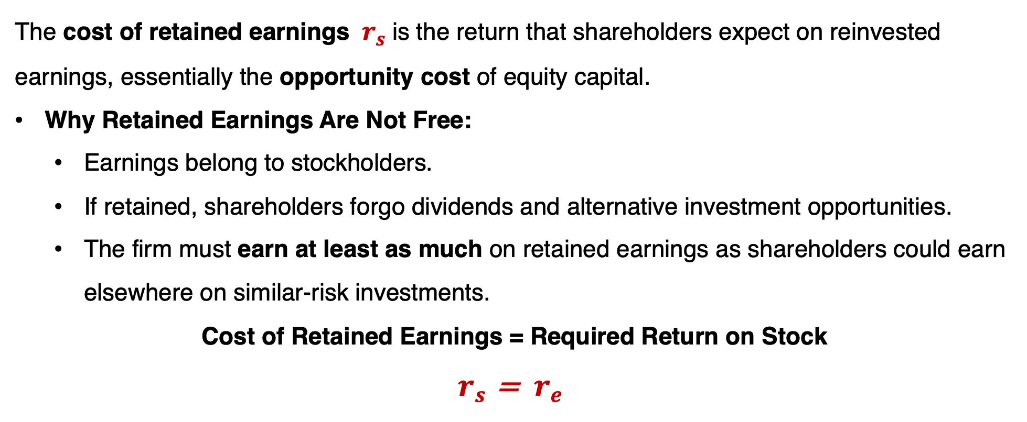
Understanding the Cost of Retained Earnings
The cost of retained earnings $r_{s}$is the return that shareholders expect on reinvested earnings, essentially the opportunity cost of equity capital.
Why Retained Earnings Are Not Free:
  Earnings belong to stockholders.
  If retained, shareholders forgo dividends and alternative investment opportunities.
  The firm must earn at least as much on retained earnings as shareholders could earn elsewhere on similar-risk investments.
Cost of Retained Earnings = Required Return on Stock
$r_{s}$ = ${ r}_{e}$

Slide 11
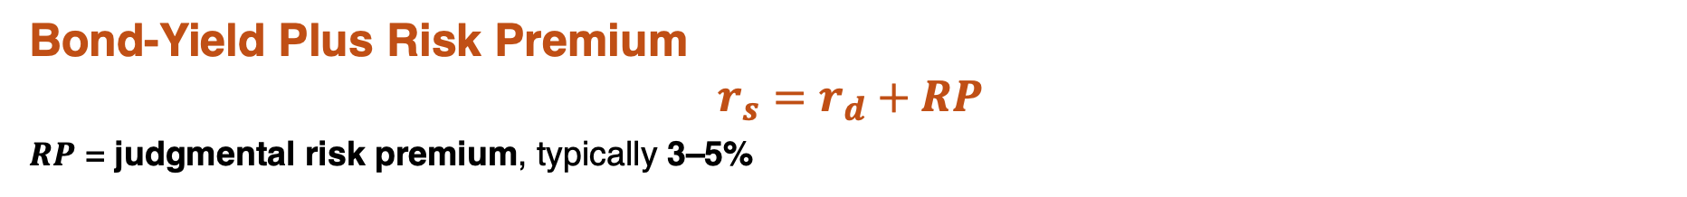

Estimation of the $r_{s}$
CAPM Approach
$$r_{s}=r_{f}+β_{i}×(r_{m}−r_{f})$$
Dividend Discount Model (DDM)
$$r_{s}=\frac{D_{1}}{p_{0}}+g$$
Bond-Yield Plus Risk Premium
$$r_{s}=r_{d}+RP$$
$RP$ = judgmental risk premium, typically 3–5%
Retained earnings are typically the primary source of new equity for mature firms.

Slide 12

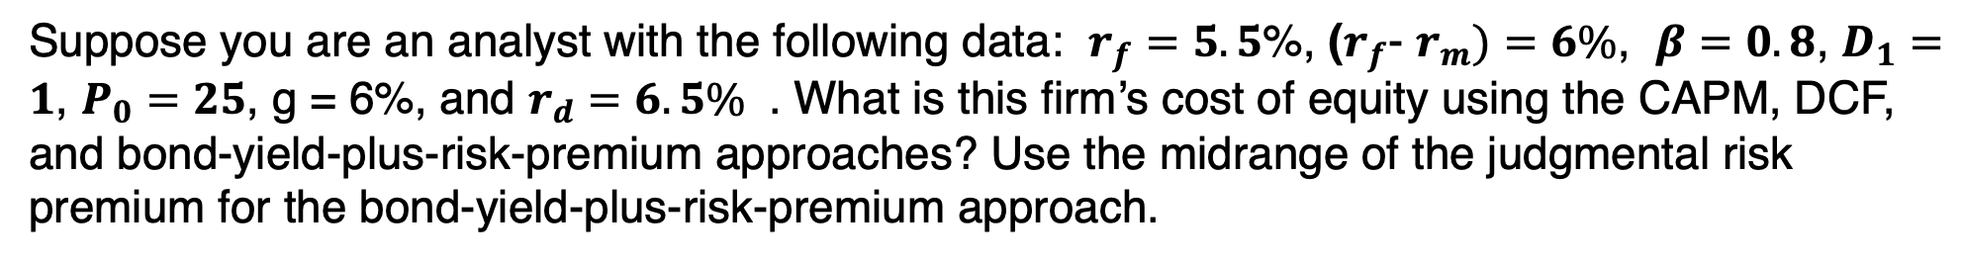
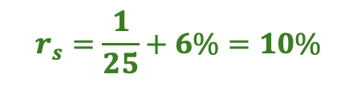


Question-2
Suppose you are an analyst with the following data: $r_{f}=5.5$%, ($r_{f}$- $r_{m})=6\%$, $β=0.8$, $D_{1}=1$, $P_{0}=25$, g = 6%, and $r_{d}=6.5\%$ . What is this firm’s cost of equity using the CAPM, DCF, and bond-yield-plus-risk-premium approaches? Use the midrange of the judgmental risk premium for the bond-yield-plus-risk-premium approach.
CAPM Approach
$$r_{s}=r_{f}+β_{i}×(r_{m}−r_{f})$$
$$r_{s}=5.5\%+0.8×\left(6\%\right)=10.3\%$$
Dividend Discount Model (DDM)
$$r_{s}=\frac{D_{1}}{p_{0}}+g$$
$$r_{s}=\frac{1}{25}+6\%=10\%$$
Bond-Yield Plus Risk Premium
$$r_{s}=r_{d}+RP$$
$$r_{s}=6.5\%+4\%=10.5\%$$

Slide 13

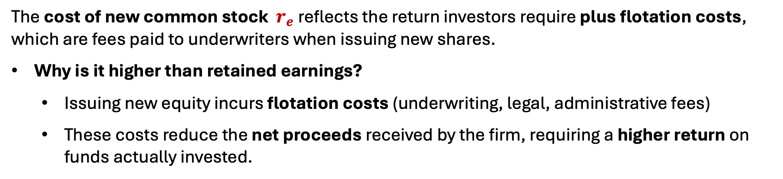
Understanding the Cost of New Common Stock
The cost of new common stock ${ r}_{e}$reflects the return investors require plus flotation costs, which are fees paid to underwriters when issuing new shares.
Why is it higher than retained earnings?
  Issuing new equity incurs flotation costs (underwriting, legal, administrative fees)
  These costs reduce the net proceeds received by the firm, requiring a higher return on funds actually invested.
$$r_{e}=\frac{D_{1}}{p_{0}(1−F)}+g$$
Where:
F = flotation cost as a decimal
Use flotation-adjusted cost when new stock issuance is involved—especially for large or ongoing capital needs.

Slide 14
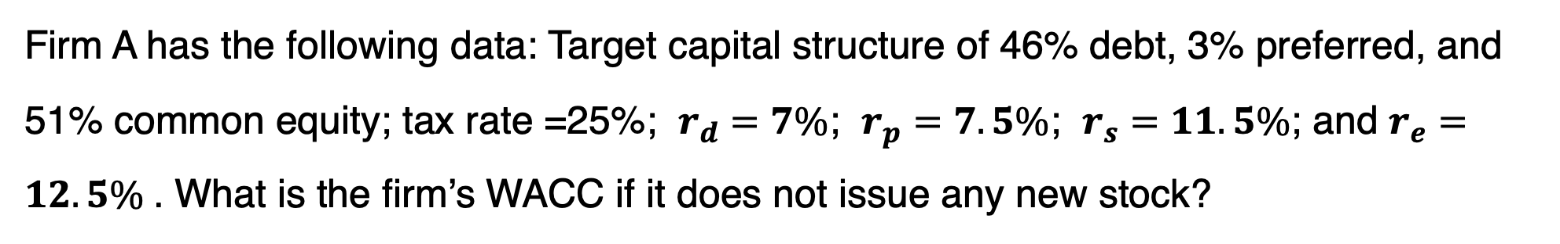
Question-3
Firm A has the following data: Target capital structure of 46% debt, 3% preferred, and 51% common equity; tax rate =25%; $r_{d}=7\%$; $r_{p}=7.5\%$; $r_{s}=11.5\%$; and $r_{e}=12.5\%$. What is the firm’s WACC if it does not issue any new stock?
$$WACC= ω_{d}.r_{d}(1−T)+ω_{p}.r_{p}+ω_{e}.r_{e}$$
$$WACC=\text{46\%}×7\%\left(1−25\%\right)+3\%.7.5\%+51\%.11.5\% ,$$
$$WACC=2.42\%+0.23\% +5.87\%,$$
$$WACC=2.42\%+0.23\% +5.87\%,$$
$$WACC=8.52\%$$

