Slide 1

Chapter 12

Slide 2
Where We Are in Capital Budgeting
So far, we learned…
  How to evaluate projects using NPV, IRR, MIRR, Payback.
  How NPV determines whether a project creates value.
Initial Cost
CF1
CF2
CF3
CF4
CF5
0
1
2
3
4
5
Now we dive deeper…
  Where do the cash flows come from?
  How do firms estimate revenues, expenses, taxes, terminal values?
  How do we deal with risk and uncertainty in these estimates?

Slide 3
What Counts as a Relevant Cash Flow?
“Which cash flows should be included, and which should be ignored?”
To answer this, we need to understand several foundational concepts:
  Free cash flow vs. accounting income
  Timing assumptions
  Incremental cash flows
  Replacement vs. expansion projects
  Sunk costs
  Opportunity costs
  Externalities (cannibalization, synergies, environmental effects)

Slide 4
Free Cash Flow vs. Accounting Income
Accounting income includes non-cash items (accruals, GAAP rules)
FCF measures actual cash available to investors
FCF = EBIT(1−T) + Dep&Amort − CapEx − ΔNOWC
Spend on fixed assets + NOWC
Recovery of NOWC and salvage value
+
Initial Cost
FCF1
FCF2
FCF3
FCF4
FCF5
0
1
2
3
4
5
If the Salvage value exceeds book value, then we have to pay tax for that additional part:
Taxes on Salvage = Tax rate $×$(Salvage Value – Book value)

Slide 5

Exp(1)
A company is considering a 4-year project with the following information:
Initial Investments (Year 0): Fixed assets $600,000 and Increase in NOWC: $50,000
Operating Assumptions:
  EBIT : $200,000 per year, Depreciation: $100,000 per year, Tax rate: 25%
  No additional CapEx or NOWC changes during years 1–4
  Salvage value at end of Year 4: $150,000 and Book value at end of Year 4: $100,000
FCF = EBIT(1−T) + Dep&Amort − CapEx − ΔNOWC
($200,000)(0.75)+ $100,000 - 0 - 0
$150,000 – (0.25 $×$$50,000)
$600,000 + $50,000
= $650,000
+
$250,000
$250,000
$250,000
$250,000
Initial Cost
FCF1
FCF2
FCF3
FCF4
0
1
2
3
4

Slide 6
Timing of Cash Flows
The most accurate capital budgeting analysis would record cash flows exactly at the moment they happen
Daily or weekly forecasting would be ideal if it were possible
Forecasting cash flows at a daily level for 5–10 years is not feasible
It provides no meaningful improvement in accuracy and increases forecasting complexity
Corporate finance generally assumes all cash flows occur at year-end. This keeps analysis simple and avoids false precision
Exceptions: Highly Predictable Projects
  For stable, regular cash flows (e.g., rentals, utilities):
    Midyear, Quarterly or monthly assumptions
  These are only used when predictability is high

Slide 7
Incremental Cash Flows
What Are Incremental Cash Flows?
  Cash flows that occur if and only if the firm accepts the project
  These are the only cash flows relevant for capital budgeting
Examples of Incremental Cash Flows
  New investments in buildings, equipment, technology
  Additional working capital needed for the project
  New sales revenues generated by the project
  Operating costs associated with running the project
Why They Matter
  Incremental cash flows isolate the true economic impact of the decision
  They answer: “How will accepting this project change the firm’s cash flows?”

Slide 8
Sunk Costs
What Are Sunk Costs?
  Costs that were incurred in the past
  Cannot be recovered regardless of whether the project is accepted
  Not relevant for capital budgeting decisions
Capital Budgeting Focus
  We care only about future incremental cash flows.
  Sunk costs do not change when the project is accepted or rejected.
Last year, the company paid $300,000 to a consulting firm to research the market for the new product.
If the project is launched, the company must spend $1,200,000 on new equipment.
  The money has already been spent
  It cannot be recovered
  The project decision does not change this cost
  This cost only occurs if the project is accepted
  It is part of the project’s incremental cash flows

Slide 9
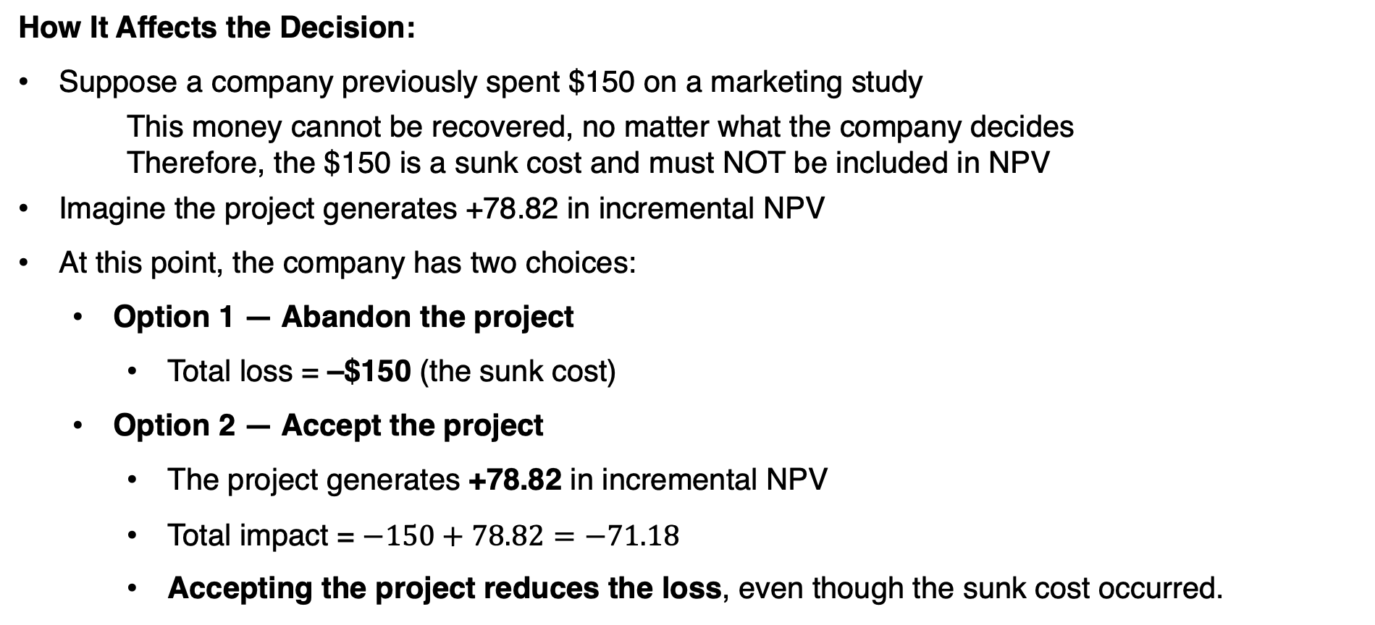
Sunk Costs
How It Affects the Decision:
Suppose a company previously spent $150 on a marketing study
This money cannot be recovered, no matter what the company decides
Therefore, the $150 is a sunk cost and must NOT be included in NPV
Imagine the project generates +78.82 in incremental NPV
At this point, the company has two choices:
  Option 1 — Abandon the project
    Total loss = –$150 (the sunk cost)
  Option 2 — Accept the project
    The project generates +78.82 in incremental NPV
    Total impact = $−150+78.82=−71.18$
    Accepting the project reduces the loss, even though the sunk cost occurred.

Slide 10
Opportunity Costs of Assets the Firm Owns
What Is an Opportunity Cost?
  The benefit the firm gives up when using an asset for one project instead of its next best alternative
  Even if the firm pays no new cash for the asset, the asset still has value
  This value must be treated as a cost in capital budgeting
Example:
  Company A owns land worth $2 million
  New store requires this land + $15 million additional investment
  True economic cost = $17 million, not $15 million
  Because using the land means giving up the $2 million the firm could get from selling it
The $2M is an opportunity cost and must be included.

Slide 11
Externalities(1)
What Are Externalities?
  Effects of a project on other parts of the firm or on the environment.
  These impacts must be included in capital budgeting → they affect incremental cash flows.
Negative Within-Firm Externalities (Cannibalization)
  Occur when a new project reduces cash flows from existing operations
  Example: Home Depot opens a new store too close to an existing one
  → New store steals customers → lowers sales at the old store
  These losses must be deducted in the NPV analysis
Why Cannibalization Is Tricky
  If the firm doesn’t build the store, a competitor might, causing the same sales drop
  Requires judgment, industry knowledge, and competitive analysis
Ignoring cannibalization leads to overstated NPV and bad decisions.

Slide 12
Externalities(2)
Positive Within-Firm Externalities
  New projects may boost existing business cash flows.
  Example: Apple’s investment in iTunes increased sales of the iPod
  A standalone NPV for iTunes might look negative
  But combined value (iTunes + iPod) is positive
  Must add complementary benefits to the NPV.
Environmental Externalities
  Project effects on the surrounding community or natural environment.
  Examples: A plant meets regulations for $1M but still emits annoying fumes
  Extra spending could reduce pollution and improve neighborhood goodwill
  Goodwill may help with: Future permits, Sales, and Government relationships
Positive, negative, or environmental externalities, must be considered because finance, competition, and the environment are interconnected.

Slide 13
Types of Projects
Two Types of Projects:
  Expansion projects: new stores, new products, new capacity
  Replacement projects: replacing old assets to reduce costs or improve efficiency
    Almost all cash flows are incremental
    We compare: New asset cash flows – Old asset cash flows
    Only the difference matters for NPV
Decision Rule
  Compute incremental cash flows
  Discount them and calculate NPV
  Replace the asset only if incremental NPV > 0
Example
  Old truck fuel cost = $15,000
  New truck fuel cost = $10,000
  Incremental savings = $5,000 per year

Slide 14
Expansion Projects
What Is an Expansion Project?
  A new investment that adds a new product, new store, or new capacity
  Cash flows are not given in real-world settings
  Must be assembled by combining data from marketing, engineering, accounting, and finance
FCF = EBIT(1−T) + Dep&Amort − CapEx − ΔNOWC
EBIT = Sale – Operating costs − Dep&Amort
Initial Cost
FCF1
FCF2
FCF3
FCF4
FCF5
0
1
2
3
4
5

Slide 15
Expansion Projects
Sales (Revenues)
Forecast units sold × price per unit
Typically provided by marketing
Drives all operating cash flows
May increase, decrease, or stay flat over time
Operating Costs
Variable costs (cost per unit × units)
Fixed costs (rent, salaries, overhead)
Provided by operations/engineering
Depreciation & Amortization
Comes from the investment in fixed assets
Affects taxes → impacts after-tax operating cash flow
Provided by accounting / tax department
Capital Expenditures (CapEx)
Money spent on equipment, technology, or buildings
Often occurs at Year 0, but may continue for growing projects
Also includes after-tax salvage value in the final year
Net Operating Working Capital (NOWC)
Typically:
  Year 0: Initial investment in NOWC
  Final year: Full recovery of NOWC
Comes from finance + operations

Slide 16
Depreciation Methods Overview
Straight-Line Depreciation
  Depreciation is spread evenly across Years 1…N.
  Annual Depreciation = (Cost – Salvage Value) / Life
  The tax shield (Dep × tax) appears each year in:
  FCF = EBIT(1–T) + Dep – CapEx – ΔNOWC.
  This makes annual FCF higher and smoother in later years
Bonus Depreciation (100% Bonus / Immediate Expensing)
  Allows firms to deduct a large portion (up to 100%) of the asset cost immediately in Year 0.
  Creates a big Year-0 tax shield, which is added back in the initial investment in fixed asset.
  Initial investment + tax shield ➔ Initial investment + (Dep × tax)
  No depreciation remains for Years 1…N, Lower FCF after Year 0.

Slide 17
Depreciation Methods Overview
FCF = EBIT(1−T) + Dep&Amort − CapEx − ΔNOWC
FCF = (Sales – Operating costs − Dep&Amort) (1−T) + Dep&Amort − CapEx − ΔNOWC
A company is considering a 6-year project with the following information:
Initial Investments (Year 0): Fixed assets $600,000, salvage value of 0, and tax rate of 25%.
Straight-Line Depreciation:
  Dep&Amort at each year = $600,000 / 6 = $100,000
  Adj years 1 to 6 based on FCF formula
Bonus Depreciation (100% Bonus / Immediate Expensing)
  Dep&Amort at year 0 = $600,000
  Adj only year 0 = -$600,000 + ($600,000 × 0.25) = -$450,000

Slide 18
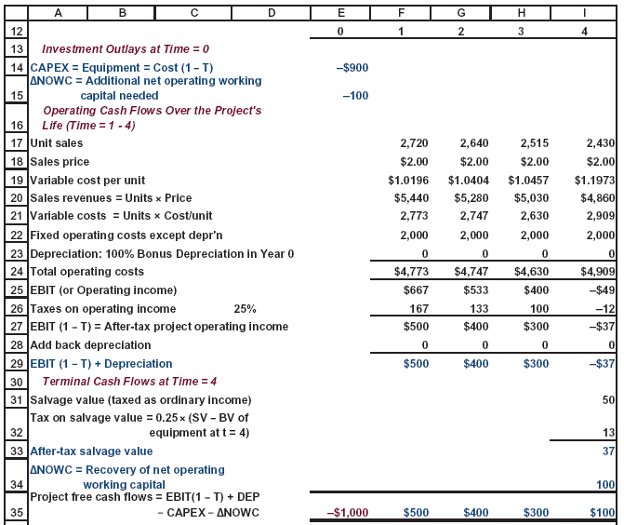
Expansion Projects

Slide 19
Question 1
You must evaluate the purchase of a proposed spectrometer for the R&D department. The purchase price of the spectrometer, including modifications, is $170,000, and the equipment will be fully depreciated at the time of purchase. The equipment would be sold after 3 years for $60,000. The equipment would require an $8,000 increase in net operating working capital (spare parts inventory). The project would have $150,000 of revenue and 100,000 of operating costs. The firm’s marginal federal-plus-state tax rate is 25%.
1- What is the initial investment outlay for the spectrometer after bonus depreciation is considered, that is, what is the Year 0 project cash flow?
What we purchase
-$170,000
Initial Investment
Tax shield if the method is bonus depreciation
+$42,500
How much net operating working capital needed
-$8,000
-$135,500

Slide 20
Question 1
You must evaluate the purchase of a proposed spectrometer for the R&D department. The purchase price of the spectrometer, including modifications, is $170,000, and the equipment will be fully depreciated at the time of purchase. The equipment would be sold after 3 years for $60,000. The equipment would require an $8,000 increase in net operating working capital (spare parts inventory). The project would have $150,000 of revenue and $100,000 of operating costs. The firm’s marginal federal-plus-state tax rate is 25%.
2- What are the project’s annual cash flows in Years 1, 2, and 3?
FCF of each year = (Sales – Operating costs − Dep&Amort) (1−T) + Dep&Amort − CapEx − ΔNOWC
FCF of each year = ($150,000 – $100,000 − 0) (1−0.25) + 0 − 0 − 0 = $37,500
Salvage value net of TAX, If > book value
$60,000 – ($60,000 × 0.25) ➔ $45,000
Adjustment for year 3
Recovery of NOWC
$8,000
$37,500 + $45,000 + $8,000
$37,500
$37,500
$90,500
0
1
2
3

Slide 21
Question 1
You must evaluate the purchase of a proposed spectrometer for the R&D department. The purchase price of the spectrometer, including modifications, is $170,000, and the equipment will be fully depreciated at the time of purchase. The equipment would be sold after 3 years for $60,000. The equipment would require an $8,000 increase in net operating working capital (spare parts inventory). The project would have $150,000 of revenue and $100,000 of operating costs. The firm’s marginal federal-plus-state tax rate is 25%.
3- If the WACC is 10%, should the spectrometer be purchased?
-$135,500
$37,500
$37,500
$90,500
0
1
2
3
NPV = PV(CF1, CF2, CF3) - Initial Cost
NPV = -$2423

Slide 22
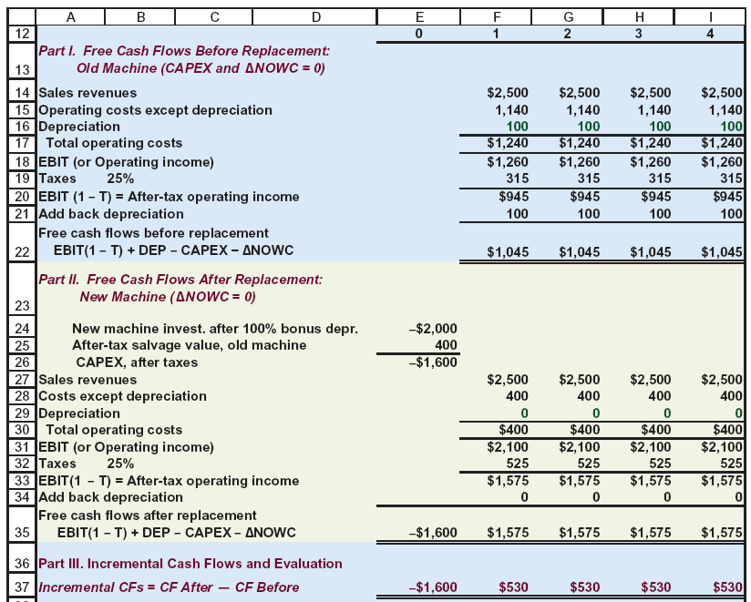
Replacement Project

Slide 23
Question 2
St. Johns River Shipyards is considering the replacement of an 8-year-old riveting machine with a new one that will increase earnings from $24,000 to $46,000 per year. The new machine will cost $80,000, and it will have an estimated life of 8 years and no salvage value. The new riveting machine is eligible for 100% bonus depreciation at the time of purchase. The applicable corporate tax rate is 25%, and the firm’s WACC is 10%. The old machine has been fully depreciated and has no salvage value. Should the old riveting machine be replaced by the new one?
STEP-1 CALCULATING INITIAL COST
What we purchase
-$80,000
Initial Investment
Tax shield if the method is bonus depreciation
+$20,000
How much net operating working capital needed
0
-$60,000

Slide 24
Question 2
St. Johns River Shipyards is considering the replacement of a 7-year-old riveting machine with a new one that will increase earnings from $24,000 to $46,000 per year. The new machine will cost $80,000, and it will have an estimated life of 7 years and no salvage value. The new riveting machine is eligible for 100% bonus depreciation at the time of purchase. The applicable corporate tax rate is 25%, and the firm’s WACC is 10%. The old machine has been fully depreciated and has no salvage value. Should the old riveting machine be replaced by the new one?
STEP-2 CALCULATING CASH FLOWS
Since this is a Replacement Project:
Cash flow of each year = (Cash flow of New - Cash flow of Old )(1-t)
($46,000 - $24,000)(0.75) = $16,500
Since Salvage is 0 and there is no Recovery of NOWC, we do not make any Adjustment
-$60,000
16,500
16,500
16,500
16,500
16,500
16,500
16,500
0
1
2
3
4
5
6
7
NPV = ???

Slide 25
Effect of Different Depreciation Rates
Depreciation does not change total cash flows over the project, but it changes timing.
4 Year project
Initial Investments: Fixed assets $600,000 and an Increase in NOWC: $50,000
Operating Assumptions:
  EBIT: $200,000 per year, Tax rate: 25%
  Salvage value at end of Year 4: $0
Straight-line depreciation: $600,000 / 4 = $150,000
0 | 1 | 2 | 3 | 4
-650,000 | 300,000 | 300,000 | 300,000 | 300,000
Accelerated depreciation: year1 $300,00, year2 $150,000, year3 $75,000, year4 $75,000
0 | 1 | 2 | 3 | 4
-650,000 | 450,000 | 300,000 | 225,000 | 225,000
Faster depreciation increases NPV

Slide 26
Effect of Cannibalization
4 Year project
Initial Investments: Fixed assets $600,000 and an Increase in NOWC: $50,000
Operating Assumptions:
  EBIT: $200,000 per year, Straight-line depreciation: $150,000 per year, Tax rate: 25%
  Salvage value at end of Year 4: $0
0 | 1 | 2 | 3 | 4
-650,000 | 300,000 | 300,000 | 300,000 | 300,000
Suppose, however, this Project would reduce the after-tax cash flows of another division by $50,000 per year.
0 | 1 | 2 | 3 | 4
-650,000 | 250,000 | 250,000 | 250,000 | 250,000

Slide 27
Risk Analysis in Capital Budgeting
Even if a project has a positive NPV, managers must consider risk. Different projects expose the firm to different levels of uncertainty, so risk must be incorporated into the decision.
Three Types of Project Risk
1. Stand-Alone Risk
Risk if this project were the only asset the firm owns.
Ignores diversification.
Measured by variability of the project’s cash flows.
2. Market (Beta) Risk
Risk to shareholders who hold diversified portfolios.
Measures how the project affects the firm’s beta.
Most theoretically important, but hardest to estimate.
3. Corporate (Within-Firm) Risk
Risk to the company itself, considering all its other projects.
Some risk can be diversified away inside the firm.
Measured by how the project affects the uncertainty of the firm’s total earnings.

Slide 28
Using Risk-Adjusted Discount Rates
Firms often classify projects into risk buckets
  Low-risk
  Average-risk
  High-risk
Adjust the WACC accordingly:
  Example:
    Average-risk project → use WACC (e.g., 10%)
    High-risk project → WACC + 5% (e.g., 15%)
    Low-risk project → WACC − 2% (e.g., 8%)
Why this approach?
  Simple and widely used
  Recognizes risk differences
  But mostly subjective, not perfectly precise

Slide 29
Measuring Stand-Alone Risk
Stand-alone risk = risk of a project if it were the firm’s only asset.
Driven by uncertainty in future cash flows (sales, costs, prices, etc.).
All inputs in a capital-budgeting model are expected values, but actual values vary.
Firms use three common tools to evaluate this risk.
The Three Tools
  Sensitivity Analysis
  Scenario Analysis
  Monte Carlo Simulation

Slide 30
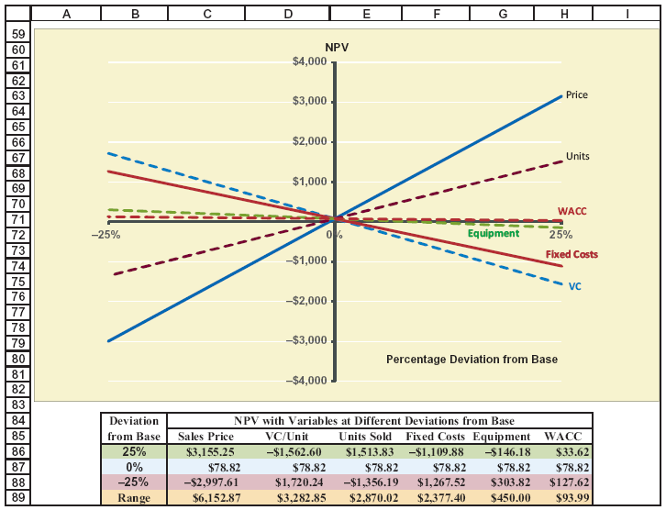
Sensitivity Analysis
Changes one input at a time:
e.g., sales, price, variable cost, fixed cost, WACC.
Measures: “How much does NPV change when this variable changes by X%?”
Helps answer manager questions like:
“What if sales drop 25%?”
“What if variable costs rise?”
Shows which inputs the project is most sensitive to.
→ Steeper line = more sensitive = riskier

Slide 31
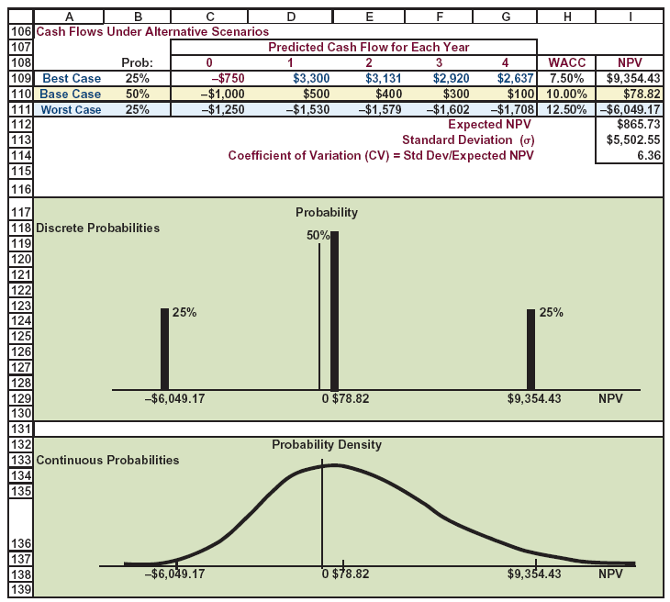
Scenario Analysis
Instead of changing one variable, scenario analysis changes all major variables together.
Examples:
✔ Best case (high sales, low cost, high price)
✔ Base case
✔ Worst case (low sales, high cost, low price)
Probability is assigned to each scenario → compute:
  Expected NPV
  Standard deviation of NPV
  Coefficient of Variation (CV) = risk per unit of return
Often reveals much wider ranges than sensitivity analysis.

Slide 32
Monte Carlo Simulation (Advanced Idea)
Extension of scenario analysis using hundreds or thousands of simulations.
Computer randomly draws values for key inputs (sales, price, cost, WACC).
Produces a distribution of NPVs instead of a single number.
Results:
  Mean (expected NPV)
  Standard deviation
  Probability NPV < 0
Used in practice by larger companies; introduced in advanced finance courses.

Slide 33
The Unequal Lives Problem
When NPV Comparison Can Be Misleading
Sometimes firms choose between mutually exclusive projects with different useful lives.
If these projects can be repeated, the regular NPV comparison may favor the wrong project.
Example:
  Project C: lasts 6 years
  Project F: lasts 3 years
If Project F ends sooner, the firm can repeat it and earn profits again, but traditional NPV ignores this!
Why it matters
  Traditional NPV only compares the first cycle.
  A correct comparison must put both projects on the same economic time frame.

Slide 34
Method 1: Replacement Chain (Common Life Approach)
Extend the Shorter Project to Match the Longer Project’s Life
How it works
Identify the Least Common Multiple of project lives.
  Example: C = 6 years; F = 3 years → common life = 6 years
Repeat the shorter project enough times to match the longer life.
Compute NPV of:
  Project C over 6 years
  Project F over 6 years (F repeated twice)
Compare NPVs on equal footing.
Even if F has a lower single-cycle NPV, repeating it may produce a higher total NPV than C.
Initial for F
FCF1
FCF2
FCF3
Initial for F
FCF1
FCF2
FCF3
Initial for C
FCF1
FCF2
FCF3
FCF4
FCF5
FCF6
0
1
2
3
4
5
5

Slide 35
Method 2: Equivalent Annual Annuity (EAA)
Convert NPV into an Annual Value for Fair Comparison
Steps
  Calculate each project’s NPV over its own life.
  Convert the NPV into an equal annual payment (EAA) using the WACC.
  The EAA represents the constant annual cash flow that has the same present value as the project’s NPV.
  We know the projects' NPVs and lives, and we know the WACC, so we can find the resulting payment, which is the EAA.
  The project with the higher EAA provides more value per year, and is the better choice.
Why EAA works
  Ideal when:
    Projects are repeatable
    Projects provide service continuously
    Managers prefer a “per-year profitability” measure.

Slide 36

Thank you

